Slide 1
Application of multiple health standards and resulting issues
Daniella Meeker

Slide 2
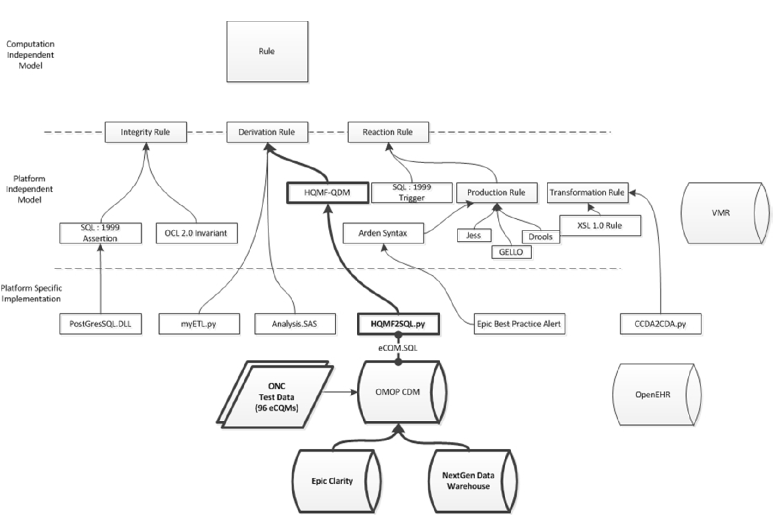
From Platform Independent Rules to Implementation
$50,000
$50,000

Slide 3
Some Historical References on SOA approaches to Health-Research Standards
CaBIG
HL7 Generations (from RIM to FHIR)

Slide 4
Learning Health “System” Interoperability between Research and Delivery
Conceptually, the data we collect in research, personally generated data, and care can be optimally collected and applied.
Predictive model for best treatment
Measuring the quality of clinical care
There are no financial incentives to researchers, patients, payers, or providers to participate in such a system, so standards that would support are generally not adopted or captured in metadata
Not a closed system

Slide 5
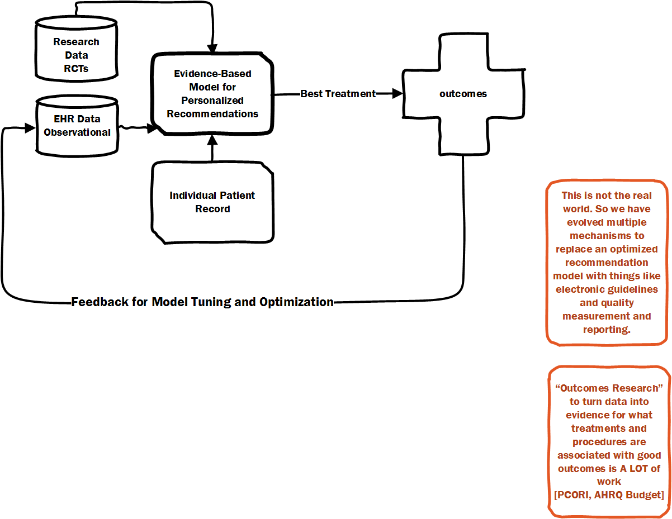
Learning Health System

Slide 6
Data Generated in Health (transactional data not originally intended for analysis)
Claims and Billing Data
Streaming, Transactional
Established terminology standards for billed services, associated diagnostics, drugs
Electronic Medical Record Data
Transactional, intended largely to enhance billing with electronic documents
Only data that is related to payment is reliably standardized
No API standard (yet)
Personnally Generated Data
mHealth
Surveys
Notes:
Challenges
History of Knowledge Management
Capture data in structured, custom formats
Analyze data in accordance with statistical standards
Obfuscate useful information by publishing in plain text journals
Conduct systematic reviews to create human-readable guidelines
Noisy Instruments
Each EHR vendor has its own implementation
Each EHR user has its own adherence to use
Data Processing is 90% of the work
Forensics (what context, what provenance, what capture format?)
Processing
Data Quality Characterization & Adjudication
Missing Data Imputation using internal and external data
Harmonization & Standardization
Top Down (Enterprise Investment)
Use-case driven*
Get it and forget it
Incremental standardization (no incentive)
Change control
What is lost?
Cross-organism information
Molecular similarity
Geographic and Socioeconomics context
Methodology
Aims for the future: data useful and actionable
Purposeful capture of data in customizable instruments
Transactional data capture
Metadata for Interoperability
Standard for identifying triggering event for computation (workflow/time series)
Standard for input data specification (data description standards)
Standard for expressing data operations/computations (rules & operations standards)
Standard for output data specification
Standard for output data presentation trigger (operation)
Metadata for Privacy Risks
Measurement of privacy loss with each access
Measurement of privacy with each transformation
Regulatory standards
What is the right level of abstraction and expressiveness?
Reference information models and terminologies (is the right reference point the active ingredients in a drug, or do I also need manufacturer/batch information?)
What is the best format for time representation?
Expressiveness of rule/operations syntax (e.g. ageAtEvent vs. Event.DateTime-person.datetime(DOB))
Incentives?
Clinicians: Payment & Value Based Care
Researchers: None
Journals?
Funding agency audit
Consumers
Mobile Devices

Slide 7
Challenges
History of Knowledge Management
Noisy Instruments
Data Processing is 90% of the work
Lost information
Aims for the future: data useful and actionable in Real Time
Metadata for Interoperability
Standard for identifying triggering event for computation (workflow/time series)
Standard for input data specification (data description standards)
Standard for expressing data operations/computations (rules & operations standards)
Standard for output data specification
Standard for output data presentation trigger (operation)
Metadata for Privacy & Regulatory Conformance

Slide 8
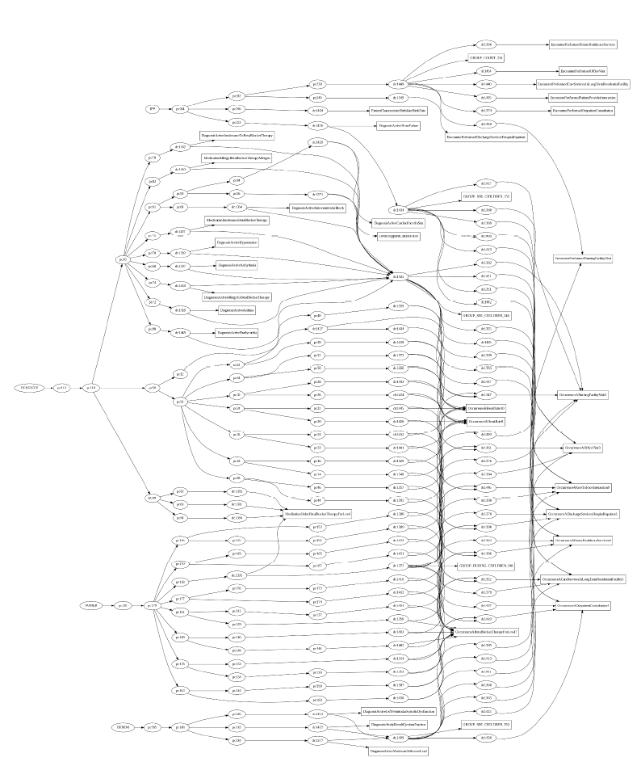
Logical representation of one Clinical Quality Indicator Derived From Transactional Data

Slide 9
What is the right level of abstraction and expressiveness for PI Rules?
Reference information models and terminologies (is the right reference point the active ingredients in a drug, or do I also need manufacturer/batch information?)
What is the best format for time representation?
Expressiveness of rule/operations syntax (e.g. ageAtEvent vs. Event.DateTime-person.datetime(DOB))
First Order Logic
Allen Interval Operations

Slide 10
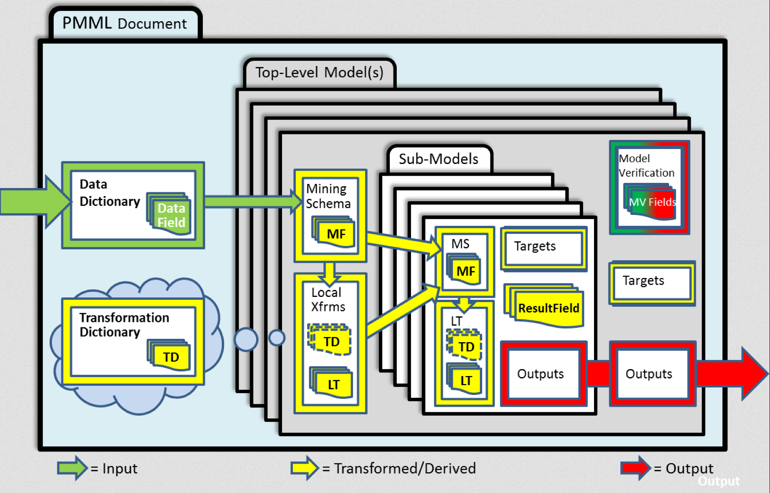

Slide 11
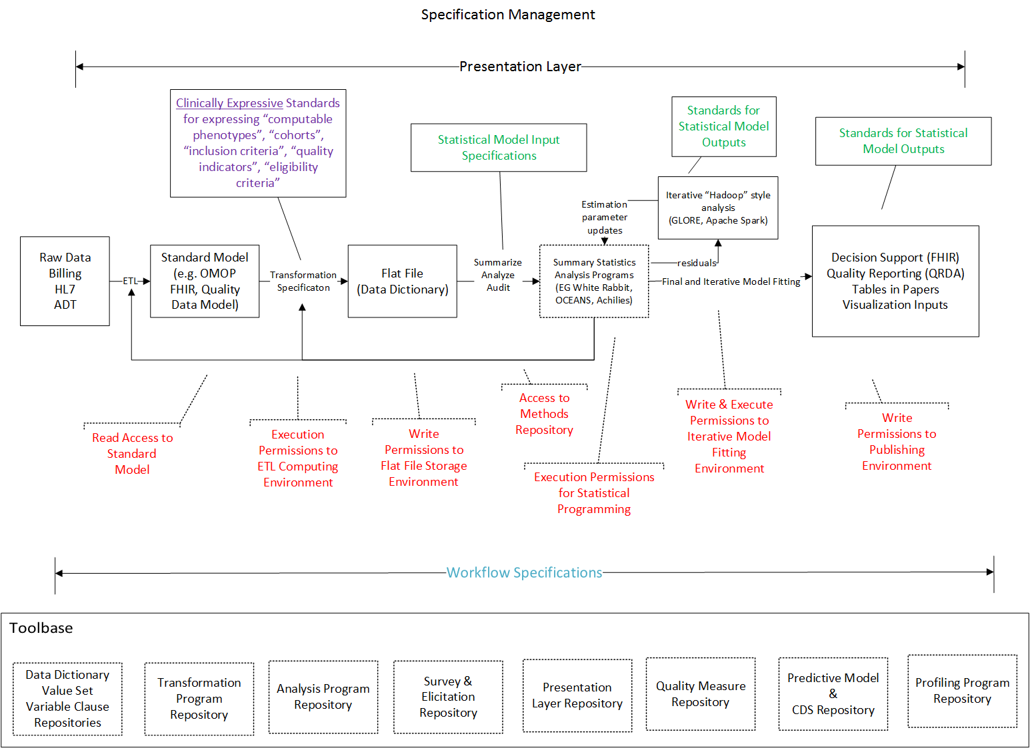

Slide 12
PMML Transformations
PMML defines various kinds of simple data transformations:
Normalization: map values to numbers, the input can be continuous or discrete.
Discretization: map continuous values to discrete values.
Value mapping: map discrete values to discrete values.
Text Indexing: derive a frequency-based value for a given term.
Functions: derive a value by applying a function to one or more parameters
Aggregation: summarize or collect groups of values, e.g., compute average

Slide 13
HQMF Operations
Interval Logic & Event/Time Series Data
(e.g. “starts before start of”)
Health-Specific Operators
(e.g. drug exposure)
Health Terminology Specific Value Sets
Value Set Authority Center
Hierarchical Standards
Reusable Logical Clauses

Slide 14
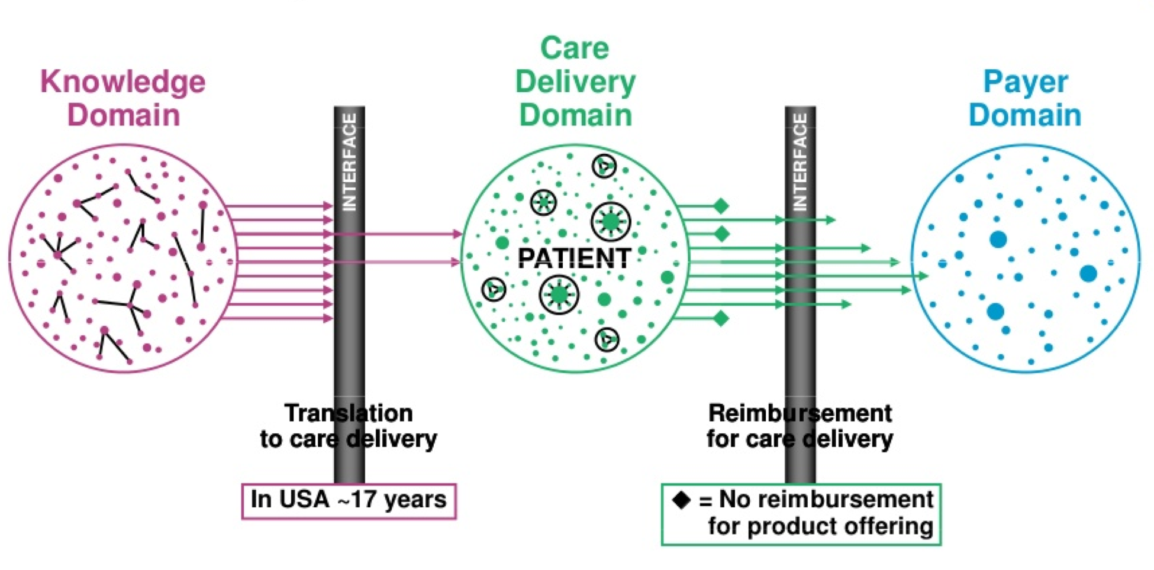
Incentives and Interfaces Cortese & Rouse, 2011
If these domains were technically and conceptually interoperable, would we improve meaningful outcomes?
Randomized Clinical Trials
??jk
?
PCOR
CBPR
mHealth
Observational Studies
Guidelines
Patient Preferences
PROs
Formulary
Pay for Performance
Prior Authorization
= Not funded research
90% in US
Research Language
EHR Language (MU)
Payer Terminology
Notes:
This is based on an analysis by Borne on how long it takes a research product to mature to a guideline. 14% of clinical research takes 17 years to get into practice.
1 – where does the information go?
Some observations about this – research networks should solve the small numbers problem
2 – what is missing?
If you don’t have patient reported outcomes at the beginning of the pipeline, they will not show at the end of the pipeline.
The data inputs are not in the practice environment, the language is completely different.

Slide 15
Challenges
History of Knowledge Management
Capture data in structured, custom formats
Analyze data in accordance with statistical standards
Obfuscate useful information by publishing in plain text journals
Conduct systematic reviews to create human-readable guidelines
Noisy Instruments
Each EHR vendor has its own implementation
Each EHR user has its own adherence to use
Data Processing is 90% of the work
Forensics (what context, what provenance, what capture format?)
Processing
Data Quality Characterization & Adjudication
Missing Data Imputation using internal and external data
Harmonization & Standardization
Top Down (Enterprise Investment)
Use-case driven*
Get it and forget it
Incremental standardization (no incentive)
Change control
What is lost?
Cross-organism information
Molecular similarity
Geographic and Socioeconomics context
Methodology
Aims for the future: data useful and actionable
Purposeful capture of data in customizable instruments
Transactional data capture
Metadata for Interoperability
Standard for identifying triggering event for computation (workflow/time series)
Standard for input data specification (data description standards)
Standard for expressing data operations/computations (rules & operations standards)
Standard for output data specification
Standard for output data presentation trigger (operation)
Metadata for Privacy Risks
Measurement of privacy loss with each access
Measurement of privacy with each transformation
Regulatory standards
What is the right level of abstraction and expressiveness?
Reference information models and terminologies (is the right reference point the active ingredients in a drug, or do I also need manufacturer/batch information?)
What is the best format for time representation?
Expressiveness of rule/operations syntax (e.g. ageAtEvent vs. Event.DateTime-person.datetime(DOB))
Incentives?
Clinicians: Payment & Value Based Care
Researchers: None
Journals?
Funding agency audit
Consumers
Mobile Devices

Slide 16
Code & Specification Repository
PRESENTATION
TRANSLATION
AGGREGATION
STORED SPECIFICATIONS
Translation Logic Tier (DAN)
TBD whether this happens locally or as a service (OR BOTH). This layer reads metadata from each site and translates platform independent specifications into platform-specific executables
Aggregation Logic Tier
This layer coordinates across results produced by multiple sites.
Aggregate for Display
Aggregate for Iteration
ASSEMBLE
PROGRAMS
STANDARDIZE OUTPUT
GLOBAL
LOCAL
Local
Authorization Tier
Local authorities verify
(may be automated,
pre-authorized, or manual)
Validity of Localization
Access Permission
Verity of Results
Authorize
Verify
Authorize
Verify
Authorize
Verify
Authorize
Verify
Authorize
Verify
Authorize
Verify

Slide 17
Some tools we’ve used
ANTLR (Grammar Translation)
SQL Alchemy (PIM to Queries)
PMML Plug-Ins to stats packages
Apache Spark Machine Learning Library Frequent Pattern Mining Methods for reverse engineering metadata

Slide 18
Thank You

