Slide 1
Welcome
To the DDI Model Review and Sprint!
Schloss Dagstuhl October 19-23, 2015

Slide 2
Why Are We Here?
Review progress and approach to the next-generation DDI specification based on a conceptual model
Goals of the model:
Improve DDI usability
Expand DDI coverage
Express model in different technical formats
Repackage the specification
Enhance the documentation
Continue to build the model through the sprint process

Slide 3
Beginnings
Began at Dagstuhl in 2012 with a paper describing the modeling approach and design principles
http://dx.doi.org/10.3886/DDIWorkingPaper04

Slide 4
Progress
Sprints have been held in
Dagstuhl, October 2013
Paris, December 2013
Vancouver, April 2014
Toronto, May 2014
Dagstuhl, October 2014
London, December 2014
Minneapolis, May 2015
Next sprint in Copenhagen, December 2015

Slide 5
Accomplishments
Adopted iterative Agile approach
Established Drupal site for modeling work – lion.ddialliance.org
Provided collaboration wiki -- https://ddi-alliance.atlassian.net/wiki/pages/viewpage.action?pageId=491703
Developed new DDI structure: Functional Views on the Library of Elements -- https://ddi-alliance.atlassian.net/wiki/display/DDI4/Structure+of+DDI+4
First preliminary release of foundational components released in Spring 2014

Slide 6
Teams
Codebook
Data Capture
Data Description
Discovery
Enhanced Citation
Qualitative
Methodology
Modeling (including Production)
New teams will come into being as others phase out.

Slide 7
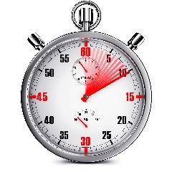
The clock is ticking
We have a lot to accomplish here with the combined review and sprint work
New Sprintmeister Michelle Edwards to help keep us on track
Need to use time wisely to be productive

Slide 8
Rewards
A job well done!
Special dinner on Thursday night
Landgasthof Paulus & Der Laden

