Slide 1
The Model-Driven DDI Approach
Arofan Gregory, Jon Johnson, Flavio Rizzolo, Marcel Hebing

Slide 2
Outline
Model-Driven DDI production flow
Products
Library architecture
Modeling style
Collections pattern
Process pattern
Production framework status

Slide 3
Production Flow
Starts with groups of content modellers working collaboratively in a Drupal-based system for content capture
Modelling Team supports and quality checks output from content modellers
Nightly automatic builds produce an XMI version of the model and generates syntax bindings and documentation

Slide 4
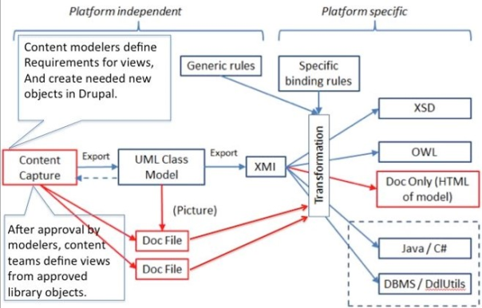

Slide 5
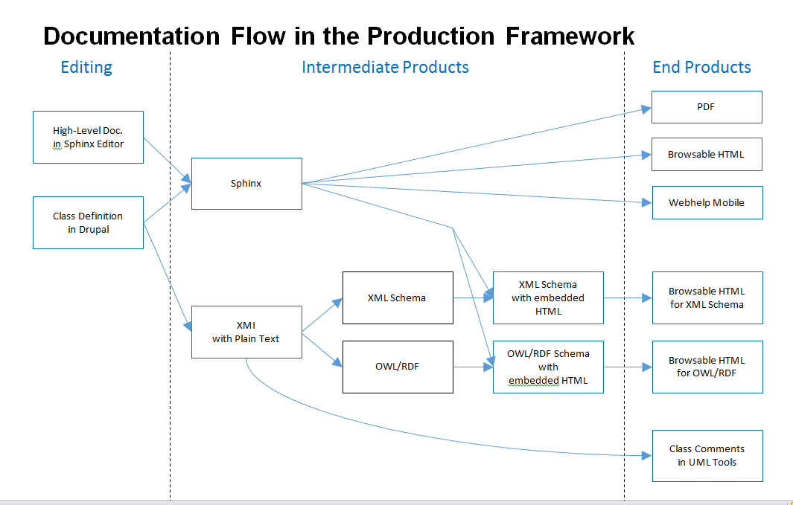

Slide 6
Two Layers to the Model
In Drupal, there is a complete “conceptual” model, which is platform independent (the Platform Independent Model or PIM)
The XMI initially exported from Drupal represents the complete model
The PIM is adjusted to meet the expressive capabilities of each target syntax. The adjusted model is the Platform Specific Model (PSM)
The PSM is a modified XMI file which is transformed into the target syntax binding

Slide 8
Products
XML Schema – one XML document type per functional view
RDF Vocabularies (described using OWL) – one vocabulary per functional view
Model documentation
PDF
HTML
Documentation is for the model as a whole, and for each functional view

Slide 9
Architecture
There are several types of information objects in the DDI Model:
Primitives (simple data types)
Extended primitives (“Complex Data Types”)
Objects (the complex business objects)
Functional views
Compositions of functional views (not currently used)
Functional views consist only of references to things in the library
May restrict the objects they reference
Designed to support a specific business function

Slide 10
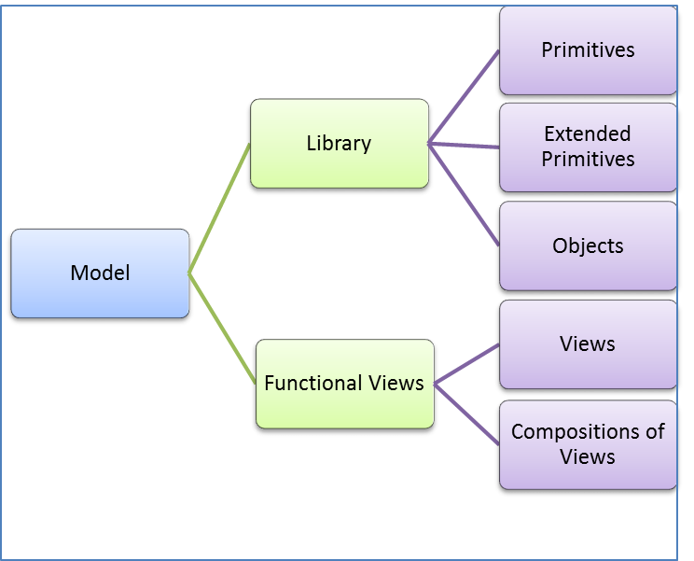
DDI Library Composition

Slide 11
Packages in the Library
Utility Packages
Pattern Packages
Basic Packages
Specialized Packages
Primitives
Complex Data Types
Identification
Utility
Collection
Process
Conceptual
Discovery
Agent
Annotation
Collection Management
Comparison /Harmonization
Data Capture
Data Description
Data Mgmt Plan
Methodology
Representations
Study Inception
Utility Packages contain classes used as data types for properties, the set of DDI identification fields, and other utility classes such as Note or External Material.
Pattern Packages contain classes that describe specific patterns such as a collection or process specification. The patterns are applied within other packages in order to maintain a consistent means of organizing certain relationships.
Basic Packages contain classes that are heavily used throughout DDI; concepts, Annotation, descriptions of agents, and non-content information used for discovery such as coverage or subject classifications.
Specialized Package contain classes related to a set of activities such as data capture, comparison, or description of physical stores.

Slide 12
Published Views
Agent View
Agent
Discovery
Classification
Data Capture
Data Description
Codebook
Question Management
Collection Management
Comparison/Harmonization
Data Capture
Data Description
Data Management Plan
etc.
Codebook View
Collection
Utility Packages
Utility Packages
Collection
Basic Packages
Agent
Agent
Methodology
Data Capture
Data Description

Slide 13
Modeling Style
The DDI Model uses a small subset of UML features:
Class diagrams
Composition
Aggregation
Inheritance relationships
Packages

Slide 14
Drupal
http://lion.ddialliance.org

Slide 15
Model Patterns

Slide 16
Conventions
There are several conventions around properties in the DDI Model
Identification
Name
Label
Description
Definition
Language specification
Others…

Slide 17
Patterns
There are two important patterns which have emerged in the development of the model so far:
Collections
Processes

Slide 18
Collections
Model-Driven DDI introduces a generic Collection pattern that can be used to model different types of groupings, from simple unordered sets to all sorts of hierarchies, nesting and ordered sets/bags.
A collection is a container, which could be either a set (i.e. unique elements) or a bag (i.e. repeated elements), of Members.
Members of different Collections can be mapped via Correspondences based on similarities or differences.
Collections (and their related classes) provide an abstraction to capture commonalities among a variety of seemingly disparate structures.

Slide 19
Binary Relations
Collections can be associated to Binary Relations (set of ordered pairs of Members in a Collection).
Relations can have different properties, e.g. totality, reflexivity, symmetry, transitivity (very useful for reasoning).
All members in the relation are related to themselves
All members of the Collection are related to each other
If a is related to b then b is related to a
If a is related to b and b is related to c then a is related to c

Slide 20
Binary Relation Subtypes
Based on those properties DDI defines different subtypes of relations, e.g. Equivalence Relation, Order Relation and Strict Order Relation, among others.
Equivalence Relations are useful to define partitions and equivalence classes (e.g. Levels in a Classification)
Subtypes can also have various semantics, e.g. Part-Of and Subtype-Of for Order Relations, to support a variety of use cases and structures, such as Node Sets, Schemes, Groups, sequences of Process Steps, etc.
Order Relations are useful to define sequences and hierarchies

Slide 21
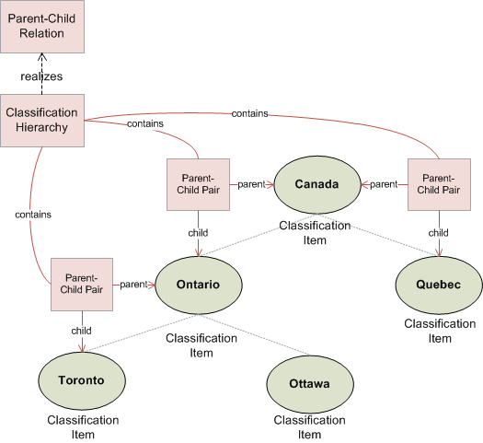
Classification Example
Consider a Geography Classification with Classification Items representing Canada, its Provinces and Cities. The Classification is a Collection whose Members are Toronto, Ottawa, Ontario, etc.
Parent-Child is anti-reflexive, anti-symmetric and anti-transitive
The Classification Hierarchy is a Parent-Child Relation containing Parent-Child Pairs
Items are organized by pairs in a Parent-Child Relation.
Ontario can be made the child of the Central Region in another Classification
By maintaining the hierarchy in a separate structure, Items can be reused in multiple Classifications.

Slide 22
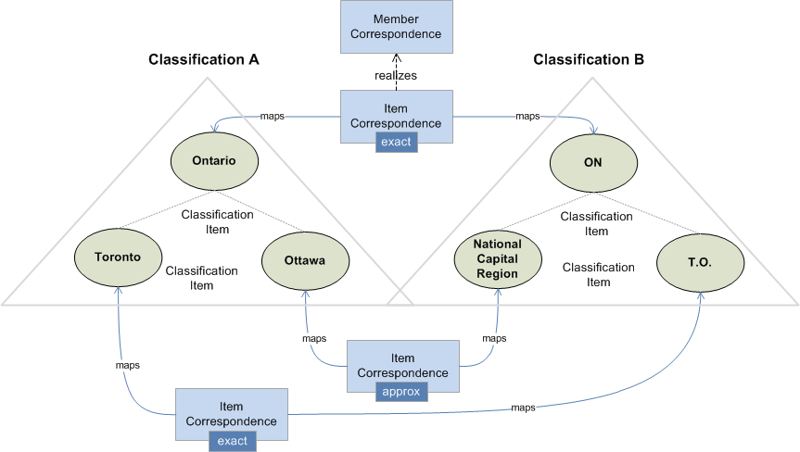
Correspondence Example
Ontario and ON are actually the same Province. The former is its name and the latter its abbreviation.
The NCR is bigger than Ottawa (in includes some suburbs). There could be another correspondence between concepts describing how they relate.
Correspondences allow to map Members of different Collections based on similarities or differences.

Slide 23
Core Process
Model-Driven DDI introduces a rich process model capable of modelling a variety of processes and workflows.
The model provides a number of generic classes. The Process Step class can be used to describe processes at any level, and is extended into a set of objects which can be used to describe logical flows (Control Constructs) and actions (Acts).
A process step can be performed by a Service.

Slide 24
Control Constructs
Control Constructs include Sequence, Repeat While, Repeat Until, Loop and If Then Else.
Act covers Questions, Statements, Instructions, etc.
The model also covers parallel processing: Control Constructs can contain multiple Process Steps, which are executed in parallel.

Slide 25
Sequence
There are three ways of specifying an ordering in a sequence
with a Sequence Order (traditional design-time ordering).
with a Temporal Interval Relation (design-time ordering, but with a twist).
with a Rule (constructor) to determine ordering at run-time.
A Sequence Order realizes the Order Relation from the Collection pattern.
A Temporal Interval Relation implements Allen’s Interval Relations.

Slide 26
Bindings
Process Steps have Collections of Inputs and Outputs.
Control Constructs have Process Steps and Collections of Bindings that link Inputs and Outputs of the Process Steps it contains.
Bindings are in fact Correspondences in the Collection pattern.

Slide 27
Bindings (cont.)
Binding Collections contain Bindings that link individual Inputs and Outputs of Process Steps
Individual Bindings are in fact Member Correspondences in the Collection pattern.
Bindings represent data flows between Process Steps.

Slide 28
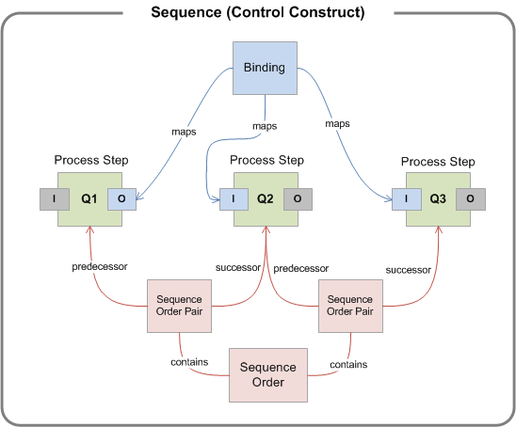
Questionnaire Example
Consider a set of questions. Each question is modelled as a Process Step.
The output of Q1 (sex) is used as input to Q2 and Q3 for their gender specific texts
Q1 determines the sex of the respondent
Questions are part of a Sequence Control Construct.
Questions are ordered by pairs in a Sequence Order.
Bindings map inputs and outputs of Questions.
The order in which questions are asked is given by a Sequence Order

Slide 29
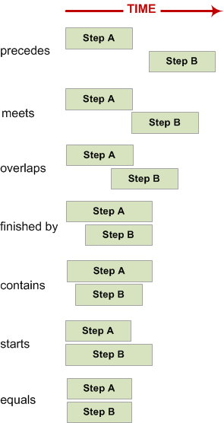
Allen’s Interval Relations
Allen’s interval algebra is one of the best established formalisms for temporal reasoning.
Allen’s interval relations provide a mechanism for expressing temporal constraints.
There are 13 Temporal Relations: those on the right + their converses (except equals).
The Process Model in Model-Driven DDI applies interval relations to Process Steps, allowing for parallel processing with temporal constraints.

Slide 30
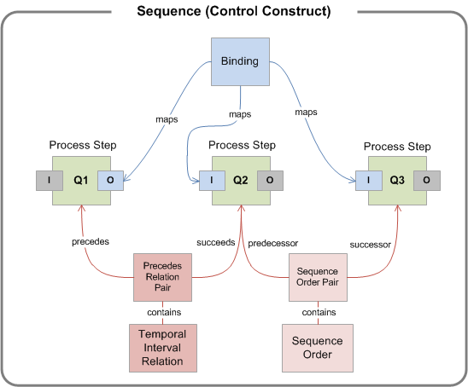
Questionnaire Example (cont.)
Temporal Interval Relations and Sequence Orders can be combined in the same Sequence.
E.g. a Precedes Interval Pair can be used to de describe the precedence between Q1 and Q2 whereas a Sequence Order Pair describes precedence between Q2 and Q3.
Q2 needs to appear before Q3 on the screen, but they can be answered together.
Q1 has to be finished before Q2 and Q3 can begin (they both need Q1’s output)

Slide 31
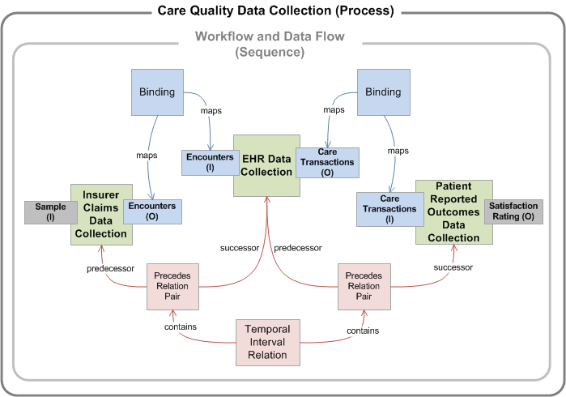
Health Care Example
From the encounters, another Process Step produces care transactions based on EHR Data
A Process Step uses insurance claims data to create a frame of encounters
A third Process Step runs the data collection for each care transaction
Process to collect data related to Care Quality

Slide 32
Process Tools
https://ddi-alliance.atlassian.net/wiki/display/DDI4/Production+Framework+Test
https://ddi4.readthedocs.org/en/latest/Introduction/modelproduction.html
http://lion.ddialliance.org

