Slide 1
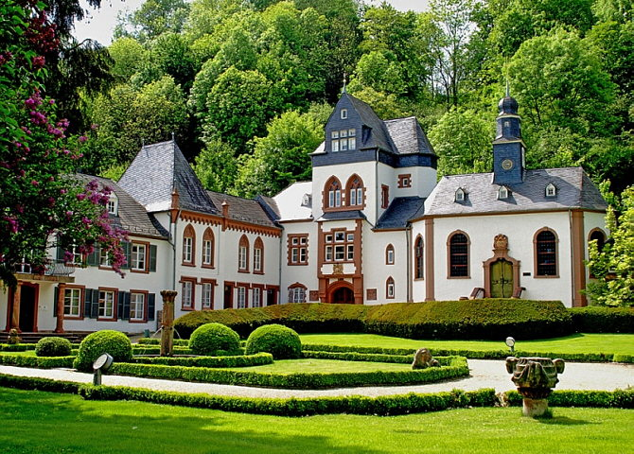
Welcome
Dagstuhl Sprint
Schloss Dagstuhl October 24-28, 2016

Slide 2
Dagstuhl Logistic Details
ID badges
Meals
Honour System
Facilities
Internet
Notes:
Link to Sprint site!

Slide 3
Introductions
Who are you?
Institution you are from?
DDI Working Group

Slide 4
Topics During Sprint
Controlled Vocabularies
Data Capture
Data Description
Funding Proposals
Long-term Architecture Framework
Structured Re-usable Documentation

Slide 5
Controlled Vocabularies
Primary goals include defining new work processes, prioritizing deliverables, identifying the appropriate format, documenting requirements for a CV workbench tool (management requirements/functional specification to contribute to plans for CESSDA tool).
Outcomes:
Requirements document regarding tool functionalities needed for developing CVs.
A document specifying the new canonical and other formats to be used for DDI CVs.
A list of prioritized CVs and a documented plan for moving ahead.
An agreed plan for integrating work processes into the DDI production activities.

Slide 6
Integration of the Data Capture into the DDI4 Model
The Data Capture Model has strong relationships with other parts of the DDI Model (eg. process pattern, data description, etc.). These pieces still require full integration, an important activity for the maturity of the DDI Model.
Outcomes:
Documented examples covering non-survey data sources (bio-medical, process data, register data). These may come from the 1st week at Dagstuhl. Emphasis should be placed on commonalities rather than on detailed description of a particular case (a template for use cases will be provided).

Slide 7
Integration of the Data Capture into the DDI4 Model
Outcomes:
Resolution of integration topics - model in Drupal updated
Design, implementation, and retrospective perspectives: is the model describing a questionnaire design? Describing historical collection? Etc. (This may be a new design pattern because process has the same issue.)
Integration with the Data Description Model
Incorporate question cascade (another potential pattern - similar to variables)
Create and document a plan for moving forward

Slide 8
Validation of the Data Description Model
The approach with the description of an atomic datum enables the description of any order of data not only unit record data. What are the most common forms? What are the limitations? In order to determine the capabilities and goodness of the existing model, a number of well documented real world examples will be produced. These will include:
Unit record (i.e. one person per logical record)
As CSV
As fixed record length
Hierarchical relationship like person to household
Multiple physical records per case
Aggregate data (eg. tables, multi-dimensional data)
Event history data
"Data lake

Slide 9
Validation of the Data Description Model
Outcomes:
A set of documented examples which may be published for the use of the community.
A document describing the validation/gap analysis of the current model.

Slide 10
Re-usable Structured Documentation
The documentation of DDI can be used for different purposes. However, it is currently structured in a way that makes the re-use of documentation difficult. At this workshop, the goal will be to identify structures that are better optimized for re-use. The rationale for the design will be thoroughly documented and detailed examples created.

Slide 11
Re-usable Structured Documentation
Outcomes:
A document describing the new structure and providing design rationale.
A detailed set of examples and guidelines for use.
A document exploring how changes to the modelling process could result in better documentation.

Slide 12
Funding Opportunities
Explore opportunities and create documentation for potential funding proposals of the local, national, and international funders. The idea here is to create building blocks for funding proposals to be used when writing proposal in their national setting. The creation of these should be coordinated with the long-term metadata infrastructure plan for the community.
Outcome:
A publishable library of proposal fragments organized according to their local, national, and international context.
Guideline on how to use these fragments in funding proposals

Slide 13
Long-term Metadata Infrastructure Plan
DDI is the basis of building a large-scale distributed infrastructure to the empirical social science. Such a plan can describe this vision. Organizations, projects, funding proposals could refer to this plan. This is in the spirit of re-use of administered metadata and software. It would share the load of the infrastructure on the shoulders of multiple organizations.
Outcome:
A document setting out a community level strategy for DDI and its infrastructure role.

Slide 14
How are we going to Accomplish this Work?
Plenary to start the day, and after Lunch
Outline the working groups today
Proposed working group participants
Note taker identified for each working group
Check-in before Lunch and before the end of the day – Reports from each group

Slide 15
Managing the Work
Use template provided – this will be a form in some cases
Document
Any background info needed/used
Decisions
Note any proposals agreed upon
Reasoning behind the proposals and decisions
If there were different positions – provide both reasons for and reasons against

Slide 16
Managing the Work
Wiki
JIRA

Slide 17
Staying on Track
The Parking Lot – for ideas, issues off task or which need more discussion
Document it and set it aside
Avoid extended debate
We do not want to lose track of issues which need to be decided through considered discussion
We cannot let them stop us from making progress
Visit Parking Lot after each session

Slide 18
Daily Schedule
07:30 – 08:45 Breakfast 09:00 – 09:15 Plenary 09:15 – 10:30 1st Working session
10:30 – 10:45 Coffee 10:45 – 11:45 2nd Working Session
11:45 – 12:15 Morning Reports
12:15 – 13:00 Lunch

Slide 19
Daily Schedule
13:00 – 13:45 Walk 13:45 – 14:00 Plenary 14:00 – 15:15 3rd Working Session
15:15 – 15:30 Cake & Coffee 15:30 – 16:30 4th Working Session 16:30 – 17:00 Afternoon Reports 17:00 – 17:30 Organization Team meets
18:00 – 19:00 Dinner 19:00 – 20:00 Possible Evening Session 20:00 – Cheese Plate

Slide 20
DDI in Dagstuhl 10 years
Tuesday evening session to celebrate
Mary Vardigan will be joining us

Slide 21
Final Comments
Don’t be afraid to ask questions!
Take advantage of the Parking Lot
Daily walks
Thursday night dinner
If you need more time and a room – come find me!! See front board on where to find me
Let the FUN begin!

