Slide 1

Dagstuhl Sprint 2014

Slide 2

Dagstuhl Details
Internet
Facilities
Honor System
Questions?

Slide 3
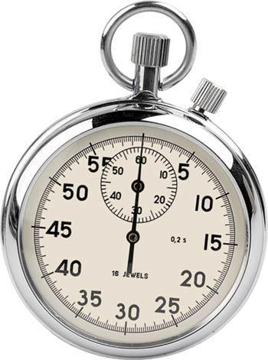
What’s a sprint?
Time boxed sessions
Specific outputs

Slide 4

There’s a reason…
Committed to January 2015 release
This week’s goals are crucial for delivery
If we are disciplined, we can do it!

Slide 5
Sprint rules
Accept personal responsibility for Sprint process and outputs
Contribute and share generously and openly
Actively listen and learn from other’s perspectives and experiences
Work collaboratively
Participate fully on all tasks

Slide 6
Sprint Team
  Sprintmaster – facilitator, process, progress, coach
  Working groups - focus on specific deliverables
  Support group – resolve issues with deliverables (modelling, classifications, conceptual)
  Facilitation team – process support
  (Sprintmaster, organizers, working group chairs)

Slide 7
Who’s Who - Facilitation
Sprintmaster: Kelly Chatain
Working Group Chairs:
  Data Citation: Larry Hoyle
  Simple Instrument: Barry Radler
  Simple Data Description: Steve McEachern
  Simple Codebook: Wolfgang Zenk-Moeltgen
Organizers: Mary Vardigan, Larry Hoyle, Arofan Gregory, Achim Wackerow, Wendy Thomas

Slide 8
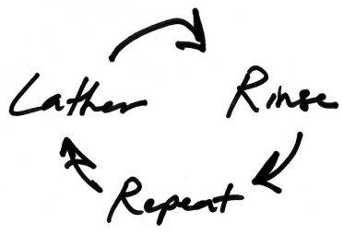
Sprint Process
Focus on tactical goals
  Specific deliverables for a set time period (a few hours to a half day)
  Defined by working groups with help from facilitation team
  Multiple goals within one session, sub-dividing probable
Wash, Rinse, Repeat

Slide 9
Managing the Work
Individuals proactively choose their work
Estimated work remaining is updated daily (standup/plenary)
If work unclear, define a sprint work item with a larger amount of time and break it down later
Update work remaining as more becomes known

Slide 10
Staying on Track
The Parking Lot – for ideas, issues off task or which need more discussion
Document it and set it aside
Avoid extended debate
  We do not want to lose track of issues which need to be decided through considered discussion
  We cannot let them stop us from making progress
Visit Parking Lot after each session, update/remove items

Slide 11
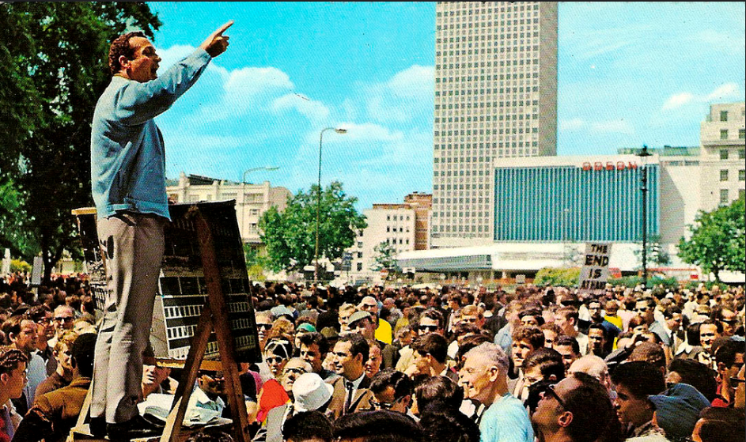
Staying on Track
The Soap Box - you have a brilliant idea (or even just an idea) to present to the group
  2 people per day during morning plenary
  3-minutes in duration
  No discussion directly afterwards (future plenary)
  Added to the parking lot
  Notify Sprintmaster the day before
The answer is 42!

Slide 12
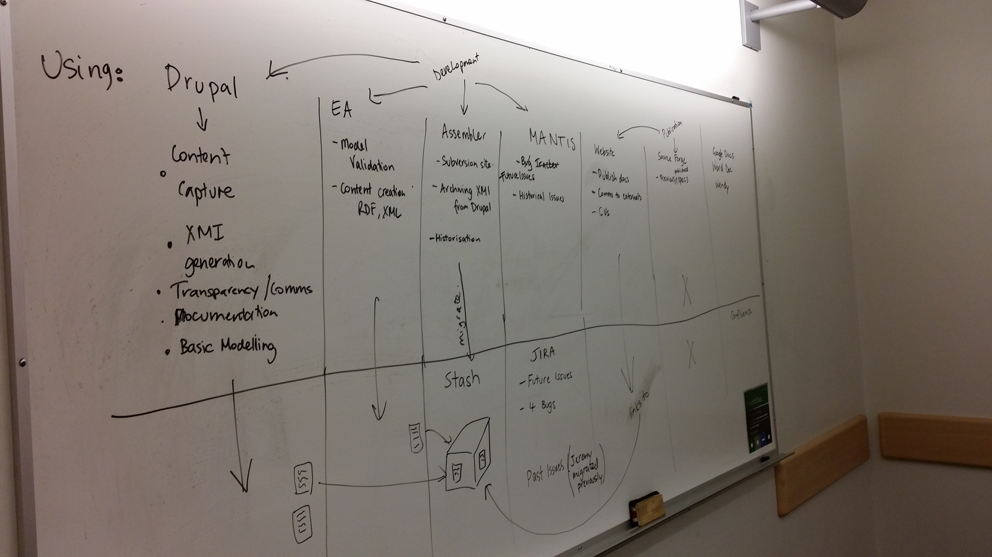
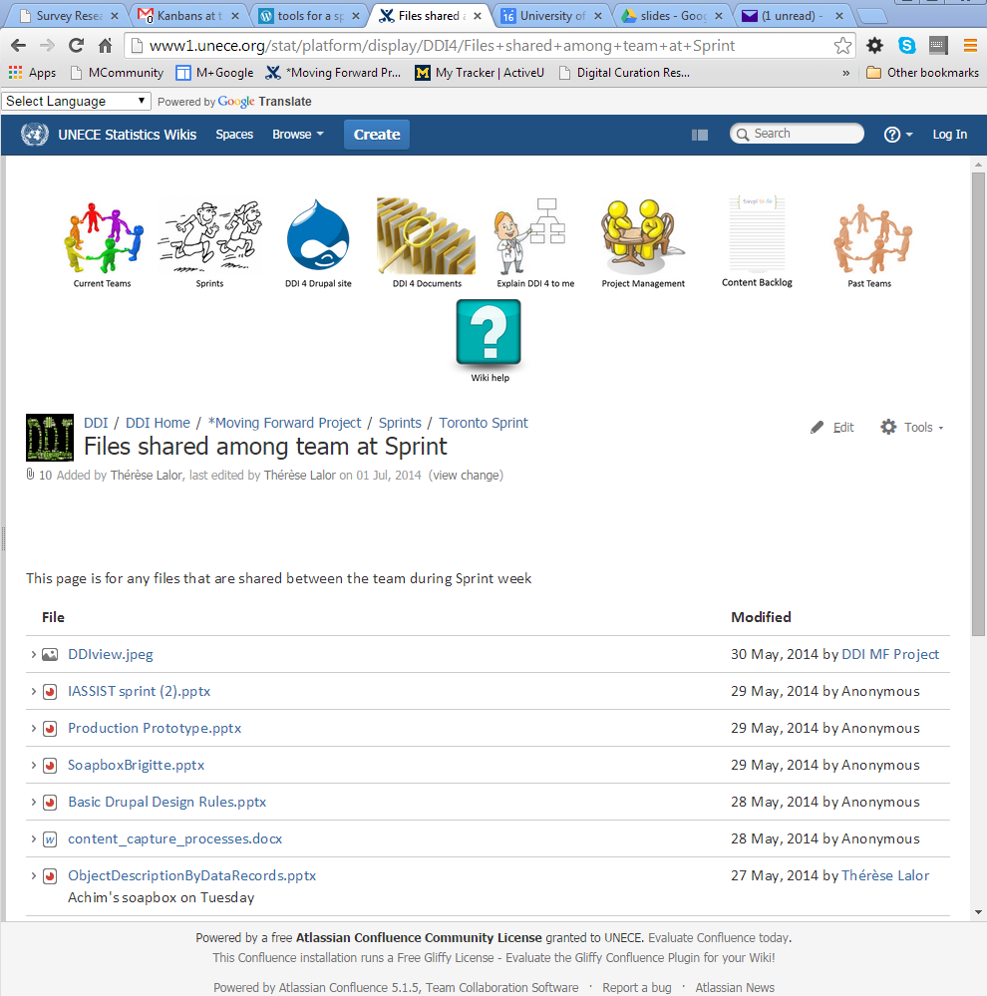
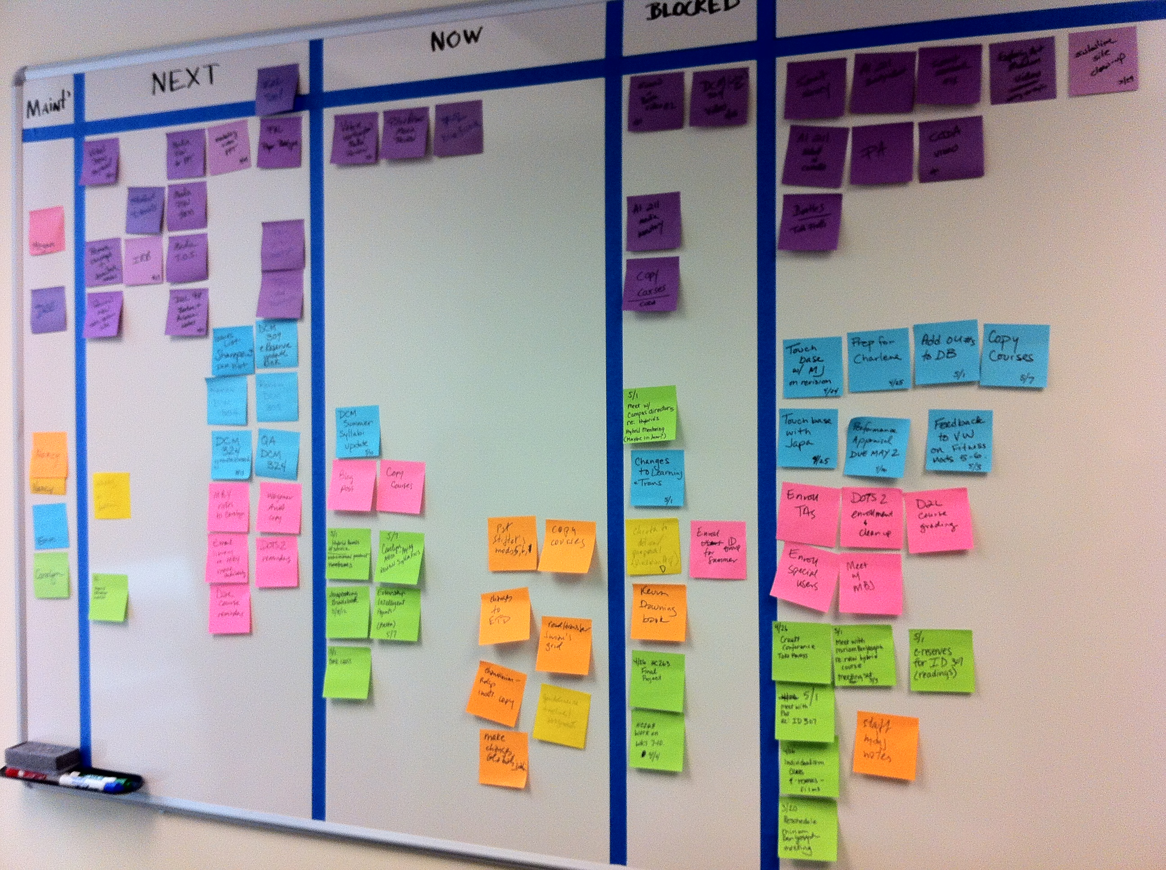

Writing It Down
Update the Wiki
https://dditools.atlassian.net/wiki/display/DDI4/
*Moving+Forward+Project
User: ddieditor
Pass: zipscript-3
Use the white boards
Use the 3x5s and Post-its
Take Pictures
Drupal

Slide 13
Daily Work Schedule
9:00 - 9:15 Morning Standup/Plenary/Soap Box
9:15 -10:30 1st Working session
10:30 - 10:45 Coffee
10:45 -12:15 2nd Working Session
12:15 - 13:45 Lunch
  Facilitation Team meets (13:30 – 13:45)
13:45 – 14:00 Afternoon Standup/Plenary
14:00 – 15:15 3rd Working Session
15:15 – 15:30 Cake & Coffee
15:30 – 16:45 4th Working Session
16:45 – 17:00 Closing Standup/Plenary
  Facilitation Team meets (17:00 – 17:30)
Schedule may be modified as needed, but this is the standard

Slide 14
Sprint Topics
  Enhanced Data Citation
  Simple Instrument/Complex
  Simple Data Description/Complex
  Simple Codebook
  Qualitative/Methodology

Slide 15
Deliverables
  Final draft model for review by the Modeling Team
    All completed objects in Drupal
  Complete use cases covered by the View with documentation
    Linked in Drupal
  A document containing:
    Description of open issues and discussion
    Description of decisions made for closed issues
    Further ideas for future development
    Parking lot issues list

Slide 16
Notes on Deliverables
Data Citation Working Group may have some additional deliverables as a result of NSF funding
  Not producing a View in DDI, impacting other Views
  Changes resulting from their work should be made to objects in Drupal
Qualitative/Methodology Working Groups are just starting
  Exploratory in nature
  May result in Drupal objects – Views are not expected to be completed
If planned work is finished before the week is out, there is plenty more to be done!

Slide 17
Next Steps
Draft Views will be submitted to Modeling Team for review
  Work with content teams to resolve any issues
  Work to take place virtually before the next sprint
Next sprint takes place before EDDI (end of November)
  Technical and production focus
  Production teams need finished models to work effectively

Slide 18

Introductions
Hello, my name is…
Experience with Moving Forward
Areas of interest/expertise
……..

