Slide 1



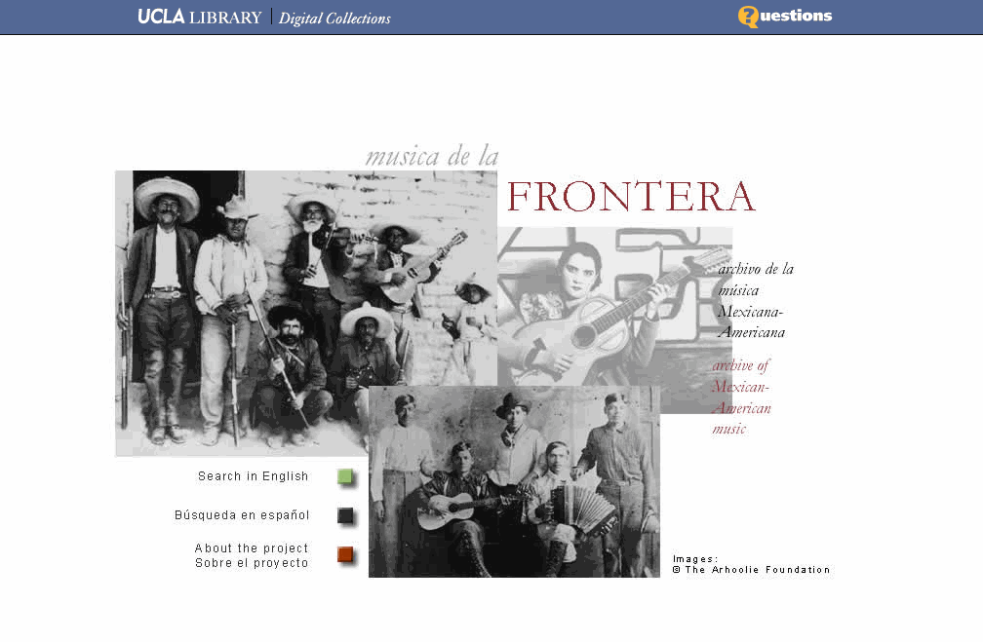


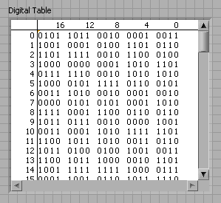

YAMZ: a cross-domain crowd-sourced metadata vocabulary
John Kunze
California Digital Library

Slide 2

Problem: traditional standardization
European Parliament Technology - DG ITEC @ flickr
  Change by committee is ugly, costly, and slow
  Example: Dublin Core, 15 cross-domain terms
Notes:
Traditional metadata standards are controlled by panels of experts, eg, FGDC, EML, Darwin Core
Change by committee is ugly, costly, and slow
Example: perhaps most widely use cross domain vocabulary is Dublin Core, 15 cross-domain terms
Agreed on in 5 years, lots of local divergence
“I love the 15, but my domain needs these 2 terms. How do we add them?” A: Make your own ontology!
Multiply by 200 domains and the result is 200 ontologies, 200 panels, 200 islands of non-interoperation

Slide 3
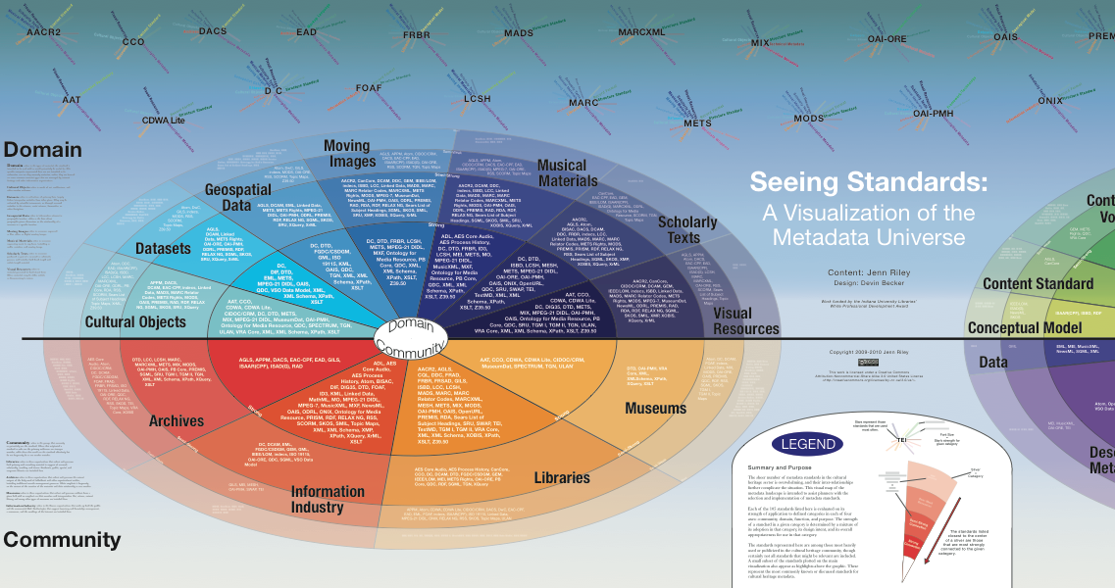
The Metadata Universe
Jenn Riley, IU

Slide 4
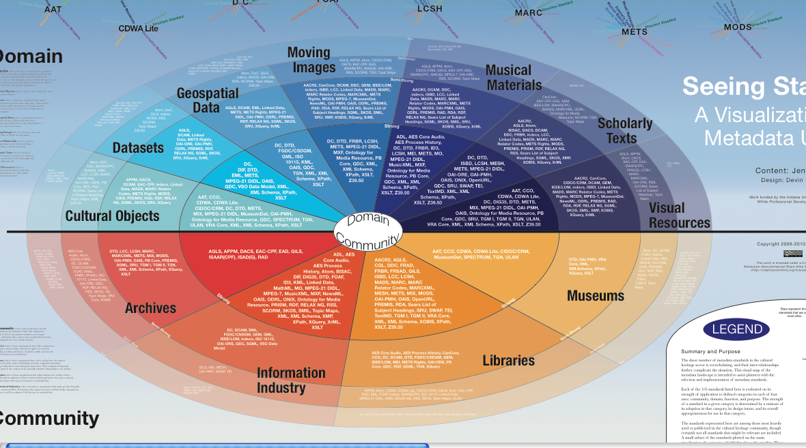
The Metadata Universe
Jenn Riley, IU

Slide 5
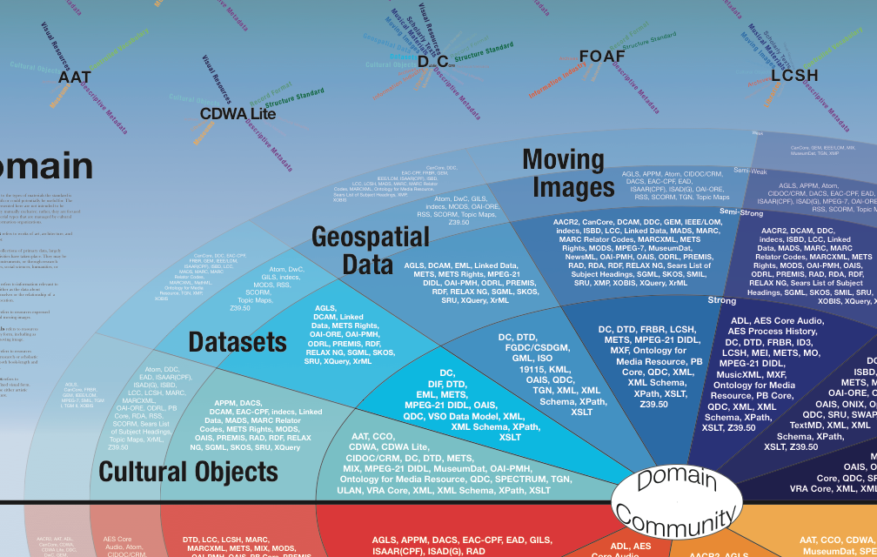
The Metadata Universe
Jenn Riley, IU

Slide 6
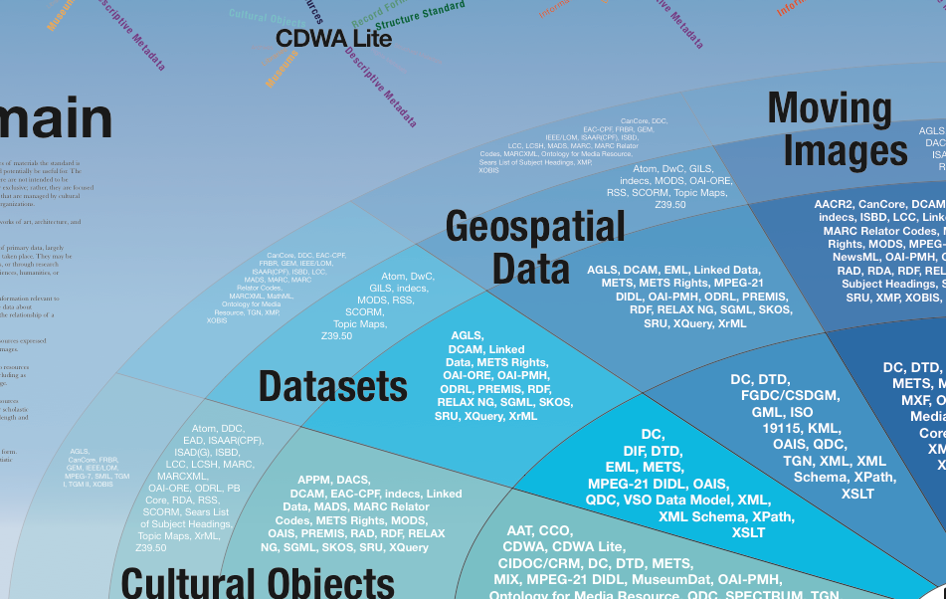
The Metadata Universe
Jenn Riley, IU

Slide 7
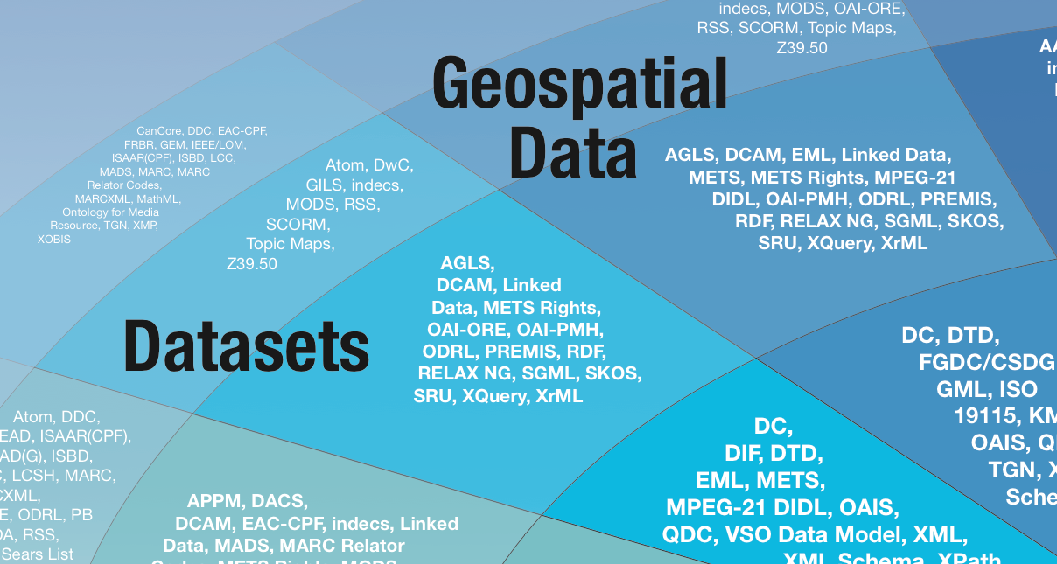
The Metadata Universe
Jenn Riley, IU

Slide 8

An alternate metadata universe
One dictionary, one namespace
Any research domain, any part of “metadata speech”
    Names, values, units, relationships, ...
Search for terms, comment on terms, add terms, edit your terms, API for automated access
All terms have globally unique persistent identifiers
THANK YOU!

Slide 9
Dictionary sociology
Crowd-sourced evolving vernacular terms, stable canonical terms, and deprecated terms
  Use evolving terms depending on your risk tolerance
Reputation-based voting means strong terms rise, weak terms decline
Applying lessons learned from Wikipedia, the Internet-Draft/RFC process, and StackOverflow
Notes:
Something between crowd-sourcing and an exclusive club
Learn from wikipedia, internet RFCs, StackOverflow, and American Heritage Dictionary

Slide 10
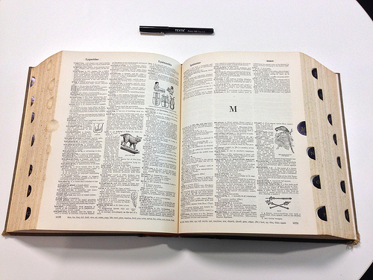
One dictionary, one namespace
SimonRobertson@flickr

Slide 11
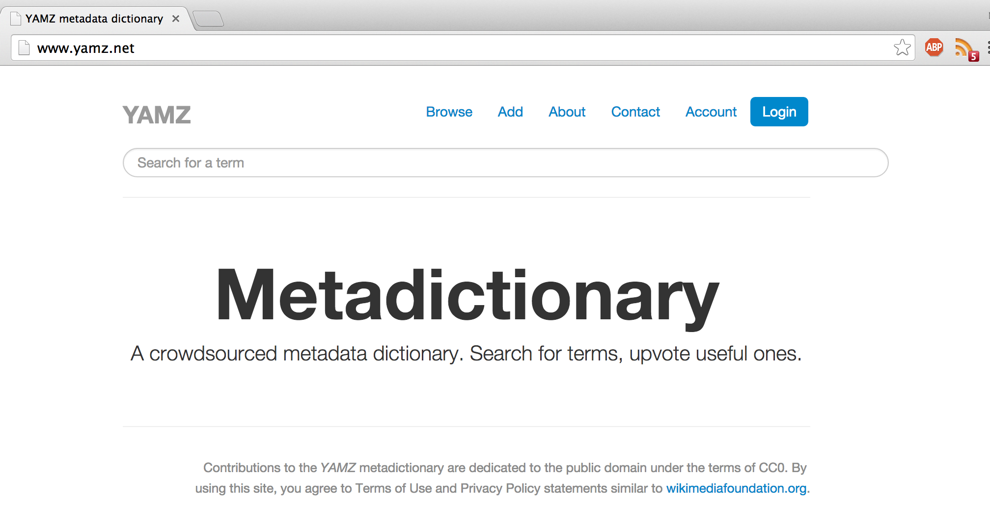
Notes:
Here’s the metadictionary.
Within 4 days of starting, using Python and off-the shelf tools, our intern put up this interface,
[click] freely hosted on heroku with the evolving code on github and an evolving design document on the github wiki. Project name is Yamz (yet another metadata zoo).
[click] Anyone can browse and read terms without logging in. But if you want to add new terms, comment, edit your terms, or vote on others’ terms, you have to login. Currently this requires you to use your google credentials.

Slide 12
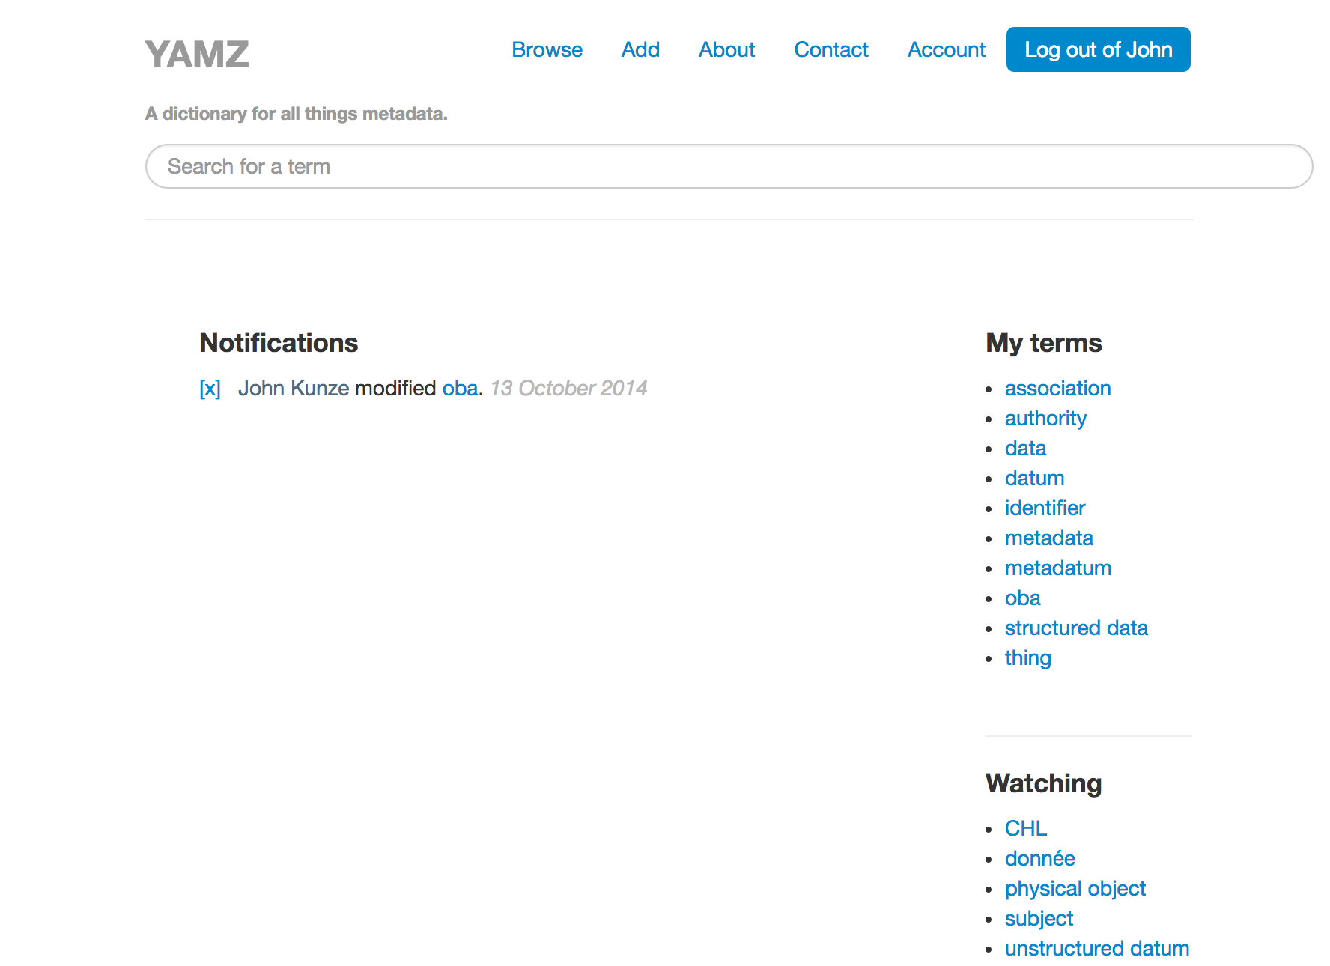

Slide 13
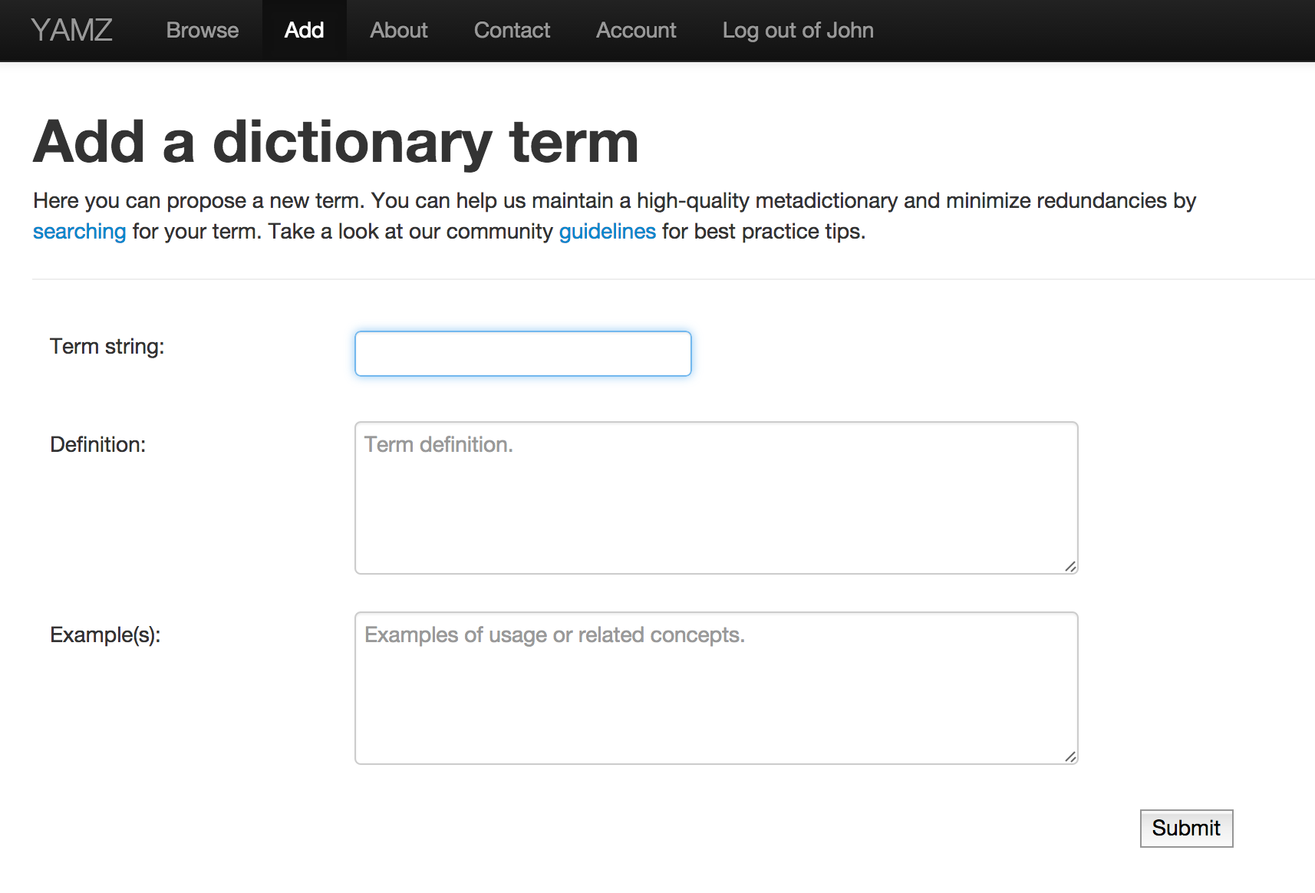

Slide 14
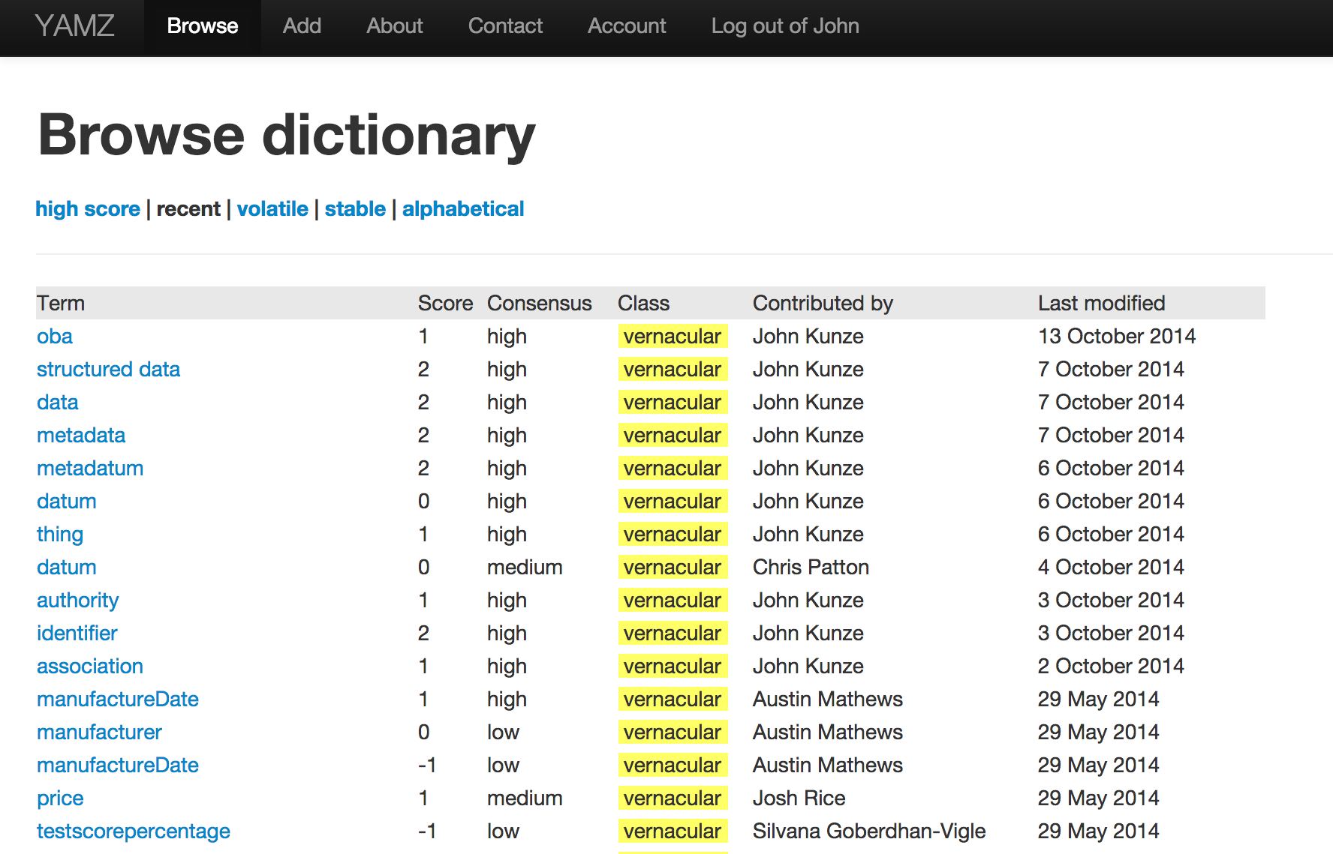

Slide 15
Feedback welcome
Try it out at
http://yamz.net
Find the code at
https://github.com/nassar/yamz

