Slide 1
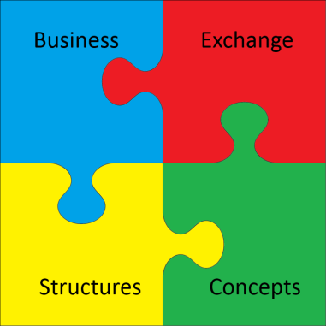
GSIM
Klas Blomqvist
Dagstuhl
2016-10-17

Slide 2
Introduction to the Generic Statistical Information Model (GSIM)
Notes:
Statistikförordningen
GD-beslut
Uppföljning

Slide 3
Why GSIM
Promote efficiency of production of official statistics, through
International collaboration
Use of standards
Harmonisation

Slide 4
HLG-MOS
High level group for the modernisation of official statistics

Slide 5
HLG-MOS

Slide 6
The Challenges
Riding the big data wave
Increasing cost & difficulty of acquiring data
New competitors & changing expectations
Competition for skilled resources
Rapid changes in the environment
Reducing
budget
Notes:
ABS, like other National Statistical Institutions, faces shared constraints and challenges.
External Challenges
rapidly changing external environment
More sophisticated users
Demand for timeliness and responsiveness
increasing demand for more accessible and ‘joined up’ data to solve complex policy questions
Constraints
Reduced funding and volatility in funding
Our costs are increasing significantly – unable to contact many households, response rates dropping, difficult to recruit and retain interviewers
skills shortages – competing for statistical and ICT skills across government
complex work programs
siloed processes
and aging infrastructure
6

Slide 7
HLG
Objectives:
Promote common standards, models, tools and methods to support the modernisation of official statistics;
Drive new developments in the production, organisation and products of official statistics, ensuring effective coordination and information sharing within official statistics, and with relevant external bodies;
Advise the Bureau of the CES on the direction of strategic developments in the modernisation of official statistics, and ensure that there is a maximum of convergence and coordination within the statistical "industry".
Means:
annual expert group workshops bringing together representatives from as many relevant groups as possible, to collectively identify priorities and plan strategies while avoiding duplication or conflicting outcomes
year-long projects which focus on one or two of the priorities identified by the workshops, that use participatory techniques to find rapid and collectively-developed solutions to the challenges of statistical modernisation
Links to past and current HLG projects can be found on the left of this page, and links to the four thematic Modernisation Committees are on the right of the page (note that while much of the material is open to public access, some areas of ongoing work are restricted to the teams involved).

Slide 8
Modernisation committees

Slide 9
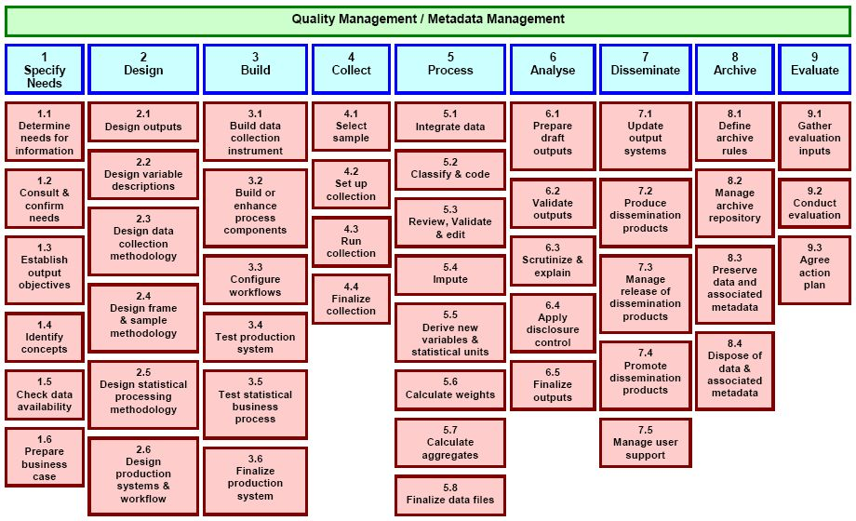
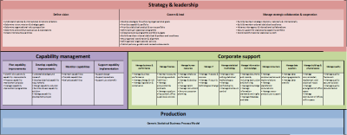
HLG initiatives
GSBPM
GSIM
CSPA
GAMSO
Big data

Slide 10
GSIM and GSBPM
GSIM describes the information objects and flows within the statistical business process.

Slide 11
Need of consistent information
Modernisation of statistics requires:
reuse and sharing of methods, components, processes and data repositories
definition of a shared “plug-and-play” modular component architecture
The Generic Statistical Business Process Model (GSBPM) will help determine which components are required.
GSIM will help to specify the interfaces.

Slide 12
What is GSIM?
A reference framework of information objects
It sets out definitions, attributes and relationships regarding information objects
It aligns with relevant standards such as DDI and SDMX
Notes:
not directly tied to them, nor other concrete implementation details
Provides common semantics that can be used unambiguously across and between different implementations

Slide 13
Purposes of GSIM
Improve communication
Generate economies of scale
Enable greater automation
Provide a basis for flexibility and innovation
Build staff capability by using GSIM as a teaching aid
Validate existing information systems
Notes:
between different disciplines involved in statistical production, within and between statistical organizations; and between users and producers of official statistics.
by enabling greater collaboration within and between organizations, especially through reuse of information, methods or technology.
of the statistical production process, thus increasing efficiency and reducing costs.
including support for the easy deployment of new statistical products and the adoption of new types of statistical data sources
that provides a simple, easy to understand view of complex information, with clear definitions
and compare with best practice in other organizations.

Slide 14
Moving to GSIM in practice
GSIM could lead to:
A foundation for standardised statistical metadata use throughout systems
A standardised framework for consistent and coherent design of statistical production
Increased sharing of system components

Slide 15
GSIM is a conceptual model: It is a new way of thinking for statistical organizations
Notes:
The conceptual model is explicitly chosen to be independent of design or implementation concerns,
The aim of a conceptual model is to express the meaning of terms and concepts used by domain experts to discuss the problem, and to find the correct relationships between different concepts.
The conceptual model attempts to clarify the meaning of various, usually ambiguous terms, and ensure that problems with different interpretations of the terms and concepts cannot occur.
Such differing interpretations could easily cause confusion amongst stakeholders, especially those responsible for designing and implementing a solution, where the conceptual model provides a key artifact of business understanding and clarity.
Once the domain concepts have been modeled, the model becomes a stable basis for subsequent development of applications in the domain. The concepts of the conceptual model can be mapped into physical design or implementation constructs
15

Slide 16
Questions…

Slide 17
GSIM verssion 1.1
http://www1.unece.org/stat/platform/display/gsim/Generic+Statistical+Information+Model

Slide 18
What is GSIM?

Slide 19
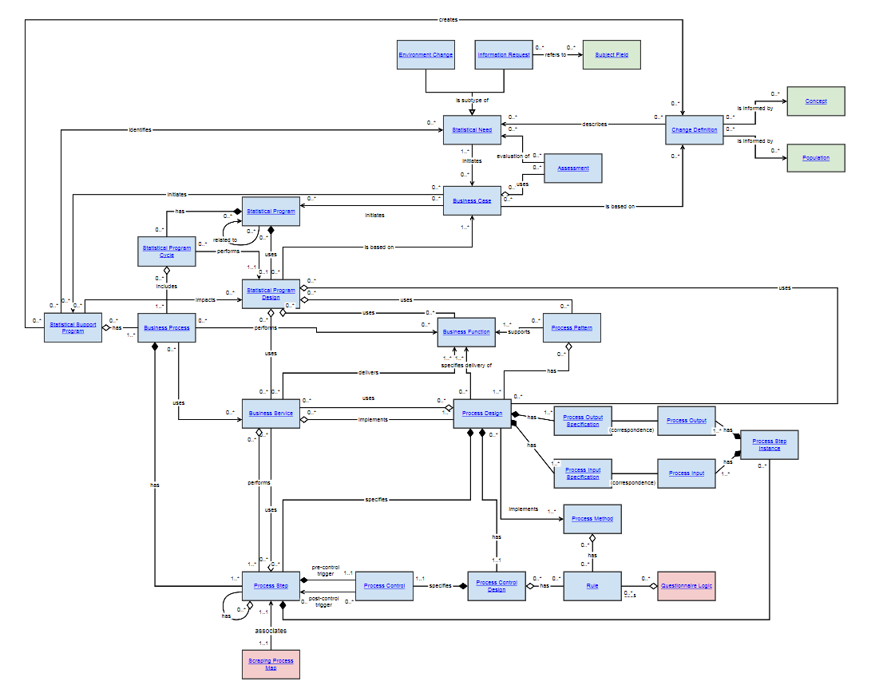
Business
Is used to capture the designs and plans of statistical programs, and the processes undertaken to deliver those programs.

Slide 20
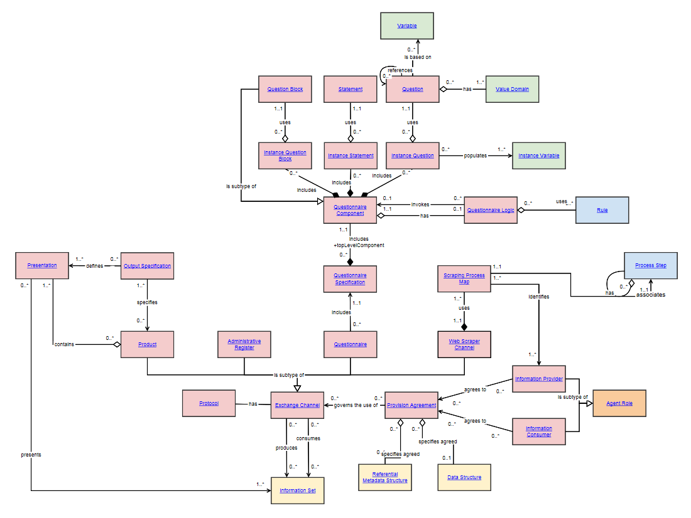
Exchange
is used to catalogue the information that comes in and out of a statistical organization.

Slide 21
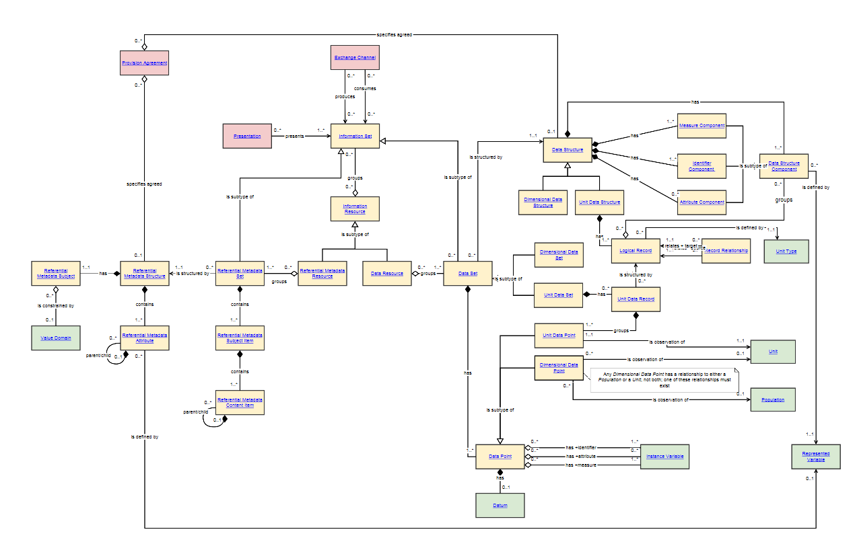
Structures
Is used to catalogue the information that comes in and out of a statistical organization.

Slide 22
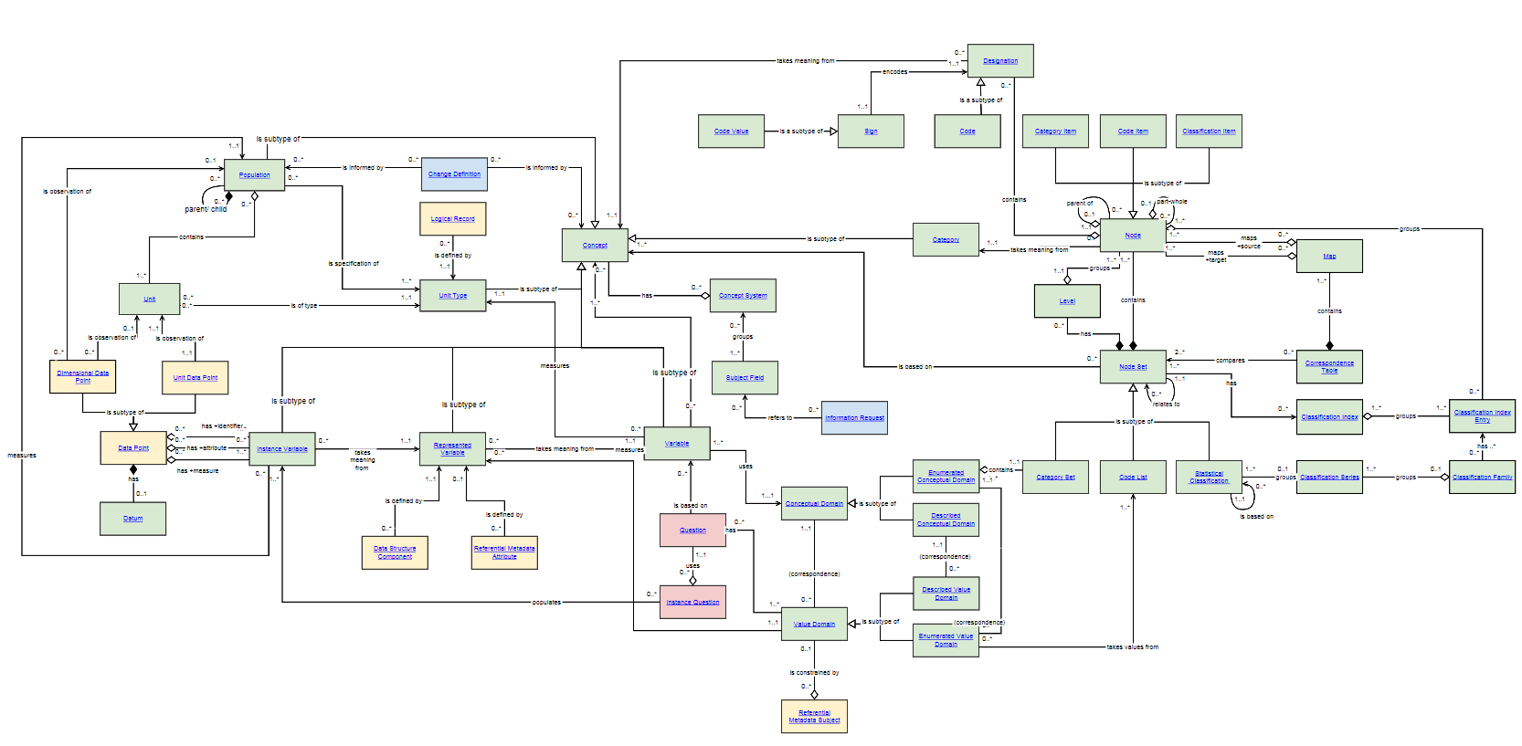
Concepts
is used to define the meaning of information to provide understanding of what the data are measuring.

Slide 23
Runs and feeds the processes
input
process
Output/
input
process
output
Notes:
Eva

Slide 24
Moving to GSIM in practice
GSIM could lead to:
A foundation for standardized statistical metadata use throughout systems
A standardized framework to aid in consistent and coherent design capture
Increased sharing of system components
Notes:
24

Slide 25
Moving to GSIM in practice
Common terminology across and between statistical agencies.
It allows NSIs and standards bodies, such as SDMX and DDI, to understand and map common statistical information and processes.
Notes:
While GSIM is a conceptual model, it can be implemented to different levels.
As a reference framework, GSIM Provides over-arching guidance to the development and use of statistical implementation and technology standards. GSIM is not directly tied to any particular implementation standard or technology solution.
Where GSBPM defines the statistical production process and sub-processes; GSIM defines the information associated with the statistical production process, including the flows of information, the business rules and process-related quality metrics. GSIM can however be implemented as a standalone framework or integrated with local business process models.
25

Slide 26
Work method
International collaboration
On line web-meetings
Interactive communication
Sprints

Slide 27
Releases
v1.0 - Released in December 2012
v1.1 - Released in December 2013
Revision planned for 2017

Slide 28
Ongoing
Modernisation Committee on standards
Operational responsibility for maintenance and development GAMSO, GSBPM and GSIM
Main activities and outputs:
To oversee the organisation of relevant workshops and expert group meetings, including on the topics of statistical standards and metadata
To oversee the SDMX/DDI dialogue process, encouraging greater coherence between these standards
To monitor developments in these areas within and beyond official statistics, and inform the HLG of any important issues
To follow developments in geospatial standards where relevant to the modernisation of official statistics

