Slide 1
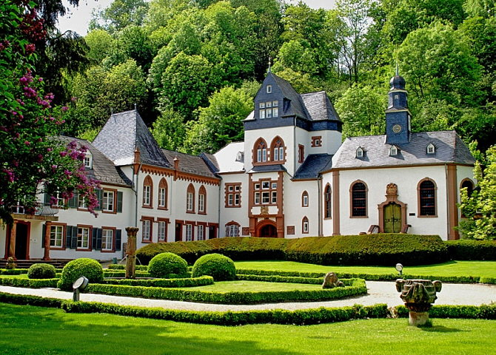
Welcome
Dagstuhl Sprint
Schloss Dagstuhl October 17-21, 2016

Slide 2
Dagstuhl Logistic Details
ID badges
Meals
Honour System
Facilities
Internet
Notes:
Link to Sprint site!

Slide 3
Introductions
Who are you?
Where are you from?
Personal Goals for this workshop?

Slide 4
2015 Workshop
Exploratory workshop
To increase awareness of DDI beyond our community
To investigate interoperability, challenges, and ways to work together
To develop relationships with external standard agencies
To provide an opportunity for an open review by invited external agencies

Slide 5
2016 Workshop – Goals
Better alignment of the DDI4 model with other related specifications.
Identify solutions to issues of interoperability for applications using multiple standards.
Explore future cooperation around the development and usage of metadata specifications.

Slide 6
Goals of 2016 Workshop
Standards Community-building
How can we work together?
Future collaboration

Slide 7
2016 Workshop Outcomes
Interoperability discussion document
Document outlining business scenarios where we would use different standards together
Tables:
High level table demonstrating commonalities between specifications when describing data
Detailed table mapping the important properties and relationships within classes, terminology differences, identify significant differences
A common definition / understanding of provenance for the purpose of this workshop
Notes:
Not DDI-focused, Something that everyone can use – since our goal is to work as a community

Slide 8
2016 Workshop Outcomes
A document outlining:
An evaluation of current design patterns in DDI4
What can we learn from the other specifications
Reason for pattern use and style of pattern
Document outlining why other specifications have chosen their particular bindings, the process used to create them, their rationale, and approaches to new releases and versioning; how to deal with issues of identification and round-tripping of data and metadata

Slide 9
2016 Workshop Outcomes
Document contrasting the approaches used to interchange protocols (REST, SPARQL, SOAP, etc..) by the different specifications; Pros and cons of having standard interfaces as part of the specification and the rationale
Presentations on discussions of Provenance for data production and Provenance for data publication
Document describing the requirements and best practices for use of RDF vocabularies in statistical applications
Document outlining the relationship of different standards for data description
The outline and draft of agreed design principles (“Data Manifesto”)

Slide 10
How are we going to Accomplish this Work?
Plenary to start the day – group discussion and/or outline the working groups
Proposed working group participants
Note taker
Spend the first 5-10 mins identifying possible breakout topics – within your working group
Evening Sessions

Slide 11
Recording your Work
Use template provided
Make note of any background info needed/used
Document ALL decisions
Note any proposals that were agreed upon
Reasoning behind the proposals and decisions
If there were different positions – provide both reasons for and reasons against

Slide 12
Staying on Track
The Parking Lot – for ideas, issues off task or which need more discussion
Document it and set it aside
Avoid extended debate
We do not want to lose track of issues which need to be decided through considered discussion
We cannot let them stop us from making progress
Visit Parking Lot after each session

Slide 13
Different Backgrounds With Different Perspectives on Data

Slide 14
Perspectives on Data
“File-centric” (DDI, SDMX, GSIM)

Slide 15
Perspectives on Data
“Transactional” (HL7 FHIR)

Slide 16
Perspectives on Data
“Publication/Reporting” (CSVW, CDISC)

Slide 17
Daily Schedule
07:30 – 08:45 Breakfast 09:00 – 09:15 Morning Standup/Plenary 09:15 – 10:30 1st Working session 10:30 – 10:45 Coffee 10:45 – 12:15 2nd Working Session 12:15 – 13:00 Lunch 13:00 – 13:45 Walk 13:45 – 14:00 Afternoon Standup/Plenary 14:00 – 15:15 3rd Working Session 15:15 – 15:30 Cake & Coffee 15:30 – 16:45 4th Working Session 16:45 – 17:00 Closing Standup/Plenary 17:00 – 17:30 Organization Team meets 18:00 – 19:00 Dinner 19:00 – 20:00 Possible Evening Session 20:00 – Cheese Plate

Slide 18
Final Comments
Don’t be afraid to ask questions!
Take advantage of the Parking Lot
Daily walks
Thursday night dinner
If you need more time and a room – come find me!! See front board on where to find me
Let the FUN begin!

Slide 19
07:30-08:45 | BREAKFAST
09:00-09:15 | MORNING PLENARY
09:15-10:30 (Session 1) | Plenary: Introductions, goals of the workshop, and overall introduction to DDI Introduction of participants Introduction to DDI DDI-Codebook DDI-Lifecycle DDI Moving Forward Project What do we work with and the challenges that we’ve encountered, especially regarding interoperability with other specifications?
10:30-10:45 | COFFEE BREAK
10:45-12:15 (Session 2) | External presentations: Klas Blomqvist – GSIM Flavio Rizzolo – LIM Arofan Gregory – SDMX Eric Prud’hommeaux – FHIR Barrie Nelson - CDISC
12:15-13:00 | LUNCH
13:00-13:45 | WALK

