Slide 1
The DDI4 LogicalDataDescription Package
Jay Greenfield, Ph.D.
Booz | Allen | Hamilton
10/17/2017

Slide 2
Specification Introduction
My involvement/role
I have been a member of the DDI Data Description Team for many years now
Over my career I have had a couple of formative experiences with data description
Maintaining the integrity of health insurance information in the course of data collection
Health insurance information amounts to a set of nested lists or rosters
ESTB x EPRS x PLAN x EPCP x COND x PMED
Collection is a pattern of enumeration and description where description may consist of completing key/value pairs and/or specifying new enumerations
The second formative experience has been with big data beginning with the idea that data is a stream whose moments correspond to regular expressions
I worked to decipher machine data
I took a fresh look at health information that began with the idea that at its inception health information is unstructured that only has meaning by pattern matching where pattern matching consists of the enriching of data with metadata in a workflow that builds on itself with enrichments on top of enrichments

Slide 3
Specification Introduction (continued)
Coverage of the Specification
The goal was to create a single framework that could describe:
Rectangular and non-rectangular data
Unit data and dimensional data
Atomic data and relational data
Graph data and tree data
The goal was to exercise this framework in several use cases:
Representation of a relational data store
Representation of a data warehouse
Lossless transformation of unit data into dimensional data
Representation of data pools and data lakes (e.g. RAIRD)
Growing data pools and data lakes into data structures
Representation of health observations and their context
openEHR
FHIR

Slide 4
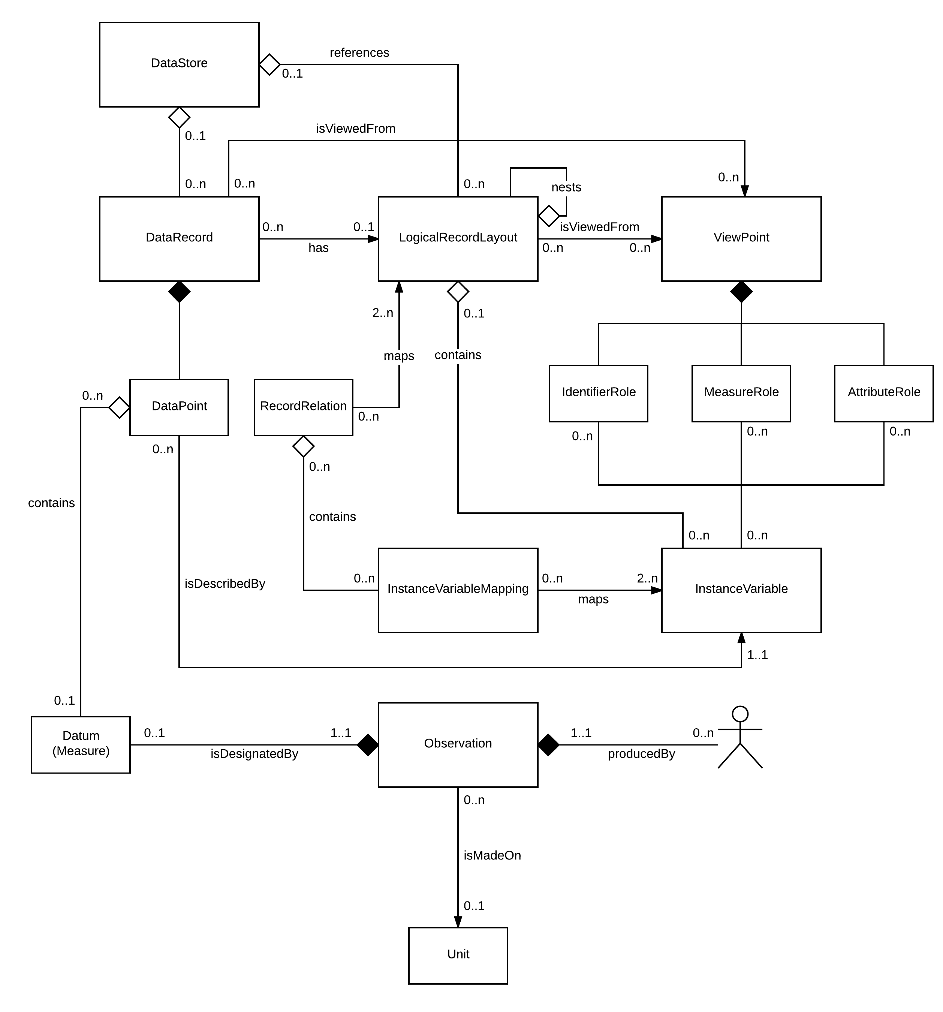
Specification Introduction (continued)
Coverage of the Specification
The goal was to create a single framework that could describe:
Rectangular and non-rectangular data
Unit data and dimensional data
Atomic data and relational data
Graph data and tree data
The goal was to exercise this framework in several use cases:
Representation of a relational data store
Representation of a data warehouse
Lossless transformation of unit data into dimensional data
Representation of data pools and data lakes (e.g. RAIRD)
Growing data pools and data lakes into data structures
Representation of health observations and their context
openEHR
FHIR

Slide 5
Specification Introduction (continued)
Who is using it?
DDI4 is only just now being published not as a whole but in UML packages – one or more at a time
LogicalDataDescription is one of its early packages
That being said, RAIRD has already adopted elements of its data description framework
DDI3 is widely used by national statistical organization and archives and DDI4 is, in part, backwardly compatible with DDI3
How is it being used?
Use is less of a fact and more of a hope
Archives of heterogeneous registry data (social science and health information) like RAIRD are an early target

Slide 6
What other specifications are being used in conjunction with your specification? (1 of 2)
Who is using them?
GSIM
ISO 11179
At what level of specificity do they interact?
Arguably both GSIM and IS0 11179 are in large part conceptual models
DDI4 both lends specificity to these standards and puts them in a larger context
The larger context is a collection pattern through which groupings can be modelled
Groupings figure into relations between members of a registry (ISO 11179)
Groupings figure into the relations between DataPoints in a DataRecord, the order of DataRecords in a DataSet and various correspondences like those between DataSets (GSIM)
The specificity takes two forms:
Like any logical model DDI4 specializes the conceptual model, adding subtypes, attributes and relations

Slide 7
What other specifications are being used in conjunction with your specification? (2 of 2)
Beyond specialization, DDI4 is able to describe data not just at each step in the data lifecycle
Now with DDI4, DDI is able to describe inputs, outputs and the operations that data undergoes in between
Indeed the DDI4 Workflows package and the Process Pattern upon which it is fashioned can both chronicle what we did with data in the past (its provenance) and support a software agent to manipulate data in the future (a “program”)
Maybe all this sounds a bit mushy…

Slide 8
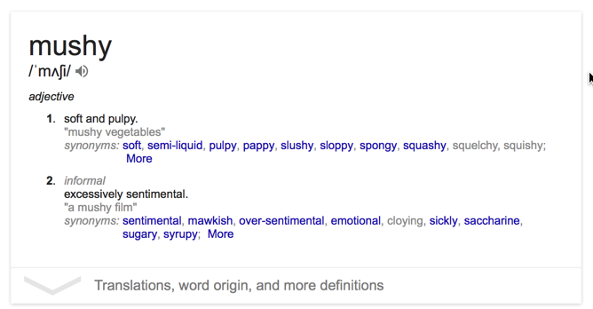
What other specifications are being used in conjunction with your specification? (2 of 2)
Beyond specialization, DDI4 is able to describe data not just at each step in the data lifecycle
Now with DDI4, DDI is able to describe inputs, outputs and the operations that data undergoes in between
Indeed the DDI4 Workflows package and the Process Pattern upon which it is fashioned can both chronicle what we did with data in the past (its provenance) and support a software agent to manipulate data in the future (a “program”)
Maybe all this sounds a bit mushy…

Slide 9
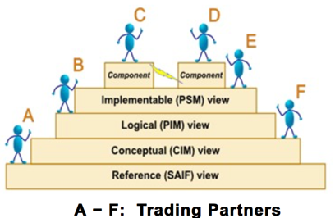
That being said, Charlie, there is no stairway to heaven!
Is “lossless transformation” a way
out of Charlie’s rabbit hole?
Notes:
Service Aware Interoperability Framework
Enterprise Conformance and Compliance Framework

Slide 10
Experience in working with a suite or set of standards
LogicalDataDescription is part of DDI4
DDI4 is a BIG suite consisting of packages, functional views and patterns that grow the capabilities of the packages and views to reason and interact
The scope of DDI4 was originally the same as DDI3: to describe the data lifecycle in a way that from one researcher to the next it would be repeatable which promotes the growth of science
However, DDI4 has come to be more capable than DDI3
All this capability should not come at the cost of complexity. This is the challenge DDI4 faces now

