Slide 1
Sample Use Cases for the SimpleCodebook View in DDI Views (DDI4)
Dan Gillman, Arofan Gregory, Larry Hoyle, Knut Wenzig

Slide 2
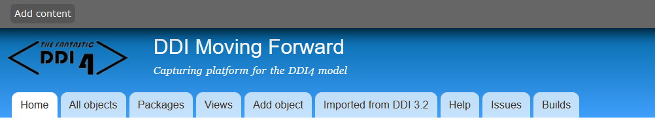
DDI Views - http://lion.ddialliance.org/
DDIViews (DDI4) has Functional Views, which are subsets of the whole model,
typically many fewer classes
All Functional Views are compatible

Slide 3
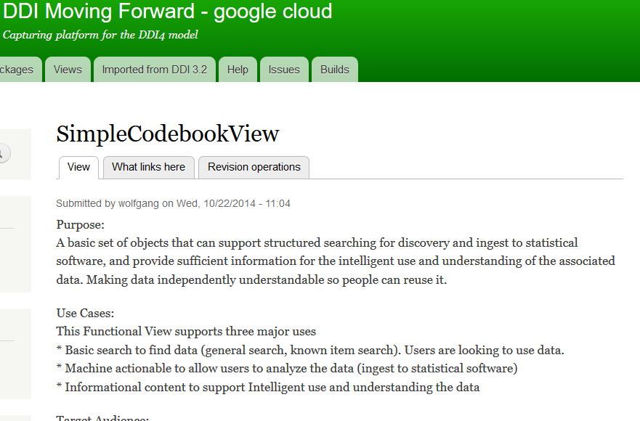
SimpleCodebook Functional View
Both
logical and
physical
file structure
Intended to be compatible with DDI 2.5

Slide 4
SimpleCodebookView – Study Level
  Resource Discovery
    (e.g. contributors, title, abstract)
  Which Variables
    Variable roles (Viewpoints)
  UnitType, Universe, and Population
  Coverages
    Temporal, spatial, topical
  Generalized Instrument
  Logical and physical record structures
    Simple rectangular
    Hierarchical
    Dimensional (ncubes)
    Event data
For more about use cases for
physical descriptions see:
http://hdl.handle.net/1808/23742

Slide 5
SimpleCodebookView – Variable level
  Variable cascade (optional)
    Conceptual, represented, instance variables
  Logical variable description
    Substantive and sentinel values
    Intended datatype
    Units of measurement
  UnitType, Universe, and Population
  Physical variable representation (ValueMapping)
    (e.g. a number as a string in a CSV)
For more about use cases for
physical descriptions see:
http://hdl.handle.net/1808/23742

Slide 6
Classes in the SimpleCodebookFunctional View
Access
AlgorithmOverview
AttributeRole
Category
CategorySet
Code
CodeItem
CodeList
Concept
Coverage
CubeLayout
DataPoint
DataRecord
DataStore
Datum
DesignOverview
Embargo
EventLayout
ExternalMaterial
FundingInformation
IdentifierRole
ImplementedInstrument
Individual
InstanceQuestion
InstanceVariable
InstanceVariableMapping
Instruction
LayoutOrderedPair
Level
LogicalRecordLayout
LogicalRecordLayoutOrder
Machine
MeasureRole
MethodologyOverview
Organization
PhysicalLayoutOrder
PhysicalLayoutOrderedPair
Population
RecordRelation
RectangularLayout
SamplingProcedure
SegmentByText
SentinelConceptualDomain
SentinelValueDomain
SeriesStatementDUMP
SpatialCoverage
Statement
StructureDescription
Study
StudySeries
SubstantiveConceptualDomain
SubstantiveValueDomain
TemporalCoverage
TopicalCoverage
Unit
UnitType
Universe
ValueAndConceptDescription
ValueMapping
Viewpoint
This view has 60 of the current 858 classes in Lion
Notes:
Lion does have a number of deprecated or unused classes though.

Slide 7
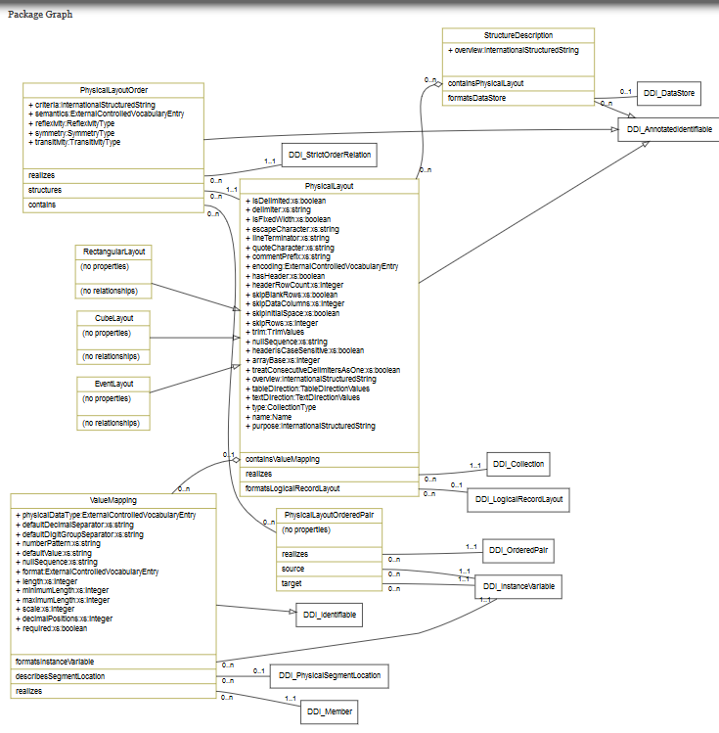
DDI-Views Packages (Example: FormatDescription)
Packages are useful when looking at, or developing, the overall model.
They are not namespaces.
Notes:
Packages divide up the large model into logically coherent parts. They are not reflected in the XML, RDF or other expressions of the model. This package is also a Pattern, a set of classes that are abstract and are “realized” by other classes. Realizing classes have all of the properties and relationships of the class they realize. Relationships connect to classes that may exist independently from the source class. Note that classes in a Functional View can make use of classes in other parts of the model.

Slide 8
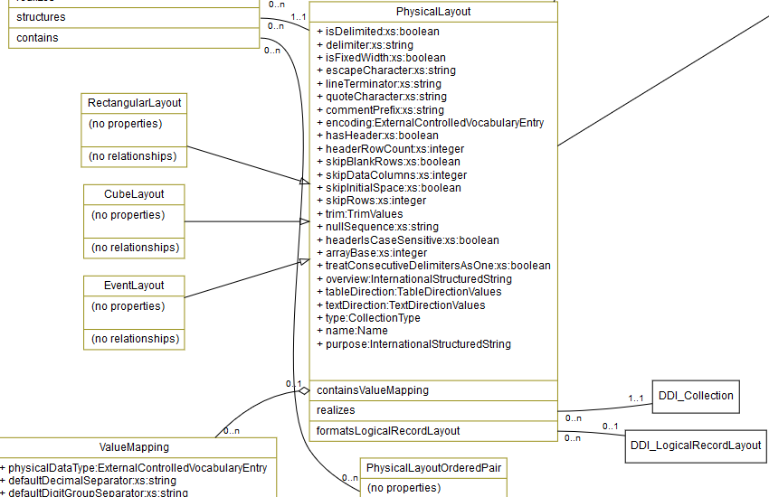
DDI-Views Packages (Example: FormatDescription Detail)
UML model features:
Inheritance
Realization
Properties
Relationships
  aggregations
  plain
Notes:
Packages divide up the large model into logically coherent parts. They are not reflected in the XML, RDF or other expressions of the model. This package is also a Pattern, a set of classes that are abstract and are “realized” by other classes. Realizing classes have all of the properties and relationships of the class they realize. Relationships connect to classes that may exist independently from the source class. Note that classes in a Functional View can make use of classes in other parts of the model.

Slide 9
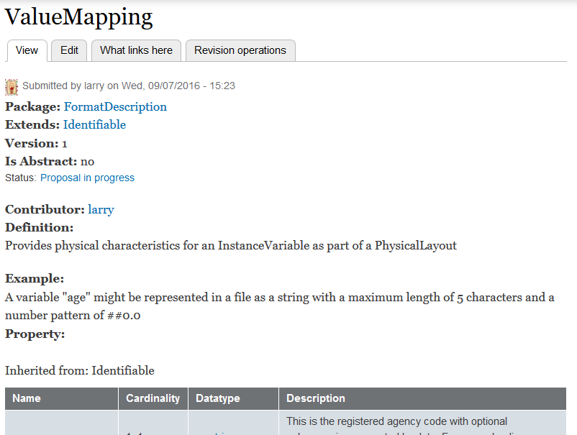
Describing a class in Lion – definition, notes, and examples
http://lion.ddialliance.org/ddiobjects/valuemapping
Notes:
Lion is a Drupal development environment for DDI-Views. Classes are entered via forms like the one shown above. They allow entry of general information about the class.

Slide 10
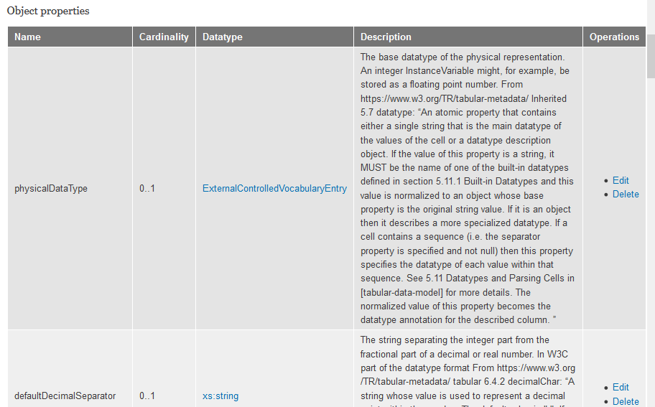
Describing a class in Lion – properties
Notes:
Lion forms also allow entry of information about properties and relationships, including description and cardinalities.

Slide 11
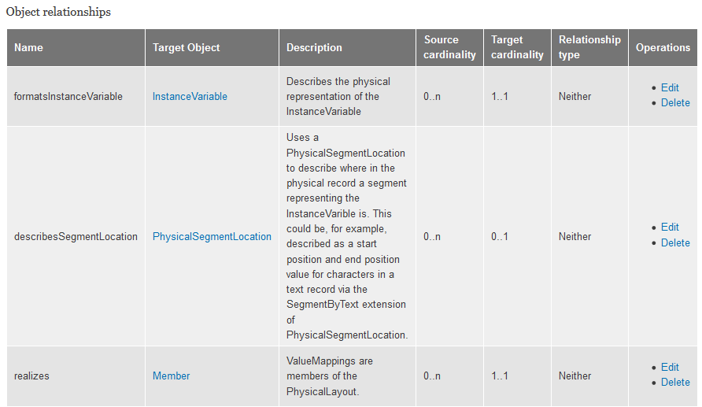
Describing a class in Lion – relationships
Notes:
Lion forms also allow entry of information about properties and relationships, including description and cardinalities.

Slide 12
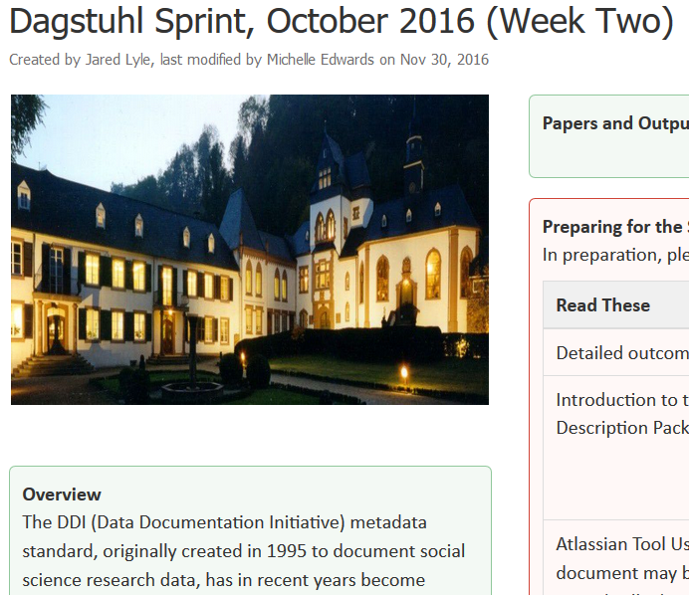
Dagstuhl Week 2 Sprint 2016 https://ddi-alliance.atlassian.net/wiki/pages/viewpage.action?pageId=39911463
Data Description working group
Tested the DataDescription View
Physical file layouts:
CSV Simple rectangular
Fixed Column rectangular
CSV Segmented
CSV Hierarchical
CSV Aggregate (ncube)
We also looked at event history data and think it will be describable with these elements too
see: https://ddi-alliance.atlassian.net/wiki/display/DDI4/Data+Description+View+Team
Notes:
There is a more detailed description of each of these cases on the Data Description Team site.

Slide 13
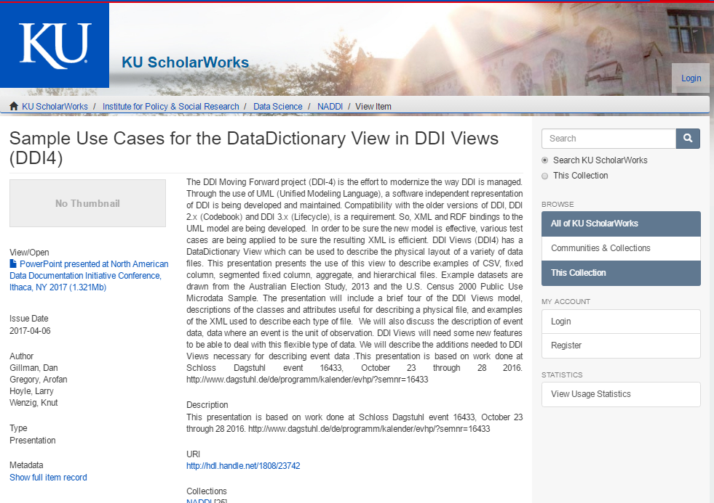
NADDI 2017 presentation http://naddiconf.org/2017/
A presentation on that Dagstuhl work is available at:
http://hdl.handle.net/1808/23742
Some of the slides from that presentation have been reused here.

Slide 14
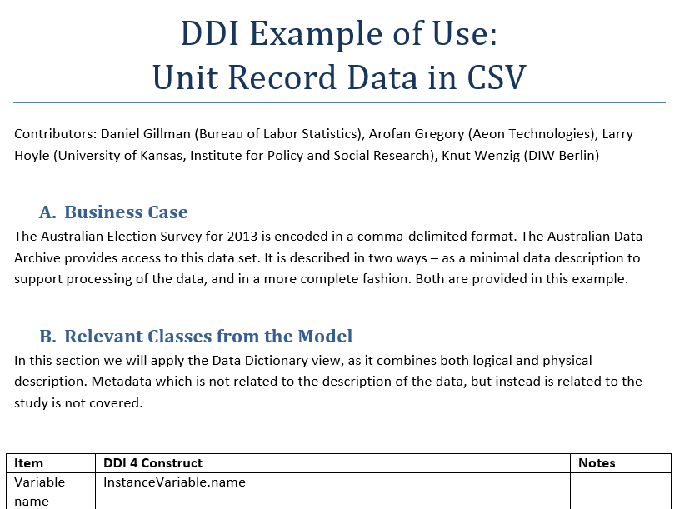
Simple Rectangular CSV https://ddi-alliance.atlassian.net/wiki/display/DDI4/Data+Description+View+Team
More details are available on the web in the report from the working group
Notes:
The CSV we created was an extract from the Australian Election Survey. The full dataset is available at: https://ddi-alliance.atlassian.net/wiki/download/attachments/39911463/DataDescriptionExamples.zip?api=v2

Slide 15
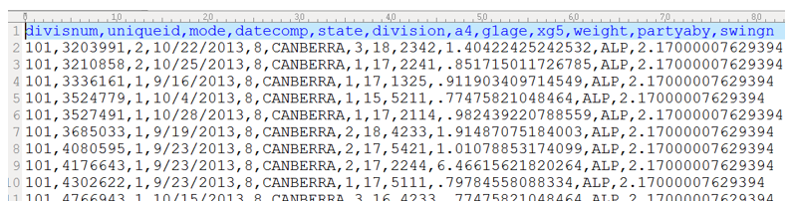
Simple Rectangular CSV – Australian Election Survey
The example uses a small representative set of variables
See: http://www.australianelectionstudy.org/about.html
Notes:
We selected a small subset of the variables in the AES for our example.

Slide 16
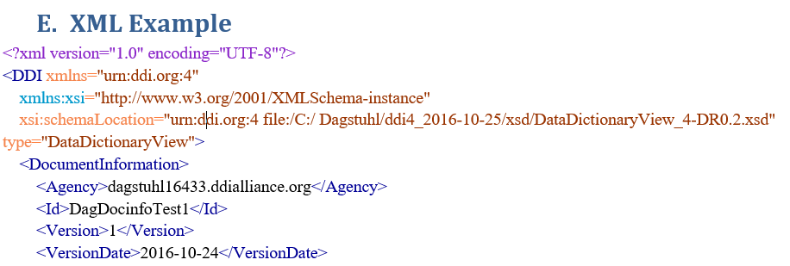
Example DDI4 XML

Slide 17
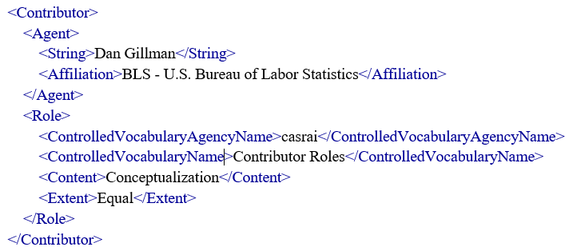
More XML

Slide 18
In this presentation we’ll look at Study related properties

Slide 19
Some properties are attached through relationships
This allows reuse:
e.g. variables, populations,
Instruments

Slide 20
Some Study Properties
QualityStatement,
ExPostEvaluation,
AuthorizationSource,
and
Embargo

Slide 21
Some Study Properties
FundingStatement,
and
Budget

Slide 22
Some Study Properties
Discovery,
and
Access

Slide 23
Some Study Properties
InstanceVariable,
Population,
and
ImplementedInstrument

Slide 24
Other Study Properties
Through:
Methodology,
Design,
Algorithm, and
Process

Slide 25
Methodology Associated Study Relationships
Methodology,
Design,
Algorithm,
and
Process

Slide 26
Methodology, Design, Algorithm, and Process have Overviews

Slide 27
Overviews

Slide 28
Annotation
Lots of Dublin Core related information

Slide 29
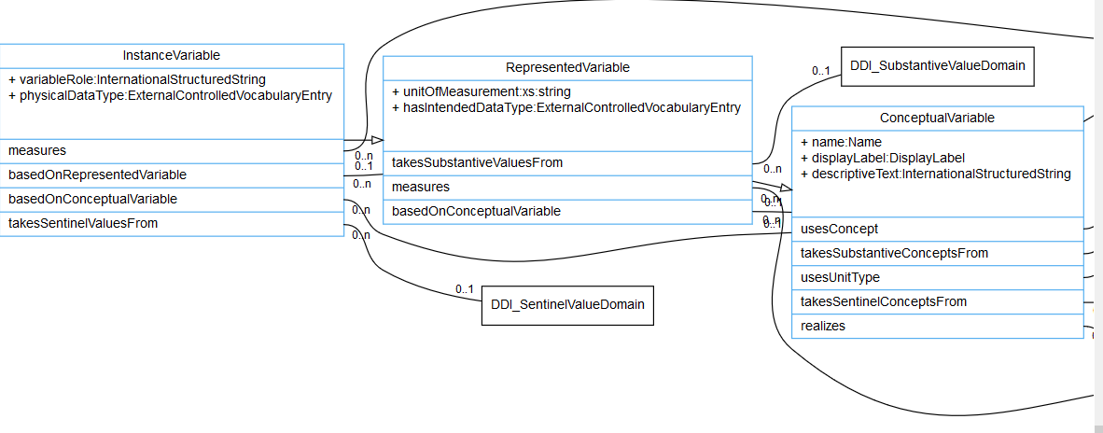
Variable Cascade in DDI http://lion.ddialliance.org/package/conceptual
The InstanceVariable can reference RepresentedVariable and ConceptualVariable
It also inherits all properties and relationships from them.

Slide 30
Variable Cascade in DDI http://lion.ddialliance.org/package/conceptual
ConceptualVariable
RepresentedVariable
InstanceVariable

Slide 31
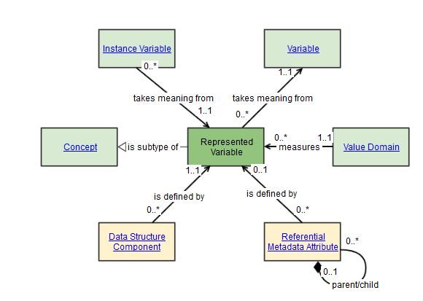
Modeled to comply with GSIM http://www1.unece.org/stat/platform/display/GSIMclick/Instance+Variable http://www1.unece.org/stat/platform/display/GSIMclick/Represented+Variable

Slide 32
Conceptual Variable http://lion.ddialliance.org/ddiobjects/conceptualvariable
Concept
UnitType
Substantive
ConceptualDomain
Sentenal
ConceptualDomain

Slide 33
RepresentedVariable http://lion.ddialliance.org/ddiobjects/representedvariable
Substantive
ValueDomain
Universe

Slide 34
InstanceVariable http://lion.ddialliance.org/ddiobjects/instancevariable
Population
SentinelValueDomain
ALSO INHERITS EVERYTHING FROM
ConceptualVariable and RepresentedVariable

Slide 35
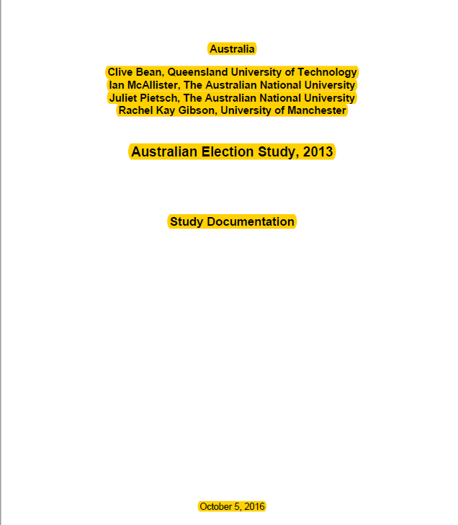
Australian Election Study Codebook
Highlighted bits
successfully
encoded in DDI4

Slide 36
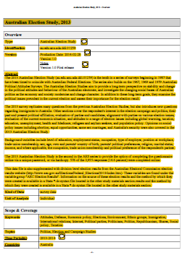
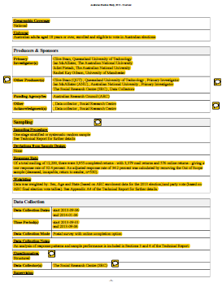
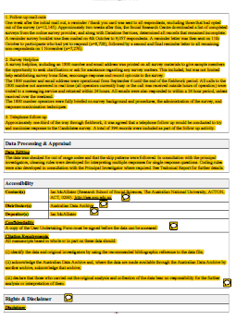

Australian Election Study Codebook
Highlighted bits (study level)
successfully encoded in DDI4

Slide 37

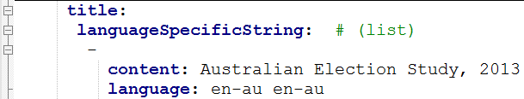
Australian Election Study – Study Level in YAML - Title
Comments in green
Notepad ++ knows YAML and can expand and collapse outline
DDI4 structure in blue
Instance content in black

Slide 38
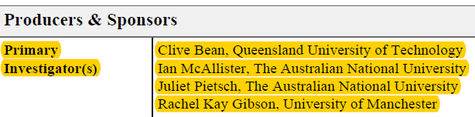
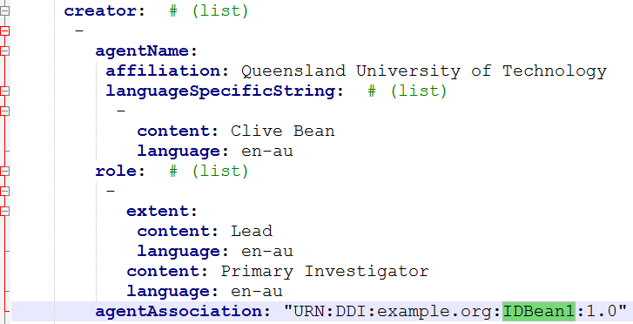
Contributor and Role

Slide 39
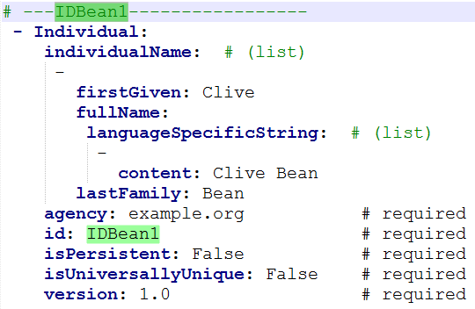
Agent Association by Reference – Individual, Organization or Machine

Slide 40
Identification: Agency, ID, and Version
URN
agency
id
version
Separate
properties

Slide 41
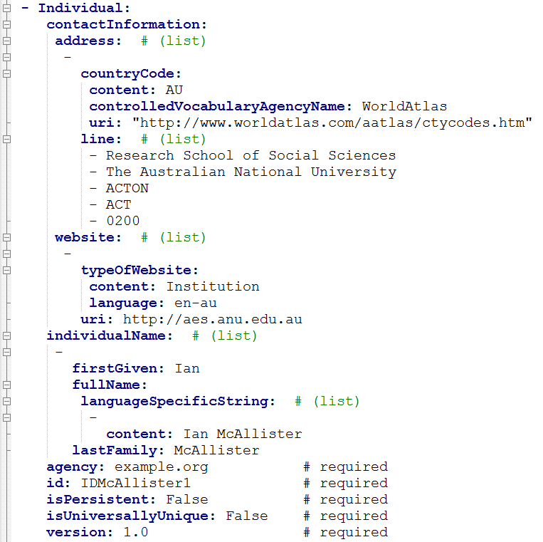
Reusable information
ContactInformation
Website
IndividualName
identification

Slide 42
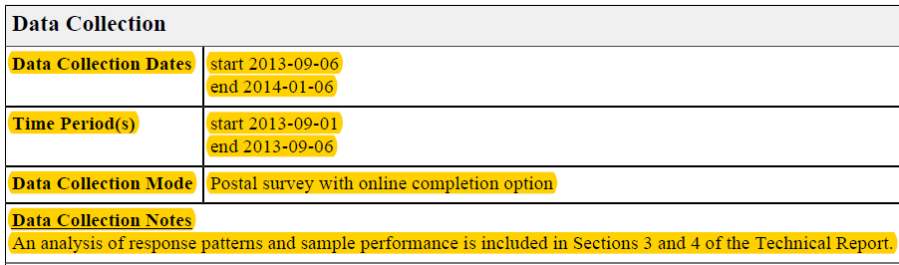
Methodology

Slide 43
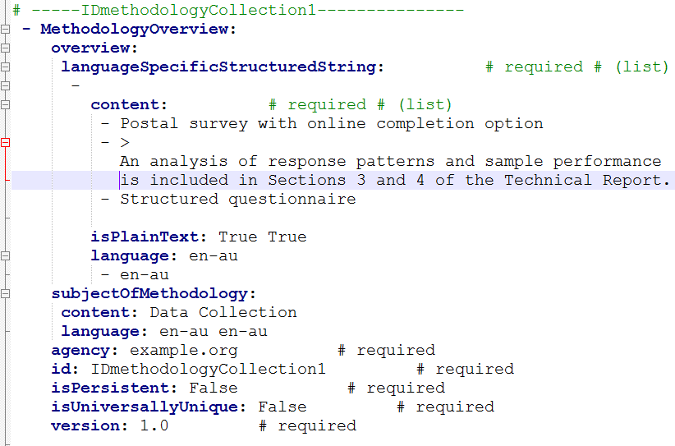
Methodology

Slide 44
Results
For the information in a Nesstar codebook:
  DDI4 can describe a CSV representation of the data (see NADDI Presentation)
  DDI4 can describe all of the Study level information
Next week
  Review logical level variable information

