Slide 1
Vision for DDI Long-Term Infrastructure and the DDI Alliance

Slide 2
Vision for DDI Long-Term Infrastructure
DDI-based infrastructure for the support of empirical sciences in the social, behavioral, economic, and health domains
Describing data in a structural and standardised way
Based on a central element registry and distributed metadata/data repositories

Slide 3
Purpose
Providing the basis for a reliable framework in a global network in order to support …
Exchange and long-term preservation of metadata
Re-using metadata in a single data collection, across waves of longitudinal data, across data collections, and across institutions
Metadata-driven data collection
Transparent research
Research reproducibility

Slide 4
Mutual Benefits
An institution realizing a part of the infrastructure framework benefits from …
a larger plan with well-defined interfaces
existing components
referencing both in proposals for funding agencies
Such a proposal would be a part of a bigger picture and no isolated development
The empirical SBE sciences benefit from a growing distributed infrastructure framework
The DDI Alliance benefits from third-party contributions
The Alliance wouldn‘t have the resources (nor it is their objective) to realize all components of the infrastructure

Slide 5
Limitations
All components of the infrastructure framework …
would need a license which allows the public use of them
need to be compliant with the related rules
Data and metadata elements could be provided with access restrictions if necessary

Slide 6
Background
The idea of a long-term infrastructure plan is borrowed from areas in sciences, astronomy and particle physics
There research depends on expensive infrastructure and related work

Slide 7
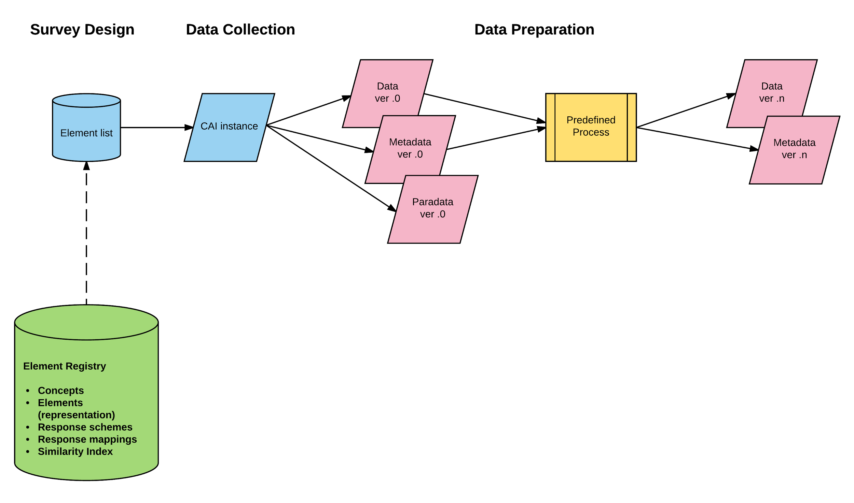
Element Registry and Survey Design

Slide 8
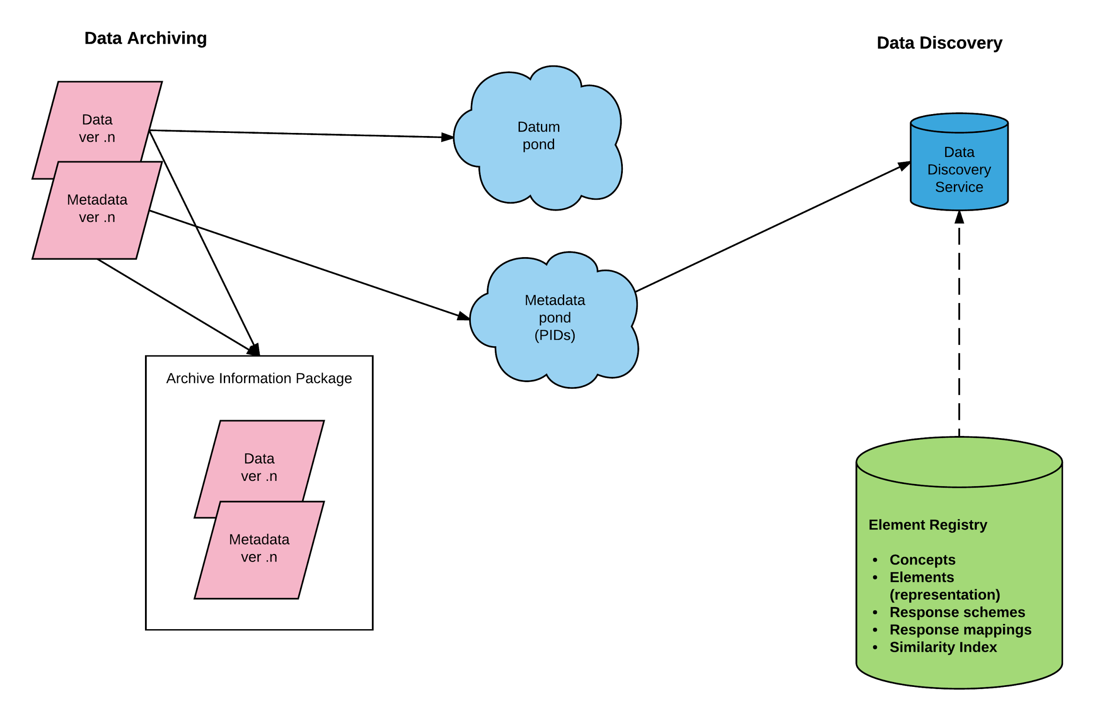
Element Registry and Data Discovery

Slide 9
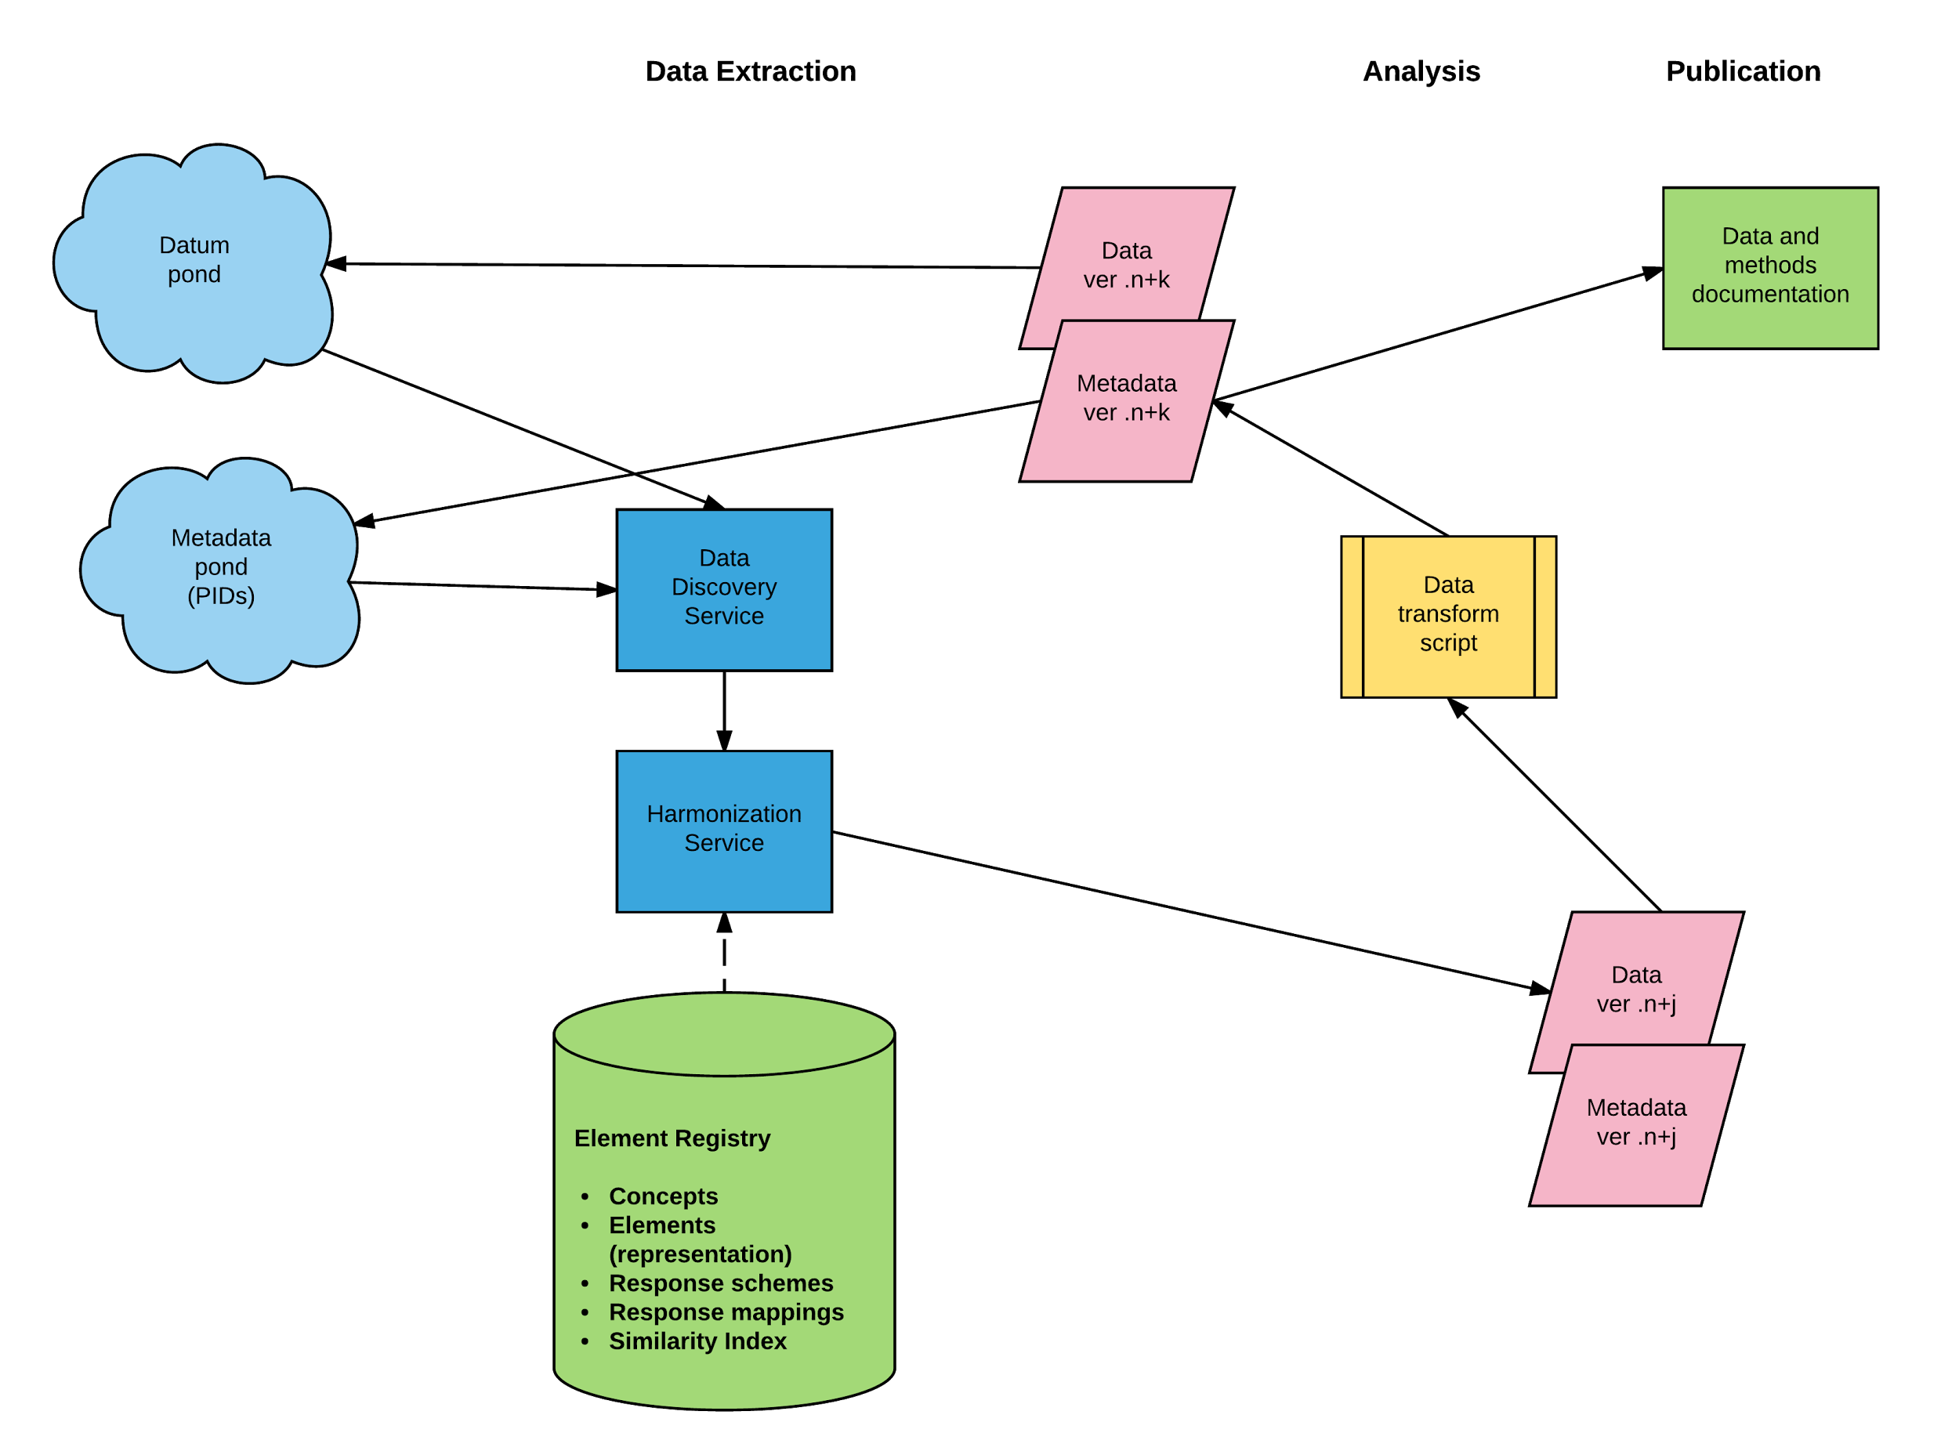
Element Registry and Data Extraction

Slide 10
Pillars of DDI Long-Term Infrastructure
DDI Specification
Definition by formal language and English documentation
Supporting material
Test cases – for the technical use
Technical instances to show the use of specific parts of the specification (i.e. in XML) for detailed purposes
Use cases – for the business use
Descriptions to show the application of the specification for business scenarios (not necessarily as technical instance)
Best Practices for achieving best results in using DDI
Identification, query, and resolution of DDI objects
Definition of DDI URN
Definition of DDI query protocol (i.e. REST)
Prototype software components for query and resolution
Rules and software for metadata registry
Metadata repositories
Software for building and querying repositories
Content of repositories

Slide 11
Who is Doing What?
 | DDI Alliance | DDI Community
Specifications including formal documentation | x
Test cases | x
Use cases
Documentation structure | x
Description | Prototype | x
Best Practices for achieving best results in using DDI
Documentation structure | x
Description | Prototype | x
Identification, query, and resolution of DDI objects
Definition of DDI URN (persistent, location-independent identifier) | x
Definition of DDI query protocol (i.e. REST) | x
Software components for query and resolution | Prototype | x
Rules and software for metadata registry | x
Software for building and querying metadata repositories |  | x
Content of metadata repositories |  | x

Slide 12
Complementary Core Documents
Vision for DDI Long-Term Infrastructure
For the DDI community and the DDI Alliance
Purpose is to provide a reliable long-term planning framework
Parts are already realized or will be realized by the DDI Alliance
Other parts can be used by the DDI community
Strategic plan of the DDI Alliance for 3-4 years
Translating the DDI Alliance parts of the vision into broadly defined goals and a sequence of steps to achieve them
Mission and Principles of the DDI Alliance - unchanged over time
Mission: declaration of the core purpose and focus
Based on the Objectives of the DDI Alliance Charter
Guiding principles: Fundamental norms, rules, or values that represent what is desirable and positive in terms of developing DDI specifications for a global network
Broad audience: DDI specification developers, DDI users, other organizations in the field

Slide 13
Steps for Developing the Documents
Discussion at DDI Alliance Annual Meeting 2017
Panel session at IASSIST conference 2017
Working group initiated by the Executive Board
Development of mature versions of the documents at Dagstuhl workshop in October 2017
Distribution to members and improvement of documents
Approval of documents at DDI Alliance Annual Meeting 2018

Slide 14
Basis Documents
Discussion paper „DDI Long-term Infrastructure Manifesto”
Started at Dagstuhl workshop in October 2016
DDI Alliance Strategic Plan, 2014-2017
Moving Forward Design Principles
DDI Mission and Guiding Principles, draft from 2012
Principles for developing metadata specifications
Started at Dagstuhl workshop in October 2016

