Slide 1
Using the Wiki during the Sprint

Slide 2
General Background
Each working group currently has a space on the Wiki
Keep minutes from sprint activities on your standard minutes page
The main page of each working group has an attachments location at the bottom which automatically lists the attached documents (use descriptive file names)

Slide 3
Entering Minutes
Most recent minutes should go at the top
Provide date (ISO YYYY-MM-DD) is clearest but go with whatever the standard in your group has been
Add a preface “Dagstuhl Sprint 2015” to the date so they are easy to find
Example: Dagstuhl Sprint 2015, 2015-10-22

Slide 4
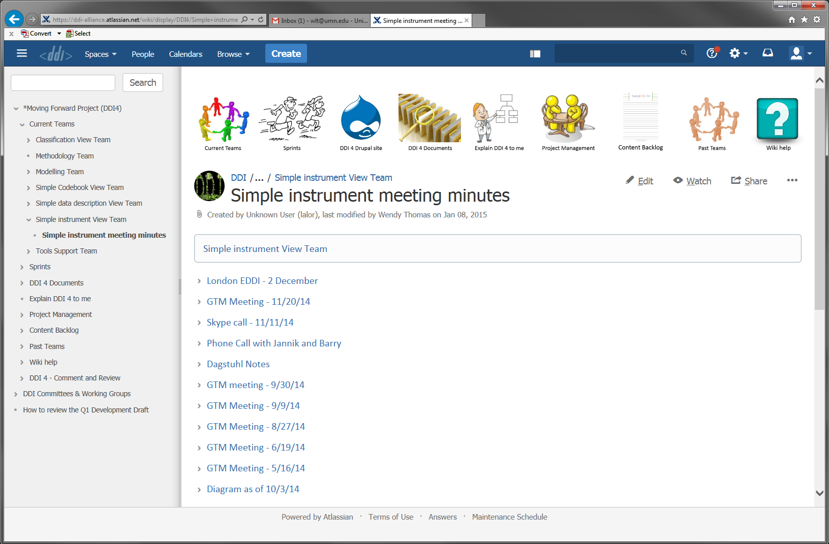

Slide 5
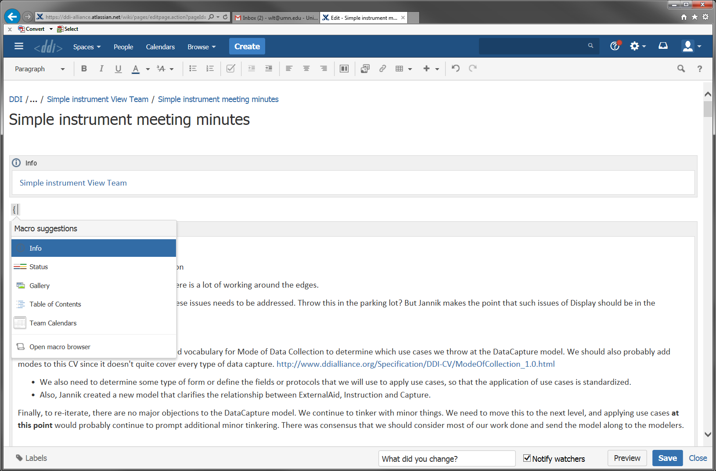

Slide 6
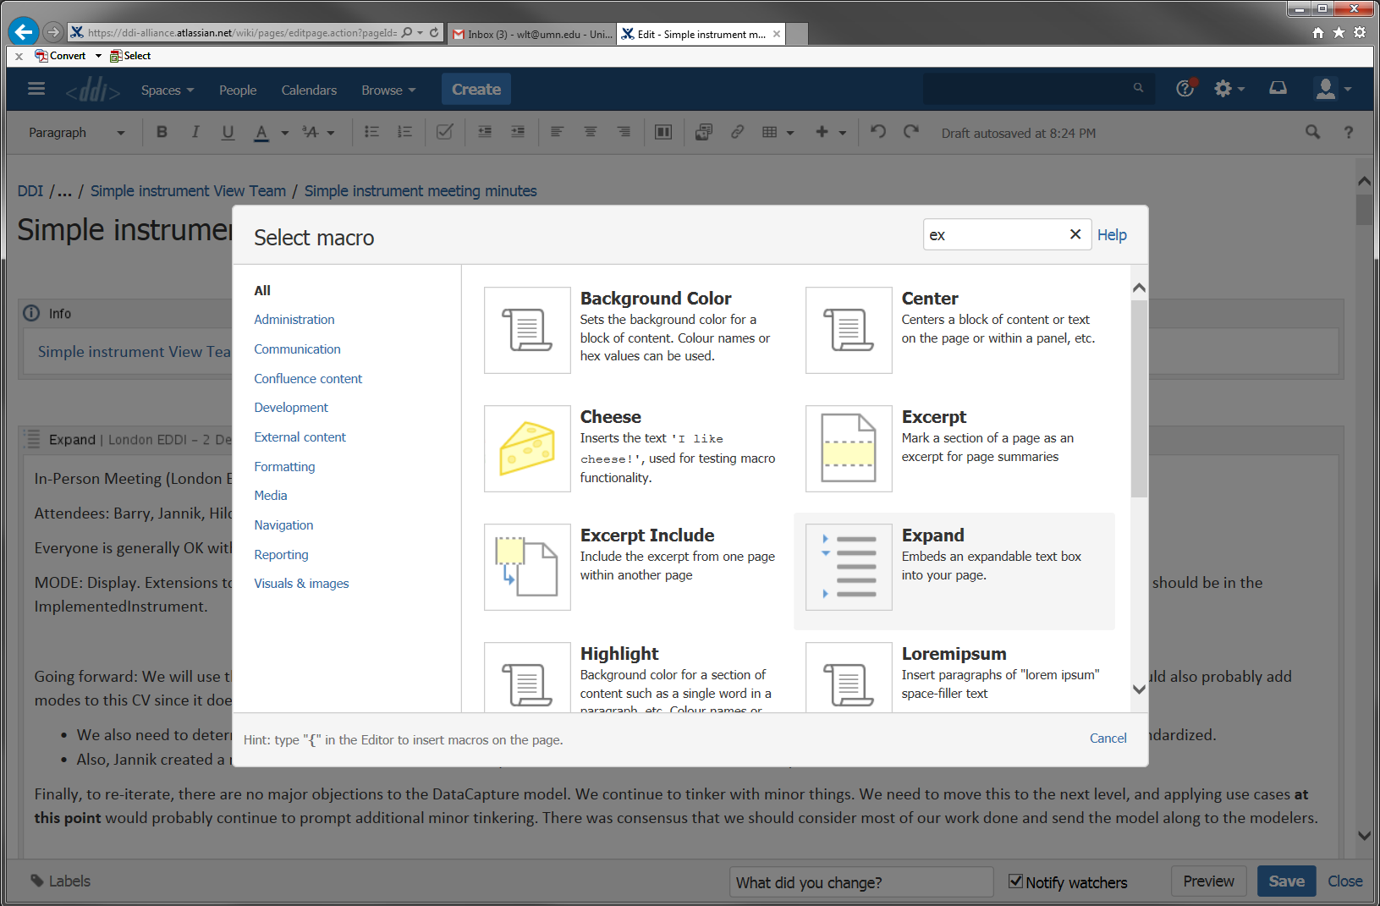

Slide 7
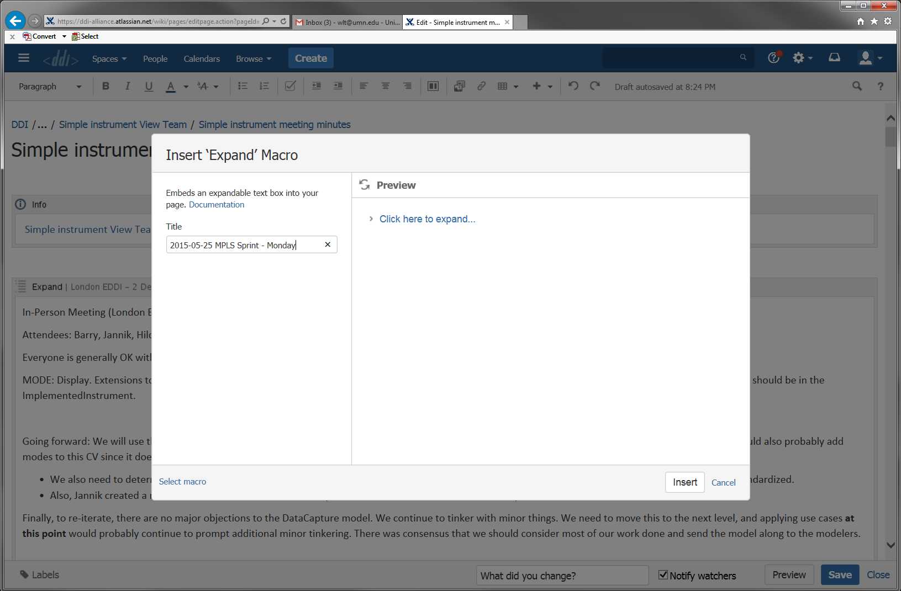

Slide 8
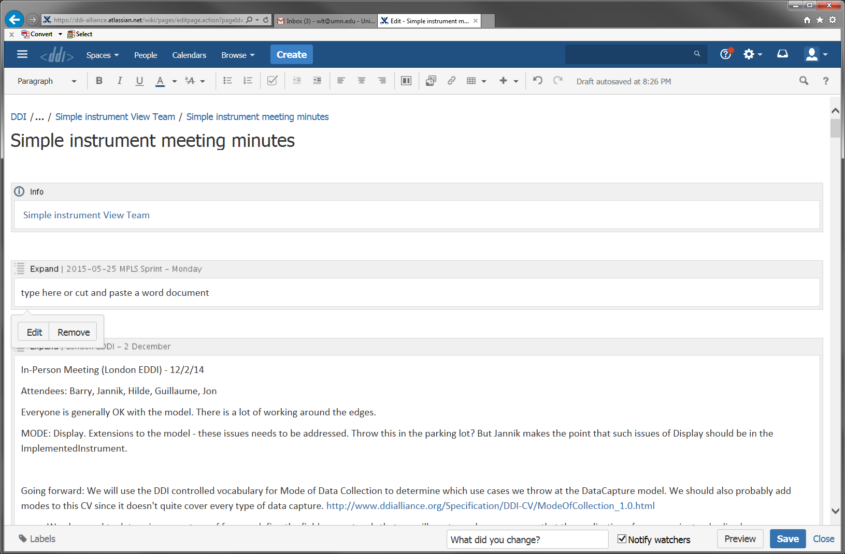

Slide 9
Minute Content
Minutes can be entered in real time (you have a limited number of format options)
Cut and paste from a Word document (retains structure)
Cut and paste from text of Google doc
Double spaces between lines to get hard return
Lose indents (need to reenter)
Name a document, upload and add a link

Slide 10
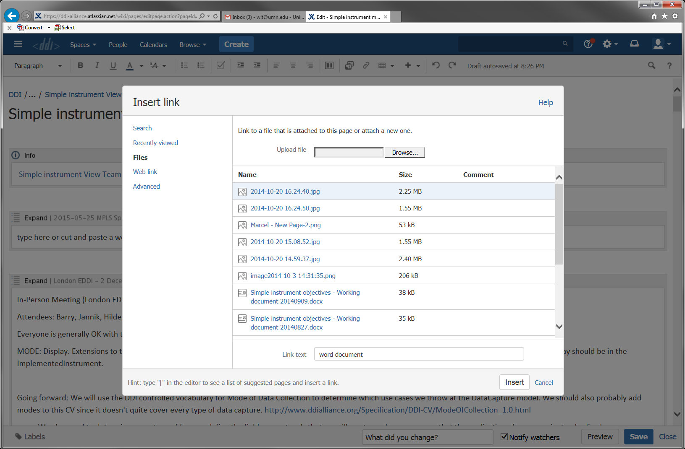

Slide 11
Larger issues (cross team)
Enter a comment in the Modeler’s issue tracker
Link from Modeler’s Team page “Ask the Modelling Team to address an issue”
Be sure to provide a clear subject line
Add your team name to the description
These items may also in the sprint parking lot; the point is to make sure they are not lost within the minutes of the sprint or your group

Slide 12
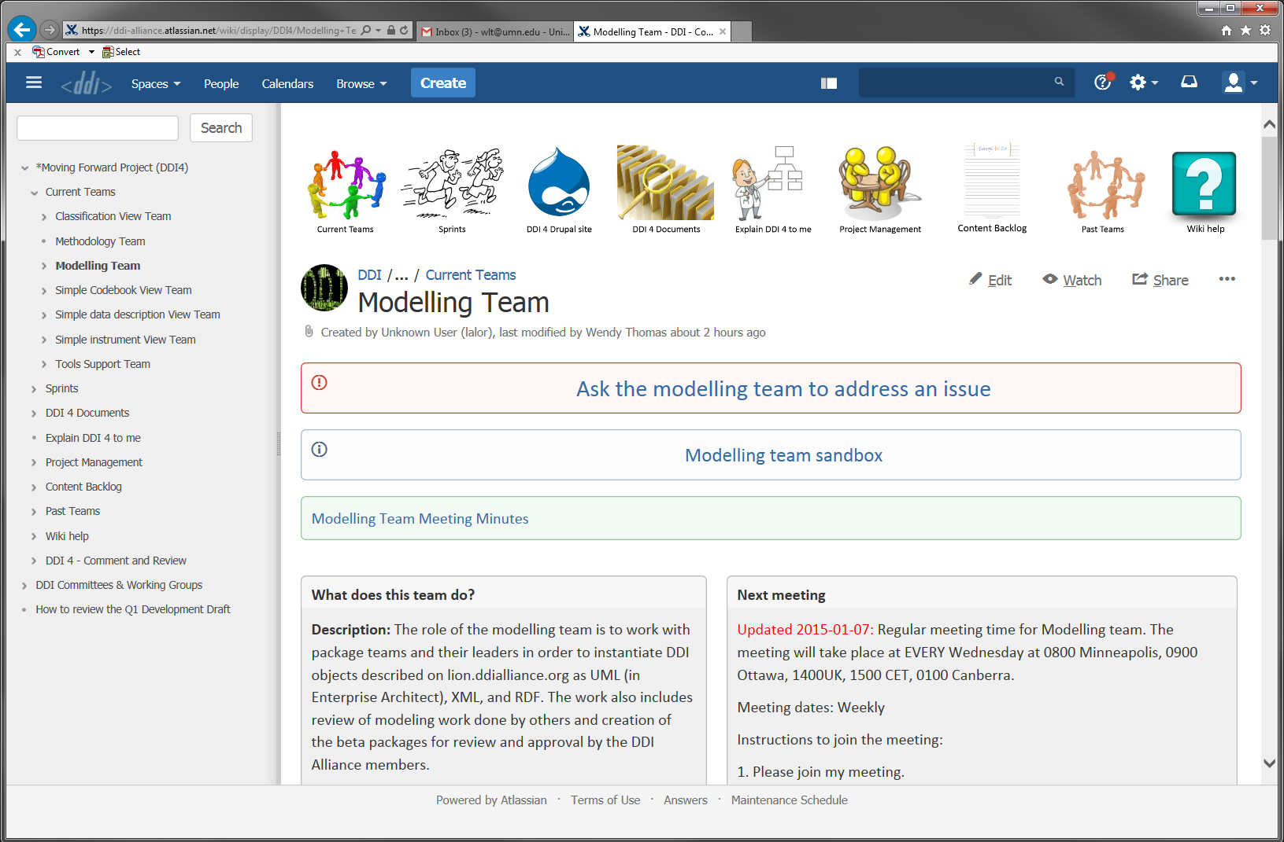

Slide 13
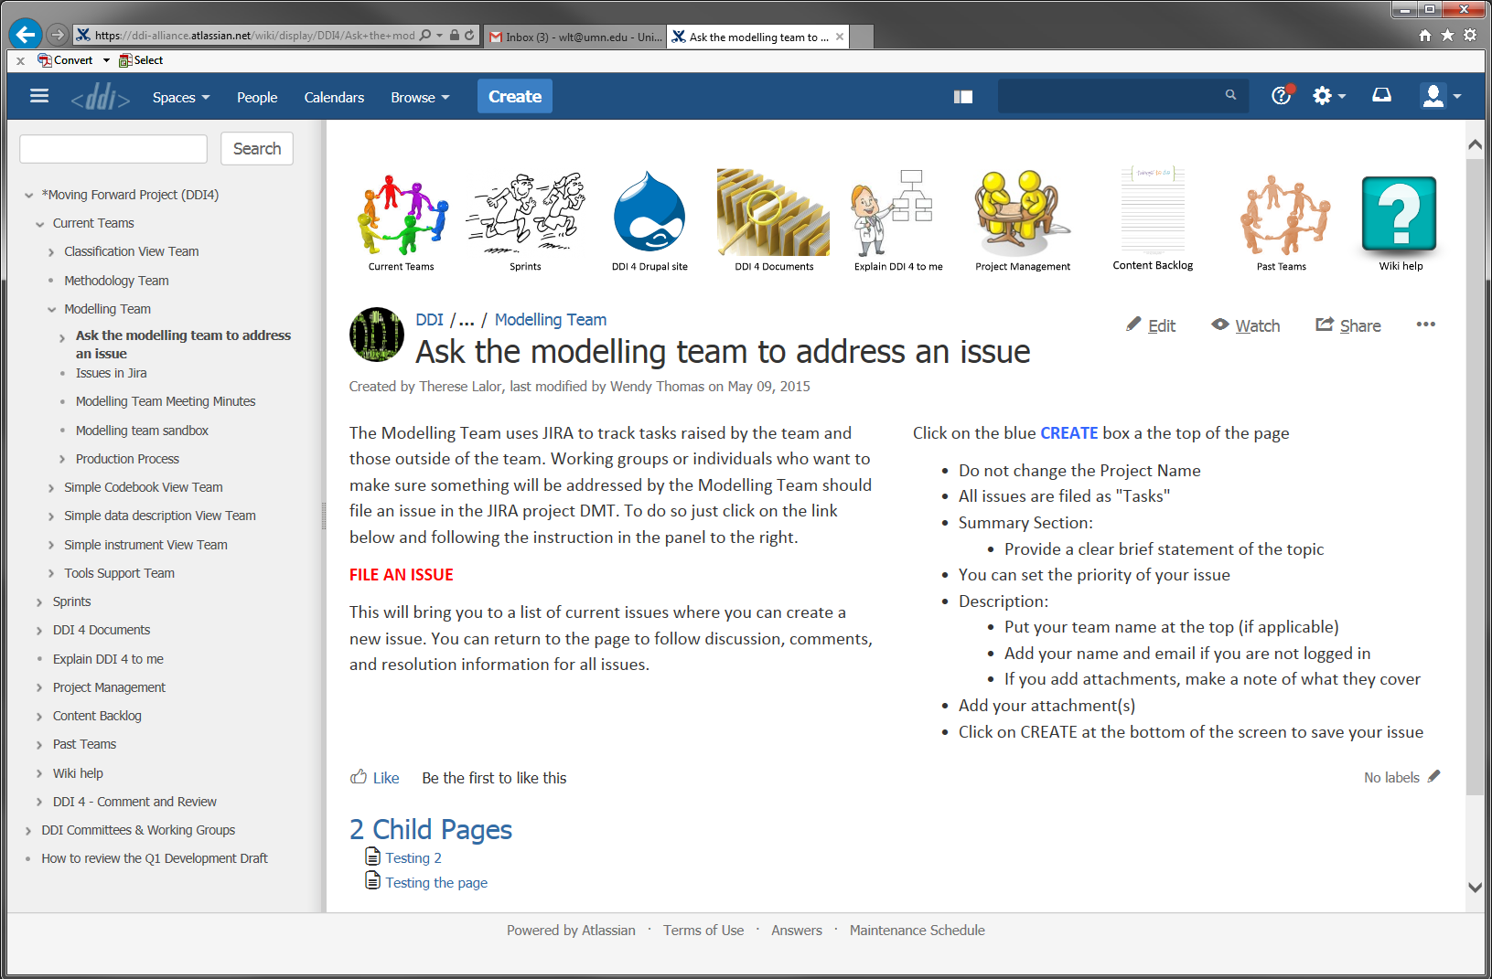

Slide 14
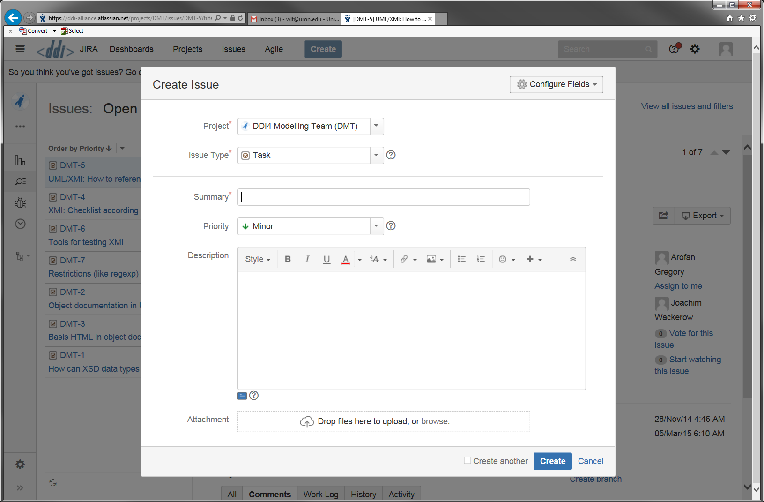
Clear topic
Team name
Detail of the issue

Slide 15
Updates to the Sprint Page
The central sprint page will provide links to your work automatically
The sprint agenda will be captured
A summary of the sprint will be prepared and posted on the Sprint page
If anything is missing, let Michelle know

