Slide 1
Dagstuhl SprÏnt 2015

Slide 2
Organizing Team
Sprintmeister: Michelle Edwards
Working Group Chairs:
Data Description: Steve McEchern
Methodology: Michelle Edwards
Data Capture: Barry Radler
Modellers Team: Arofan Gregory
Organizers: Mary Vardigan, Arofan Gregory, Achim Wackerow, Wendy Thomas

Slide 3
Sprint Overall goals
Finalize draft work in the DDI Working Group content areas that are present
Leverage the expertise and perspectives of standards experts present at this week’s Sprint

Slide 4
What’s a sprint?
Time boxed sessions
Specific outputs

Slide 5
Sprint Rules
Accept personal responsibility for Sprint process and outputs
Work collaboratively
Participate fully on all tasks
Contribute and share generously and openly
Actively listen and learn from others perspectives and experiences
Be patient and communicate clearly to accommodate the wide variety of backgrounds among participants

Slide 6
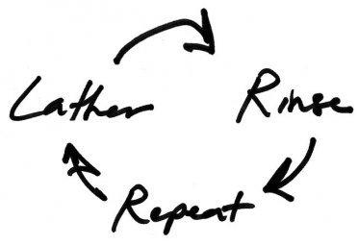
Sprint Process
Focus on tactical goals
Specific deliverables for a set time period (a few hours to a half day); often just documentation of discussion
Defined by working groups with help from organizing team
Lather, Rinse, Repeat

Slide 7
Managing the Work
Individuals will be ‘voluntold’ their assignments
Plenaries are used to coordinate work
Organization of work is flexible and may be changed by the Sprintmeister as needed

Slide 8
Sprint Sidebars
The Parking Lot – for ideas, issues off task or which need more discussion
Document it and set it aside
“Soap boxes”- 3 minute presentations to the morning plenary to promote specific ideas
A slot must be requested from the Sprintmeister the night before
Maximum limit of 3 soap boxes
Informal evening discussions after dinner should be arranged with Sprintmeister
Participation is voluntary

Slide 9
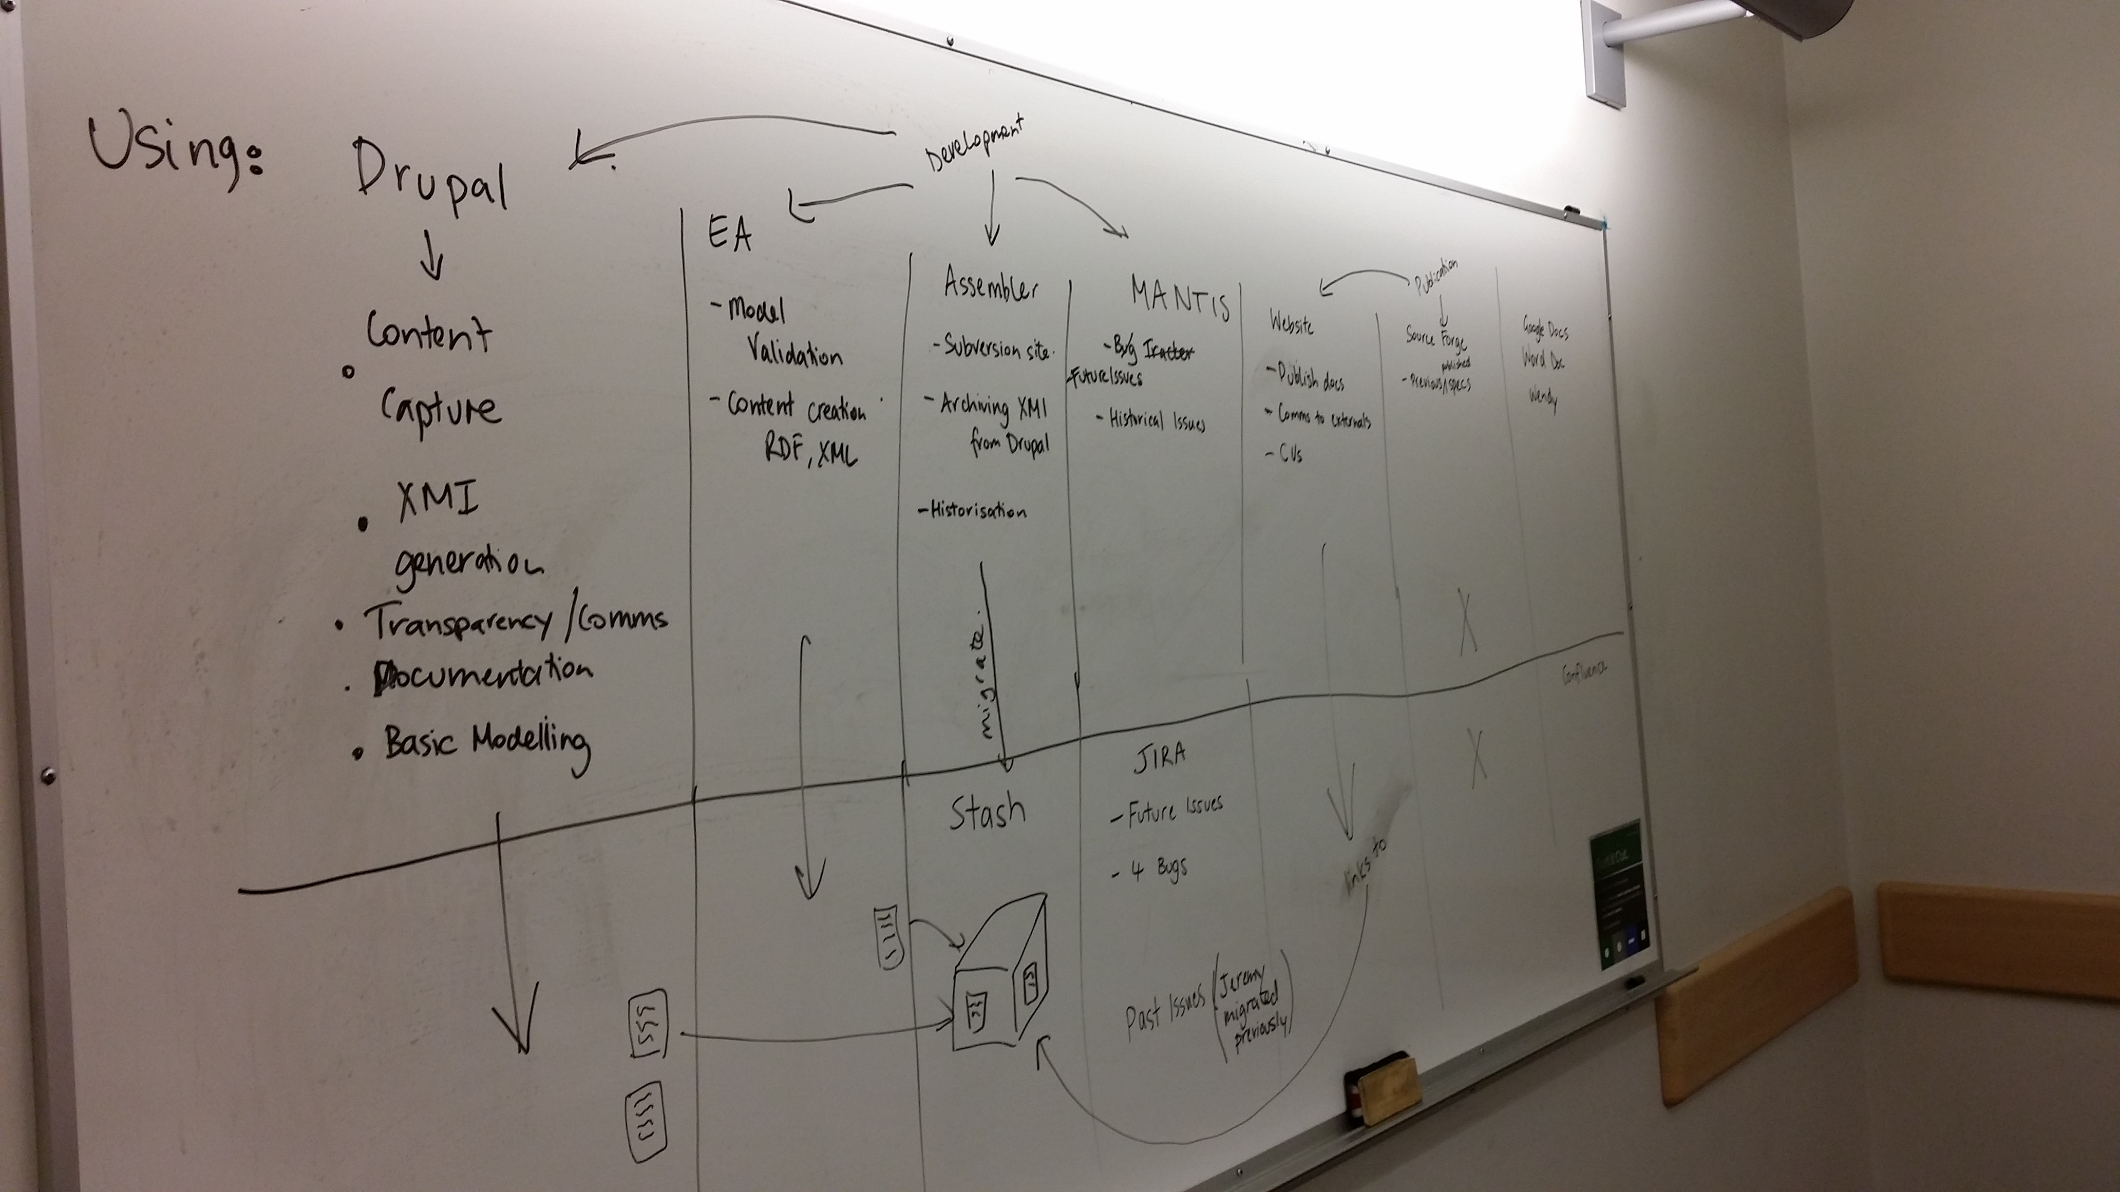
Documentation
Use the DDI Confluence (team pages)
Write documents and upload
Use the white boards
Take Pictures and upload
Drupal
The goal is to not lose the discussion

Slide 10
Daily Work Schedule
9:00 Morning Standup/Plenary
9:15 -10:30 1st Working session
10:30 - 10:45 Coffee
10:45 -12:15 2nd Working Session
12:15 - 13:45 Lunch
13:45 – 14:00 Afternoon Standup/Plenary
14:00 – 15:15 3rd Working Session
15:15 – 15:30 Cake & Coffee
15:30 – 16:45 4th Working Session
16:45 – 17:00 Closing Standup/Plenary
Organization Team meets (17:00 – 17:30)
Schedule may be modified as needed, but this is the standard

Slide 11
Special Sessions
Tuesday: DDI Qualitative Discussion (Larry Hoyle)
Thursday: Dinner at the “slow food” place, Landgasthof Paulus
Others can be organized by talking to Sprintmeister

Slide 12
Schedule Overview
MONDAY | TUESDAY | WEDNESDAY | THURSDAY | FRIDAY
Introduction | Plenary | Plenary | Plenary | Plenary
DDI Introduction | Data Description | Data Description | Methodology | Writing Hunker
DDI Introduction | Data Description | Data Description | Methodology | Writing Hunker
DDI Working Group Presentations | Plenary | Plenary | Plenary | Debrief with External Experts
External Experts Presentations | Data Description | Methodology | Data Capture | Where do we go from Here?
External Experts Presentations | Data Description | Methodology | Data Capture | Complete work
 | Plenary | Plenary | Plenary

Slide 13
Who Is Here?
Experts from Standards other than DDI
DDI Working Group members:
Data Description: Focus is on the physical store of data and relationships to defining metadata
Methodology: Focus is on describing different methods / protocols / criteria / experimental design
Data Capture: Focus is on describing the structured capture of data
Modeling Team: Ensuring consistency and quality in the model across content groups

Slide 14
Deliverables: External Experts
Identify a set of activities / topics after initial presentations
Groups of external experts and DDI participants will be organized to work on them
External experts will also work with the DDI working groups to conduct external reviews of the model

Slide 15
Deliverables: Data Description
Final draft of the model describing CSV / Fixed Format files delivered to Modeling Team
External experts review of datum approach with documented critique and analysis
One member of the content with 1-2 external members

Slide 16
Deliverables: Data Capture
Integration of process and collection patterns in Drupal
Documentation of the process for implementing the process and collection patterns (Jon)
External experts review of the Data Capture model
Is the model general enough to meet requirements in other domains (HL7, RDA, CDISC, etc.)?
One member of the content with 1-2 external members

Slide 17
Deliverables: Methodology
Documented Use Cases / Examples
Update Drupal to reflect current model and changes
External experts review of the Methodology model
Is the model general enough to meet the requirements of other domains?
One member of the content with 1-2 external members

Slide 18
Deliverables: Modeling Team
Finalize the Collection and Process patterns in Drupal
Implement the patterns in the models currently in Drupal
Address standing documentation issues
Prioritize and address issues listed in JIRA
Updating XML binding
Discussion and documentation of Views
Rules for restriction and output
Standard content

Slide 19
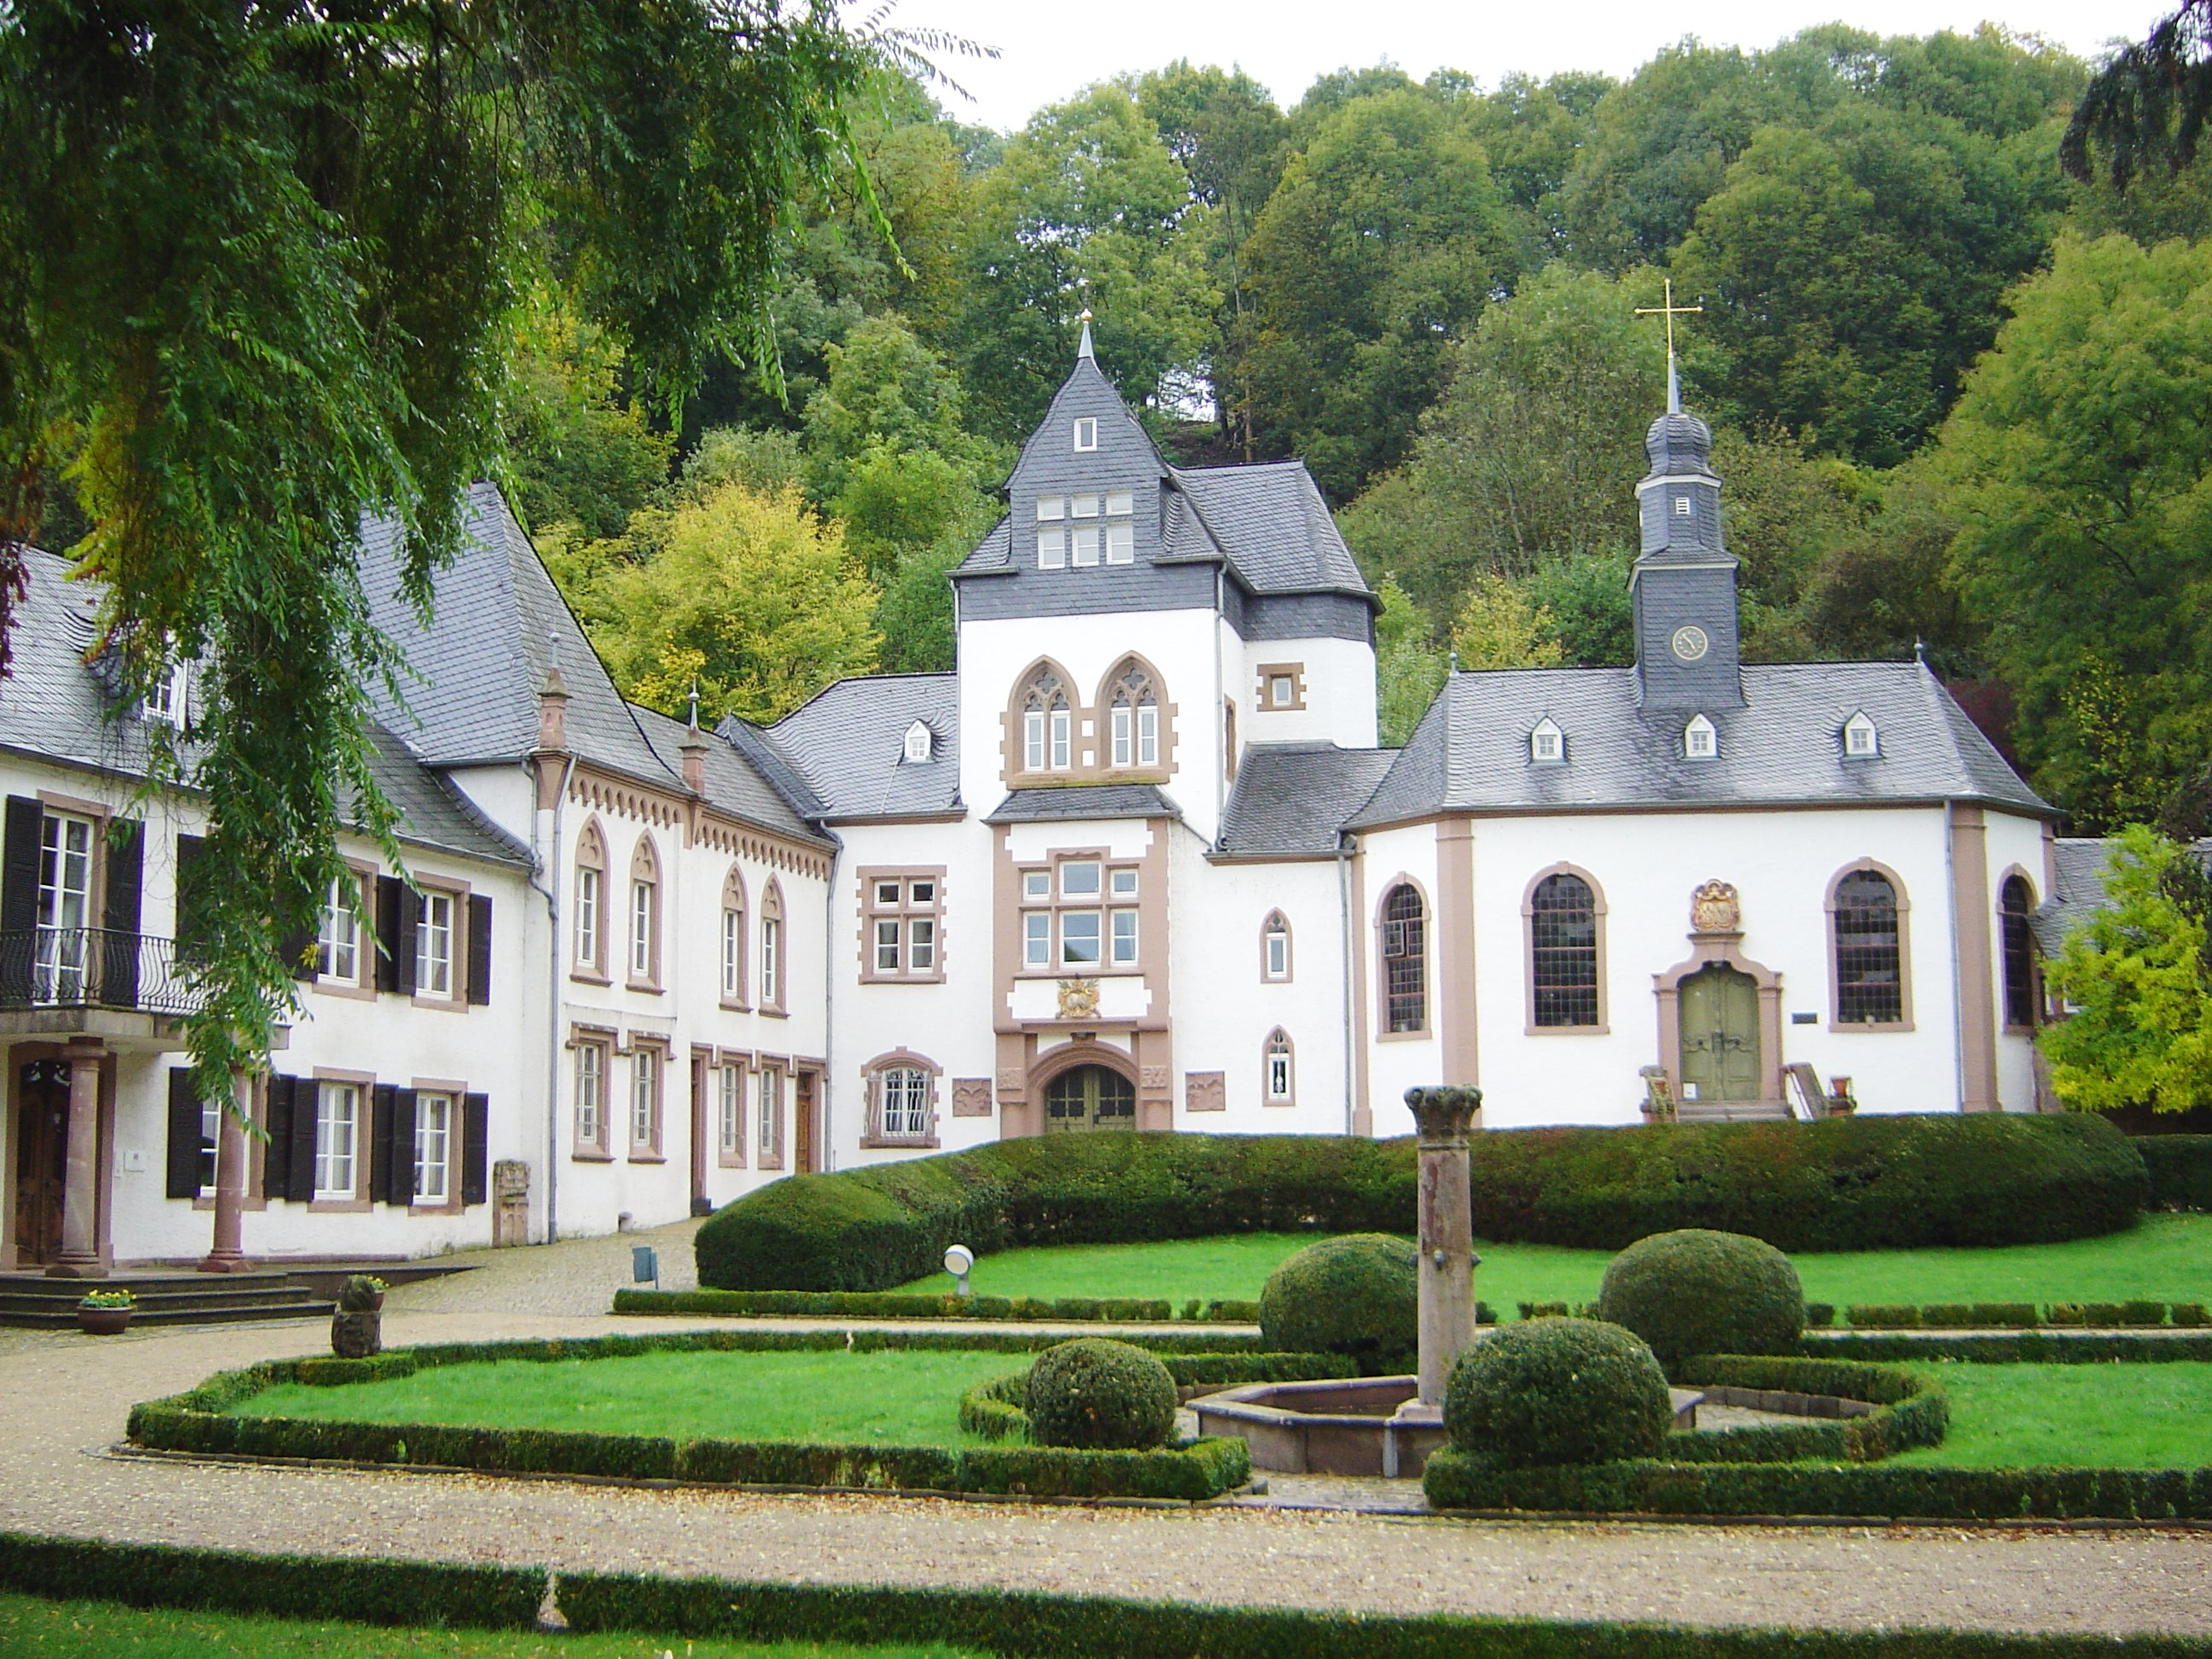

Slide 20
Dagstuhl Ambience
There are two groups meeting during the week, each has a separate eating section in the dining room
Breakfast has free seating
Lunch and dinner seating randomly assigned (You MUST sit where you are assigned)
After lunch, weather permitting, a short walk will be organized

Slide 21
Dagstuhl Ambience
An hour after dinner cheese is available in the Wine Cellar
The Wine Cellar is assigned to our group, the other group will be in the coffee room
Eat only cheese encountered in the Wine Cellar
Billiards, ping-pong, a sauna, laundry facilities, bicycles, and a music room are available
Coffee, beer, wine, and sundries are available at various points in the Schloß – coffee is free, keep track of everything else you consume

Slide 22
Introductions
……..

Slide 23
What we REALLY want to know is…
Organizational affiliation
Skills and expertise
Background / domain
What standards do you work with and in what capacity?
Why do you think you are here?

