Slide 1
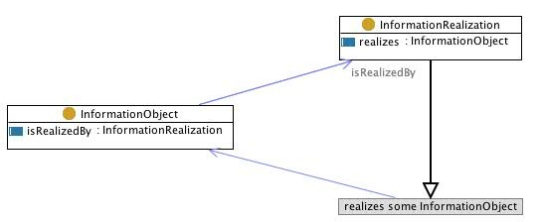
The Use of Ontology Design Patterns for Metadata Semantics: Methods, Chances, and Limitations
Gary Berg-Cross
SOCoP Executive Secretary
US RDA Advisory Group

Slide 2
Outline of Talk
We agree - Metadata Semantics needed for human and computer understanding
What are Ontology Design Patterns (ODPs) and what are they used for ?
How are they created?
Examples
What are the opportunities & limitations?
Some mapping of metadata schemas to ontologies involve a complicated procedures....

Slide 3
Broad View of Metadata Status & Argument for More Semantics
Richness issue
Ambiguity Even when done well, simple annotations and structured metadata are not rich enough to support ad hoc use and certainly not reasoning based on meaning.
Heterogeneity There are many MD schemas and a broad challenge is to link/integrate them.
“Metadata schemas are created for resources’ identification and description and - most of the times - they do not express rich semantics”
Stasinopoulou, Thomais, et al. "Ontology-based metadata integration in the cultural heritage domain." Asian Digital Libraries. Looking Back 10 Years and Forging New Frontiers. Springer Berlin Heidelberg, 2007. 165-175.

Slide 4
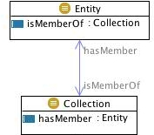
ODPs (similar to microtheories) small, well engineered, coherent, modular, starter set
Patterns are used in many areas as "templates" or abstract descriptions encoding best practices of some field.
What Problems, including semantics ones, do they address?
It is hard to reuse only the “useful pieces" of a comprehensive (foundational) ontology, and
the cost of reuse may be higher than developing a scoped ontology for particular purpose from scratch
Solution Approach
“For solving semantic problems, it may be more productive to agree on minimal requirements imposed on .. Notion(s)
Werner Kuhn (Semantic Engineering, 2009)
Use small, well engineered, coherent, minimally constrained schemas as modular starter set ontologies (ODPs) with
explicit documentation of design rationales,
best reengineering practices to facilitate reuse,
ODPs serve as an initial constraining network of “concepts” with vocabulary which people may build on/from for various purposes.
Thus they represent a step towards more structured metadata.
http://ontologydesignpatterns.org/wiki/Submissions:Collection

Slide 5
Potential Advantages (if it works similarly to domain ODPs)
Can cover a wide range of metadata types
May be more easily, faithfully extended than less structured efforts
Supports multiple metadata granularity levels
Semantics of parts, components etc.
Potential axiomatization beyond mere surface semantics
E.g. alternate ID not the same as primary ID
Could have some hooks to parts of well-known ontologies / patterns (such as for InformationObjects).
‘A data store is an information object in a chain of information objects that begins with real world events and things.’
In this chain events and things are observed and observation yields information.....

Slide 6
K Janowicz on Patterns as Central to Providing minimal interoperability in face of heterogeneity
Modifiable locally
Common Pattern Found
Different ontologies
Common Pattern

Slide 7
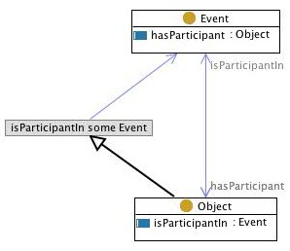
Patterns Can be Built Out

Slide 8
A Simple Example of Conceptualizing

Slide 9
How are ODPs created?
Define the Scope of what we are talking about
Most ontologies are under-speciﬁc, intended meaning or scope remains unclear
Conceptual Modeling
Identify & Clarify Problems, Components (objects & parts) and Relations
Correctly captures intuitions of domain experts as they express intended content (expressivity)
Organizing Phase
Systematic organization & framing with visual expression as a model
Formalization - Ontology Engineering
We often defer formalization as an ontology to later discussions

Slide 10
In a Conceptual model we collect & relate terms that form the Vocabulary
As part of this:
Often best to start capturing ideas as English sentences and sketchboard models
We may capture primitive terms and some reoccurring relations – patterns
What’s the relationship to metadata? Simple example:
A digital object (DO) is represented by a bitstream,
is referenced and
identified by a persistent identifier and
has properties that are described by metadata
Notes:
Not necessarily the best point to decide whether things are OWL classes, properties, etc.
We can defer several but our ontologists will be making notes.

Slide 11
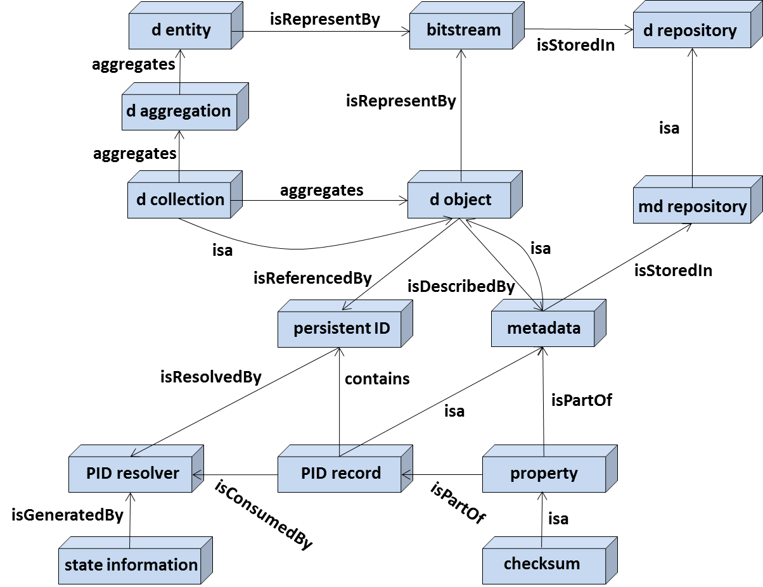
Organizing opportunities We may expand MD defs to richer schemas
Simple, Conversational Conceptual Model Example
Frames, Organizes, Structures, Visualizes
Part of Simple Language for RDA Discussions on Data Management

Slide 12
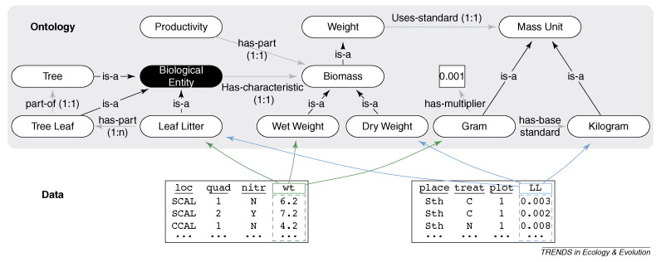
Opportunity to Use Lightweight Methods & Products
Choose lightweight approaches grounded by scenarios and application needs.
Low hanging fruit leverages initial vocabularies and existing conceptual models for use in early stages of work
Reduced entry barrier for domain scientists to contribute
Simple parts/patterns & direct relations to data
Triple like parts
Constrained not totally
Specified.
Grounded
Ecological..
Notes:
Advancing ecological research with ontologies
Joshua S. Madin1, 2, ,
Shawn Bowers3,
Mark P. Schildhauer1,
Matthew B. Jones1

Slide 13
Chain of Information Idea – leverage Path Model?
Chain
Trajectory
Position
hasSegment
hasFix
hasLocation
Segment
Fix Observation
nextFix
hasAttribute
hasAttribute
Attribute

Slide 14
(Some) Challenges
Most early work has been on domain models and their more specific metadata schemas
Shortage of expertise in semantics involved in many data/metadata efforts
Many things called “ontologies” are not so much that
Only modest experience & funding making this work
Useful ODPs can be generated in 2-4 days of work by 3-7 people teams with the right mix of skills

Slide 15
Example of Formalization and Commitments

