Slide 1
Some experiences from development and implementation of standards from UN/CEFACT, OASIS UBL, ISO20022 and WCO
Martin Forsberg

Slide 2
My background
Active in standardization related to trade and financial processes
OASIS UBL Technical Committee
UN/CEFACT Supply Chain + Methodology groups
CEN committees for e-invoicing and e-procurement
Large scale implementation of standards
E-invoicing in Sweden and Europe
Import/Export customs declaration (Swedish Customs)
Payment processes – corporate -> banks

Slide 3
Some challenges we struggle with
Naming of concepts when several domains share library/registry
Flexability vs stability and compatibility
Publication of XML schemas
Harmonization of different models and standards

Slide 4
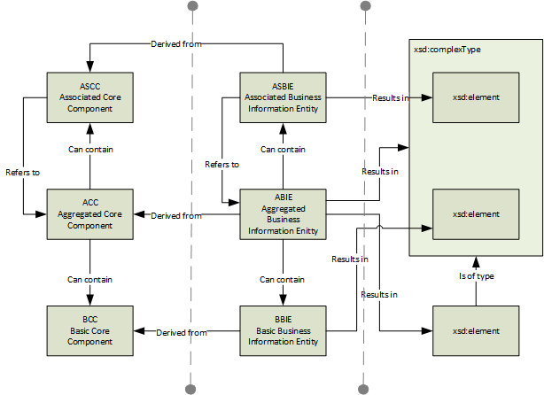
Core Component Technical Specification

Slide 5
Naming and registries

Slide 6
Models vs format
International standardization groups develop ”semantic” models, defining libraries of reusable classes/aggregated components
The models are used to create XML Schemas
Users take advantage the XML schemas
But have challenges accepting the definitions/names of the concepts/business terms
Two contradicting goals
Precise/contextualized meaning of concepts/terms
Stable and reusable formats for implementation, regardless of context

Slide 7
Versioning
It requires lots of effort to change version when a XML Schema has been implemented on a large scale – particularly when a version change affects namespaces
The information modelling teams often have little understanding of the consequences on XML-level
Its not just a ”push on the button” to produce new XML Schemas (of high quality)

