Slide 1
Semantic Metadata
Michel Dumontier
Associate Professor of Biomedical Informatics, Stanford University
Chair, W3C Semantic Web for Health Care and Life Sciences Interest Group
North American Technical Lead, FAIR initiative

Slide 2
High Quality Metadata are Critical for Large-Scale Reuse leading to Knowledge Discovery
Notes:
Biomedical researchers will remain stymied in their ability to take full advantage of the Big Data revolution if they can never find the datasets that they need to analyze, if there is lack of clarity about what particular datasets contain, and if data are insufficiently described.

Slide 3
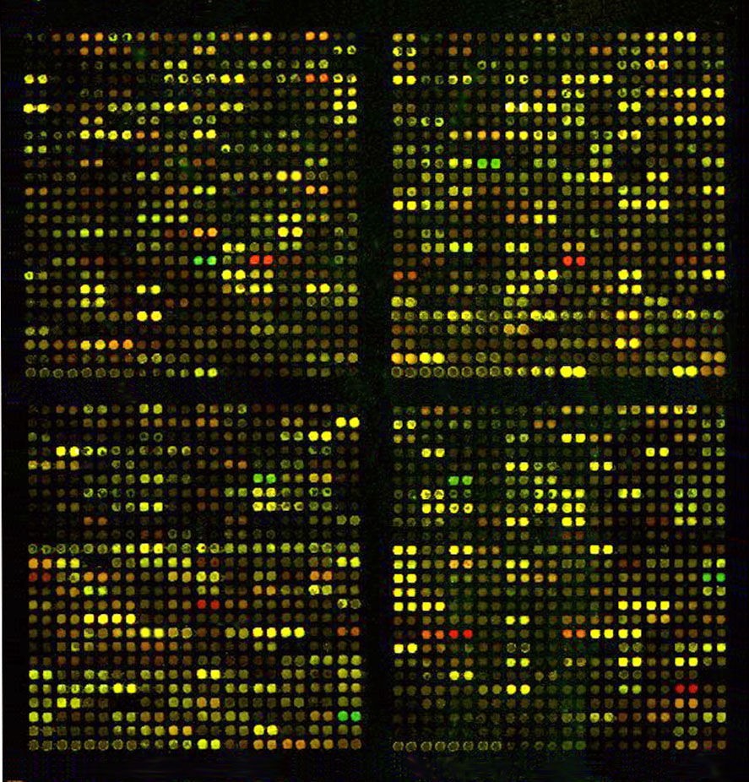
What is this colored picture about?
Notes:
Omics is big data

Slide 4
Working with Data on the Web
Rich metadata are essential to finding and reusing datasets
But,
Datasets often have inadequate descriptions (aka metadata) so we don’t know what they are about, how they were constructed, where they are available, when they were created, and who is responsible for them
Moreover, these data may change over time, challenging the reproducibility of studies that use these data.
Data may also be available in a variety of formats, or be available in multiple locations, all of which pertain to their accessibility and interoperability

Slide 5
We need shared principles, specifications, and guidelines to accurately capture and publish data and their metadata

Slide 6
FAIR – Findable, Accessible, Interoperable, Reuseable Principles
To be Findable:
F1. (meta)data are assigned a globally unique and eternally persistent identifier
F2. data are described with rich metadata
F3. (meta)data are registered or indexed in a searchable resource
F4. metadata specify the data identifier
To be Accessible:
A1 (meta)data are retrievable by their identifier using a standardized communications protocol
A1.1 the protocol is open, free, and universally implementable
A1.2 the protocol allows for an authentication and authorization procedure, where necessary
A2 metadata are eternally accessible, even when the data are no longer available
To be Interoperable:
I1. (meta)data use a formal, accessible, shared, and broadly applicable language for knowledge representation.
I2. (meta)data use vocabularies that follow FAIR principles
I3. (meta)data include qualified references to other (meta)data
To be Re-usable:
R1. meta(data) have a plurality of accurate and relevant attributes
R1.1. (meta)data are released with a clear and accessible data usage license
R1.2. (meta)data are associated with their provenance
R1.3. (meta)data meet domain-relevant community standards

Slide 7
On the Semantic Web there are many vocabularies and standards for data and metadata But! few resources to put it all together using a shared representation

Slide 8
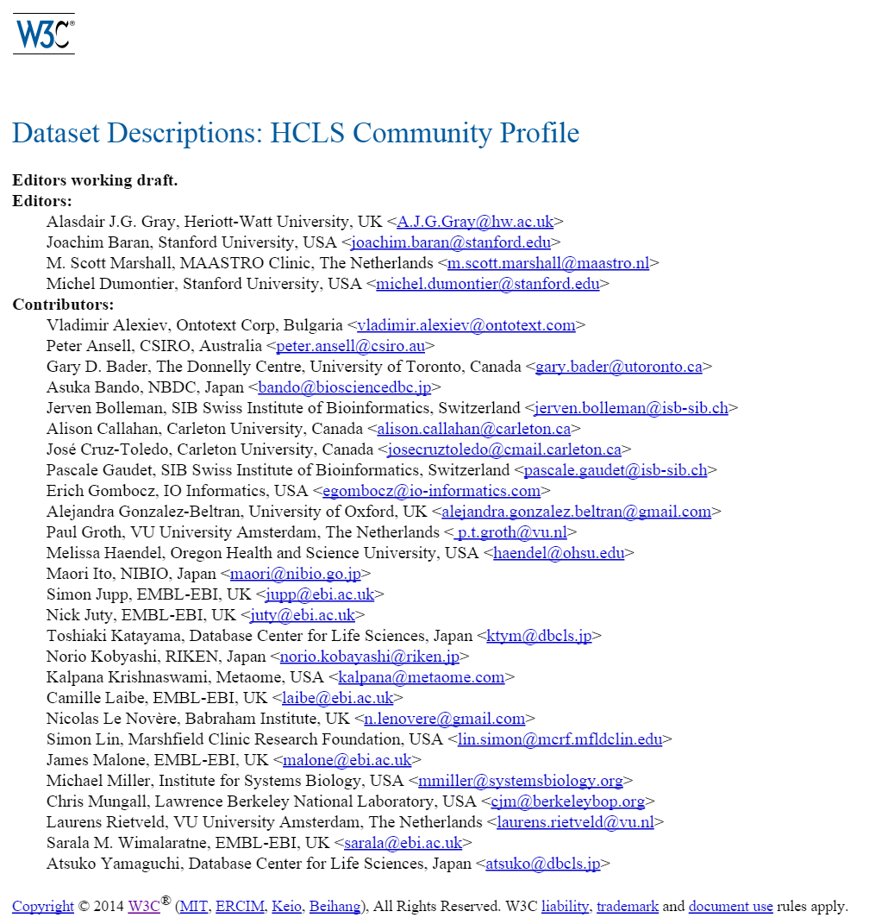
http://www.w3.org/TR/hcls-dataset/

Slide 9
HCLS DD Objectives
Develop a guidance note for reusing existing RDF vocabularies to describe datasets
Provide tools to author and validate metadata
Evaluate the specification through feedback on implementation

Slide 10
We compiled a list of metadata fields used across the community
and then surveyed over 20 vocabularies to see if they provided relevant metadata elements or value sets
To produce a big spreadsheet that maps metadata needs with existing vocabularies

Slide 11
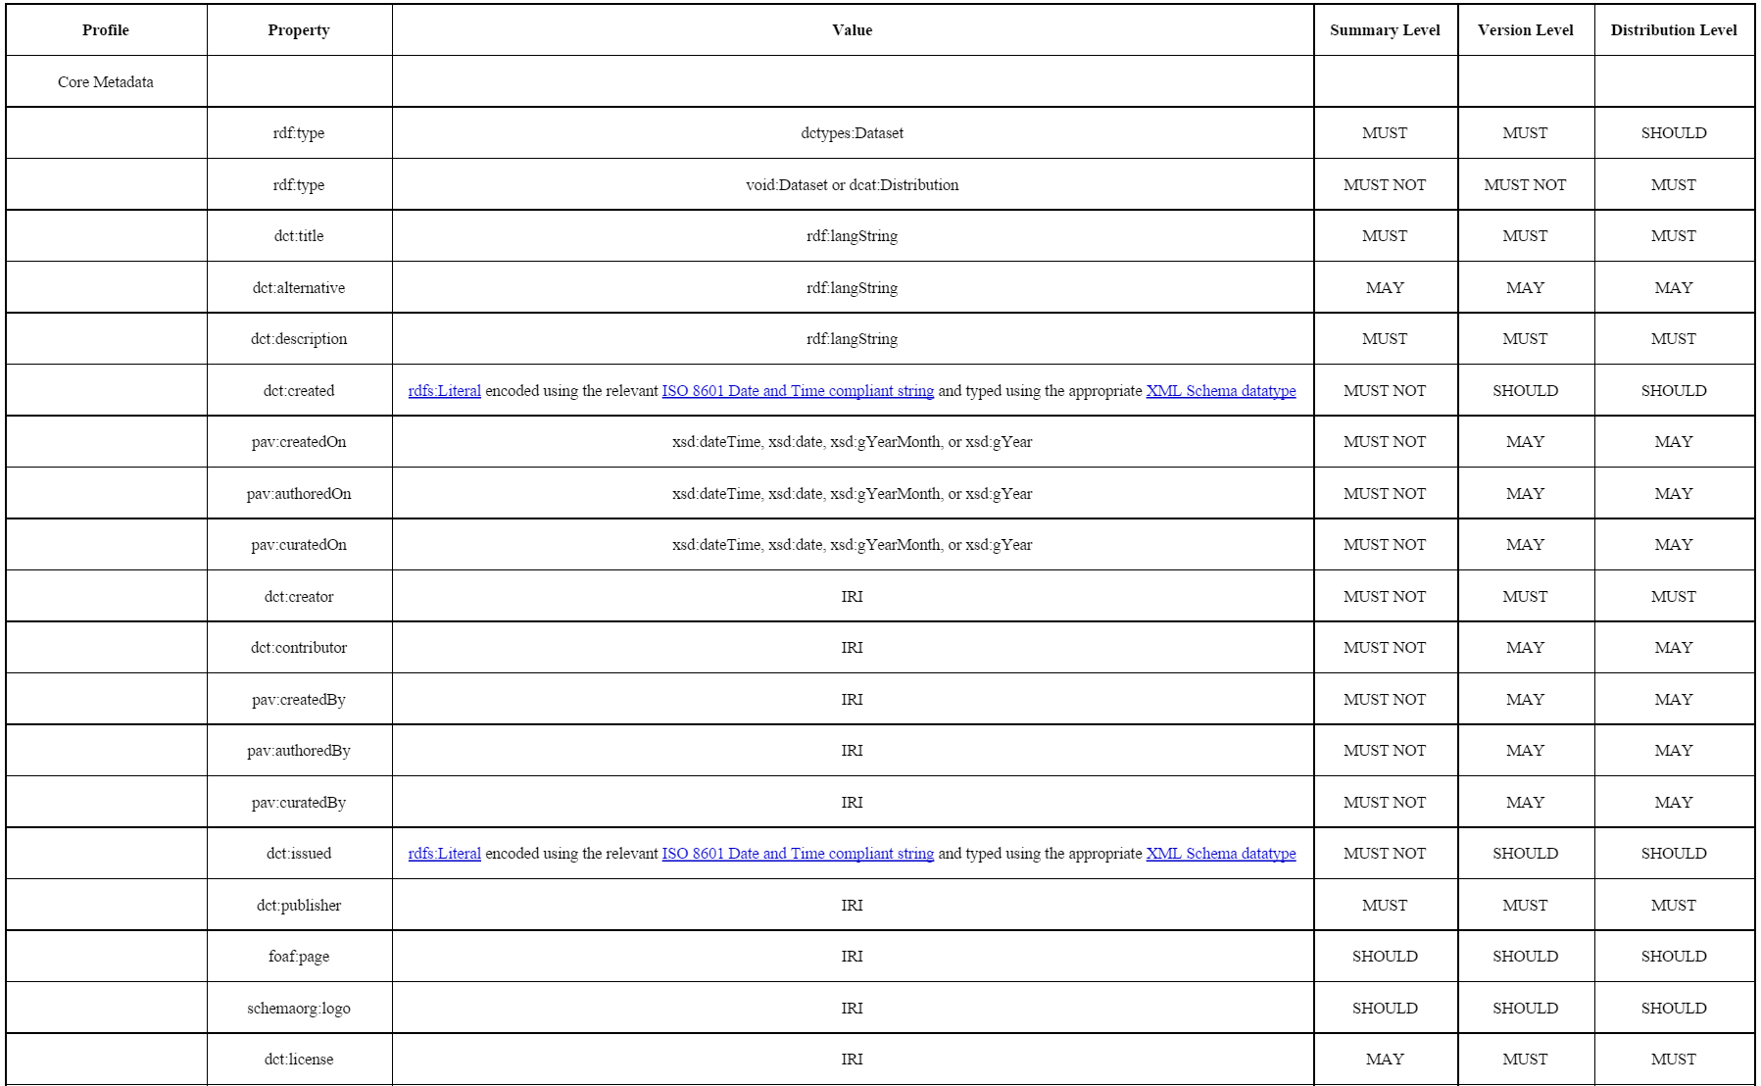
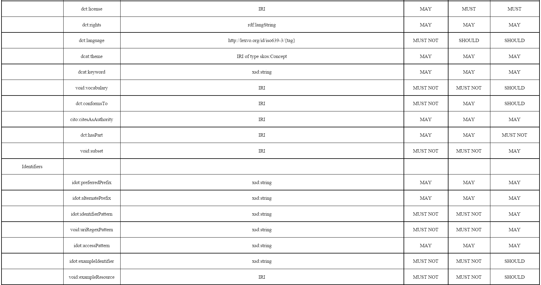
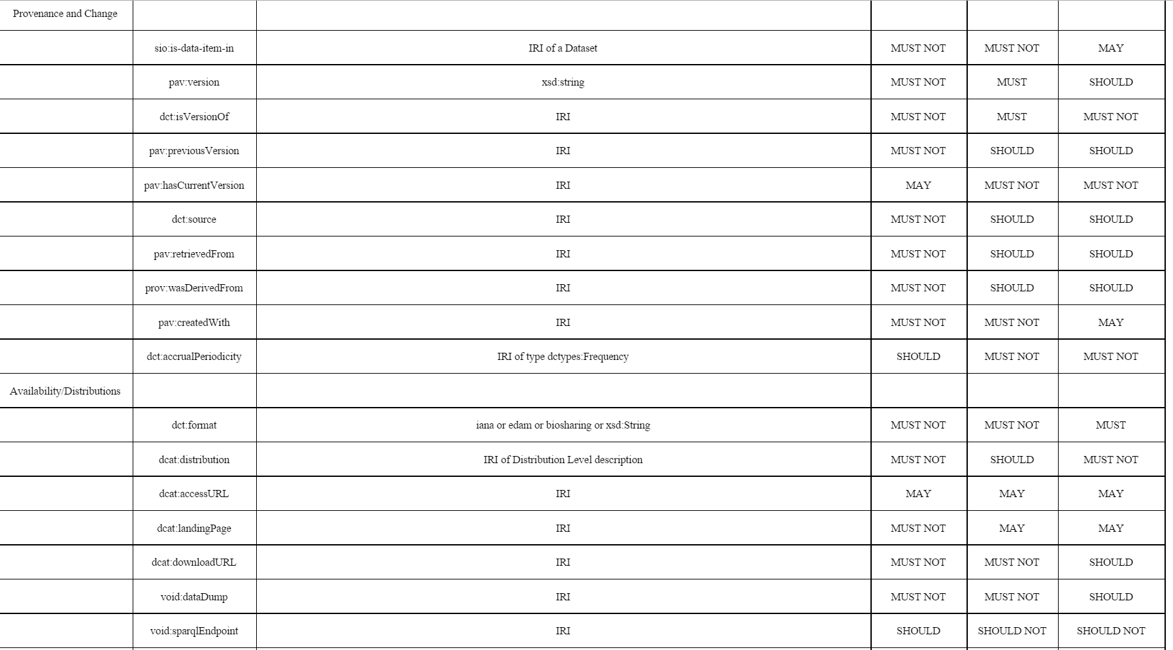
61 metadata elements

Slide 12
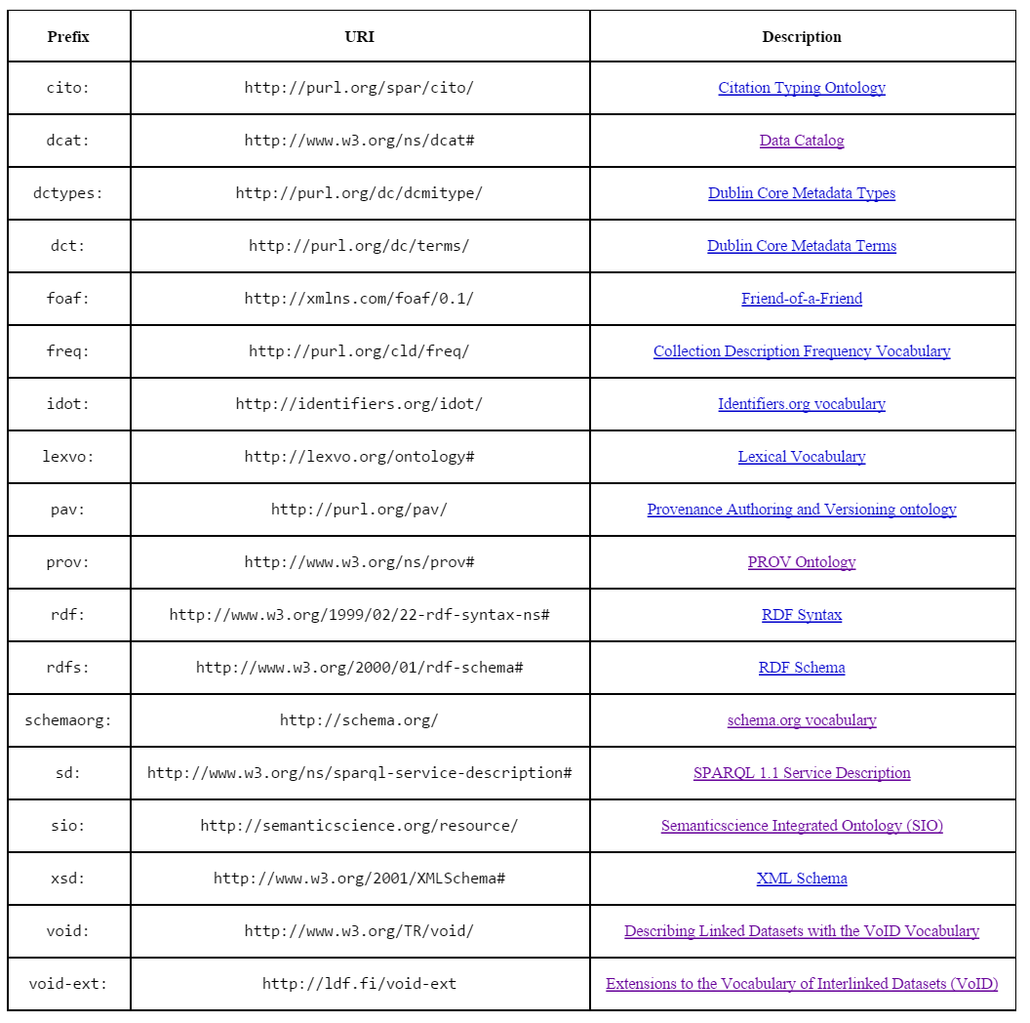
Reference 18 Vocabularies

Slide 13
Dataset Metadata
Core Metadata
Extended Metadata
Identifiers
Title
Description
Homepage
License
Language
Keywords
Concepts and vocabularies used
Standard compliance
Publication
Provenance Metadata
Versioning Metadata
Content Metadata

Slide 14
Element, description, and example

Slide 15
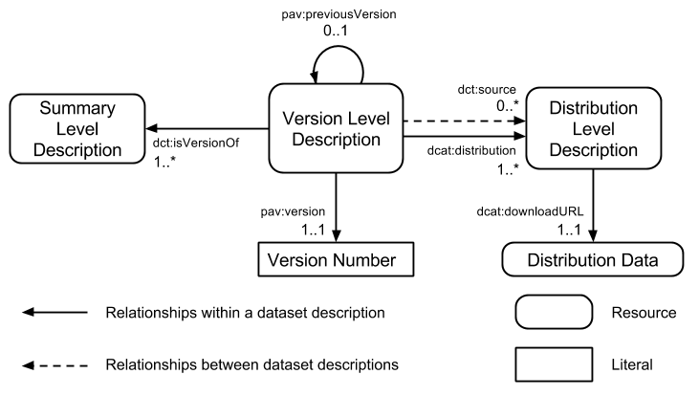
Three Component Metadata Model: description – version - distribution

Slide 16
Constraints
The key words "MUST", "MUST NOT", "REQUIRED", "SHALL", "SHALL NOT", "SHOULD", "SHOULD NOT", "RECOMMENDED", "MAY", and "OPTIONAL" in this document are to be interpreted as described in RFC 2119 [RFC2119].

Slide 17
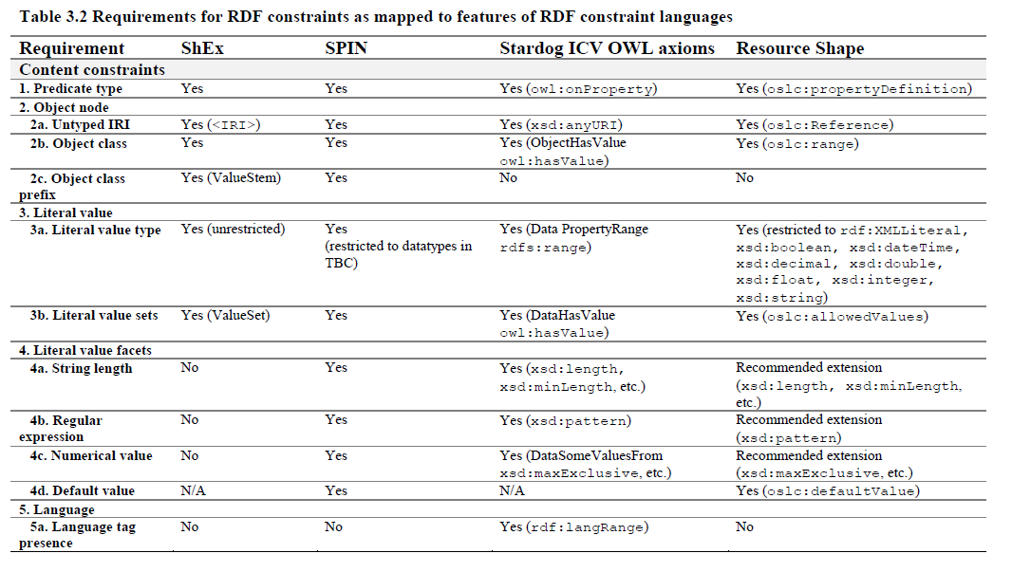
Survey of computable RDF constraints
Vladimir Choi. 2015. Big Metadata: A study of Resource Description Framework (RDF) technologies to enable machine-interpretable metadata in biomedical science. Master's Programme in Health Informatics. Karolinska Institute.

Slide 18
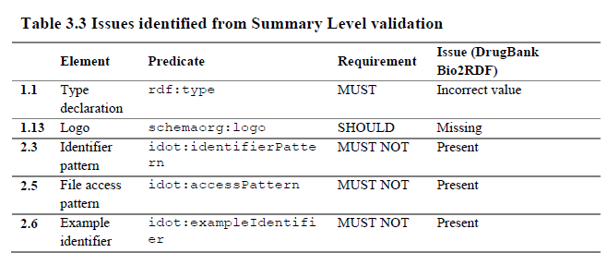
Validation using ShEX

Slide 20
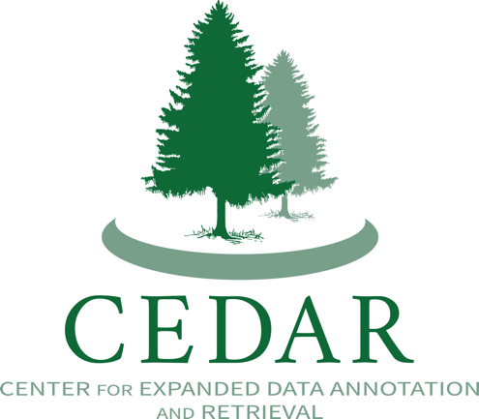
Making it Easier, Possibly Even Pleasant, to Author Rich Experimental Metadata

Slide 21
CEDAR will empower users to meet and exceed the minimal metadata standards
Emphasis traditionally has been on development of simple checklists of metadata elements
Little practical consideration for
Using shared value sets (search, browse, query)
Common knowledge representations (interoperable ecosystems of tools and data)
Metadata validation against community standards (richness and quality)
We need a more expressive—and computable—framework for describing metadata

Slide 22
CEDAR technology will give us
Tools
To author metadata templates that define a community standard while reusing previously defined elements
To facilitate the capture of experimental metadata that conform to one or more community standards
To discover datasets that meet a plurality of dataset and experimental requirements
Methods
To learn metadata patterns from unstructured, semi-structured, and structured metadata
To efficiently guide predictive entry of new metadata
To index, query, and reason about ontology-based metadata
To explore, verify, and collaboratively augment experimental metadata even when the data are located elsewhere

Slide 23
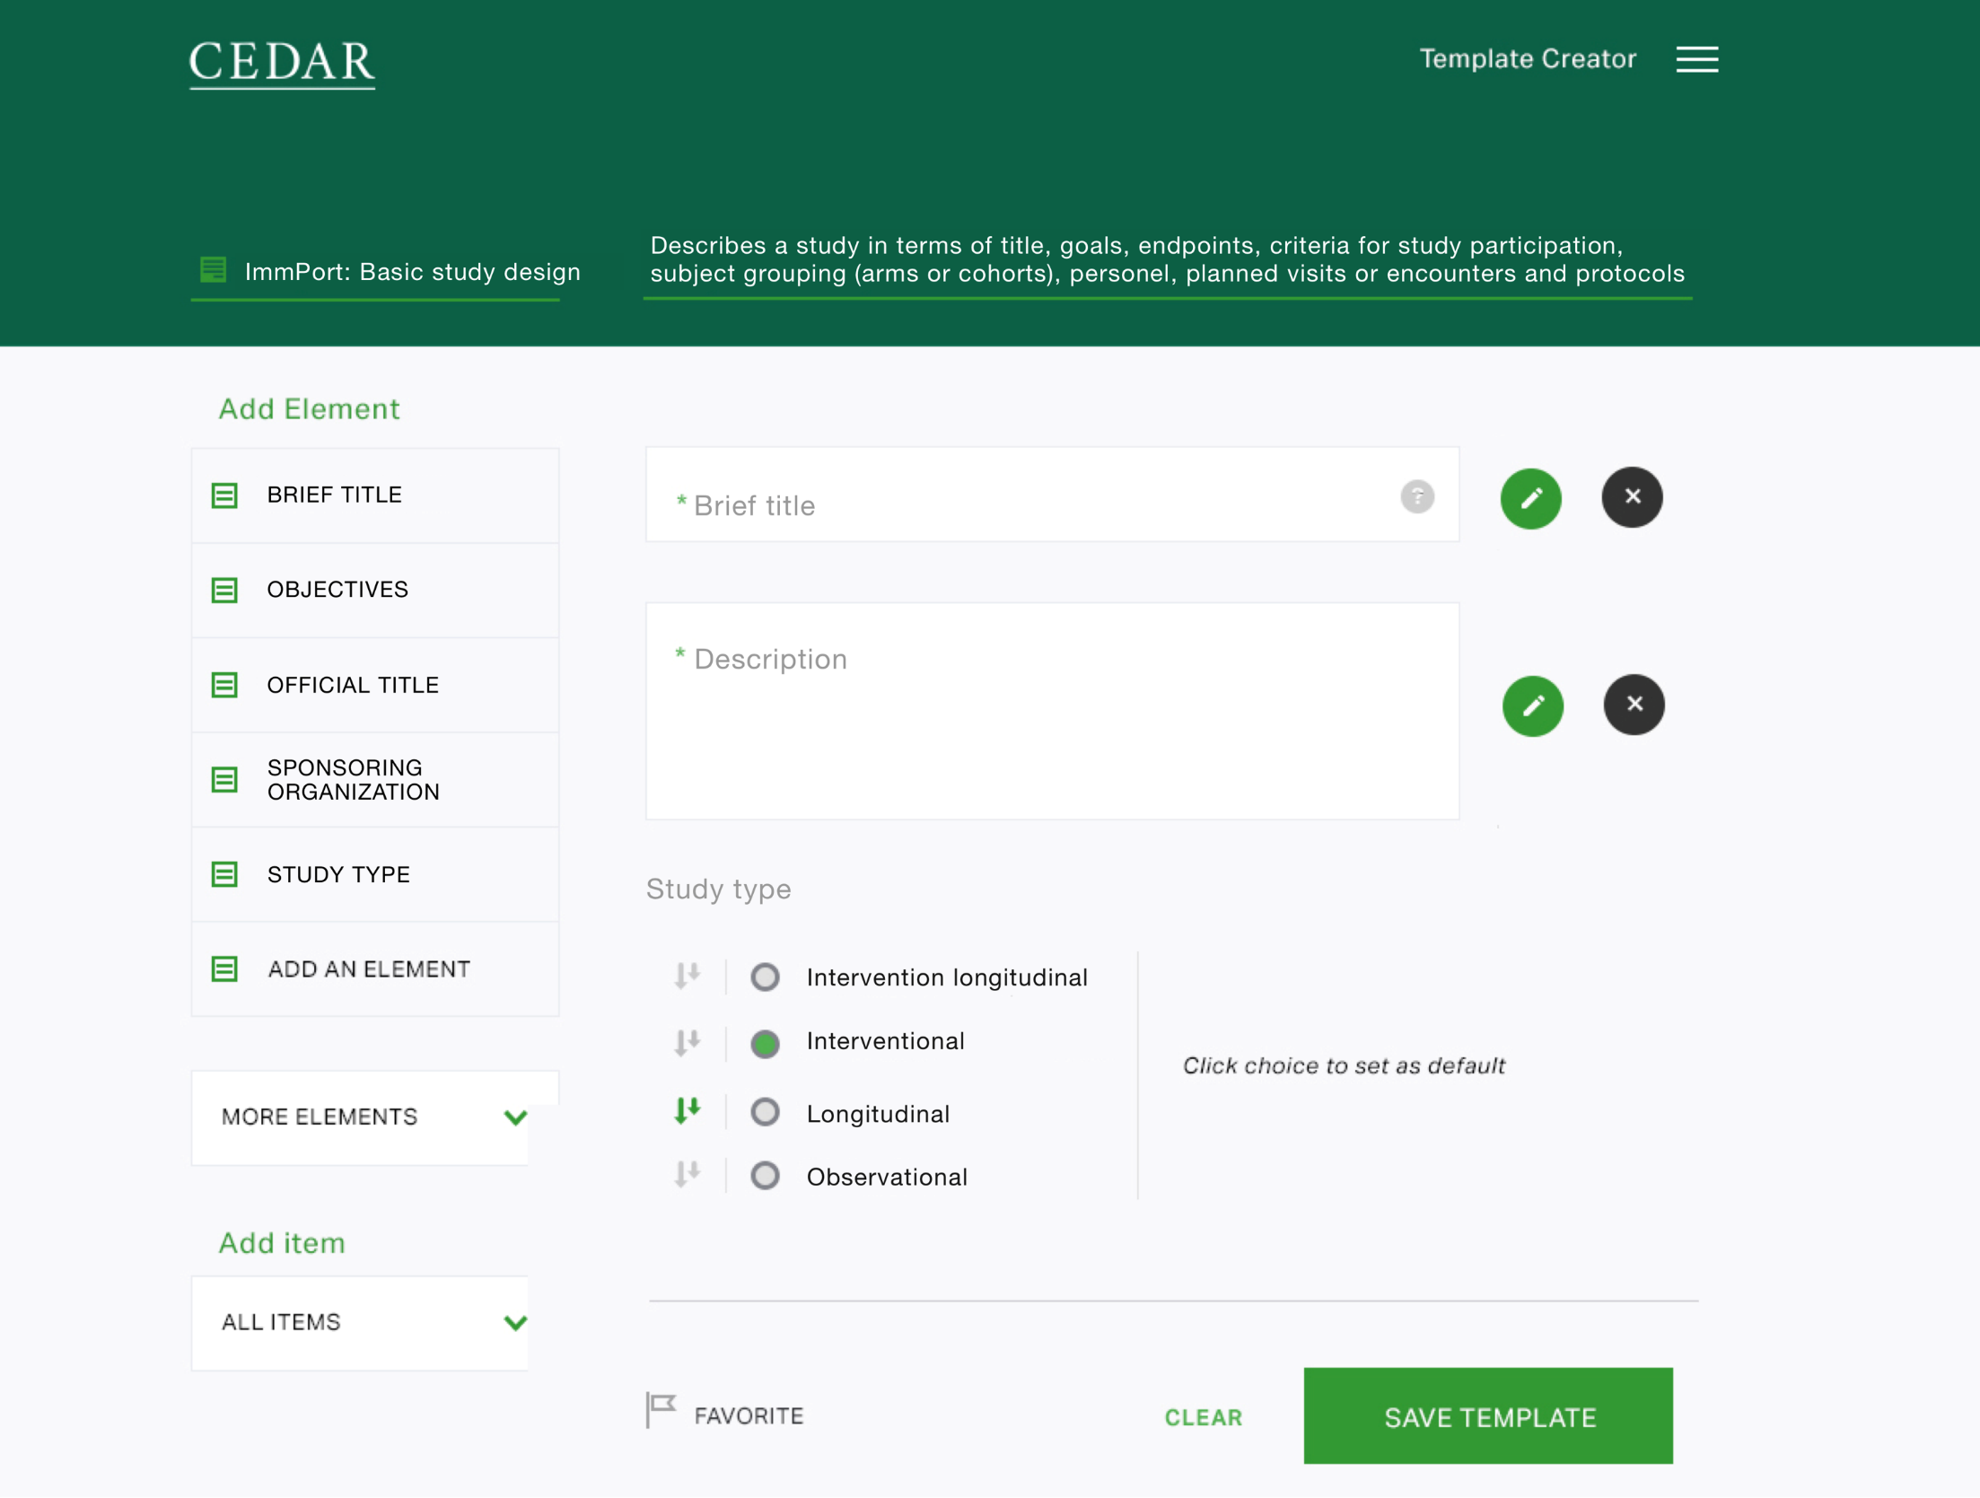

Slide 24
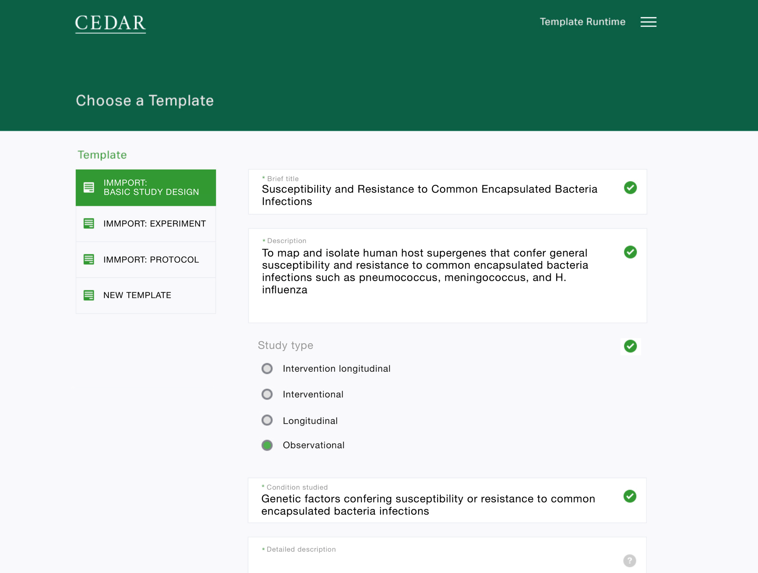
Notes:
Now we can instantiate the template with actual data. But filling in these templates is a mess. Can’t the “study type” be inferred from the “description”? Does knowing who the “investigator” is suggest other elements of the study design?

Slide 25
We also want to help users compose templates and auto-magically suggest metadata values

Slide 26
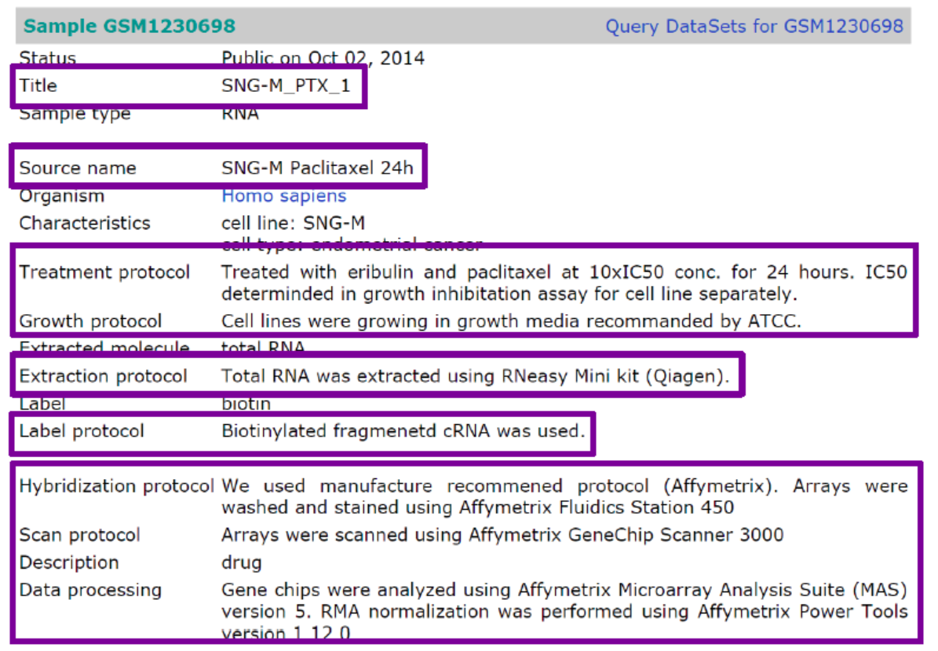
Can we use free text to predict structured and semi-structured values?

Slide 27
Predicting structured metadata (accuracy)
Predicting semi-structured metadata
Using multi label tree
Accuracy of 72% to predict 39 most-occurring keys
Average precision 79% (for all keys)
Average recall 82% (for all keys)

Slide 28
Metadata: The Next Frontier for Big Data
Simple, effective, computable, and interoperable principles, specifications, and guidelines for data and their metadata
Methods and tools to ease the collaborative capture and verification of ontology-annotated data and metadata

