Slide 1
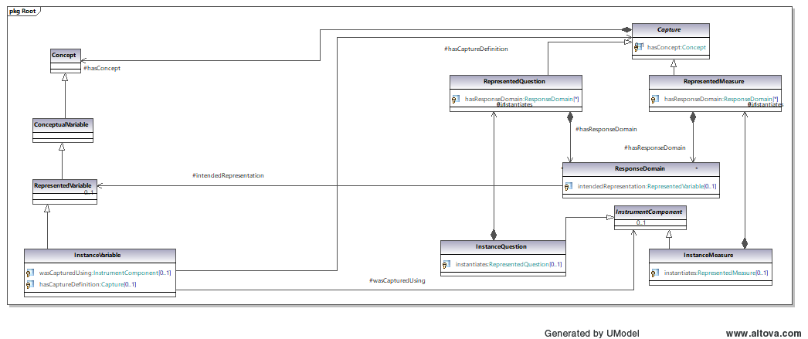
Current Model
0
0 – ResponseDomain to RepresentedVariable – doesn’t work due to lack of sentinel values

Slide 2
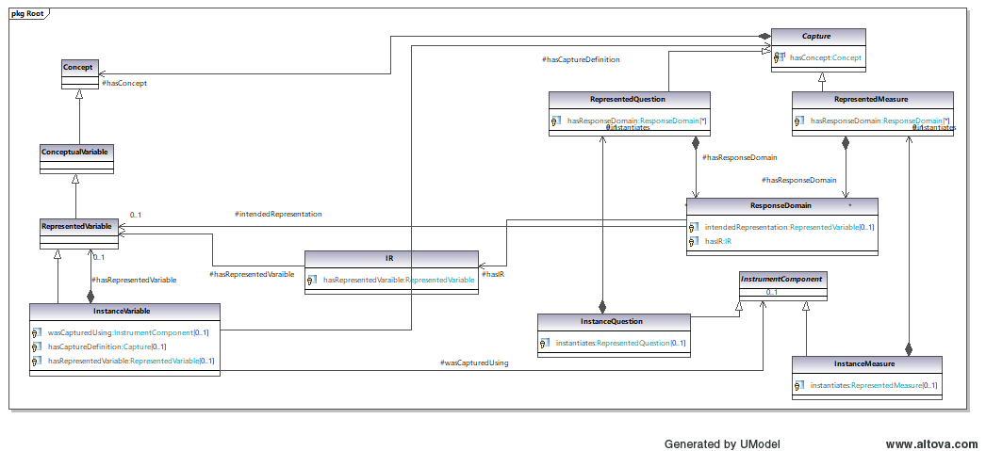
2 other options
1
2
1 – Connect concepts in CV and Capture (oops missed this one goes from Capture to ConceptualVariable)
2 - Path through IR – doesn’t work due to lack of sentinel values in RepresentedVariable

Slide 3
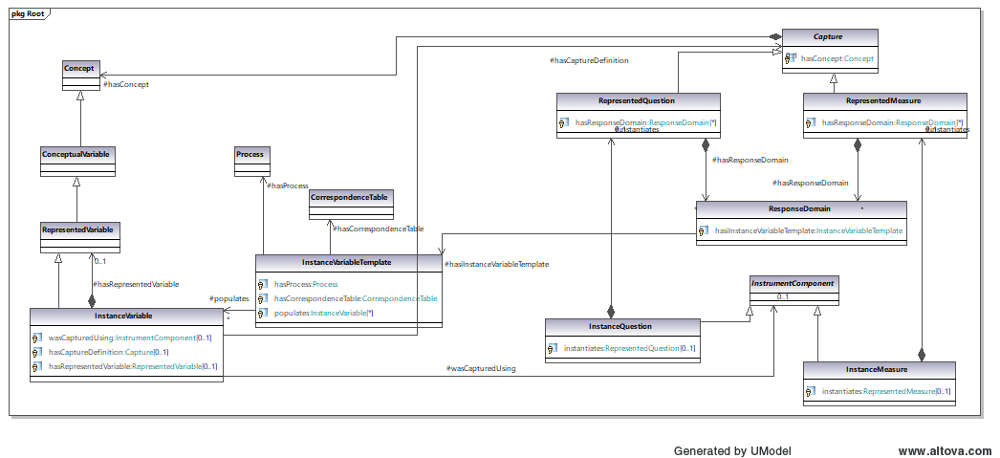
DCAP-61 Proposal
3
3 – Create an InstanceVariableTemplate and route through this to InstanceVariable

