Slide 1
A Catalog of Data Transformation Schemas
Powered by the DDI 4 Collections and Data Description Models

Slide 2
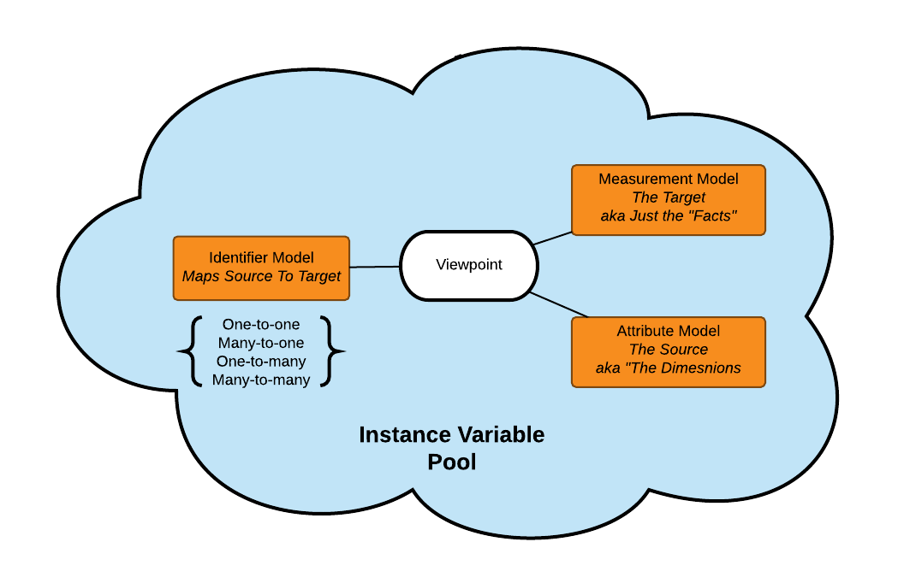
What is a Data Transformation Schema in DDI 4?

Slide 3
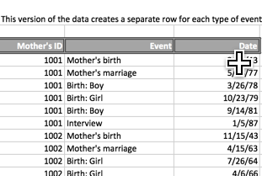
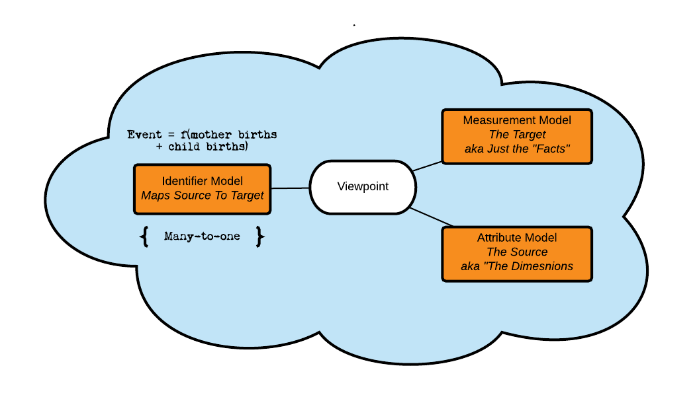
Creating Events for an Event History (1)

Slide 4
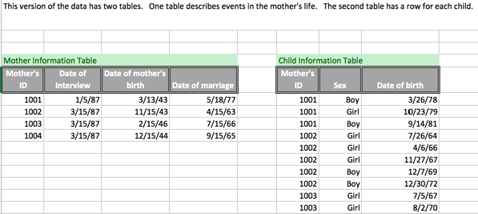
Creating Events for an Event History (2)

Slide 5
Timeout
The data transformation schema has three parts:
An identifier role that provides a formula for creating a target from the source
Source data in the Attribute Role
Target data in the Measurement Role
Depending on the formula, there can be multiple sources and/or multiple targets
The data transformation schema in DDI may host code that executes the transformation but the transformation itself is performed on another platform
The schema can provide details of this platform including its name and version so that the same transformation can perhaps be executed again
Additionally, once the C²Metadata project is online, the data transformation schema can host a C²Metadata description of data transformation steps written in pseudocode, DDI or both

