Slide 1
Eclipse Project File Import
Tutorial - Generating DDI-CDI in the Language of your Choice
Joachim Wackerow
2020-11

Slide 2
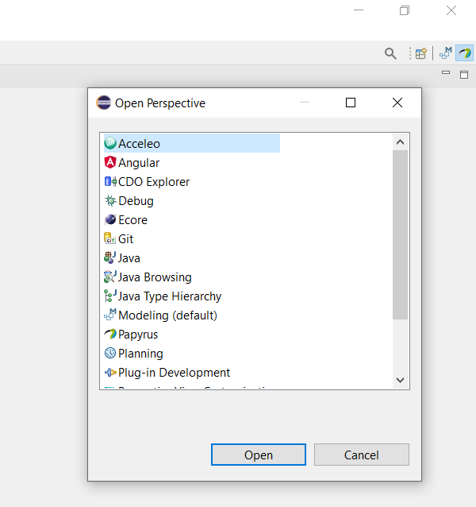
Switch to Acceleo Perspective
Open Perspective

Slide 3
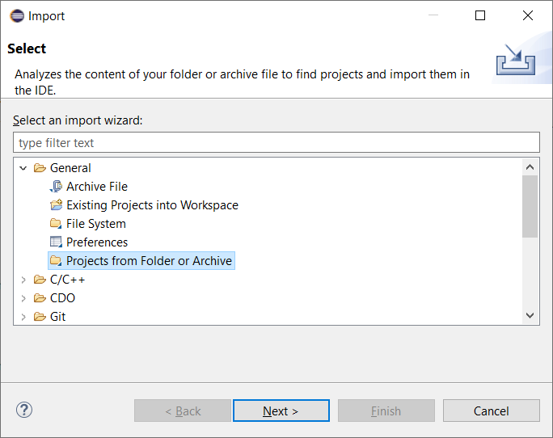
Import of the Project File – Step 1
File / Import / General / Projects from Folder or Archive

Slide 4
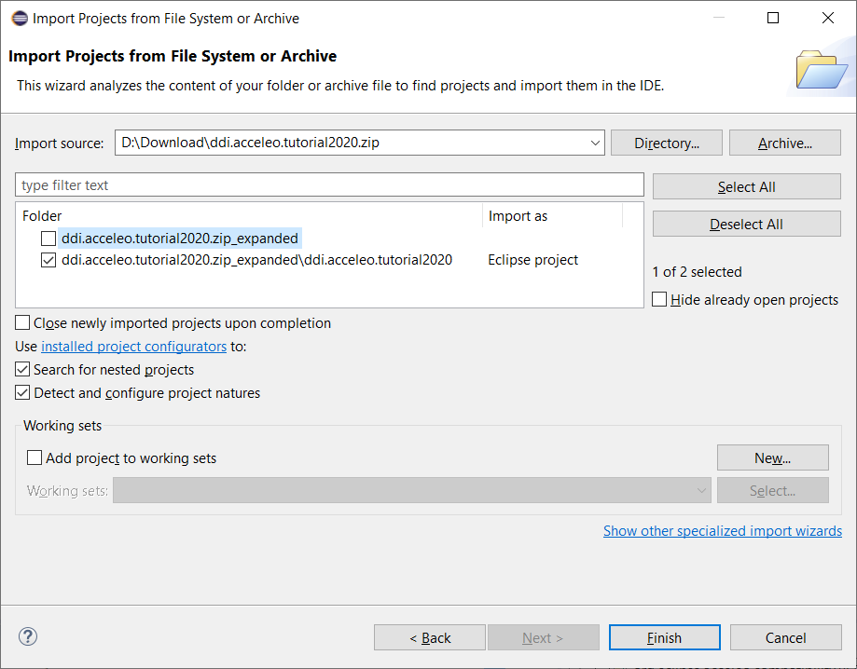
Import of the Project File – Step 2
Only Eclipse project should be checked

Slide 5
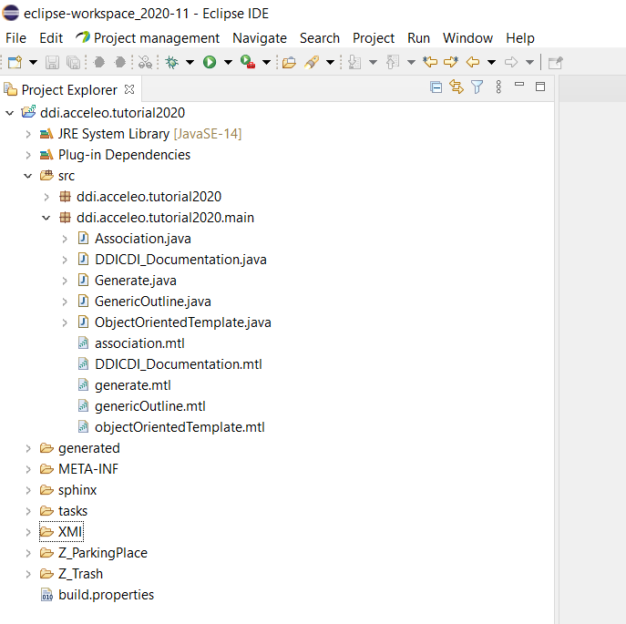
Resulting View

