Slide 1
Software Installation
Tutorial - Generating DDI-CDI in the Language of your Choice
Joachim Wackerow
2020-11

Slide 2
Overview
Following software is required for the exercises
Eclipse IDE (integrated development environment)
Tested with 2020‑09
Acceleo (Eclipse plugin)
Tested with 3.7
Code generator: implementation of the MOFM2T standard (Model to Text Transformation Language of the OMG - Object Management Group)

Slide 3
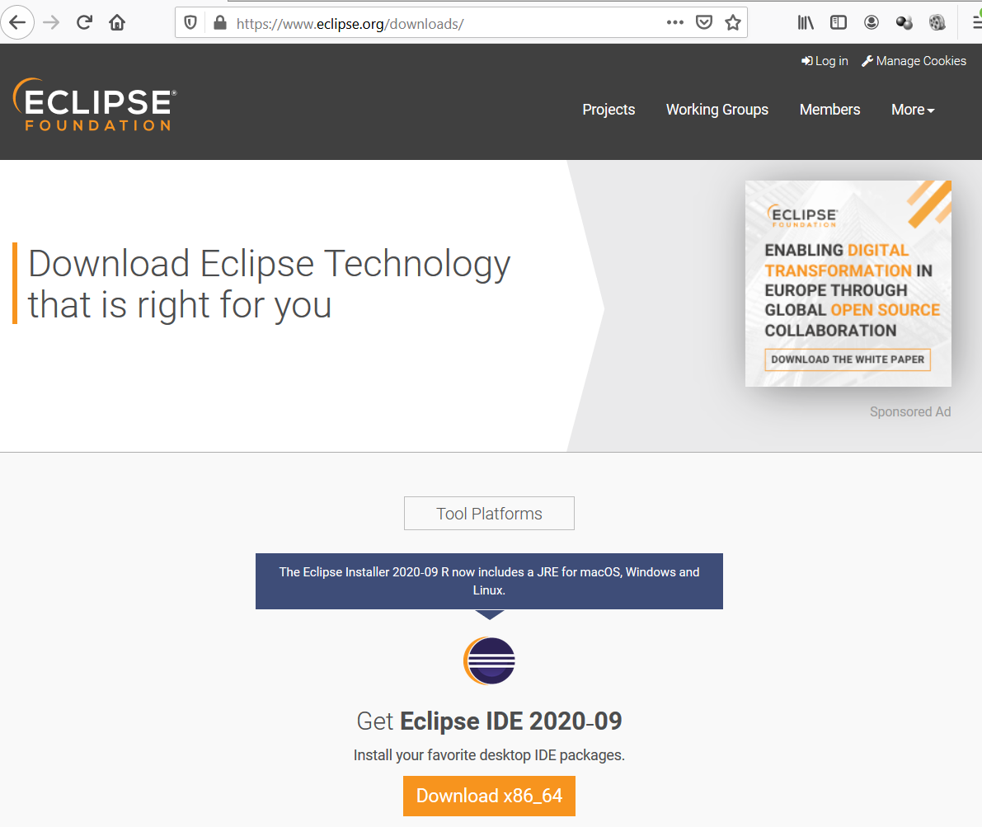
Eclipse Download Installer

Slide 4
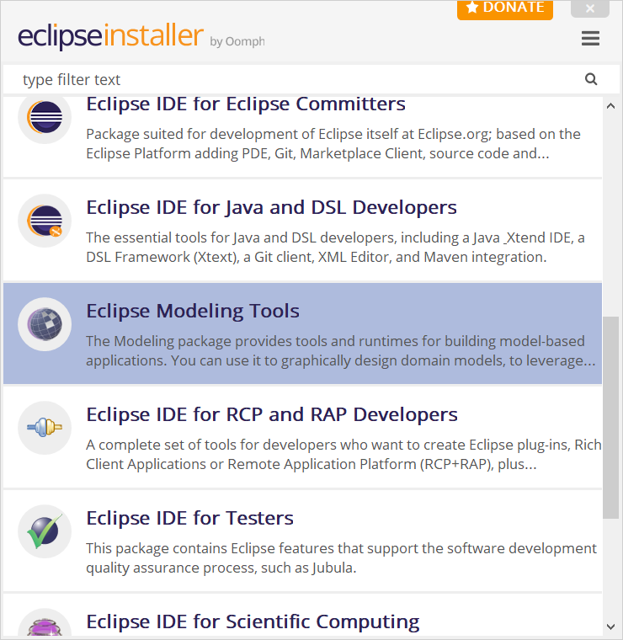
Eclipse Installation of Modeling Tools – Step 1

Slide 5
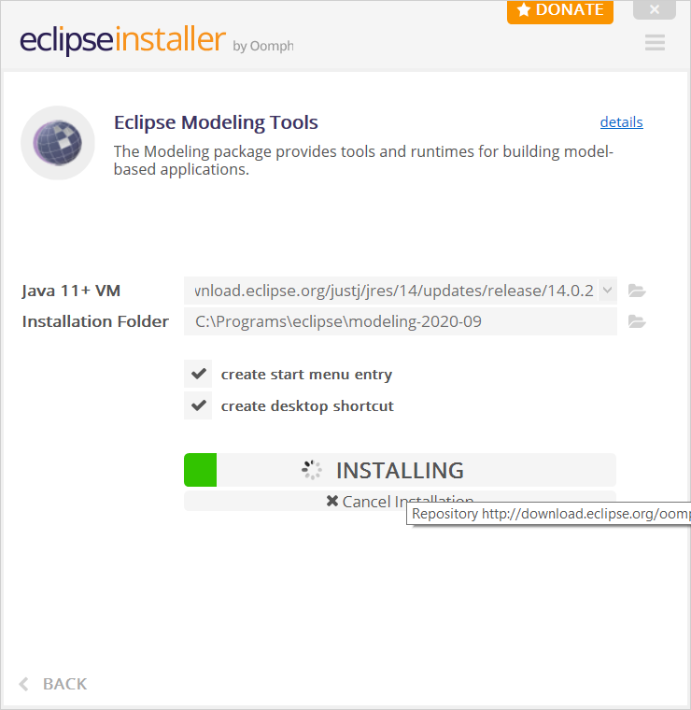
Eclipse Installation of Modeling Tools – Step 1

Slide 6
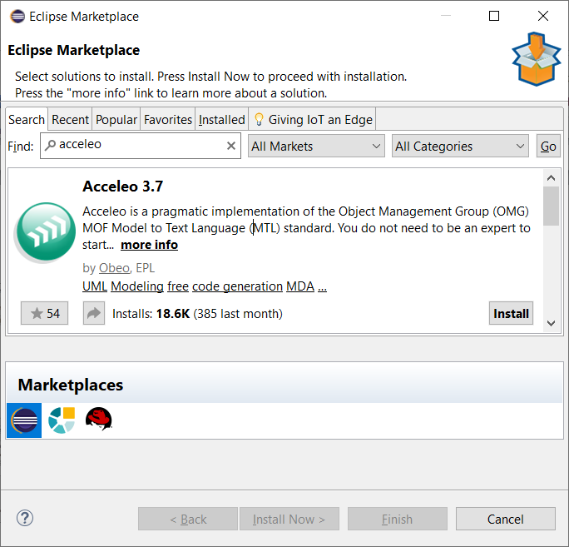
Acceleo Installation - Step 1
In Eclipse: Help / Eclipse Marketplace / Find “Acceleo”
Install Acceleo 3.7

Slide 7
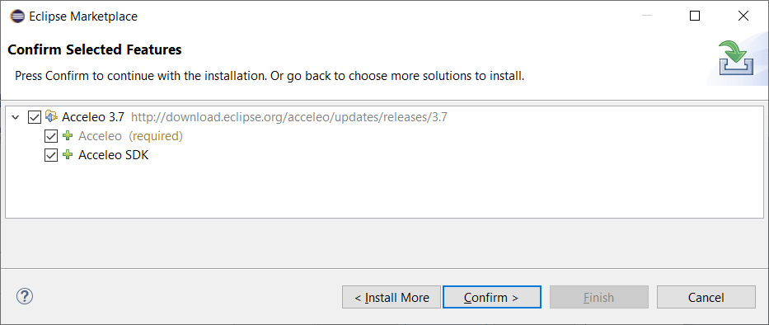
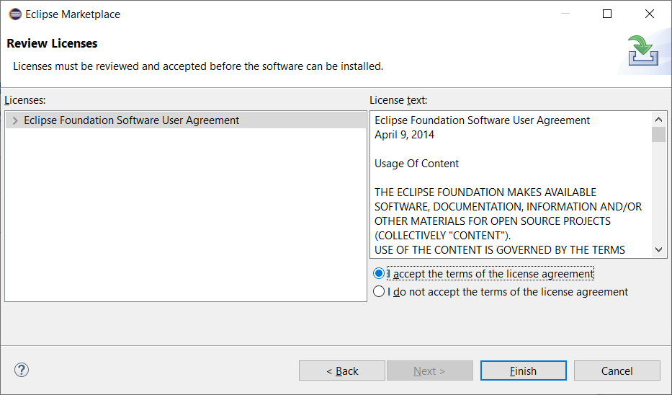
Acceleo Installation – Step 2
Restart of Eclipse

