Slide 1
Visions for
The ESS Multilevel Data
Bodil Agasøster and Knut Kalgraff Skjåk
Norwegian Centre for Research Data,
Archive of the ESS
Workshop on Interoperability for Cross-Domain Research: Use Cases for Metadata Standards, Dagstuhl, September 27, 2021

Slide 2
2
European Social Survey: Overview
Survey, data and infrastructure with gold standard methodology. National Teams, CST (NSD)
Pre-harmonization, int. standards etc., Comparable data
DDI life-cycle
About 500.000 interviews completed
6,000 international publications Journal articles, books, working and conference papers that analysed our data have been published (2003-20)
Open science

Slide 3
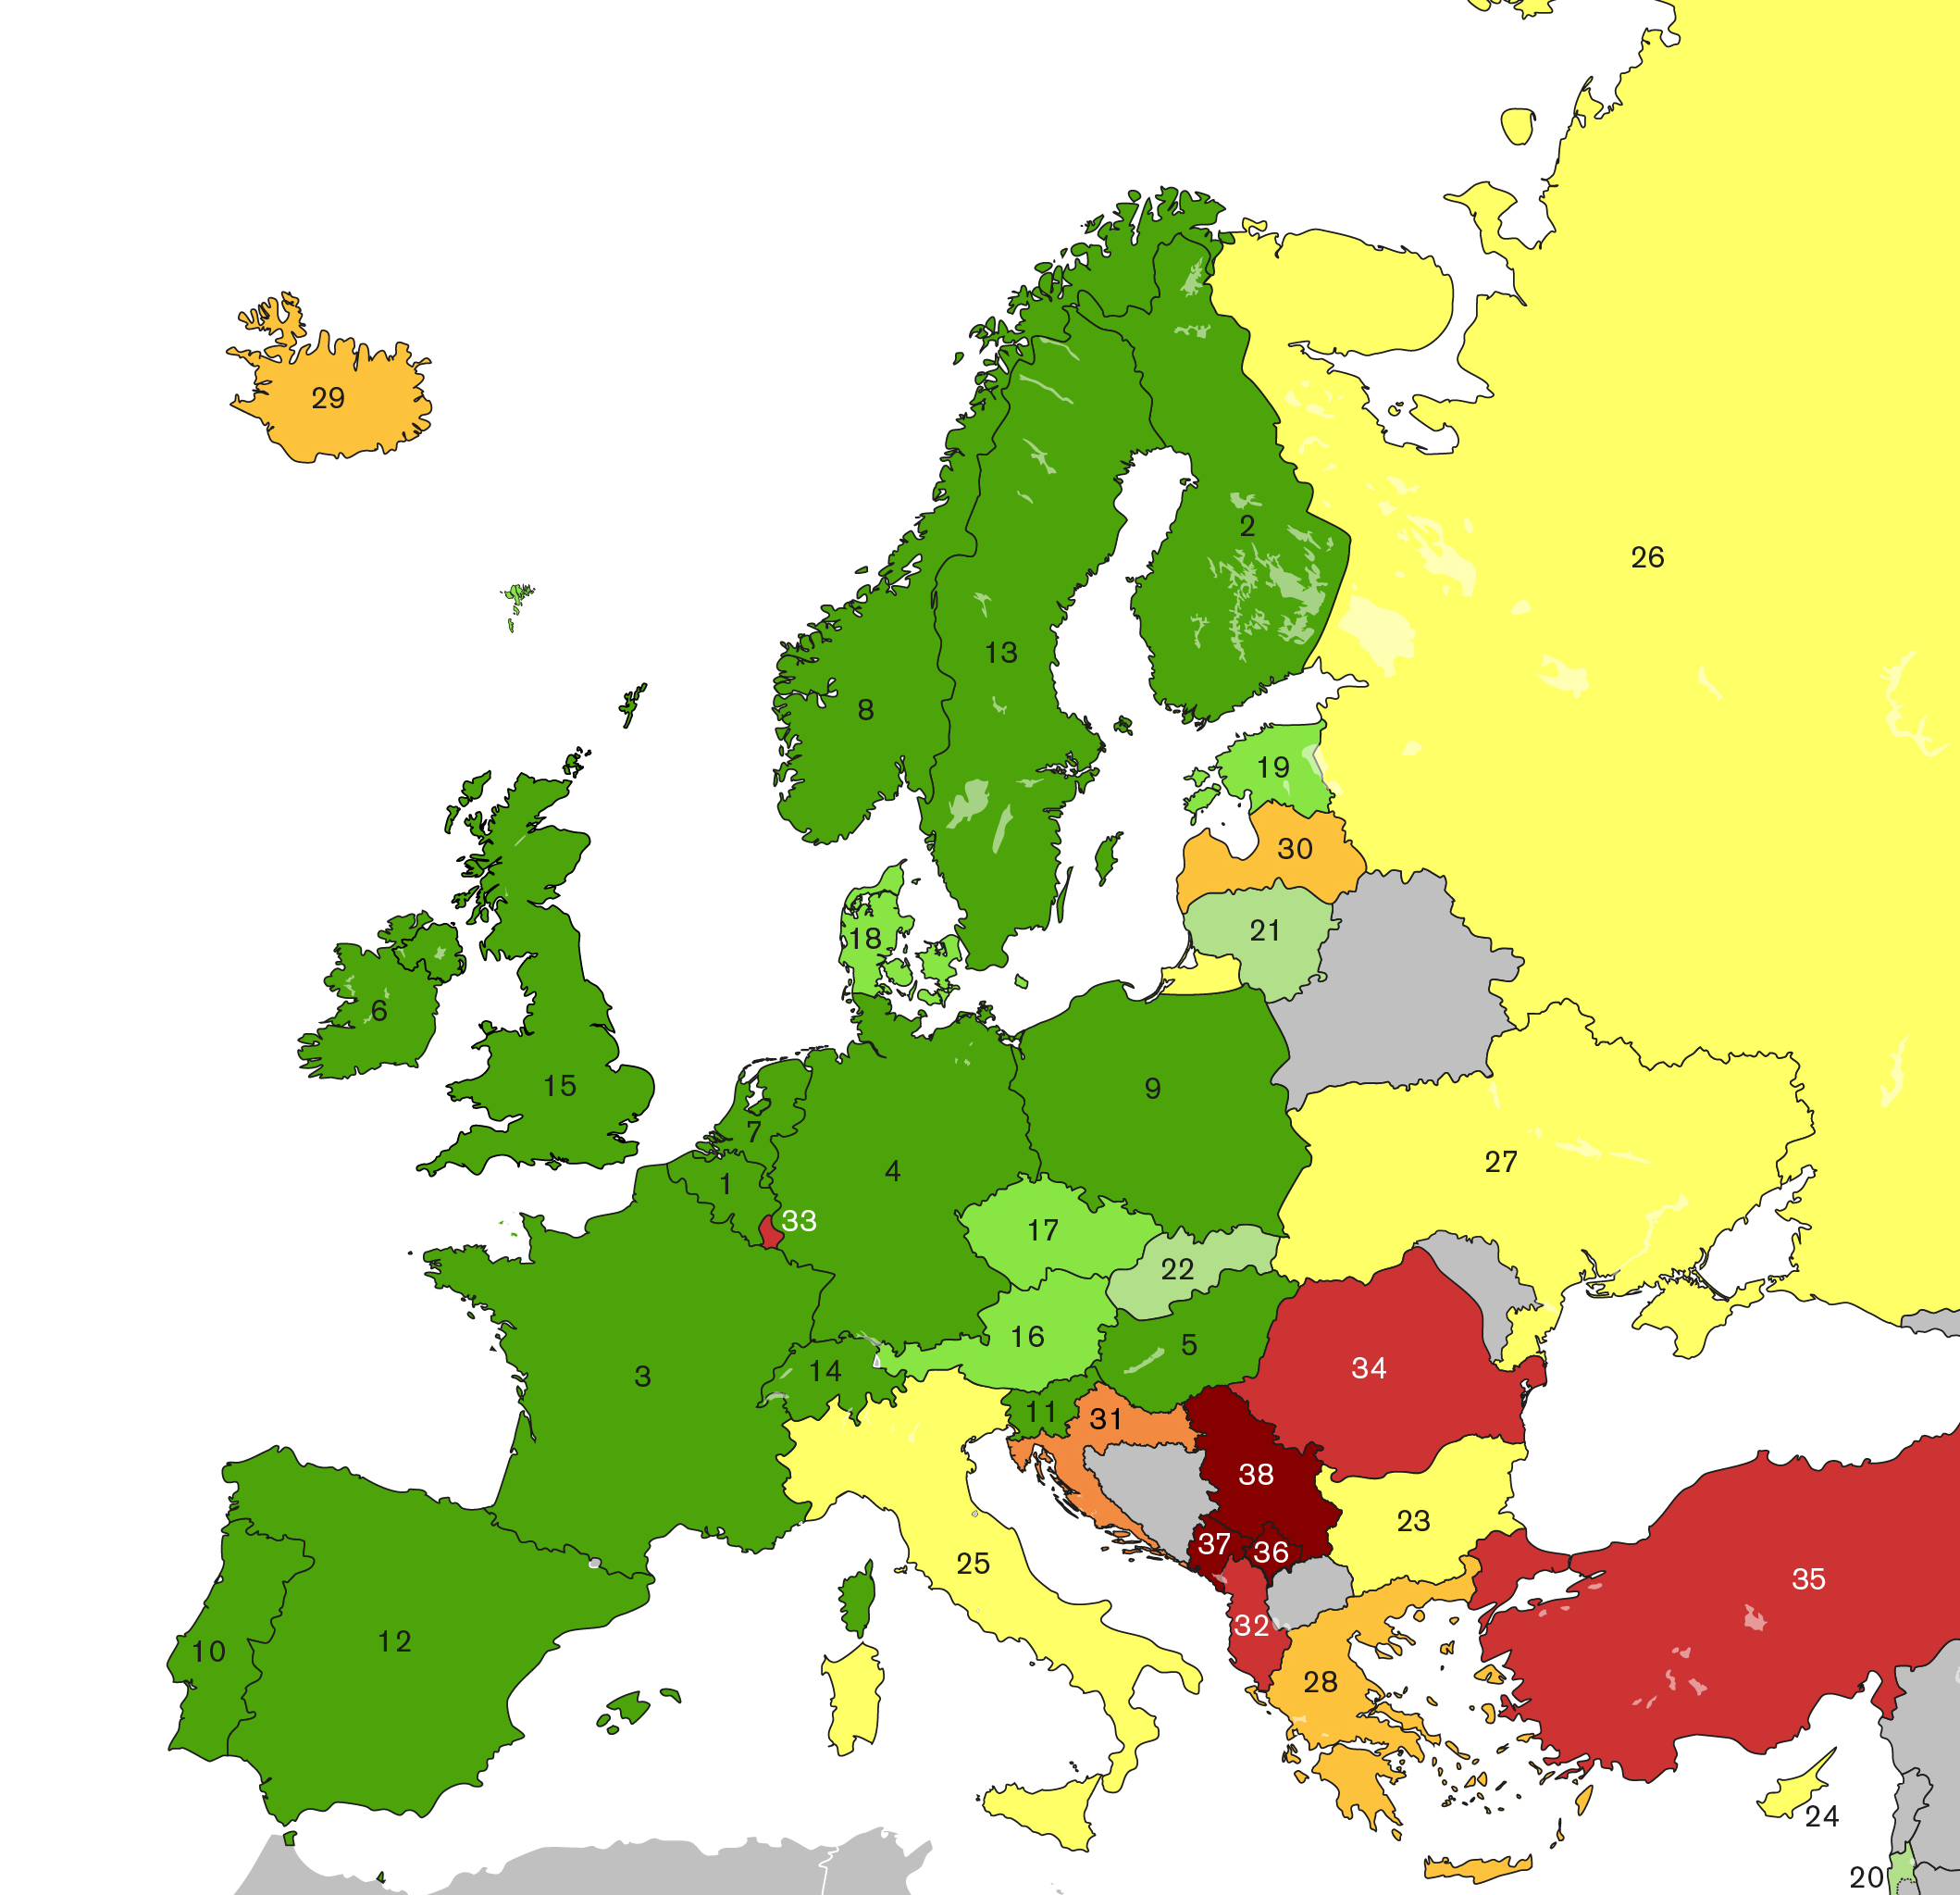
3
Participating countries
Klikk for å legge til tekst
Klikk for å legge til tekst

Slide 4
4
Questionnaire
Media use; Internet use; social trust 6 questions
Political interest, trust in others / institutions, electoral and other forms of participation, party allegiance, socio-political orientations, immigration 43 questions
Subjective wellbeing, social exclusion, crime, religion, perceived discrimination, national and ethnic identity, vote intention in EU referendum 35 questions
Socio-demographic profile, including: household composition, sex, age, marital status, type of area, education & occupation of respondent, partner, parents, union membership, income and ancestry 35 questions
Human Values Scale 21 questions
Rotating modules Two sections of approx. 30 questions on a single academic and/or policy concern within Europe
Notes:
Three ex, of rotating

Slide 5
5
The ESS Blueprint 1999
"Right from the beginning the ESS must take all necessary steps to ascertain that as many as conceptually meaningful institutional and contextual variables are added to the individual data and that links to data holdings of e.g. EUROSTAT are included which permit the integration of individual and contextual information.
Similarly, political and economic macro indicators on the level of nations must be included early on in the micro data files."

Slide 6
6
ESS MD launched in 2012, updated every 2nd year
Topics, “regional data”
Demography
Economy
Education
Composite measures, e.g. Human Development and Gender Inequality Indexes
Political Institutions
Health
Crime
Immigration
Regional levels
NUTS Nomenclature, level depending on
Available data
Disclosure risk
7,700 users have downloaded data
Notes:
Funded by EUs Descartes prize

Slide 7
7
Current flow
Contextual data
Multilevel
data
Human operable harvesting and transformation
Individual data
Values
Attitudes
Behaviour
Living conditions
Life experience
Health
Socio-economic
Demography
Area
Registered data
Regional data
Area

Slide 8
New political agendas
Societal challenges
Climate change
Extreme weather
Biodiversity
Pandemics
Discussion and strategic views in ESS:
Panels, city surveys, regional divisions.
Synergies with EOSC future and PAUL
Notes:
To be relevant------

Slide 9
9
Contextual data in the future
Machine operable harvesting and transformation.
Provenance
FAIR
Contextual data
FAIR
Multilevel
data
Lingua
franca
Individual data
Values
Attitudes
Behaviour
Living conditions
Life experience
Health
Socio-economic
Demography
Area
Registered data
Regional data
+Biomedical data
+Sensor data
+
Location

Slide 10
10
Contextual data beyond the future
When can we start implementing DDI-CDI?
Datum-level maintenance?
Thank you!
Notes:
Coming deliverables in SSHOC
Thankful for being selected as use-case -

Slide 11
Email address here

