Slide 1
Introduction
Interoperability for Cross-Domain Research: Use Cases for Metadata Standards

Slide 2
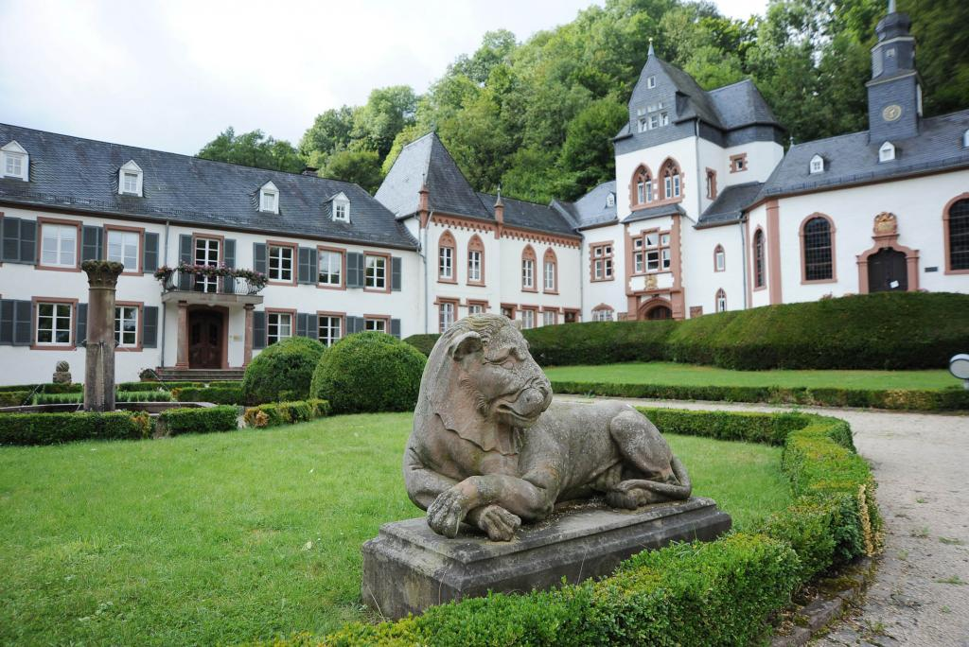
Normally, all participants would gather together here, near the statue of the lion.

Slide 3
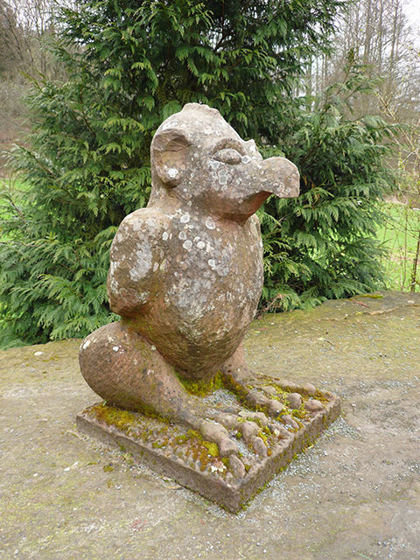
This year, we will (conceptually, anyway) be gathered
near this statue of an Elwedritsche, a hybrid creature
which comes from the Pfalzerwald (part chicken,
part snake, part deer, part kobold!)
Please bear with us – this is the first time we have tried
to organize a “hybrid” event! Be considerate of remote
participants, and remember to document your
discussions for all to see!

Slide 4
Objectives and Programme
Test an emerging Core Interoperability Framework
Explore it with four use cases
Day 1, Mon 27 Sept, plenary introduction to the CIF and the Use Cases
Day 2, Tue 28 Sept:
European Social Survey
NGSI-LD (Next Generation Service Interfaces from INTERSTAT - Open Statistical Data Interoperability Framework)
Day 3, Weds 29 Sept:
Smart Energy Research Laboratory
Helmholtz Association Metadata Collaboration (HMC)
Day 4-5, Thu 30 Sept-Fri 1 Oct: Status of deliverables, continue work in groups.

Slide 5
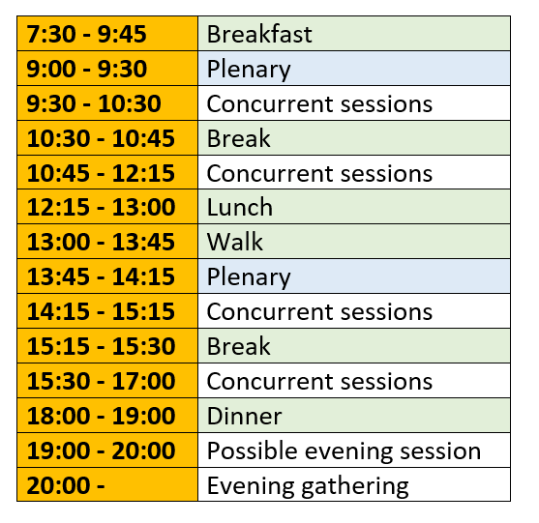
Daily Schedule

Slide 6
Introductions
Who are we?

Slide 7
Dagstuhl Logistics
ID badges: Wear them during your stay
Honor System: Write down what you use and pay
Facilities: Bikes, piano
Internet wireless access: Use your DOOR credentials, or eduroam

Slide 8
COVID 19 RULES – Dagstuhl
WEAR MEDICAL FACE MASKS: Whenever you are not eating, drinking
KEEP DISTANCE: 1.5 meters between persons
COVID TESTS: All guests are advised to perform a self test for SARS-CoV-2 on the first day of their stay (usually Monday), and every other day after that (usually Wednesday and Friday). Schloss Dagstuhl provides the test kits. If you are fully vaccinated or had COVID the testing is not mandatory.
COVID SYMPTOMS or positive test? Stay in your room and contact the organisers.

Slide 9
COLLABORATING TOOLS
Confluence: Use to publish content for others to view: https://bit.ly/cross-domain-confluence
Dagstuhl Page: https://bit.ly/cross-domain-dagstuhl
GDrive Folder: https://bit.ly/cross-domain-folder
Cross-Domain: Framework document https://bit.ly/cross-domain-framework-document
Main Zoom Room: will be send by e-mail.
[Breakouts will be physical rooms with corresponding “rooms” in Zoom – links to be provided]
MIRO Whiteboards Guidelines: https://help.miro.com/hc/en-us – links to whiteboards on the next page

Slide 10
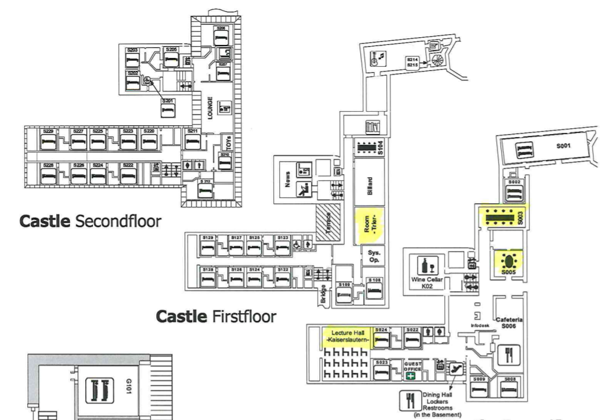
RROOMS IN DAGSTUHL
S106
R

Slide 11
MIRO Whiteboards
USE CASE EUROPEAN SOCIAL SURVEY
https://miro.com/app/board/o9J_lvf7oO0=/
USE CASE NGSI-LD
https://miro.com/app/board/o9J_lvfeHqk=/
USE CASE SERL
https://miro.com/app/board/o9J_lukq1-g=/
USE CASE HMC
https://miro.com/app/board/o9J_lvfeHxY=/
COMMON INTEROPERABILITY FRAMEWORK
https://miro.com/app/board/o9J_lvfeHUQ=/

Slide 12
Document your work
Document Decisions
Note any proposals agreed upon
Reasoning behind the proposals and decisions
If there were different positions – provide both reasons for and reasons against

Slide 13
QUESTIONS?
Please contact the organisers:
Achim - Joachim.Wackerow@gesis.org
Arofan - ilg21@yahoo.com
Hilde - hilde.orten@nsd.no
Simon - simon@codata.org

Slide 14
Looking forward to collaborating with you all!

