Slide 1
SERL (Smart Energy Research Lab)
Darren Bell
Director Technical Services
27 Sep 2021

Slide 2
UKDS “Traditional” data infrastructure
Approx. 8000 “wide” social science surveys deposited/disseminated as SPSS/STATA/CSV with PDF documentation
Data persisted in files on Windows/Linux folders (with different levels of security)
Metadata held in MS-SQL databases; DDI2.5 available on OAI and Nesstar
Discovery (search and download) website based on Solr. Either immediate download (Open); machine-mediated download (Safeguarded); human-mediated dissemination (Controlled).
Other data exploration tools like Nesstar (based on MySQL, JSP)
Very much an early 2000s architecture

Slide 3
SERL Project
Historically and currently very difficult for researchers to get access to good quality energy data in the UK
Smart meters could be a game-changer
However significant investment required to access smart meter data
Technical
Legal
Financial
Hence SERL funded to be a central resource for the UK research community
Duration 5 Years 2017-2022 with UKDA; University College London and six other UK universities
An effective mechanism for collecting and linking energy data with other contextual data:
Socio-demographics from surveys (e.g. EHS)
Building characteristics from EPCs
Weather data

Slide 4
SERL researcher questions
Scottish Energy Efficiency Program (SEEP) Evaluation
Smart Energy Performance Certificates (EPC’s) and Smart Energy Advice for consumers
Understanding habitual energy consumption
Determining the energy responsiveness of dwellings to external temperature
To what extent can end-use energy consumption be disaggregated using smart meter data?
How do socio-demographic factors impact demand profiles?
What is the impact of smart home technologies such as HEMS or smart heating controls?.
Distributional impact of switching suppliers/tariffs on bills and energy consumption.
Identification, targeting and mitigation of fuel poverty

Slide 5
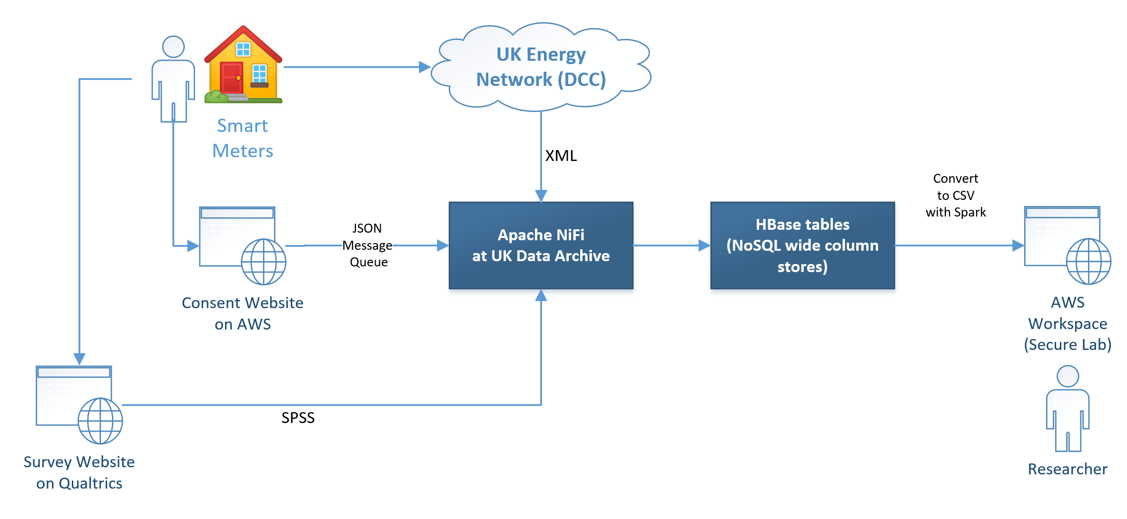
SERL Data Flow

Slide 6
SERL Data

