Slide 1
Intro: Cross-Domain Interoperability Framework

Slide 2
Cross-Domain FAIR Sharing
Consider what is needed for automating the reuse of data/metadata across domain and infrastructure boundaries
Services/applications for providers and users
Shared registry infrastructure
Agreed information payload to support needed functions between counter-parties
Agreed classification(s) of “domains”/”infrastructures”
This is a monumental task!
Where do we start?
Core functions for FAIR sharing
Agreed information payload for data to be exchanged

Slide 3
CDIF and Use Cases: Questions to Consider
Which functional areas are of concern to the use cases being explored?
What common requirements / approaches exist within examples being discussed within the group?
What standards are being used to address the requirements of the use case? And why are you using them?

Slide 4
General Questions: Cross-Domain FAIR
When CDIF is more mature, there will be multiple ways to use it – what guidance is required?
What are the overlaps between the mentioned specifications? Where are the gaps?
What are the handshakes between the specifications?
What could be a formal frame for CDIF?

Slide 5
What is CDIF?
A set of recommended practices for using a coordinated set of domain-agnostic standards – most often as specific subsets or profiles of those standards – to support a core set of functions for cross-domain FAIR reuse.
Addresses the “agreed information” requirement for cross-domain FAIR
Suggests a list of needed functions for supporting these exchanges
Provides a foundation for the creation of registries/applications/services
Does not provide a classification of domains/infrastructures

Slide 6
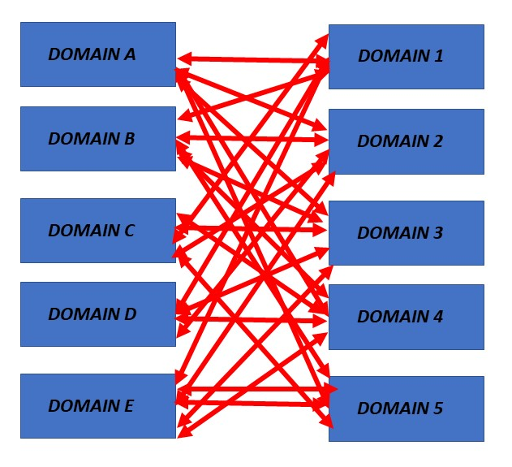
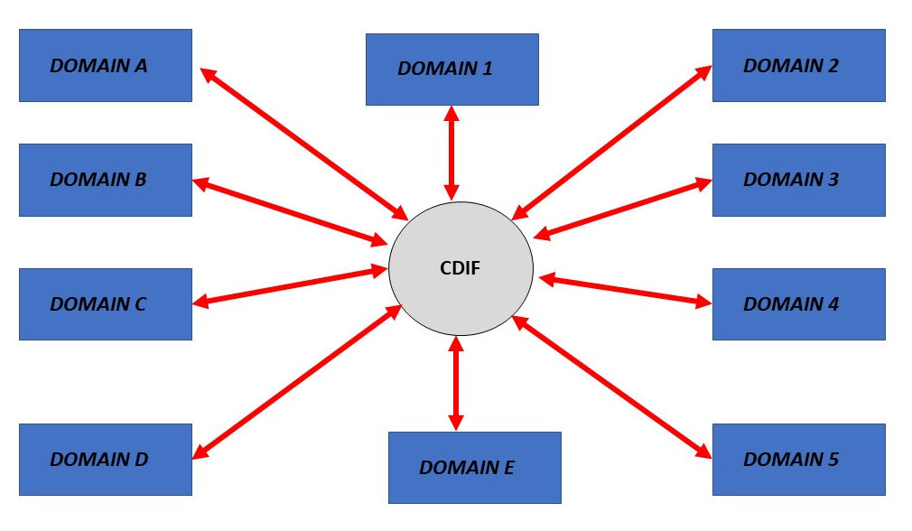
Many-to-Many or Many-to-One?

Slide 7
Foundations: The FAIR Digital Object Framework (FDOF)
It is necessary that a set of basic protocols exist to support scalable FAIR sharing
The FDOF is the primary focus
If FDOF doesn’t do it, something else will – because it has to!
The FDOF development is being driven by GO FAIR and others
Not yet finished
“Hotzone” week in Leiden (https://www.fdo2022.org/programme/hotzone-week)

Slide 8
Components of the FDOF
FAIR Implementation profiles (FIPs): Human- and machine-readable descriptions of FAIRness within specific communities
FAIR Data Points (FDPs): Repositories of FAIR Digital Objects
FAIR Digital Objects (FDOs): The generic model for describing FAIR resources of all kinds

Slide 9
Registry of Catalogues
FAIR Data Point
PID
(By Domain)
ACCESS
FIPs
DATA
(By Domain)
FAIR Digital
(Data) Object
The FDO
provides the “types”
of objects, their metadata and relevant schema
STRUCTURAL
METADATA
(META)METADATA
RESOURCES
SEMANTICS/
CLASSIFICATIONS
PROVENANCE/
PROCESS
METADATA

Slide 10
The FDOF Alone is Not Enough
For cross-domain/cross-infrastructure FAIR sharing, the number of standard models is very large
Domain ontologies/vocabularies
Metadata specifications
Formats and encodings
Etc.
To build generic FAIR sharing services, we need to have an agreed “core” set of standards/models to support common functions
CDIF is based on the set of common models and approaches observed across different FAIR implementations and projects
Guidance is needed for coordinated use
There are some gaps which need filling!
CDIF becomes a “lingua franca” built on top of the foundations of the FDOF

Slide 11
Considerations
Standards must function across domains
Standards must be as easy as possible to adopt
Flexibility (in terms of technologies)
Low barrier to entry
Standards should build on existing technology investments
Approach must be practical and based on real-world requirements

Slide 12
Functions for Scalable FAIR Sharing (Work in Progress)
Find the needed resources
Catalogues
Search/Discovery
Assess the resource – is it fit for purpose?
Determine (and meet) conditions of use and access
Interoperability/Reusability
Import the resource into the local system
Understand the resource
Semantics
Provenance
Use the resource (integration, harmonization)
Manage the entire process
To the greatest extent possible, these functions need to be automated!
Affordable, usable software/services/solutions

Slide 13
Candidate Standards

Slide 14
Standards for Findability
This subject covers cataloguing of data, searching for data, and initial assessment of data for use
Two established specifications seem to dominate this space at the generic (supra-domain) level
Data Catalog Vocabulary (DCAT, including several different profiles e.g., DCAT-AP)
Schema.org
Both of these are based to some extent upon Dublin Core
Other metadata schemes to support discovery and cataloguing metadata exist at the domain and supra-domain level, but are not as widely accepted
DOIs are an important standard for persistent identification

Slide 15
Standards for Accessibility
Data (and also metadata) can be subject to different conditions of use in different domains, and this can be a challenge to manage, especially in a cross-domain scenario
For example, authentication and authorization infrastructure (AAI) is currently a major concern for research infrastructures and EOSC
Two W3C specifications are being developed to address these areas
Open Digital Rights Language (ODRL) – now version 2.2
Data Privacy Vocabulary (DPV) – still being developed (version 0.4)
Other models and standards may be useful
More exploration and consideration is needed

Slide 16
Standards for Interoperability and Reuse
The integration, harmonization, and effective reuse of data is an established need
It is traditionally labor-intensive – current approaches do not meet the demand
Automation based on machine-actionable metadata could potentially produce greater efficiencies
These aspects of FAIR are the most metadata-intensive
Often rely on the same or related sets of information
Involve complex models with different critical aspects
Require the highest levels of RDM maturity
Are very expensive in terms of effort to achieve
Are very domain-dependent
Three aspects are considered here:
Structural metadata
Semantics and vocabularies
Context and fully-described “observations of interest”

Slide 17
Structural Metadata
Many domain standards and proprietary formats contain this metadata – fewer standards for use across domain boundaries or technology environments
Data Documentation Initiative – Cross Domain Integration (DDI-CDI)
Soon to be released specification
Is designed to generically describe data sets and structures at a very granular level
Connects process descriptions (PROV-O, SDTL, VTL, proprietary) and descriptions of related data and metadata
Aligns with external standards (both generic and domain-specific)
Designed to provide a framework for effective use of semantic standards/vocabularies
Other more limited standards
W3C CSV on the Web
W3C Data Cube Vocabulary/SDMX
W3C Metadata Vocabulary for Tabular Data
Others (NGSI-LD? SOSA/SSN? Etc.)

Slide 18
DDI-CDI
Designed to provide some of the needed metadata
Description of different data structures
Description of the processes involved in producing data
Description of granular “datums” as they appear in different contexts (and are used to produce other datums)
Designed to be domain-independent
Structural/functional commonalities
Configurable to reflect domain semantics
Designed to be used with other standards
In combination with other domain-independent standards
As an expression of/link to domain-specific standards
To fill some of the gaps
Designed to be technology agnostic
Model-driven
“Implementation guides” provide details of community practice

Slide 19
Semantics
Many domain-specific ontologies and vocabularies
Some generic ones
Geography/time
Units of Measure (e.g, DRUM recommendations)
A few useful standards which are generic and widely used
OWL, RDF-Schema, etc.
Simple Knowledge Organization System (SKOS - and XKOS for statistical classifications)
One issue is attaching semantics to the structures of data
Different concepts can play different roles in different data sets (as a variable, as a category in a representation of a variable, as a unit type, etc.)
Vocabularies and traditional classifications/thesauri are important here
The “Ten Simple Rules” document is a good start down the path to making such resources FAIR
Semantic bridges/harmonizations exist
OBO Foundry/BioPortal
Simple Standard for Sharing Ontology Mappings (SSSOM) - https://github.com/mapping-commons/SSSOM
FAIRsFAIR metamodel for semantic resources(?)

Slide 20
Context and Fully Described Observations of Interest
Data shared across domain boundaries lacks much of the implicit knowledge which traditionally facilitates reuse
One major aspect of this is provenance and process
Standards such as the W3C PROV Ontology (PROV-O) are widely adopted
Some data-specific profiles also exist (e.g., PROV-ONE, etc.)
We have standards for describing processing functions (e.g., SDTL, VTL)
Clusters of variables are often important in understanding specific measurements or observations
Standards and models related to “observable properties” exist, notably from RDA’s I-ADOPT working group (also Observations & Measurement/OGC/SOSA/SSN work)
Still relatively new

Slide 21
Managing FAIR Resources at the Business Level
There is an entire level of activity which goes beyond the immediate description of resources
What are resources created to do?
How are they used?
What are the costs/benefits?
This is one of the less-explored aspects of FAIR
There are some standards worth considering
Common European Research Information Format (CERIF)
UN/ECE Generic Activity Model for Statistical Organizations (GAMSO)

Slide 22
Engaging with Use Cases at Dagstuhl
We are here to explore an important aspect of cross-domain FAIR sharing – CDIF!
We will use case studies to provide detail and direction for the creation of this framework
Consider the set of functions needed to support FAIR sharing
Consider the set of standards which can be recommended to support these functions
Workshop goal is to produce a first draft of the CDIF recommendations

Slide 23
Beyond the Workshop
The work here at Dagstuhl will be a key input to the WorldFAIR project
11 domain case studies systematically looking at FAIR within and across domains
Will organize a working group to further the work on CDIF
Welcomes input from experts not currently involved in the WorldFAIR use cases
The more-complete CDIF is intended to be published in a first production version following WorldFAIR
Hopefully with agreement from a broad range of groups
With a sustainable organization to complete and maintain the work

Slide 24
CDIF and Use Cases: Questions to Consider
Which functional areas are of concern to the use cases being explored?
What common requirements / approaches exist within examples being discussed within the group?
What standards are being used to address the requirements of the use case? And why are you using them?

Slide 25
General Questions: Cross-Domain FAIR
When CDIF is more mature, there will be multiple ways to use it – what guidance is required?
What are the overlaps between the mentioned specifications? Where are the gaps?
What are the handshakes between the specifications?
What could be a formal frame for CDIF?

