Slide 1
EOSC Future WP6.3 - SP9 Climate Neutral and Smart Cities
Visions for the European Social Survey Multi-Level Application

Slide 2
Framing: EOSC Future - what is it?
EOSC Future: An EU-funded H2020 project that is implementing the European Open Science Cloud (EOSC). The aim of EOSC is to give European researchers access to a wide web of FAIR data and related services through the EOSC Portal.

Slide 3
WP6 of EOSC Future
EOSC Future WP6 is the space where Science Clusters and e-Infrastructures join forces.
Different approaches, different languages, different culture.
Huge potential through integration activities by identifying their interfaces or trading zones*
* From https://eoscfuture.eu/wp-content/uploads/2021/11/Arvanitidis_PPT_Day_1_Session_2.pdf

Slide 4
Science project 9 of EOSC Future WP6.3 - Objectives
Demonstrate that relevant environmental data and data on citizens’ values, attitudes, behavior and involvement can be combined for social, political and scientific analysis
Data available via the EOSC Future Platform
Upgrade of the ESS Multilevel Application tool

Slide 5
Expected users
1) Social and behavioral scientists
2) Policy makers
3) Researchers from other domains (Environmental scientists)

Slide 6
The European Social Survey Multi-Level Application - Background
The European Social Survey (ESS) - the context that respondents live in has been regarded as important from the start.
In 2012 European Social Survey MultiLevel Application was launched, facilitating integrated data download of regional level data on demography, economy etc. together with data from the ESS.
Funding from the EOSC Future WP 6.3 Science Project 9 opens new possibilities.

Slide 7
The European Social Survey Multi-Level Application Work in progress towards realisation
Work is ongoing to upgrade of the application, with the aim to support integration of data from different domains for coss-domain analyses:
Survey data from the European Social Survey (ESS)
Regional contextual data already supported by former version of the tool (Eurostat, World Bank, etc.)
Air quality data
Climate data

Slide 8
Background – Module on Climate Change and Energy Use, ESS 8 2016
Concept:
Concept:
Climate change concerns
Climate change beliefs

Slide 9
Some research questions
Do observable indicators related to climate change and local air pollution, have effect on climate change concerns and beliefs?
Local air pollution data could, when combined with other data from the ESS, also be used to explore effects on people’s well-being.

Slide 10
Environmental indicators and target variables (computed measures)
Concept | Indicator | Indices (computed measures)
Climate change (observable properties) | Temperature | Standardized Mean Temperature Anomaly Heat episode days
 | Precipitation | Extreme precipitation days
 | Wind strength | Storm – extreme wind
 | Drought | Dry spells
Air quality (classic indicators) | Inhalable particular matter (PM10, PM2,5) | EEA Air Quality index as basis for computed measures: Day of interview: Worst index level value across pollutants Last two days: Worst index level value on one or more of the selected pollutant indicators Week before the interview: Number of days with days with ‘poor’ level or worse on one or more of the selected pollutant indicators. Etc.
 | Nitrogen Dioxide (NO2)
 | Sulfur Dioxide (SO2)
 | Ozone (ground –level) (O3)

Slide 11
Regions and Time
Geographic regions under consideration in SP9
Urban region. Domicile = big city, suburb or outskirt of big city ESS Round 8 (including Climate and Energy module)
 | N
Stockholm (SE11 Stockholms län) | 246
Berlin (DE3 Berlin) | 125
Prague (CZ010 Hlavní mesto Praha) | 277
Budapest (HU110 Budapest) | 291
Vienna (AT13 Wien) | 398
Madrid (ES30 Comunidad de Madrid) | 167
Paris (FR10 Île de France) | 158
Bruxelles/ Brussels (BE10 Région de Bruxelles-Capitale /Brussels Hoofdstedelijk Gewest) | 182
London (UKI London) | 143
Oslo (NO01 Oslo og Akershus) | 251
Area of respondent defined by NUTS polygons​
Area of measurement defined by station location point or grid
Time
Time unit: Day (to be computed from hour)
Time period: 2016-01-01 and onward
Reference data for comparison (1990 – 2020)

Slide 12
Possible data sources
Data sources under exploration
Data source (ID) | Data source name | Reference (URL) | Comment
2 | EEA | https://www.eea.europa.eu/ | Air quality indicator data
3 | ERA5 | https://www.ecmwf.int/en/forecasts/datasets/reanalysis-datasets/era5 | Reanalyses climate data
4 | CAMS | https://ads.atmosphere.copernicus.eu/cdsapp#!/dataset/cams-europe-air-quality-reanalyses?tab=overview | Reanalyses air quality data
5 | SPEI | https://spei.csic.es/home.html | Dry spells – to be further explored
6 | ENVRI hub | https://envri.eu/envri-hub/ | Possible future source
etc.
Detailed measurements to form basis for creating derived measures

Slide 13
Planned functionality of the tool
Open data
Explore data: Descriptives and tabulations, graphics (box plot etc.).
Download of user defined data – select variables, time and location
Rich metadata on high level of granularity – DDI Cross-Domain Integration (DDI-CDI)
to bridge between data from different domains and different data structures.
Provenance information
Open APIs
Harvest data from multiple sources
Allow harvesting from the new source

Slide 14
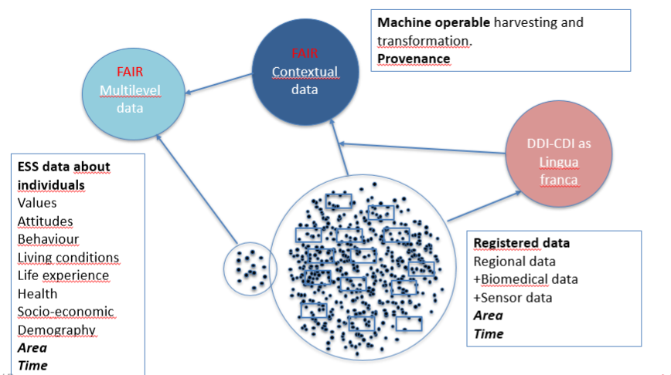
The ESS Multi-Level Application FAIR and Open data

Slide 15
Partners and Contributors
SSHOC
ESS ERIC
Eric Harrison, ESS HQ, City University of London
Hanna Thome Pettersen, Sikt - Norwegian Agency for Shared Services in Education and Research
Hilde Orten, Sikt
Knut Kalgraff Skjåk, Sikt
Arofan Gregory, Consultant, Sikt
Joachim Wackerow, Consultant, Sikt
CESSDA ERIC
Dave Rayner, University of Gothenburg/SND - Swedish National Data Service
Ilse Laze, SND
Iris Alfredsson, SND
ENVRI Consortium
Hannah Clark, IAGOS - In-service Aircraft for a Global Observing System
External contributors:
Kjetil Tørseth, NILU
Øystein Godøy, Norwegian Meterological Institute
ESS ERIC, ESS HQ and Sikt - Norwegian Agency for Shared Services in Education and Research (SP leader)

Slide 16
Milestones – to be revised
"Start" date: April 2021 (M1)
1. Plans for SP integration and implementation (M10)
2. MD standards aligned (M20)
3. Data prepared for the tool (M20)
4. The multilevel data tool upgraded including access management, and tool and Services Registry populated with the new components (M26)
5. Science project integrated based on tests and data analysis (M26)
6. Input to outreach and learning (M28)
7. Documentation and reports delivered to LIFEWATCH (M29)
8. Horizontal services, visible through EOSC portal and catalogues (M30).

Slide 17
Activities autumn 2022
Ongoing activities
Prepare functional specification for the upgrade of the application
Prepare data from different sources for integration
Explore metadata understanding, availability, sources and standards used
Forthcoming
Define metadata ‘profile’ for the application upgrade
Mapping of metadata standards used by data from different sources to DDI-CDI
Development work for the application upgrade starts

Slide 18
Ongoing data harmonisation activities
Three dimensions:
Topical (variables/parameters)
Time (time representation and scope)
Geography (NUTS polygons (ESS), grids (ERA5), geopoints (EEA)

Slide 19
Geograpical mapping - to be explored
Geographic projection
Common denominator needed EPSG 4326, EGPS 3035, other?
Sampling
Find best match in sampling between NUTS polygons (ESS), grid data (ERA5) and geo points (EEA)
Geographic mapping – changes over time
Standards mapping (NUTS 2016, 2021 etc.)
Variable representation of geographic identifiers in ESS, EEA and ERA5 data

Slide 20
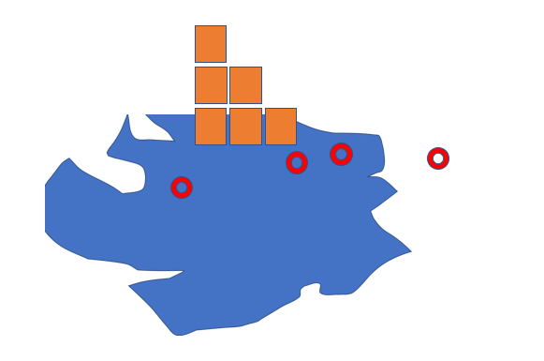
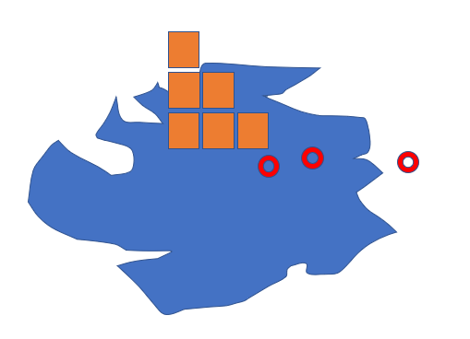
Geographic mapping – changes over time
Time point 1
Time point 2
ESS survey data in NUTS polygons
Grid data, ERA5 reanalyses data
In situ measurement stations, EEA

Slide 21
Prepare data from different sources for integration
Detailed tasks and progress of work

Slide 22
Questions?
Thank you very much for your attention!

