Slide 1
Conceptual framework

Slide 2
Five Safes
Safe dimension | Ritchie et al. assessment | ONDC Principle
Safe projects | Is this use of the data appropriate? | Data is shared for an appropriate purpose that delivers a public benefit
Safe people | Can the researchers be trusted to use it in an appropriate manner? | The user has the appropriate authority to access the data
Safe data | Is there a disclosure risk in the data itself? | Appropriate and proportionate protections are applied to the data
Safe settings | Does the access facility limit unauthorised use? | The environment in which the data is shared minimises the risk of unauthorised use or disclosure
Safe outputs | Are the statistical results non-disclosive? | The output from the data sharing arrangement is appropriately safeguarded before any further sharing or release

Slide 3
Joint and severable
Dimensions are designed so that each can be evaluated independently of the others, as far possible.
All five dimensions need to be considered jointly to evaluate whether a data access system can provide an ‘acceptable’ solution.

Slide 4
Safe projects
Intended use
Fitness for purpose, public benefit, academic contribution, commercial benefit
Context
Ethics
Ethics approval, privacy impact assessment, code of conduct
Risks
Confidentiality, reputation, commercial
End users
Sponsors, research users, funders
What about research programs?
Grouping

Slide 5
Safe people
Desai, Ritchie and Welpton (2016):
Do the users have the necessary technical skills?
Do the users need training in handling confidential data?
Are users likely to follow procedures?
CWG additions:
Past track record
Institutional affiliation
Institutional rules
Institutional support
Institutional legitimacy
Considered further under “Organisations”
Examples: GA4GH and ICPSR “Researcher Passports”

Slide 6
Safe data
Confidentiality and privacy: risk of identification of participants
Sensitivity and security: sensitivity of the data itself (e.g. national security)
Utility: the released data is faithful in critical ways to the original data (analytically valid data)
Useability: Contextual information (often metadata or paradata) is provided that could better support use
Data integrity: does treatment of the data undermine it’s useability
Access conditions: constraints placed on access to data as a condition of use
Challenge of different data types (e.g. SOCEY qualitative data assessment)

Slide 7
Access conditions (data licenses?)
User characteristics e.g., access for staff but not students
Limits on purposes e.g., no use for commercial purposes
Time-limited access to data or work environment (as resources)
Notification on and review of outputs from analysis of the data
Licenses and other documentation required

Slide 8
Safe settings
“whether all parties have taken reasonable steps to ensure data will be used in an appropriately safe and secure environment, i.e. one that minimises unauthorised use, access or loss of data”
Physical environment
IT environment
(Training in use of settings)

Slide 9
DATS Descriptors for Access
Access method | Description
Download | The data are available for download. A license may be required
API | Interaction with the data may be automated via defined communication protocols, i.e., APIs
Remote access | Users may access the data in a secure remote environment (“virtual data enclave”). Individual-level data may not be downloaded, only approved results
Remote service | A user may submit program code or the script for a software package to be executed in a secure data center. The remote site returns outputs. It may perform a review before releasing the results
Enclave | Access is provided to approved users within a secure facility without remote access. Results may remain at the enclave or be released after review

Slide 10
Safe outputs
Characteristics of a princples-based output statistical disclosure control
Researchers and output checkers both trained in SDC
Rules-of-thumb rather than hard rules
Freedom to approve any output in principle
No duty to release any output
Responsibility for producing good output resting with the researcher
Output checkers considering the value of the output
Output checkers considering resource constraints

Slide 11
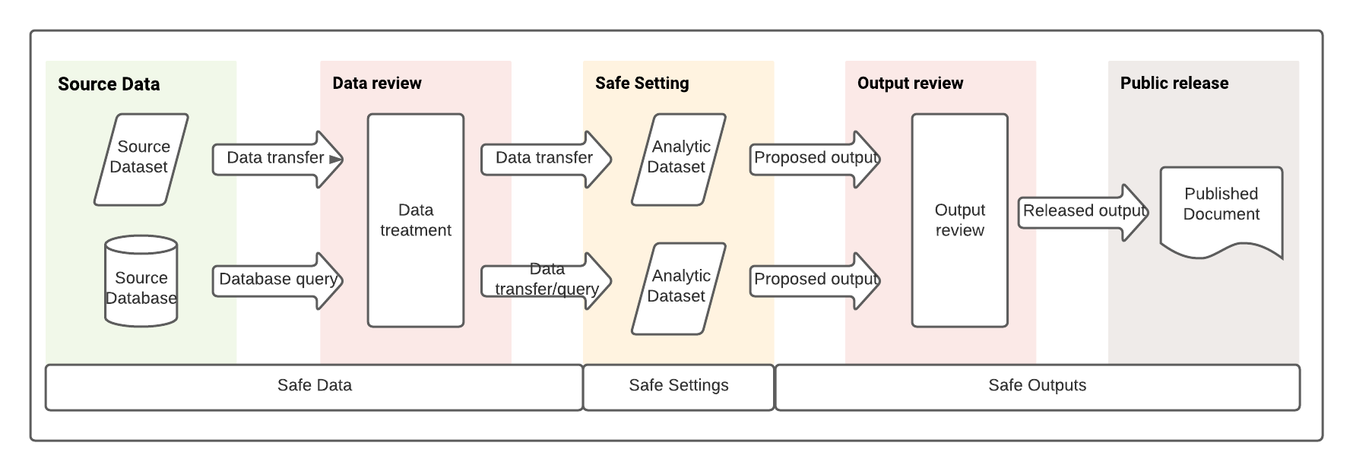
Safe data, settings and outputs

Slide 12
Extensions
Organisations
Affiliations
Roles of people in organisations
Organisations provide:
Legal status
Resources and infrastructure
Legal and ethical control systems for affiliates
Some data sharing agreements require an organisational affiliation
Groups
People in teams/organisations
Projects in programs
Data files in datasets
Datasets in collections
Use of multiple settings
Collected outputs from analysis
Likely to be CILogon

Slide 13
Interactions
Intersection | Example | People | Projects | Data | Settings | Outputs
People and Projects | Data custodians assess the characteristics of the person (such as the type of organisation they work in) in assessing the project. E.g. Can a researcher working in a for-profit company conduct research that is primarily for public benefit, or are the benefits largely private?
Projects and data | Data custodians will assess the project requirements and research questions in determining the content of the dataset to make available for the project
Data and Settings | A data provider will assess the setting and how the data will be accessed in determining what level of treatment to apply to the data prior to transferring it to the setting
Settings and outputs | A data custodian will assess the capacity of the setting to allow review of the outputs in assessing it’s suitability for use
People and settings | Users of settings are required to undertake training in the Five Safes and the specific setting before access to the setting is provided.
People and outputs | Users of settings are trained in suitable outputs for release as part of training programs – a “virtuous circle” model (Ritchie et al., 2017_

Slide 14
Alignments
Alignment | People | Projects | Data | Settings | Outputs
A Person’s role and organisational affiliation
Assessment of suitability of data treatments depends on the setting it will be available in, and whether additional output check will (or can) be undertaken
Whether an intended user has undertaken training (e.g. for a given dataset, for use of a given setting, in production of outputs)

Slide 15
Operationalisation
Data Use Ontology
Data Tags Suite
AAF attributes
CILogon

Slide 16
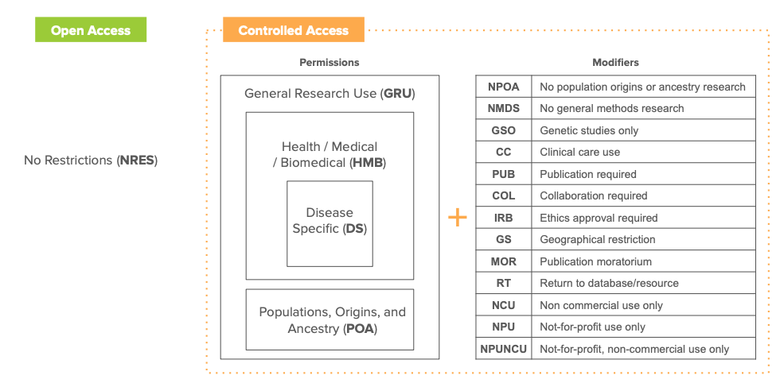
Data Use Ontology

Slide 17
DUO and the Five Safes
Five Safes dimension | DUO permissions | DUO modifiers
(Non-specific) | NRES - No Restrictions
People |  | GS – Geographical restriction COL – Collaboration required US – User specific restriction
(Organisations) |  | Institution specific restriction NPUNCU – Not-for-profit, non-commercial use only*
Projects | GRU – General Research Use Health/Medical/Biomedical (HMB) Disease specific (DS) Populations, Origins, and Ancestry (POA) | NPOA – No population origins or ancestry research NMDS - No general methods research GSO – Genetic studies only CC – Clinical care use IRB – Ethics approval required NCU - Non-commercial use only NPU – Not-for-profit use only NPUNCU – Not-for-profit, non-commercial use only* PS - Project specific restriction TS - Time limit on use
Data | (None) | (None)
Settings | (None) | (None)
Outputs |  | PUB – Publication required MOR – Publication moratorium RT – Return to database/resource
Australian Survey of Social Attitudes (2020) | Longitudinal Survey of Australian Youth
DOI: http://dx.doi.org/10.26193/C86EZG | DOI: http://dx.doi.org/10.4225/87/PJO7GB
Data Use Limitations GRU - General Research Use - DUO_0000042 | Data Use Limitations GRU - General Research Use - DUO_0000042
Modifiers PS - Project specific restriction – DUO_0000027 | Modifiers PS - Project specific restriction – DUO_0000027 GS - Geographic restriction – DUO_0000022
Custom metadata block?

Slide 18
Data Tags Suite (Alter et al., 2020)
Authorisation
Authentication
Access
Aligns with DUO and other standards

Slide 19
Data Authorisation
Authorisation type | Description
None | Not covered by a DUA
“Click through” online license | Users must agree to an online agreement without providing additional identification
Registration | Users must register before access is allowed and agree to conditions of use. Registration information may be verified
DUA signed by an individual | An agreement signed by the investigator is required. DUAs may require additional information, such as a research plan and an IRB review (see discussion of licenses below)
DUA signed by an institution | An agreement signed by the investigator’s institution is required. DUAs require additional information, such as a research plan and an IRB review (see discussion of licenses below)

Slide 20
Data Authentication
Authentication type | Description
None | No authentication required
Simple login | Single-factor login or the use of an authentication key or registered IP address is required
Multi-factor login | Multiple-factor login using a combination of IP address, password protection, authentication key, or other forms of authentication

Slide 21
Data Access
Access method | Description
Download | The data are available for download. A license may be required
API | Interaction with the data may be automated via defined communication protocols, i.e., APIs
Remote access | Users may access the data in a secure remote environment (“virtual data enclave”). Individual-level data may not be downloaded, only approved results
Remote service | A user may submit program code or the script for a software package to be executed in a secure data center. The remote site returns outputs. It may perform a review before releasing the results
Enclave | Access is provided to approved users within a secure facility without remote access. Results may remain at the enclave or be released after review

Slide 22
Applying the 3 As to ADA
Dimension | ADA Open | ADA General | ADA Special (e.g. Ten to Men)
Authorisation | None | Registration* | DUA signed by an individual
Authentication | None | Simple login | Simple login
Access | Download | Download | Download

Slide 23
Combining DUO and DATS – Ten To Men
DUO Dimensions | Ten To Men Release 3
DOI | http://dx.doi.org/10.26193/JDE1TD
Data Use Limitations | GRU - General Research Use - DUO_0000042
Modifiers | PS - Project specific restriction – DUO_0000027 US – User specific restriction (Institution-specific restriction??)
DATS Dimension | Ten To Men Release 3
Authorisation | DUA signed by an organisation (or individual?)
Authentication | Simple login
Access | Download

Slide 24
Aligning standards and the Five Safes
Five Safes dimension | Proposed identifier/PID | Relevant standards/frameworks
People | ORCID?? | AAF attributes, Data Use Ontology (DUO), Scholix/ResearchGraph??
Projects | RAID | Data Use Ontology (DUO), Data Tags Suite (DATS)
Data | DOI | DataCite, DCAT, Scholix/ResearchGraph??, Others??
Settings | (RAID??) | Data Tags Suite (DATS)
Outputs | Handle, DOI | Data Use Ontology (DUO)
Organisation | ROR | Data Use Ontology (DUO)
Group | ??? | CILogon

Slide 25
Aligning standards and the Five Safes (Alternative)
Five Safes dimension | Proposed identifier/PID | Custodian requirements specification | Information source for provision
People | ORCID?? | Data Use Ontology (DUO) | AAF attributes, Scholix/ResearchGraph??
Projects | RAID | Data Use Ontology (DUO), Data Tags Suite (DATS) | (CADRE specification)
Data | DOI | ??? | DataCite, DCAT, Scholix/ResearchGraph??, Others??
Settings | (RAID??) | Data Tags Suite (DATS) | (CADRE specification?? Existing standard??)
Outputs | Handle, DOI | Data Use Ontology (DUO) | DataCite, DCAT, Scholix/ResearchGraph??, Others??
Organisation | ROR | Data Use Ontology (DUO) | ROR specification (who is ROR provider?)
Group | ??? | ??? | CILogon
Initial work on information model https://cloudstor.aarnet.edu.au/plus/s/u6SdXBELo5s08Go

Slide 26
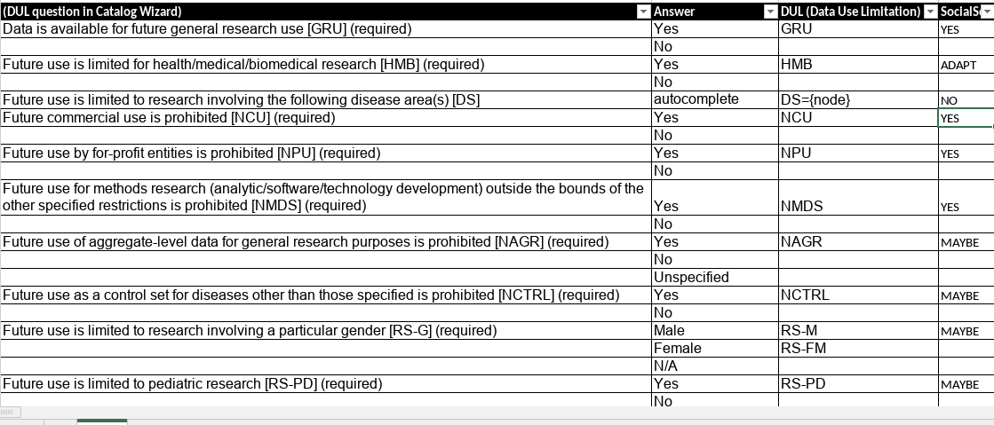
Sample questions for custodians – defining data access conditions (Source: DUO specification)
https://cloudstor.aarnet.edu.au/plus/f/5938010800

Slide 27
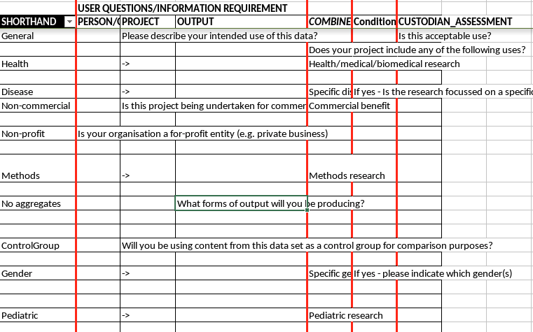
Sample questions for users - meeting conditions

Slide 28
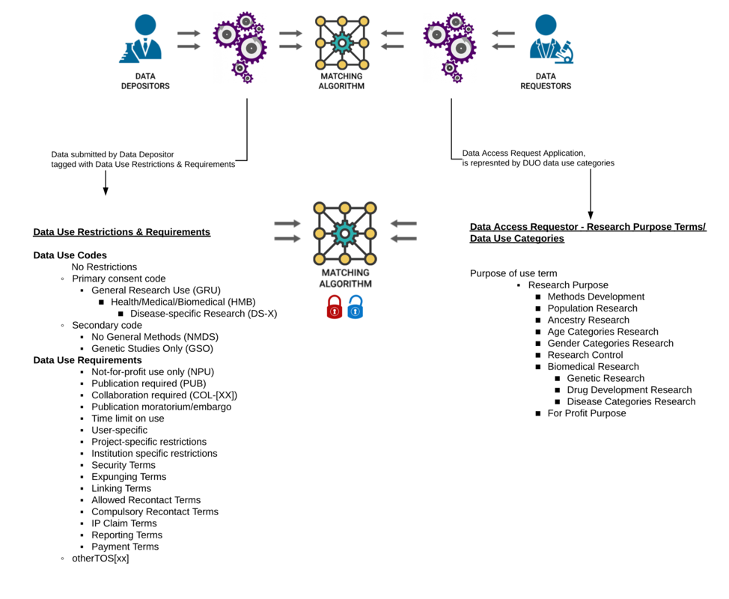
Matching Restrictions and Requests (DUO)
https://github.com/EBISPOT/DUO/raw/master/doc/figs/DUO_matching.png

Slide 29
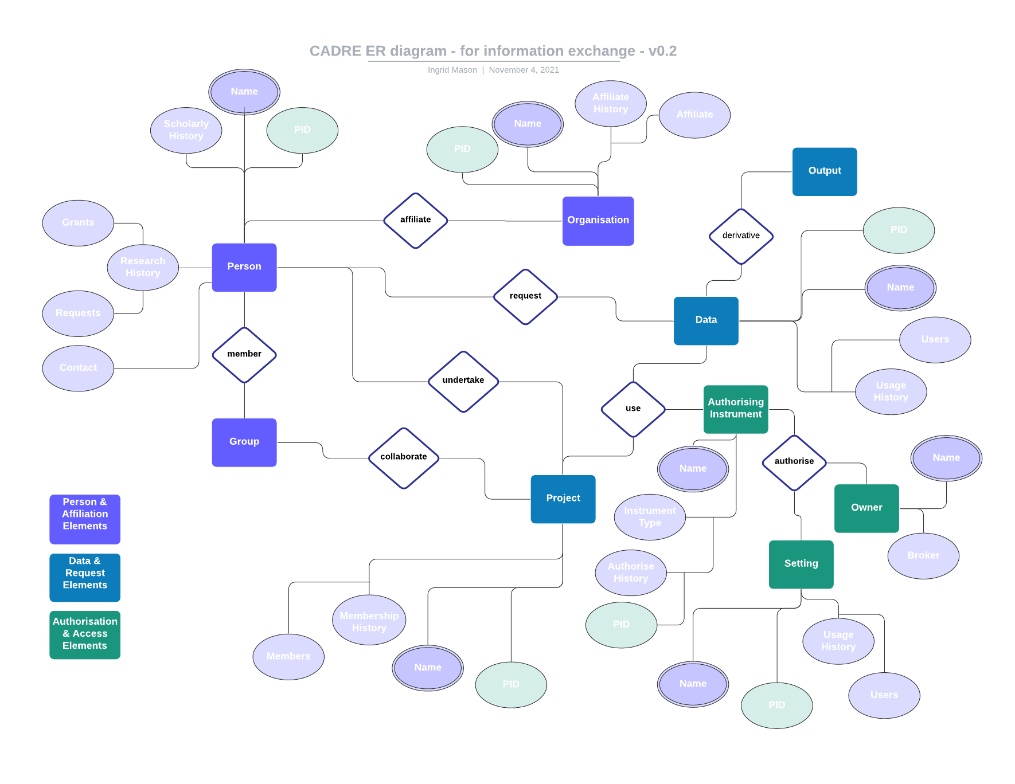
CADRE ER diagram
https://cloudstor.aarnet.edu.au/plus/f/5984726369

