Slide 1
INSPIRE Network

Slide 2
INSPIRE background
The INSPIRE Data Hub is a FAIR data resource containing longitudinal population health data from HDSSS in southern and eastern Africa
Demonstrates ability to combine population health data with data from other sources, notably routine healthcare data from clinics
It is designed to be both scalable and extensible, based on international standards, allowing for additional data in without requiring a new hub infrastructure
INSPIRE aims to benefit from WORLDFAIR, as part of a broader, global data-sharing infrastructure for health research

Slide 3
Introduction
The Vision is to build a network for users and producers of longitudinal, population-based health data. This network will include a data hub that will produce FAIR data that can be used by researchers and policy makers to answer important policy relevant questions.
INSPIRE objectives
Building the network – increase HDSS sites
The long-term goal is to provide a robust pan-African platform for data integration
Promoting knowledge of FAIR in Africa
The hub is designed to coordinate with other African initiatives such as the national network service providers (NRENs) and the African Open Science Platform (AOSP)

Slide 4
GOVERNANCE STRUCTURE
Partnership Forum - Liaisons (focal points) from the member LPSs
Management work stream
Lead: KIRAGGA
- Fundraise
- Convene
- Connect
- Guide
Executive Directorate
- Executive Director of APHRC
- PI from either ALPHA Network or SAPRIN or CODATA
Board of Management
Knowledge Translation work stream
Lead: TAYLOR
- Policy engagement
- Dissemination
- Catalyze
Secretariat - Hosted at APHRC and led by a Program Manager
Capacity Strengthening work stream
Lead: TODD
- Teaching
- Academic
Data Mesh work stream
Lead: GREENFIELD
- Anonymization
- Storage
- Sharing
Data Analytics work stream
Lead: MUYINGO
- Standardization
- Harmonization
- Catalyze

Slide 5
INSPIRE network and OHDSI/OMOP
OMOP CDM Use cases
IDSR data into OMOP (disease surveillance)
DHIS-2 data
National COVID-19 data in 4 African countries (funded by IDRC Canada)
COVID-19 excess mortality into OMOP
Longitudinal HIV data (Alpha network) into OMOP
Training
Completion of basic modules to introduce OMOP databases
Advanced modules are being developed
Hosting the training material on the website www.InspireData.network

Slide 6
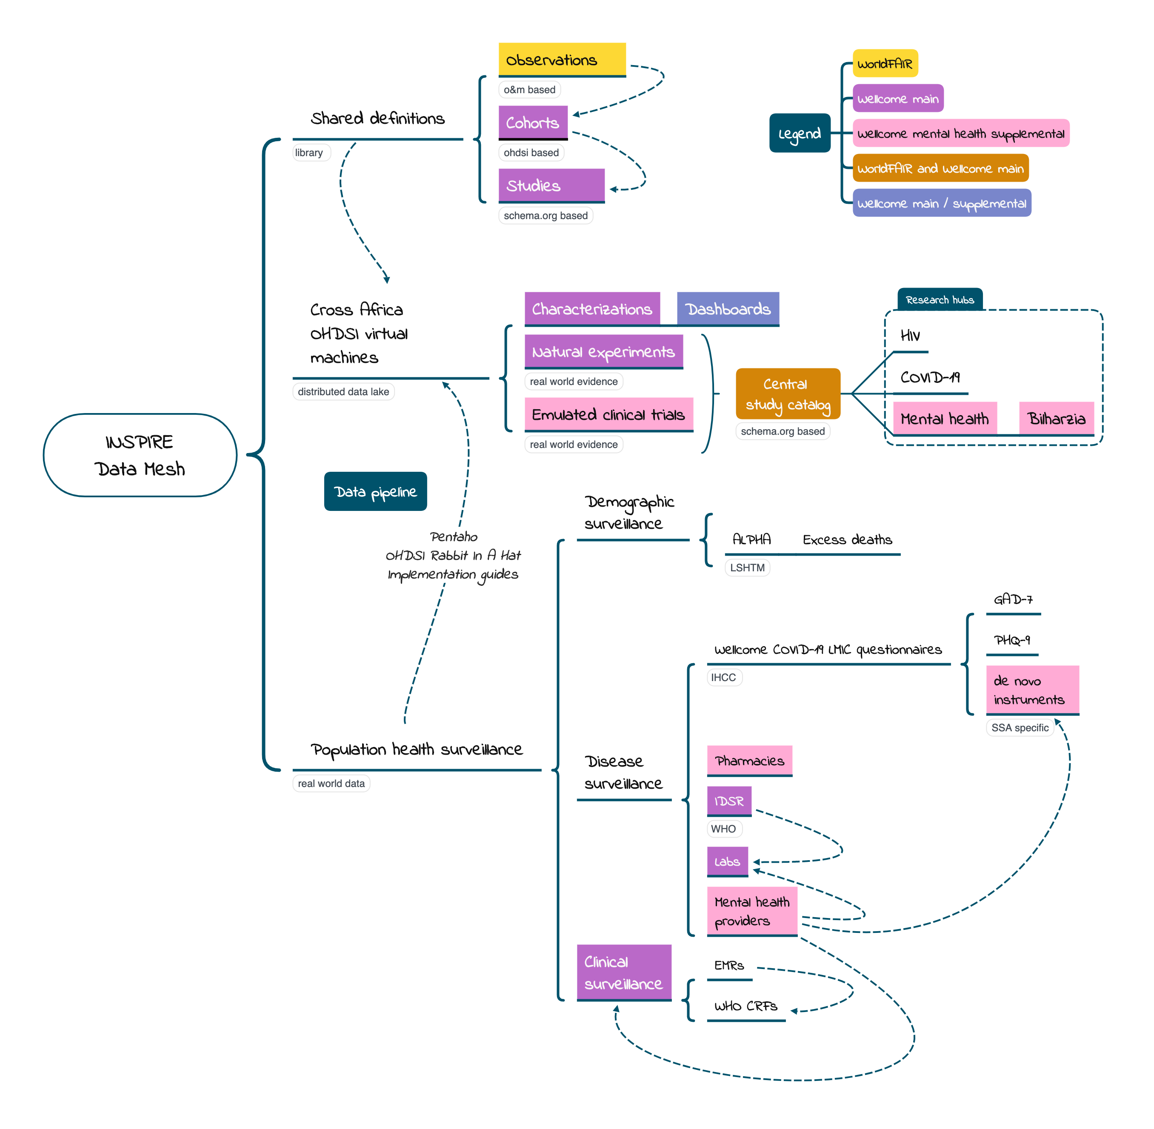
Data Mesh/Web

Slide 7
FAIR INSPIRE data
OMOP CDM
Biomedical Observational Study Cookbook
Studies are conducted on top of observations leveraging a design template from schema.org
Research Results by Study Factors
Multidimensional data with aggregate measures
Integrates with location level exposure data
The template includes OHDSI extensions for cohort definitions, analysis approach and federated research
Along with study factors, dimensions may include geoms and time periods
The same aggregate measure may have several statistics
Exposures are sampled and may include both the exposure dose and the absorbed dose
Observations come from labs registries, questionnaires, clinics, hospitals, story tellers, supply chains, ports of entry and/or pharmacies
The federated research extension enumerates multiple partner databases
Each measure comes with an attribute describing its provenance
Fit for UN SDG indicator reporting and MoH dashboards
FAIRification across one or multiple data sources as needed occurs by way of OMOP
Study descriptions and data access instructions appear in Google Dataset Search
Fit for sentinel surveillance
OHDSI Services
Data partners may have their own OMOP CDM instances through which they either contribute to a central repository, share individual datasets ad hoc, and/or provide aggregates to a research data cube

Slide 8
Some data sharing user stories that come to mind…
INSPIRE data sharing models
The platform used simply as a FAIRification service by an individual research center
Research centers can use the platform to conduct a single study across geopolitical boundaries
Research centers share person-level data in a secure data enclave or a more open data repository
Research data centers can to share study aggregates

Slide 9
Acknowledgement
APHRC
Damazo Kandegye, Sylvia Muyingo, Marylene Wamukoya
LSHTM
Jim Todd, Tathagata Bhattacharjee, Keith Tomlin
MUBAS
Amelia Taylor, Tuntufye Mwayongo
SAPRIN
Linda Maoyi
CODATA
Jay Greenfield, Simon Hodson, Arofan Gregory

