Slide 1
Making Data Work for Global Grand Challenges: DDI-CODATA Collaboration, DDI-CDI, CDIF and WorldFAIR
Simon Hodson
Executive Director
CODATA
www.codata.org
Interoperability for Cross-Domain Research
Schloss Dagstuhl
29 August 2022

Slide 2
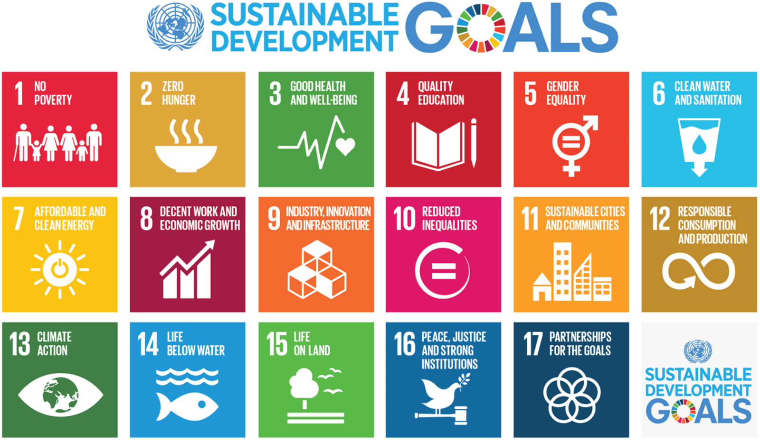
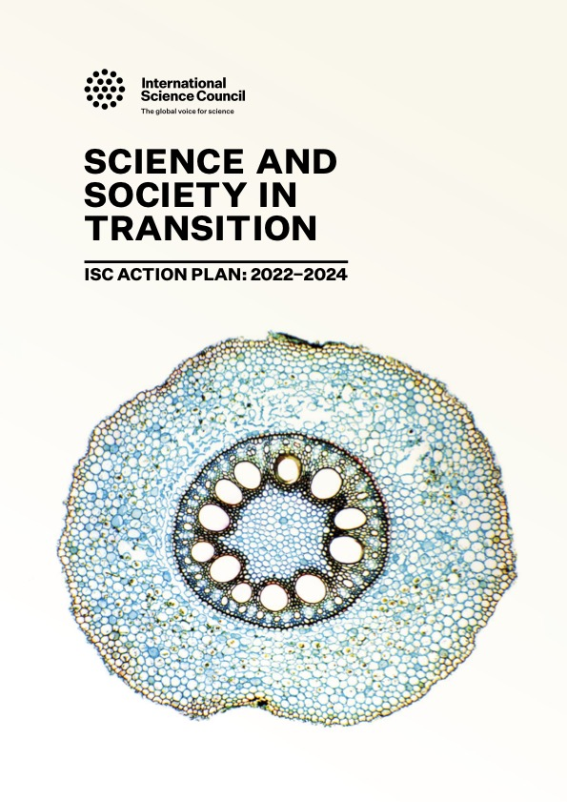
Making Data Work for Cross-Domain Grand Challenges
ISC Action Plan entrusts CODATA with an initiative ‘Making Data Work for Cross-Domain Grand Challenges’: establish a global (decadal) programme to address these issues.
The major, pressing global scientific and human issues of the 21st century can ONLY be addressed through research that works across disciplines to understand complex systems, and which uses interdisciplinary and transdisciplinary approaches to turn data into knowledge and then into action.
Preparatory Phase: exploring technical issues and case studies through Dagstuhl workshops, TGs and WGs, funded projects etc, to understand the challenges and prepare the programme.
Core Interoperability Framework: units, vocabularies, data structure, data description…
Case Studies: in a range of domain and cross-domain research areas.
WorldFAIR Project: takes this approach forward in the context of an EU-funded project.

Slide 3
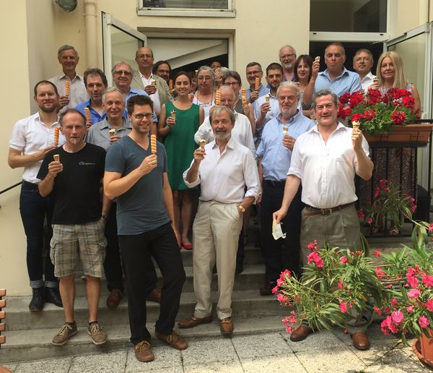
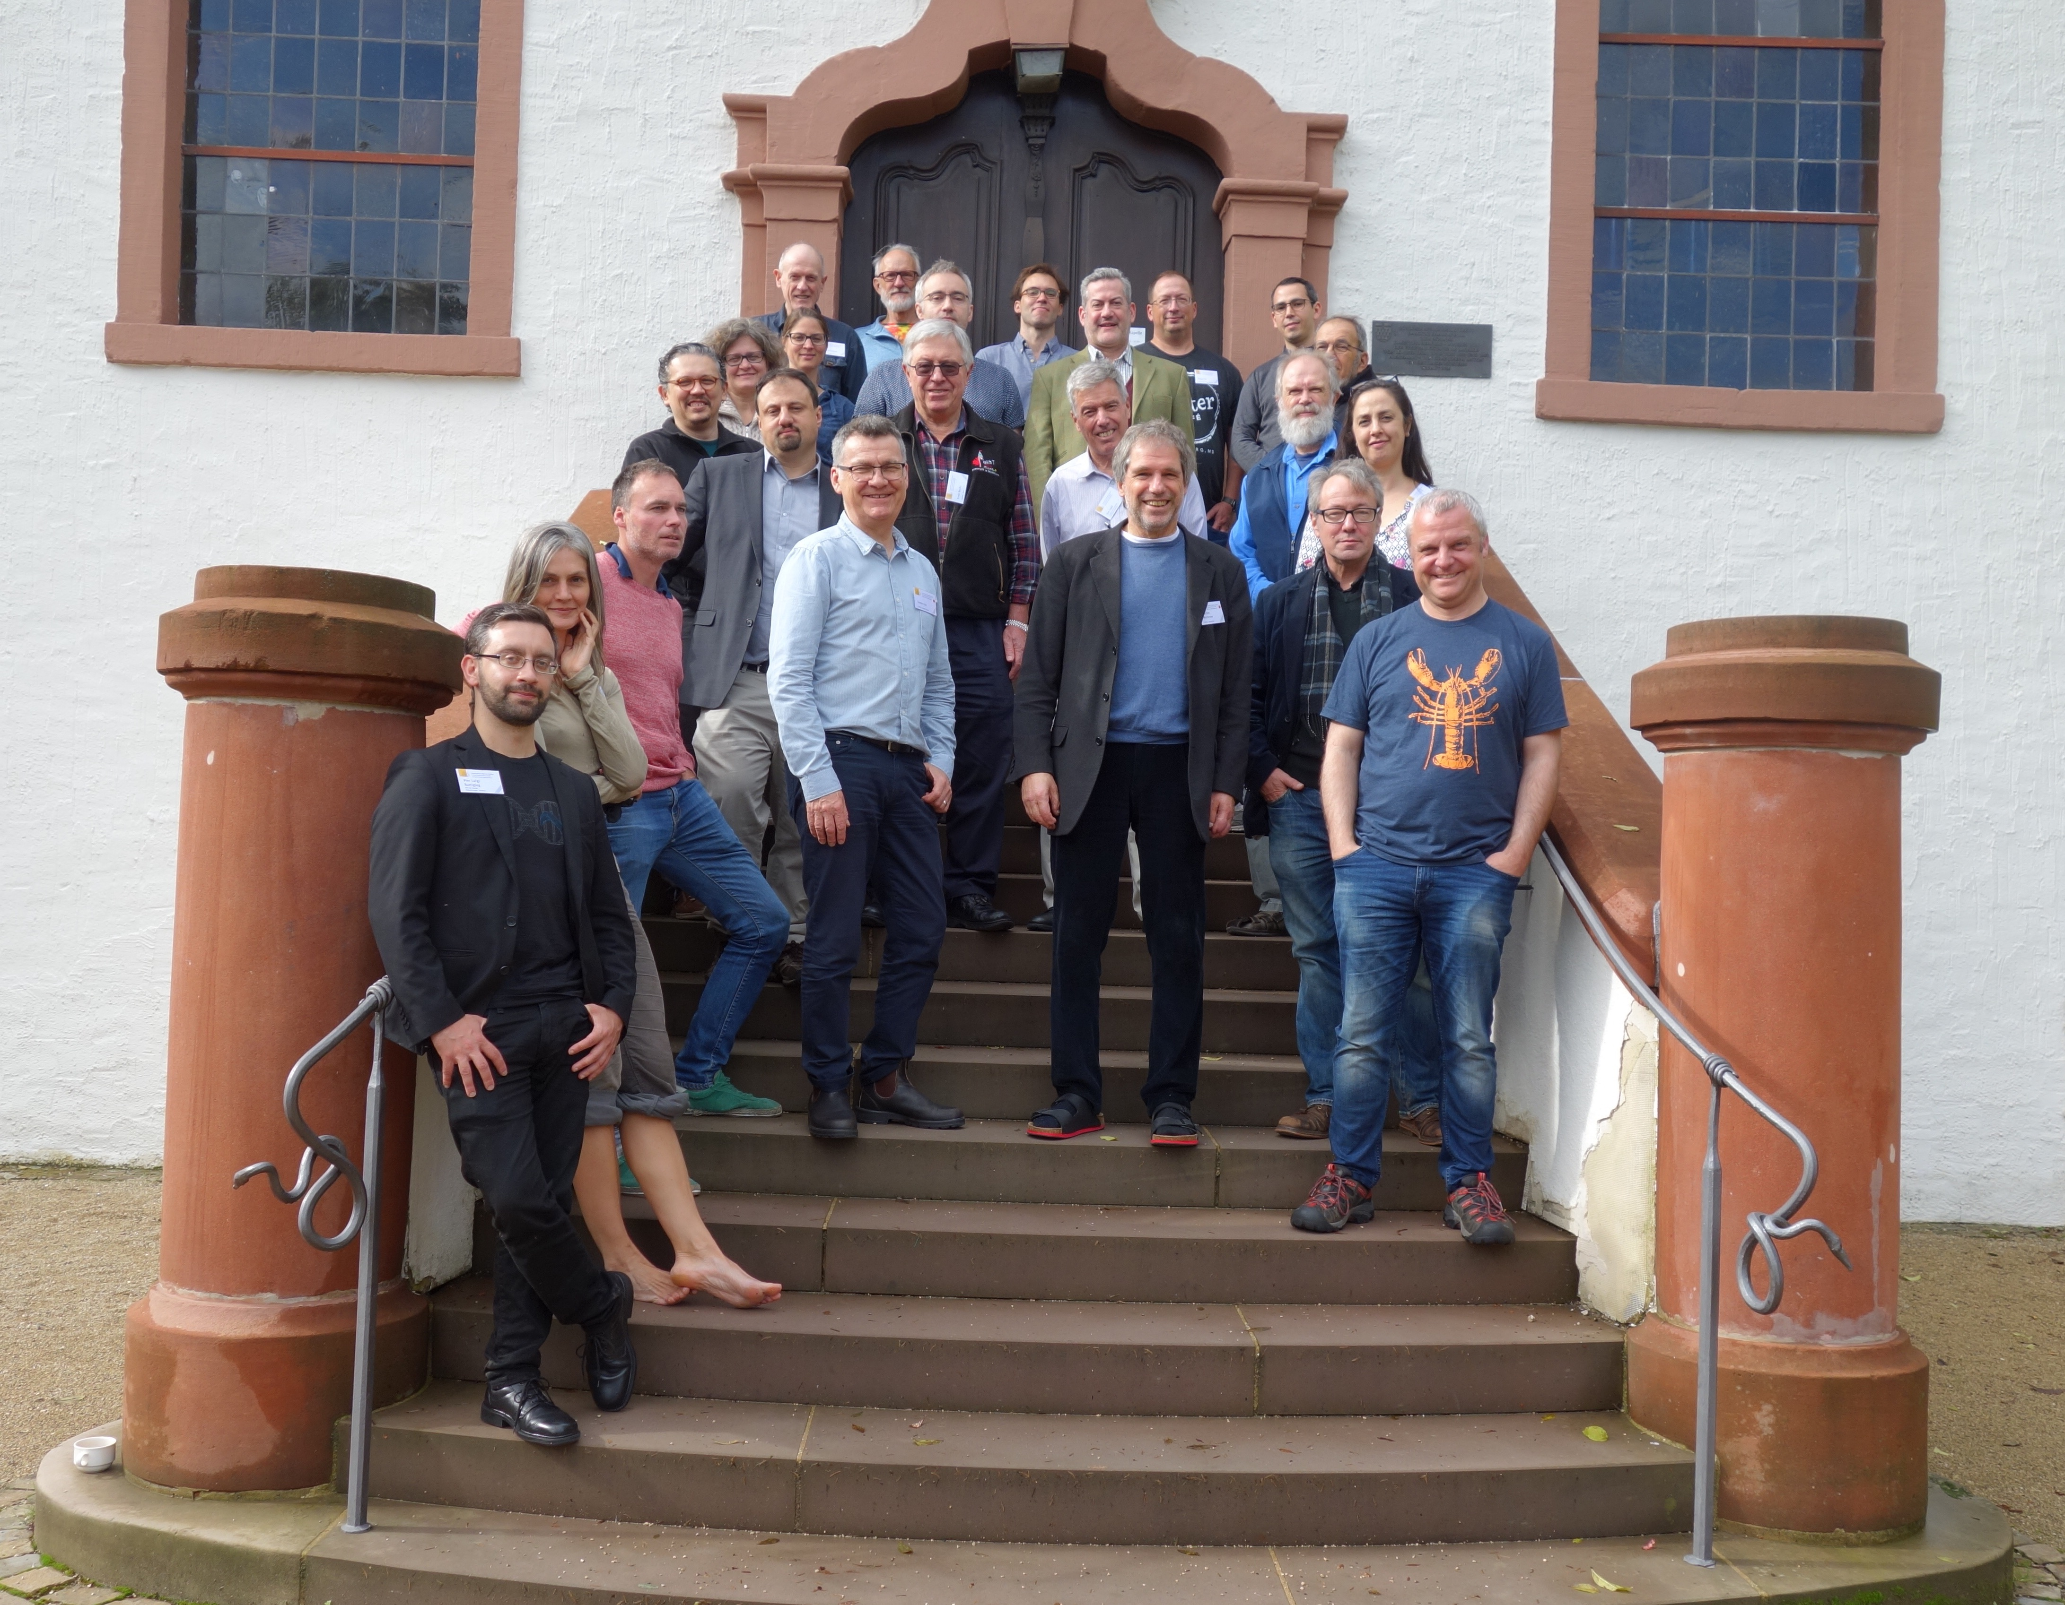
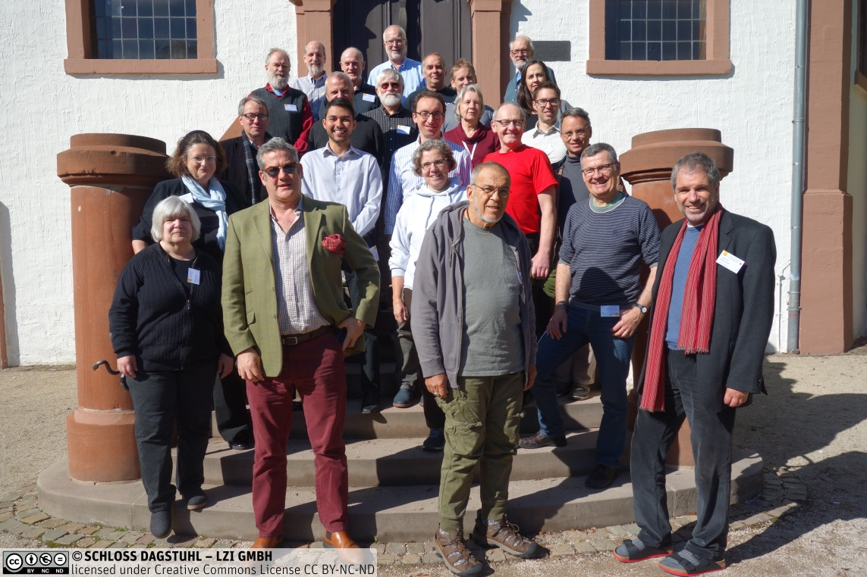
Preparatory Activities
Series of exploratory workshops
Two workshops in 2017, in Paris (ISC-CODATA) and London (Royal Society) launched the activity.
Series of Dagstuhl Workshops: 2018, 2019, 2021 (cross-domain and vocabularies) and 2022!
Related outputs and activities
DDI Alliance work on DDI-CDI
Cox et al. group (formed at Dagstuhl) produced ‘10 Simple Rule for Making a Vocabulary FAIR’ https://arxiv.org/abs/2012.02325
IUSSP-CODATA WG on FAIR Vocabularies in Population Science http://bit.ly/IUSSP-CODATA-FAIR-Vocabs
CODATA TG on DRUM (Digital Representation of Units of Measure)
Continuing engagement with various case studies
Including infectious disease/epidemiology work on Ebola, COVID; urban health (including ISC UHWB Programme and Salurbal); DRR including ISC activities and CODATA TG; case studies from DDI-CDI report; and more.

Slide 4
The Role of DDI-CDI in EOSC: Possible Uses and Applications
DDI-CDI (Cross Domain Integration) is designed to interface with other standards and to help interoperability and integration of data between different data types, standards, formats.
EOSC co-creation project to explore uses and applications and make recommendations for EOSC and the specification.
The Role of DDI-CDI in EOSC: Possible Uses and Applications, final report https://doi.org/10.5281/zenodo.4707263
Report examines the challenge for EOSC: issues of scale and the challenge of cross-domain data reuse.
Presents examples of how DDI-CDI can be used in data integration and cross domain use cases; describes how DDI-CDI can interact with other standards, notably DCAT; describes how DDI-CDI fits into a FAIR Ecosystem of FAIR Digital Objects; describes how DDI-CDI can be implemented in the Dataverse platform.
Series of webinars to assist review of specification: http://bit.ly/DDI-CDI-webinar-series

Slide 5
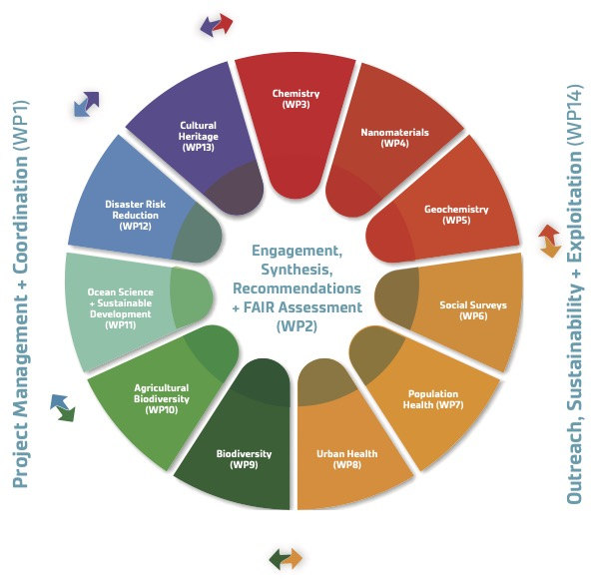
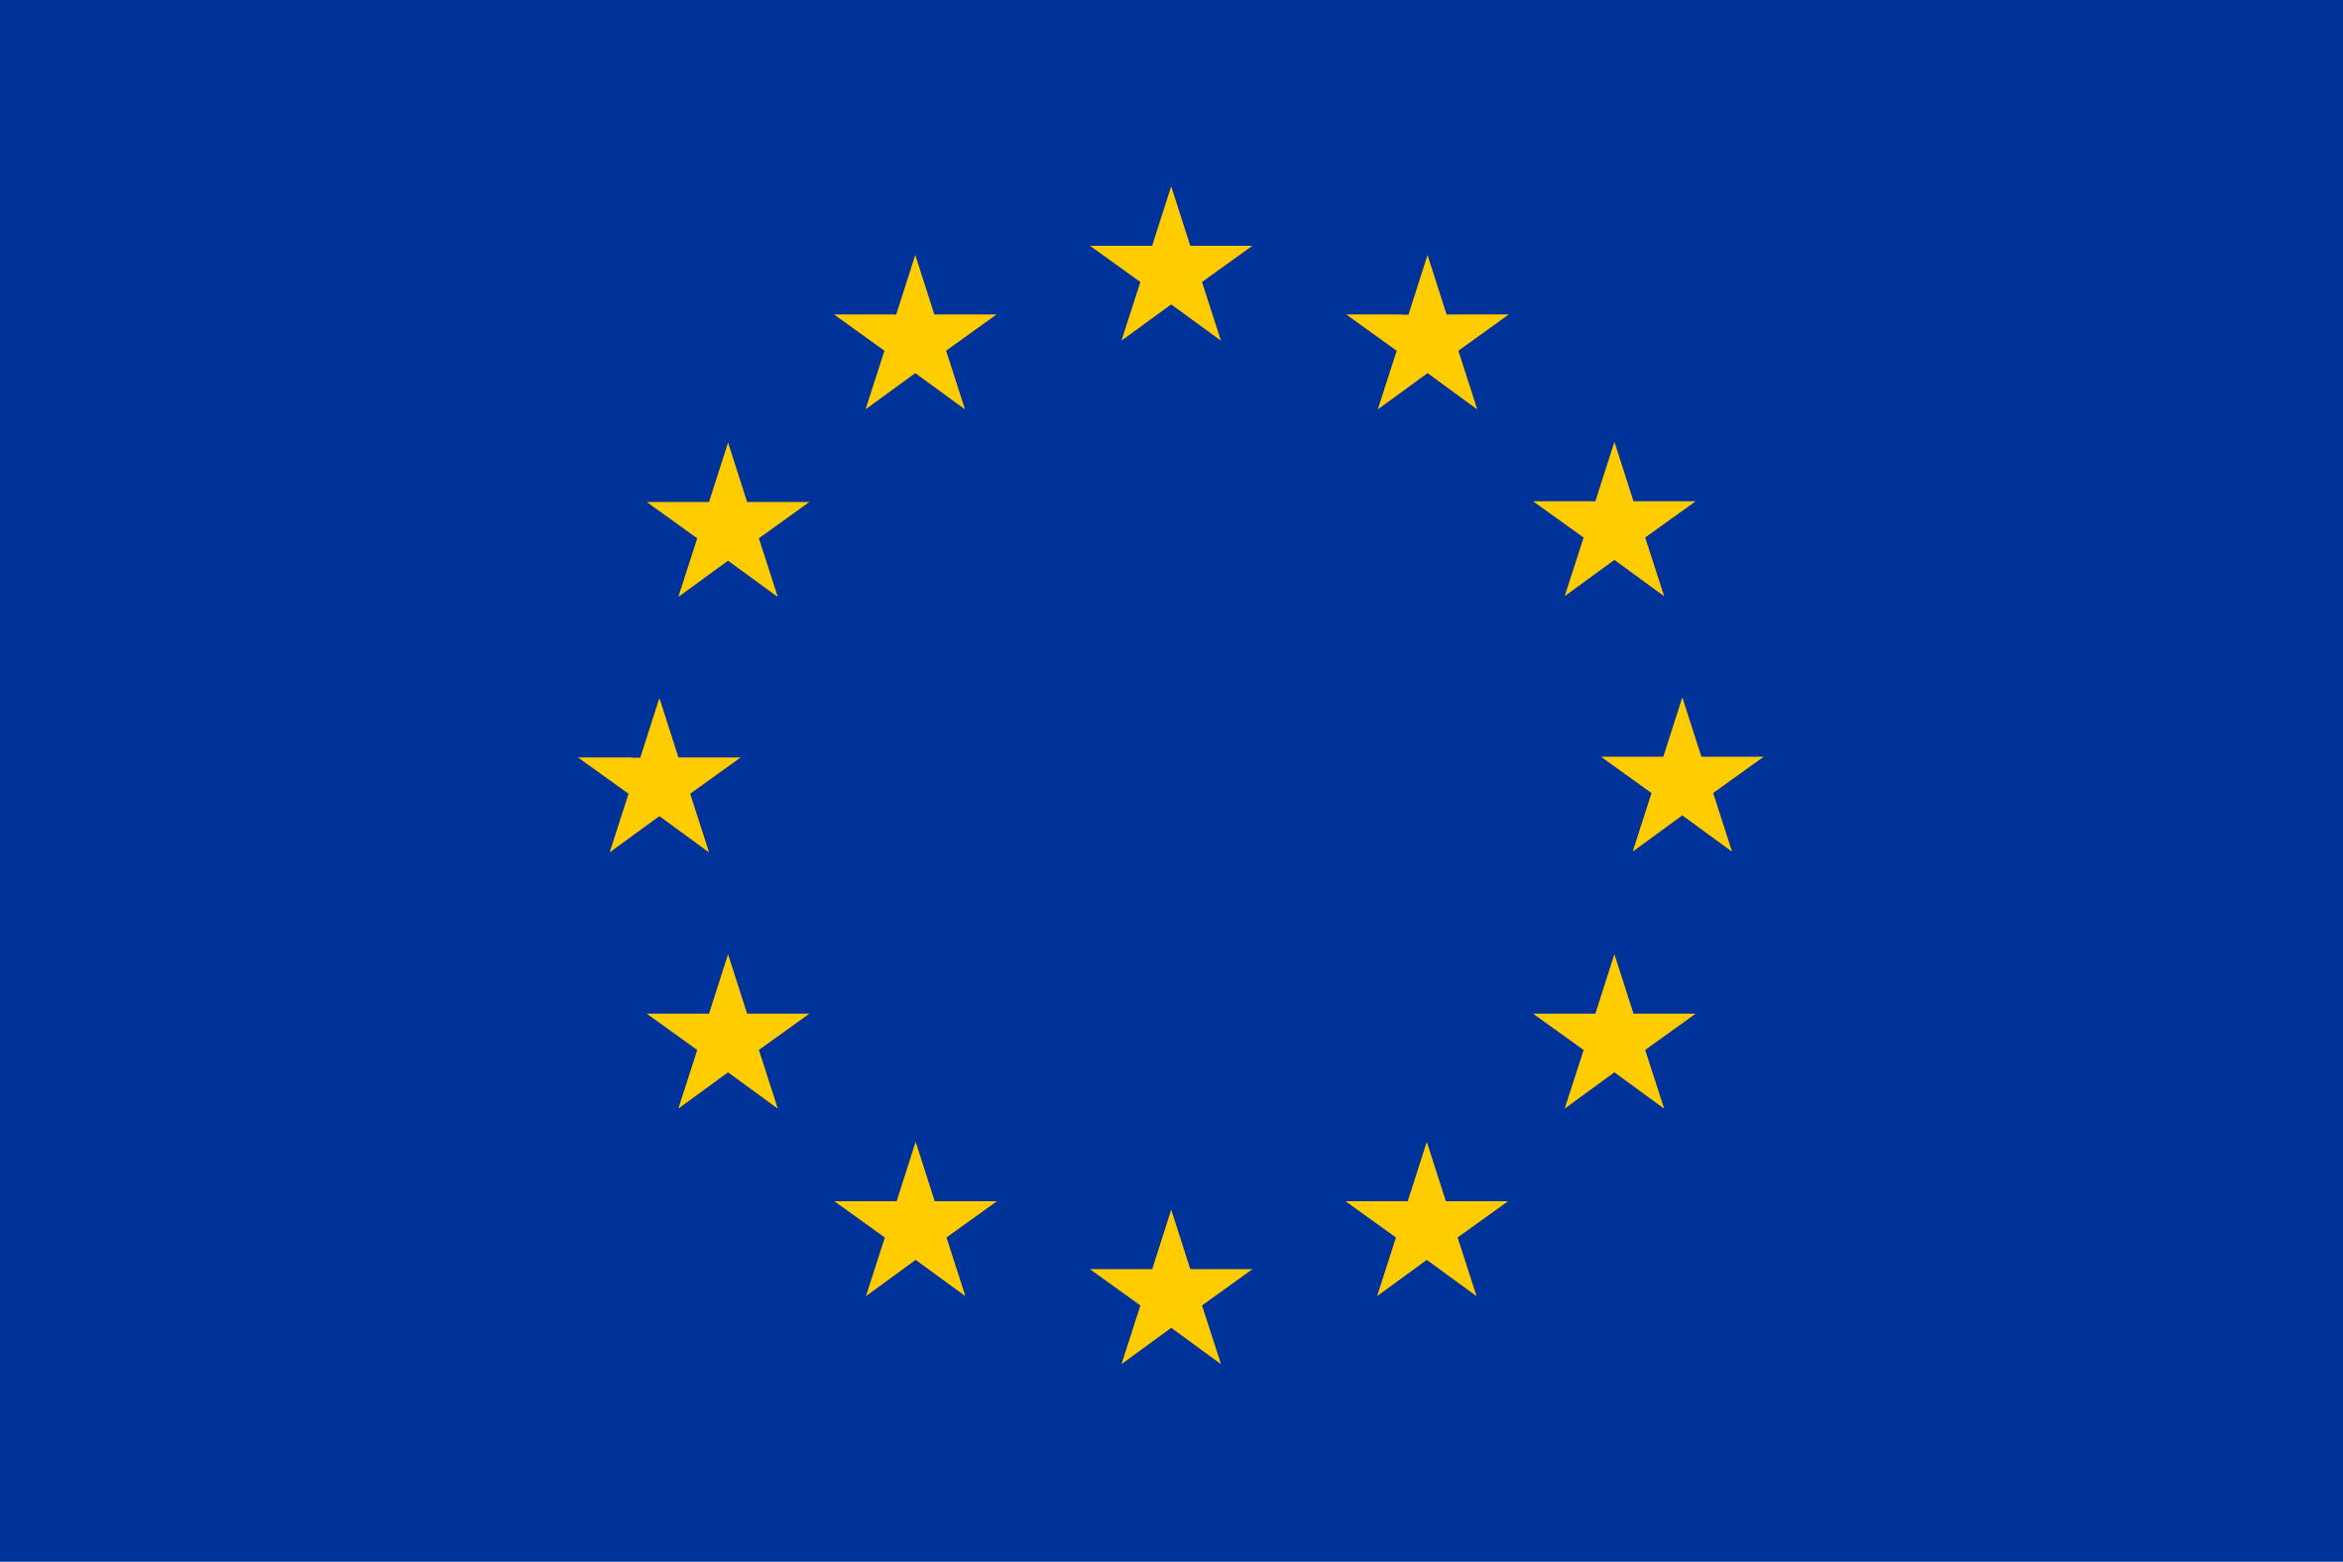
WorldFAIR: Global cooperation on FAIR data
policy and practice
Two year project to advance implementation of the FAIR principles in a range of disciplines, or cross-disciplinary research areas.
Funded by the European Union, HORIZON-WIDERA-2021-ERA-0 — Project: 101058393
Two years from 1 June 2022.
Nineteen partners.
Institutions in France, Belgium, Cyprus, Denmark, Germany, Ireland, Norway; Australia, Brazil, Kenya, New Zealand, USA; UK.
Important partnership between CODATA and Research Data Alliance.

Slide 6
WorldFAIR
Among the most important, but most challenging, recommendations of the Turning FAIR into Reality report, is R.4:
‘Develop interoperability frameworks for FAIR sharing within disciplines and for interdisciplinary research: Research communities need to be supported to develop interoperability frameworks that define their practices for data sharing, data formats, metadata standards, tools and infrastructure. To support interdisciplinary research, these interoperability frameworks should be articulated in common ways and adopt global standards where relevant.’
UNESCO Recommendation on Open Science and ISC Action Plan make similar recommendations.
CODATA-ISC Decadal Programme and WorldFAIR project.

Slide 7
WorldFAIR Case Studies
Chemistry - making IUPAC assets FAIR
Nanomaterials - applying NanoInchi and FAIR recommendations in Nanosafety.
Geochemistry - recommendations for FAIR in geochemistry, particularly vocabularies.
Social Surveys Data – data harmonisation between ESS and AussiESS.
Population Health - INSPIRE - Integration of population surveys with clinical and genomics data for COVID-19 research in eastern and southern Africa.
Urban Health - terminologies and making urban health data FAIR
Biodiversity – improving GBIF data model in collaboration with TDWG - GBIF (Global Biodiversity Information Facility)
Agricultural Biodiversity - pollinator data (KALRO, Embrapa, Meise, HiveTracks)
Ocean Science - Implementing FAIR in the ODIS (Ocean Data and Information System) for the UNESCO Oceans’ decade.
Disaster Risk Reduction - recommendations on making DRR data and terminologies FAIR, case studies in Africa and Pacific Islands
Cultural Heritage - recommendations on making cultural heritage data FAIR (particularly digital representation of heritage artefacts)

Slide 8
WorldFAIR Cross-Domain Interoperablity
Each case study will explore aspects of FAIR implementation in their domain and cross-domain research area.
FAIR Implementation Profiles (how do you implement FAIR, what are the FAIR enabling resources that you use?)
Exploring features of a Cross-Domain Interoperability Framework with case studies from a range of research areas.
Units, vocabularies, data description, data structure, provenance…
Recommendations for domain sensitive FAIR assessment.
Practical Cross-Domain Data Sharing: Envisioning a Core Interoperability Framework: https://bit.ly/cross-domain-IF-webinar
Explicitly aim to add additional Case Studies through further funding and collaboration.

Slide 9
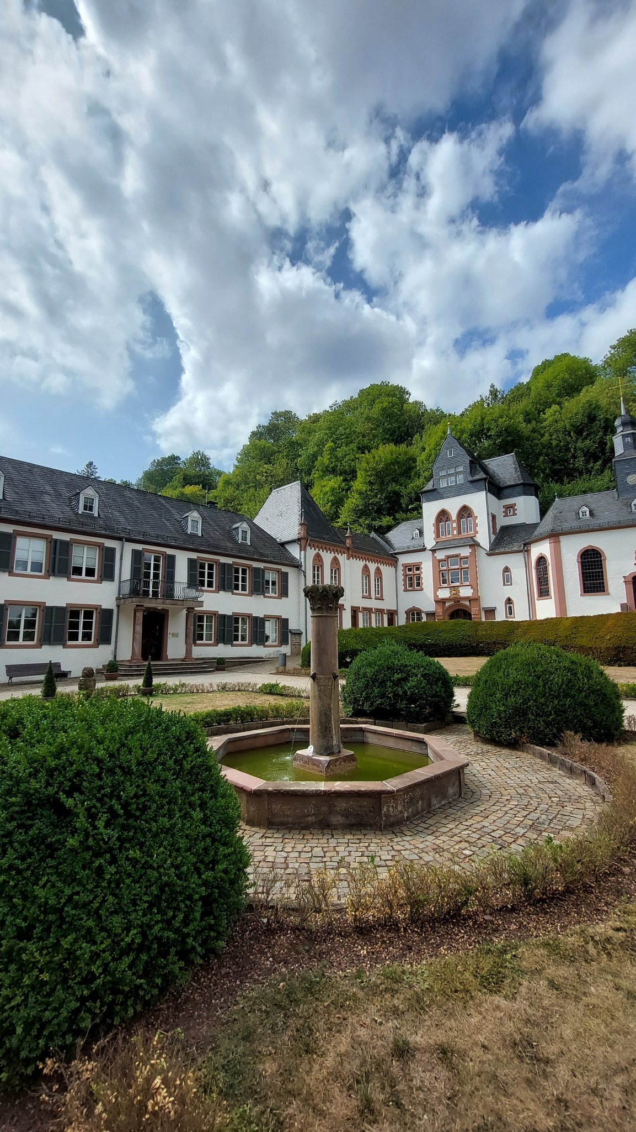
Dagstuhl 2022
A set of very rich case studies, some with sustained engagement and a mutual understanding of what we’re trying to do.
An increasingly mature idea of the functional components of interoperability and therefore what might compose a CDIF.
Good collaborations, building on a number of years and now enhanced by the WorldFAIR project.
Image credit, Ari Asmi, twitter

Slide 10
Thank you for your attention Simon Hodson, CODATA www.codata.org simon@codata.org @simonhodson99 ; @CODATAnews

Slide 11
Making Data Work: programme design
1: Making Data Work
Programme of technical and consensus building activities for interoperability
Programme design comprises three broad work areas.
Consensus and technical solutions for data interoperability (terminologies, ontologies, metadata, machine learning);
Mobilising domains and breaking down silos (working with Unions, Associations and other domain organisations);
Advancing solutions through cross-domain case studies.
2: Mobilising Domains and Breaking Down Silos
3: Advancing Interoperability through Cross Domain Case Studies

Slide 12
Making Data Work for Cross Domain Grand Challenges
1: FAIR Vocabularies
Promote use of community vocabularies, terminologies
Current Technical Work and Collaborations focussing on three areas
FAIR Vocabularies
FDOs and FIPs
DDI-Cross Domain Integration
Applying these to cross-domain case studies: including resilient and healthy cities, infectious diseases, policy monitoring (SDGs, Sendai etc).
Funding proposal underway to considerably expand these cases studies.
3: Further Develop DDI-CDI
Cross Domain Integration specification to assist machine processing.
2: FDOs and FIPs Particularly important for processing

