Slide 1
The Fully-Described Observation
ISO Observations, Measurements and Samples (ISO 19156),
together with Related Standards
Kathi Schleidt
DataCove e.U.
Jay Greenfield
CODATA

Slide 2
Observations, Measurements and Samples
ISO 19156:2011 Geographic information — Observations and measurements (O&M)
Currently under update as: ISO/DIS 19156:2022 Geographic information — Observations, measurements and samples (OMS)
Part of the ISO 191XX Suite of Spatial Data Standards
OGC provides as Abstract Topic 20
Widely utilized across diverse areas from Environmental Monitoring to Smart Cities and Digital Twins

Slide 3
InteroperAble Descriptions of Observable Property Terminology (I-ADOPT)
Created by the Research Data Alliance Working Group on InteroperAble Descriptions of Observable Property Terminology
A community-agreed framework for representing observable properties
Where possible integrating existing terminologies pertaining to what is observed or measured

Slide 4
Observational (Meta)Data
Room 236
observed Property:
Color
host:
Kathi
Observation
Swatch Comparison
observer:
procedure:
color:
YELLOW
featureOfInterest:
result:
featureOfInterest:
result:
HAPPY
expression:
Kathi
observer:
procedure:
Face Recognition
"smiley": {
"color": "Yellow",
"expression": "Happy"
}
host:
observed Property:
Expression
Room 236

Slide 5
Observational (Meta)Data
Room 236
observed Property:
Color
host:
Kathi
Swatch Comparison
observer:
procedure:
Color:
YELLOW
featureOfInterest:
result:
featureOfInterest:
result:
HAPPY
Expression:
Kathi
observer:
procedure:
Face Recognition
host:
observed Property:
Expression
Room 236

Slide 6
Observational (Meta)Data
April 7th
host:
Room 236
observed Property:
Color
observer:
host:
Kathi
Swatch Comparison
observer:
procedure:
Color:
YELLOW
featureOfInterest:
result:

Slide 7
Observational (Meta)Data
Times in Observation:
phenomenonTime
resultTime
validTime
Room 236
observed Property:
Color
host:
Kathi
Swatch Comparison
observer:
procedure:
time: April 7th
time: April 7th – April 8th
Color:
April 7th YELLOW
April 8th GREEN
YELLOW
featureOfInterest:
result:

Slide 8
Observational (Meta)Data
Feature of Interest (FoI):
proximateFoI
ultimateFoI
Room 236
observed Property:
Color
host:
Kathi
Swatch Comparison
observer:
procedure:
time: April 7th – April 8th
Color:
April 7th YELLOW
April 8th GREEN
YELLOW
proximateFoI:
featureOfInterest:
result:
sampledFeature:
ultimateFoI:

Slide 9
Sampling (Meta)Data
Book Press
processingDetails:
Pressed & Dried
preparationStep:
Random Selection
samplingProcedure:
sampler:
time: April 7th
Kathi
sample:
sampledFeature:
featureOfInterest:

Slide 10
Observational (Meta)Data
Room 236
observed Property:
Color
host:
Kathi
Swatch Comparison
observer:
procedure:
time: April 7th
time: April 7th – April 8th
Color:
April 7th YELLOW
April 8th GREEN
YELLOW
featureOfInterest:
result:

Slide 11
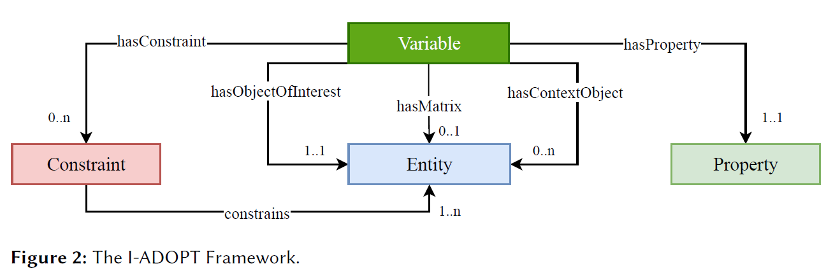
I-ADOPT Observable Property Extension
Sticker
Stickerbook
Color
hasMatrix:
hasObjectOfInterest
hasConstraint:
hasProperty:
Dry
Color of a dry sticker in a sticker book
Room 236
observed Property:
Color
host:
Kathi
Swatch Comparison
observer:
procedure:
time: April 7th
time: April 7th – April 8th
Color:
April 7th YELLOW
April 8th GREEN
YELLOW
featureOfInterest:
result:

Slide 12
References
ISO 19156 Observations, Measurements and Samples: https://www.iso.org/standard/32574.html
OGC Observations, Measurements and Samples (equivalent to ISO 19156): https://www.ogc.org/standards/om
RDA I-ADOPT: https://i-adopt.github.io/ https://doi.org/10.15497/RDA00071 https://www.researchgate.net/publication/350837843_The_I-ADOPT_Interoperability_Framework_a_proposal_for_FAIRer_observable_property_descriptions/link/6168a0fb8ad119749b1f18f4/download

