Slide 1
Interoperabilit(ies) for Official Statistics
Flavio Rizzolo
Statistics Canada

Slide 2
What we do
Ask questions and provide answers (supported by the data)
What’s new
  The cross-domain nature of the questions
    Multitude of factors, from a variety of domains, impacting social and economic statistics
    Ex: industrial production is affected/impacted/determined by climate, health, social change, wars…
    Ex: migrations are affected/impacted/determined by socioeconomic changes, climate, health, wars…
  The sources of data – larger number, some less reliable than before (unknown methodology)
  The types of data – larger, more complex, interdependent, and of varying (dubious?) quality
  The increased ability to compute with the data, e.g. ML and analytics wizardry
What we need
  More complete, machine-actionable metadata
  Improved “context” for data (i.e., provenance, semantics)
  Ability to describe, and integrate, data in new data formats/structures, e.g. long, streams, schema on-read data lakes.
  Broader range of technology platforms (cloud, virtualization, analytics, AI, sensors, etc.)

Slide 3
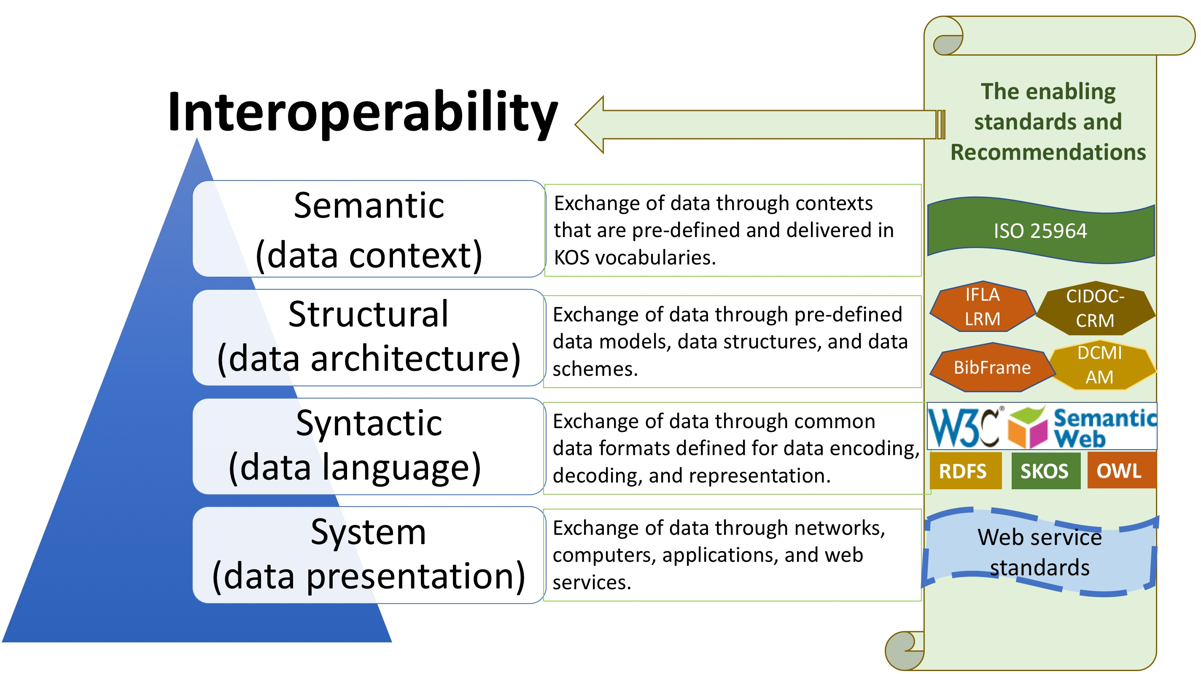
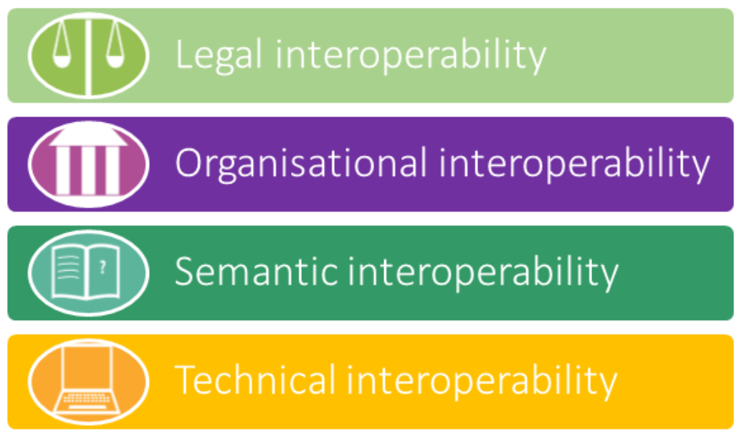
Types of interoperability
Interoperability is not just about the exchange of standardized entities with well-defined structure and semantics. It should also standardize all means of accessing and exchanging those entities.
Data standards enable interoperability within and across domains, e.g. Social and Economic.
Interoperability in turn rely on multiple machine-actionable syntax representations including XML, RDF and JSON-LD to implement data solutions and services.
Source:
International Society for Knowledge Organization (ISKO) Encyclopedia of Knowledge Organization
Source:
European Interoperability Framework (EIF)

Slide 4









Longitudinal interoperability – data preparation
Ingest
Structural validation
De-identify
Basic data preparation
Record linkage
Prepare
Cleansing
Distribute
Views
Need to know
De-identification
Transformation
Coding
Value added
Data Lake
(Raw Data)
Advanced Data Management
PPP / Data Mart
De-identification
Environment
Fit for consumption
Administrative Data
& Register Products
Base
Statistical
Registers
Cleansing
Environment
Interoperability needs to be preserved thru all data and metadata flows

Slide 5


Longitudinal interoperability – data enrichment
Integrate
Integrate survey
&
admin data
Process
Impute
Adjust
Analyze
Reports
Publish
Weights
StatCan Website
Custom Requests
Data Lake
Operational Data Store
Data Mart
Data Mart
Electronic
Questionnaire
Paper
Questionnaire
Data Mart
Fit for consumption
Administrative Data &
Register Products
Production Environment
Fit for use
Analytical File
CODR (Dissemination)
Interoperability needs to be preserved thru all data and metadata flows

Slide 6


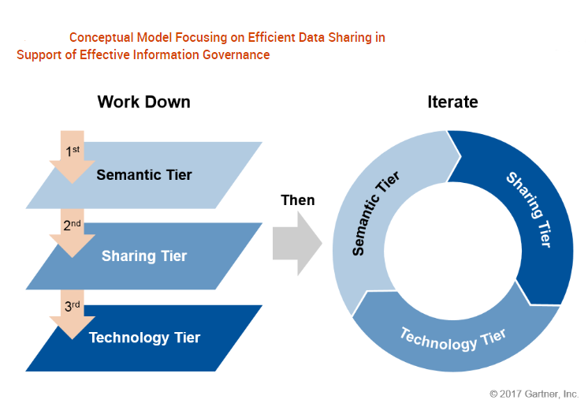
Semantic coherence for data sharing
Data Sharing
What is a Statistical Data Hub?
A data repository comprised of multiple sources, built for sharing-purposes
Contains well-described data with quality, standardized metadata, reference data as well as a reference data catalogue
Supports powerful search and discovery
Use case Support
Canadian Centre of Energy Information (CCEI), Diversity & Inclusion, Sustainable Development Goals, Wellness Hub, Personal Protective Equipment Project (PPE), Global Environment for the Economic Statistics Ecosystem (GEESE)

Slide 7
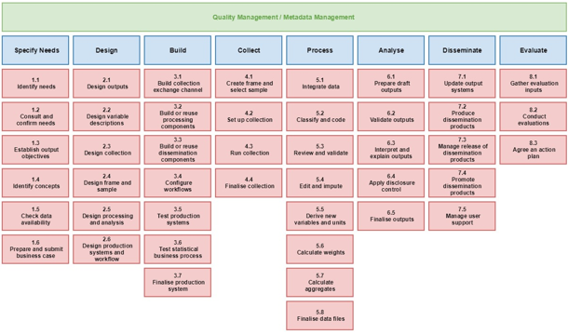
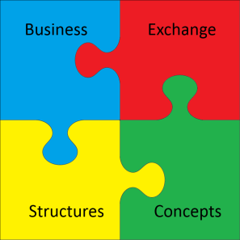


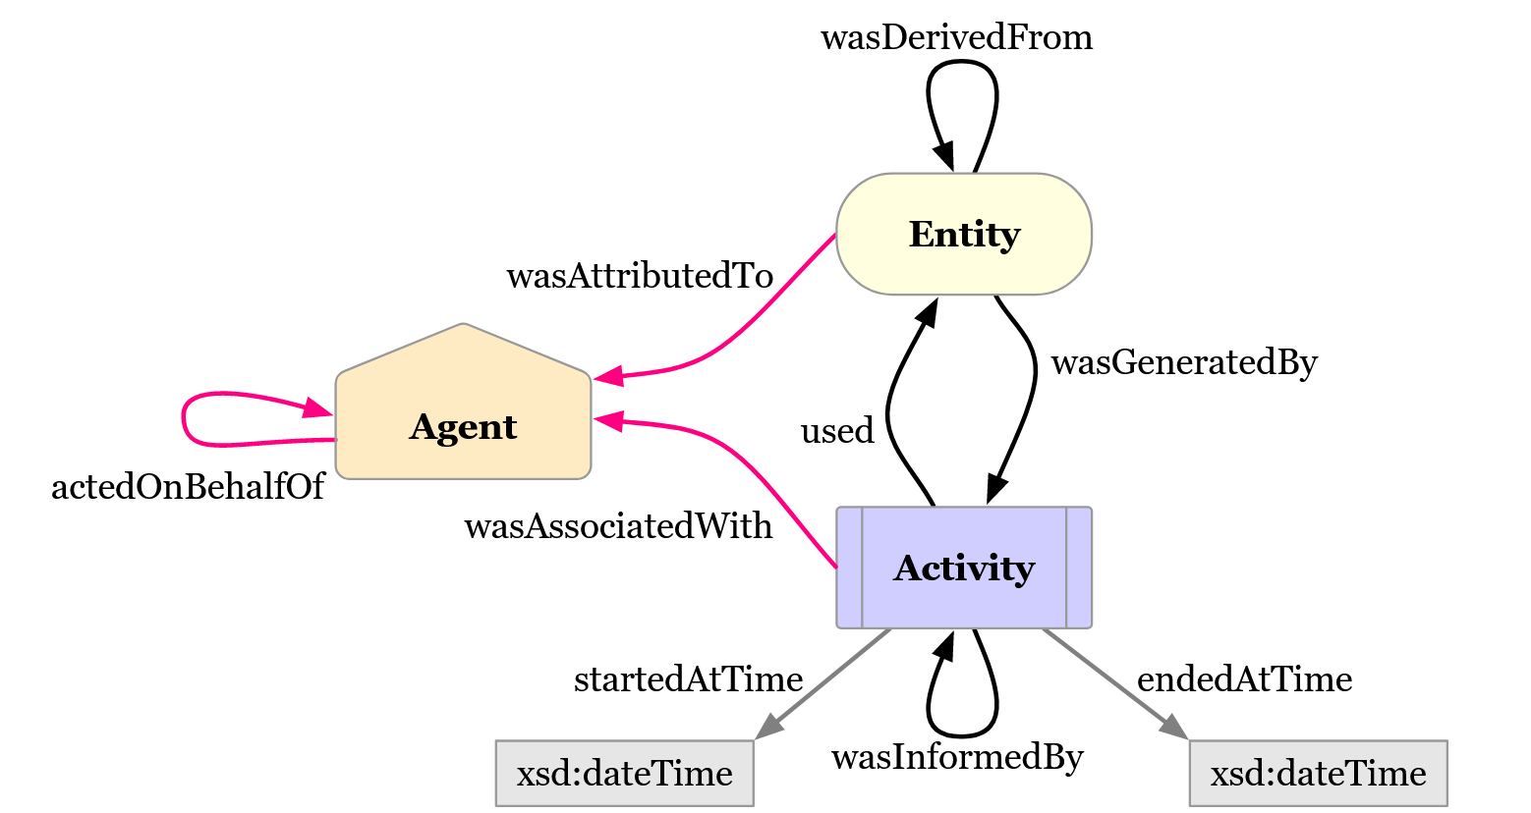
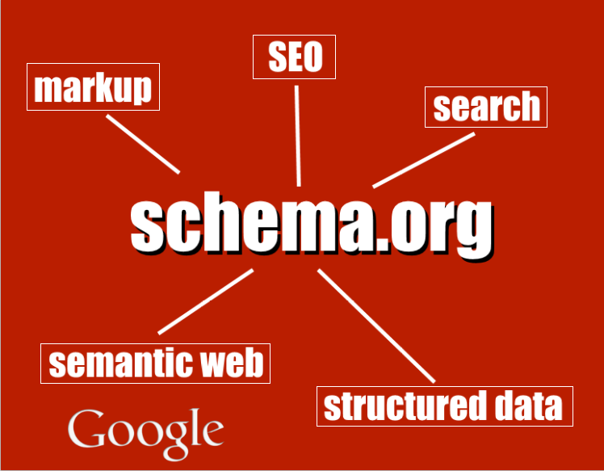
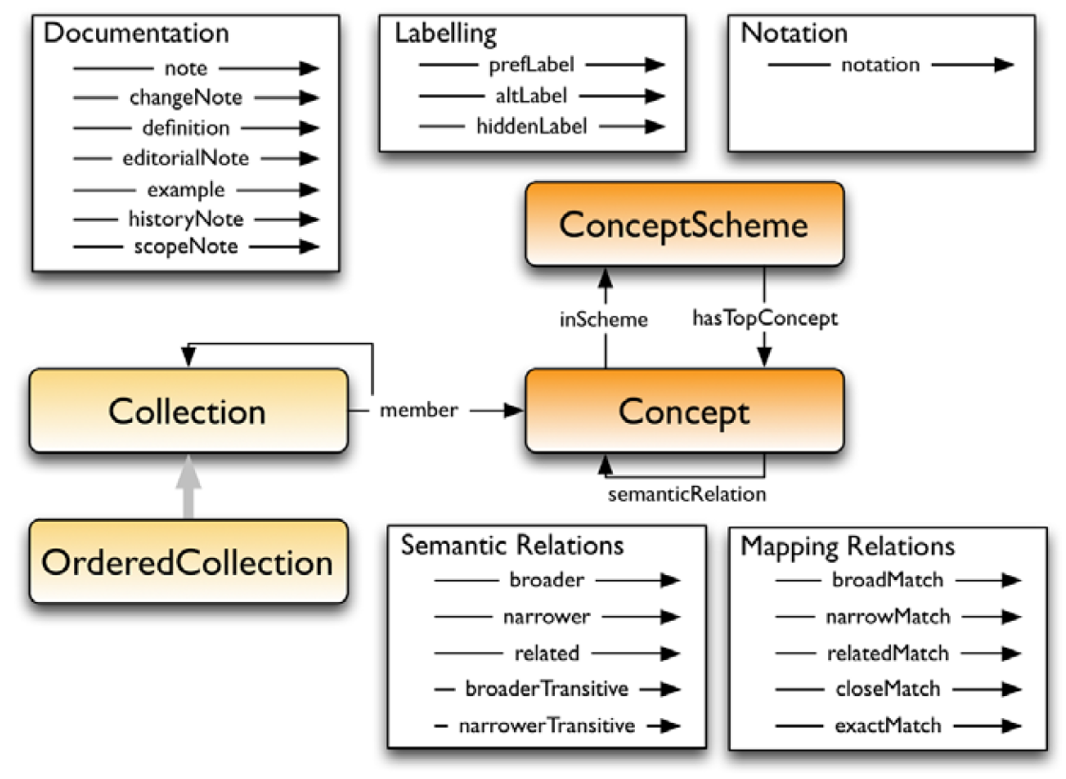
Single-domain data description – initial standardization
GSBPM
GSIM
Information Capabilities
(CSDA)
DCAT
PROV
SKOS

Slide 8
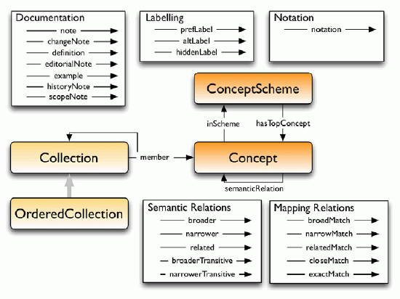
Cross-domain data description – advanced standardization
GSBPM
GSIM
Information Capabilities
(CSDA)
enables
implements
enables
other implementation Standards…
DDI-CDI
integrates
integrates
integrates
integrates
integrates
integrates
SKOS
PROV-O
DCAT

Slide 9
Making it all work is not so simple…
Main challenges:
End-to-end content integration – Linking across tools (without duplication) is a problem
End-to-end provenance and lineage – Tracing source and derivation across tools is a problem
End-to-end change management – Tracking change across tools is a problem
End-to-end UI (UIs should not be multiplied beyond necessity) – Providing a quality, seamless user experience is a problem

