Slide 1
Model to Text Tool for UCMIS UML Class Model Interoperable Subset
Joachim Wackerow

Slide 2
Subset of UML Class Diagram Items for DDI-CDI
Packaging
Model – only one model
Package – multiple packages, can be nested
Class definition
Class – template for creating objects, each related object can be identified by a DDI URN (persistent identifier)
Property – used for attributes and association ends, have multiplicity definition
Relationships
Association – only binary, directed associations, with association name (DDI-CDI usage violates currently the requirement of unique names in a package), without association end (role) names, both ends have multiplicity definitions
Generalization – inherits all attributes and associations of the whole inheritance tree, only single inheritance
Data types
DataType – structured data types, attribute type definitions could relate to primitive data types or other structured data types
Enumeration – set of named values
EnumerationLiteral – used in Enumeration
LiteralInteger – used in multiplicity definition
LiteralUnlimitedNatural – used in multiplicity definition
PrimitiveType
Boolean
Integer
Real
String
UnlimitedNatural
Documentation
Comment – can be attached to any item
The UML items are used in the XMI representation with the prefix „uml:“ like „uml:Class“.
Links of items go to pages of XMI validator of NIST.
Useful UML documentation: UML Diagrams by Kirill Fakhroutdinov

Slide 3
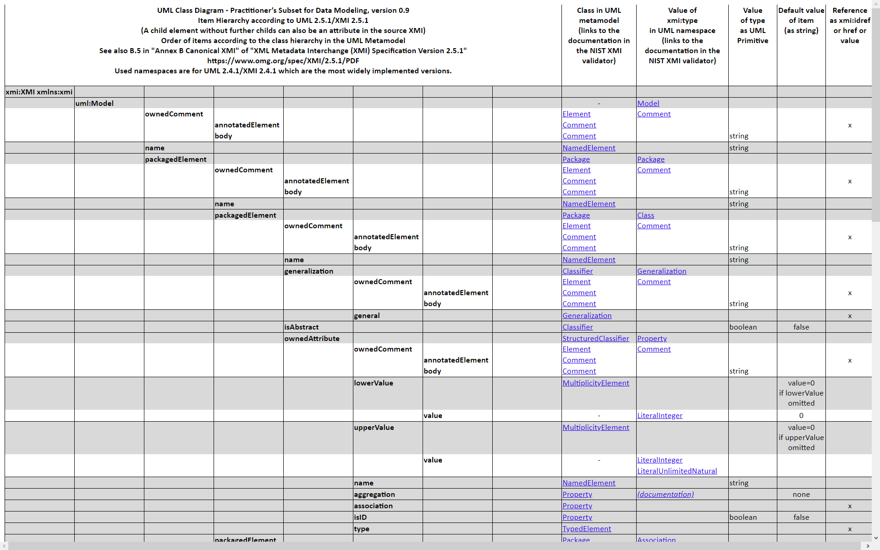
Subset of UML Class Diagram Items: Details

Slide 4
Flow Chart of UCMIS.M2T

Slide 5
Model to Text
MOF Model to Text Transformation Language (Mof2Text or MOFM2T) is an Object Management Group (OMG) specification for a model transformation language
Specifically, it can be used to express transformations which transform a model into text (M2T), for example a platform-specific model into source code or documentation
MOFM2T is one part of OMG's Model-driven architecture (MDA) and reuses many concepts of MOF, OMG's metamodeling architecture
Whereas MOFM2T is used for expressing M2T transformations, OMG's QVT is used for expressing M2M transformations.
From wikipedia

Slide 6
Acceleo – Model to Text
Embedded in Eclipse
Can be used standalone
Implementation of Model to Text Transformation language (MOFM2T, OMG specification)
First stable release in 2006
Kind of high-level programming language
Powerful and small scripts
Initial learning curve
More powerful than approaches with Java, Python, XSLT
Operates on the model structure
Code is written in templates
Easier to develop, easier to debug

Slide 7
Acceleo Environment - Features
Syntax highlighting
Smart completion
Documentation on hover
Context assistant (ctrl+space)
Outline view
Code folding
Search references of objects (ctrl+shift+g)
Dynamic error detection while editing

Slide 8
Acceleo Resources
Website
Installation instructions (from the Eclipse marketplace)
Getting Started
User Guide
FAQ
Best Practices
In Eclipse 2020-09 documentation
References
Operations
OCL Operations
Videos
Automatic Code Generation, Shaun Lindsey (18 min)
Code generation using Acceleo, Marco Di Natale (87 min)
User forums
Eclipse community forum M2T (model-to-text transformation)
Stack Overflow - Questions tagged [acceleo]
Standalone usage, Ant (limited support), Maven
Query and navigate in EMF models

Slide 9
Resources
Repositories
UCMIS: https://bitbucket.org/ddi-alliance/ucmis/
UCMIS.M2T: https://bitbucket.org/wackerow/ucmis.m2t/
Generated output
Field-level documentation: https://ddi-alliance.bitbucket.io/DDI-CDI/DDI-CDI_v1.0-rc1/field-level-documentation/
Syntax representations: https://bitbucket.org/ddi-alliance/ddi-cdi/src/master/build/encoding/
Model input
XMI: https://bitbucket.org/ddi-alliance/ddi-cdi/src/master/build/encoding/xmi/ddi-cdi_canonical-unique-names-eclipse.xmi

