Slide 1
Introduction: Non-Numeric, Non-Code Datums

Slide 2
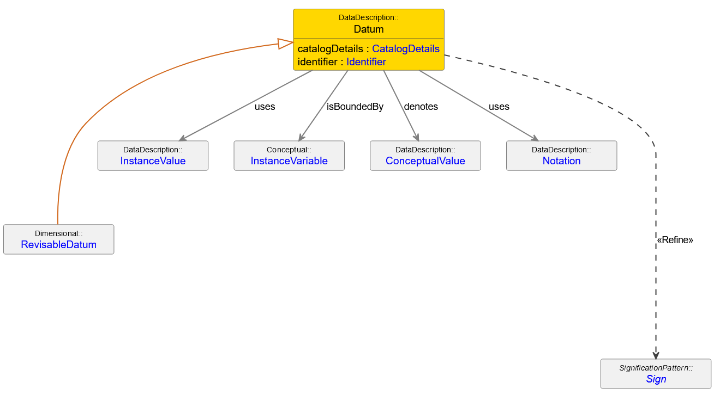
DDI-CDI Numeric or Coded Datum

Slide 3
Goal
Datum could be anything – not only numeric or coded data
Examples:
Text
Image
Audio
More complex data structure like a table

Slide 4
Addressing Segments of an Object
A selector could address segments of an object
Example: W3C Annocation TextPositionSelector, DDI-CDI TextPositionSelector (with start and end)
Web Annotation Ontology proposes some selectors
Choice | CssSelector | CssStyle | DataPositionSelector | Direction | FragmentSelector | HttpRequestState | Motivation | RangeSelector | ResourceSelection | Selector | SpecificResource | State | Style | SvgSelector | TextPositionSelector | TextQuoteSelector | TextualBody | TimeState | XPathSelector

Slide 5
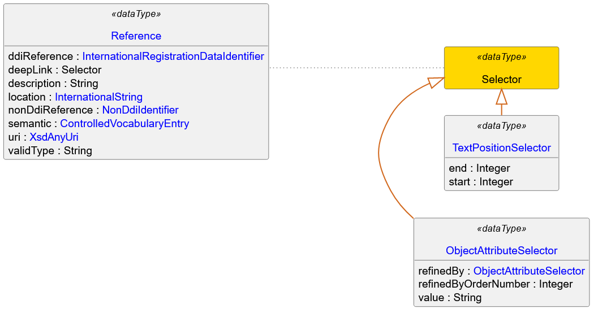
DDI-CDI Data Type Selector and Sub-Types

Slide 6
Some Questions
Which features are necessary?
Reference to an object including a selector for addressing segments of an object?
More?
What is necessary to integrate this into the model without breaking it?

