Slide 1
Representations of a UCMIS Model

Slide 2
Encoding / Platforms /Languages
A UML model conforming to the UML Class Model Interoperable Subset (UCMIS), a subset of UML class diagram items can be represented in an encoding as a metadata schema or a programming language.

Slide 3
Model Level

Slide 4
Data Structure / Object Orientation
Examples of representing a model as a data structure might include an XML Schema or and OWL Ontology.
In a programming language the model might be represented as a data structure, e.g. a tree, or a set of dictionaries and lists..
The model itself might also be represented as a set of classes (e.g. ClassDefinitions and DatatypeDefinitions) with the specific classes or datatypes (e.g. a DDICDI DataPoint) as instances (objects) of these classes. This is very generic and should work for any model implemented in UCMIS.
In a programming language, functions to operate on the metadata might also be defined. These, together with the class object might be considered an ecosystem for the metadata.

Slide 5
UCMIS Level vs Model Content Level
Some things in a representation stem from the UCMIS model
E.G. Distinction between classes and structured datatypes
Some things stem from the content of a specific model
E.G. Persistent Identifiers and Collections in the DDI-CDI model

Slide 6
Generic vs Language Specific Constraints
UCMIS distinguishes between Classes and DataTypes
Only Classes may have associations
Some languages may not have the distinction – everything may be a class
How are associations to be represented?

Slide 7
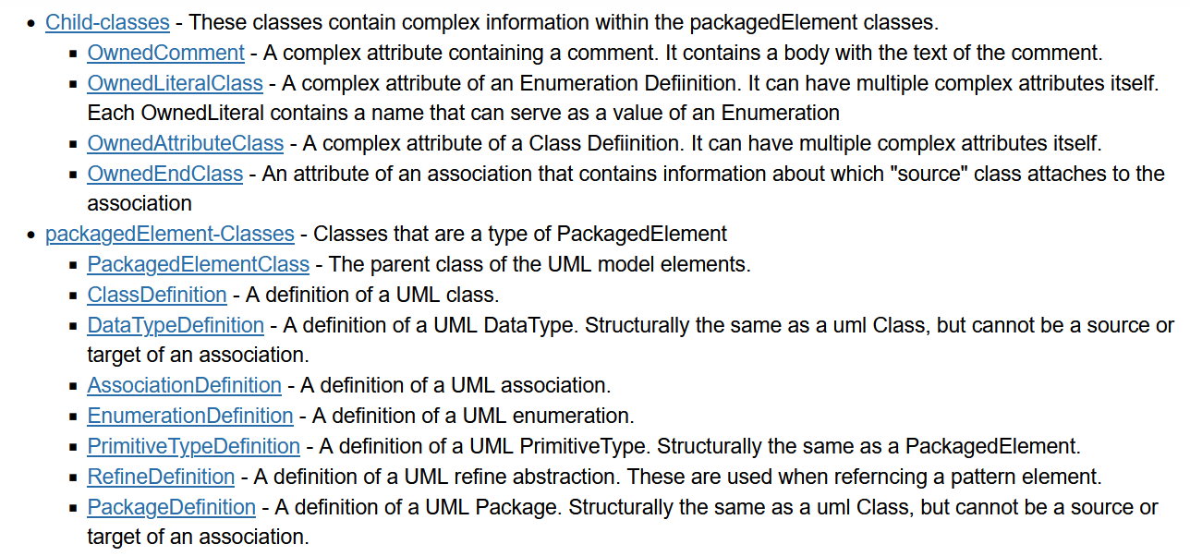
Classes at the Model XMI level – (Python example)

Slide 8
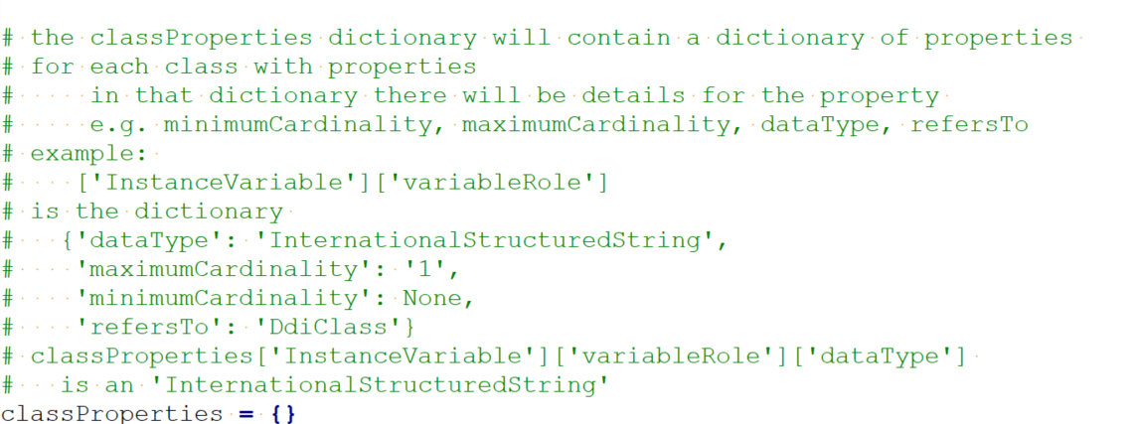
Hybrid approach – DDItoR.py
In an earlier project a Python program generated an R package where Instance classes were R R6 classes.
In the Python generator program the model was represented internally as a set of hierarchical dictionaries.

Slide 9
Instance Level

Slide 10
Model Classes vs Instance Classes
At a different level, instances of model classes could be described structured with class definitions for specific objects. This is specific to a particular model. With DdiCdi, for example, there would be a DataPoint class - instances of which would be specific data points in specific data structures.

Slide 11
Programming Language Implementations
Implementing in a programming language offers certain opportunities
Validating content on creation
Attaching metadata to data as they are created and processed
E.g. in R or Python metadata objects could be attributes of variables or “tables”
Operating on metadata as data
Functions and operators to work with metadata

Slide 12
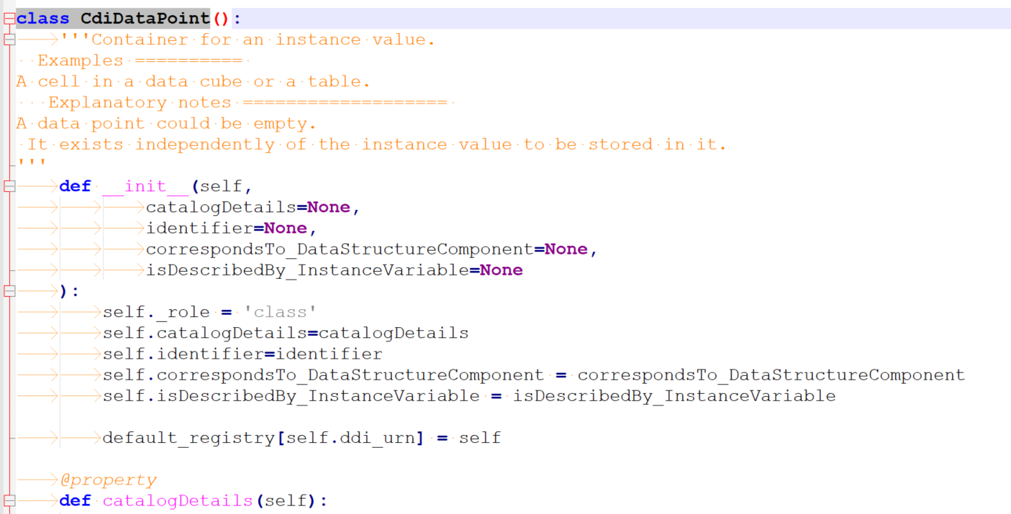
Example: Python Class for DataPoint

Slide 13
Validation

Slide 14
Object Validation is “at” the UCMIS Level
Validating properties and associations could be at the UCMIS level
Class for association
Datatype for attributes
Conformance with cardinality for both

Slide 15
Functions
Generic (UCMIS level) functions to
Validate objects on creation
Count filled properties or relationships
Return empty properties or relationships
Print objects
Comparison of content of complex objects (equality, subset of, difference)
Fingerprint
DDICDI
Manage a session level registry of identifiable objects (DDI URN lookup)
Manage a session level reverse registry of references to objects
Import / Export other (DDI) schemas
Functions on collections
Use of DDI persistent globally unique identifier

Slide 16
Example: Equality Function on a collection
SPSS repeats codelists
SAS and Stata share codelists
An equality operator or function simplifies harmonizing metadata

Slide 17
Codelists – What is the Difference Between A and B?
CodelistA
1 denotes "Very unhappy”
2 denotes "Somewhat unhappy”
3 denotes "Neither”
4 denotes "Somewhat happy”
5 denotes "Very happy”
6 denotes “Ecstatic”
CodelistB
1 denotes "Very unhappy”
2 denotes "Somewhat unhappy”
3 denotes "Neither”
4 denotes "Somewhat happy”
5 denotes "Very happy”
(CodelistA – CodeListB)
6 denotes “Ecstatic”
(CodelistB – CodeListA)
NULL

Slide 18
More Complex Functions
“getter” for complete “tree” from an object
All properties
Not only references, but all associated (referenced) objects
Including external searches?
Deep content comparison –
Comparing the content of two “trees”, ignoring IDs of associated objects.
Example - comparing the value domains of two SPSS categorical variables.

Slide 19
Repositories
Local instance: Dictionaries of objects keyed on DDI URN
External search functions

Slide 20
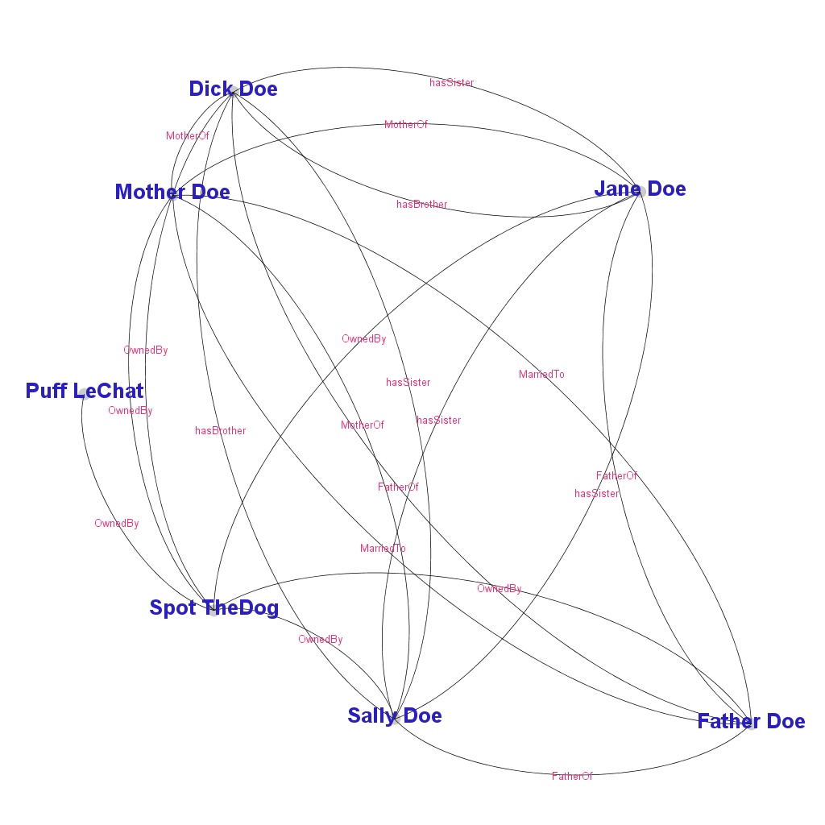
Visualization of DDI-CDI collections
Example Agent relationships in an AgentStructure
Note: this is not generic to UCMIS

Slide 21
R vs Python
For me, Python is a more comfortable language for some of the desirable structures.
Examples – Python dictionaries vs Using R environments
Complex datatypes are a more natural thing in Python
There doesn’t seem to be just one R to target (“traditional” vs Tidyverse)
“The tidyverse is an opinionated collection of R packages designed for data science. All packages share an underlying design philosophy, grammar, and data structures.” https://www.tidyverse.org/
Both languages allowed for implementation though

Slide 22
Generic Pitfalls
Fitting into existing language infrastructure – will attaching metadata objects survive use in
E.g. R6 classes and TidyVerse
Python NumPy and pandas
Will established communities see a need or find that metadata implementations make sense?
DDI-CDI and DDI-LifeCycle encourage reuse of objects through a globally unique identifier. UCMIS does not necessarily do so. Identifiers can be local to some collection of objects.

Slide 23
For More Details
For more details see NADDI 2019 Hoyle and Wackerow:
DDI4 in R – New Possibilities Operations on Metadata

Slide 24
From NADDI 2019

Slide 25
Design Patterns
The DDI4 model adopted the notion of a design pattern. From Wikipedia: “A design pattern is the re-usable form of a solution to a design problem.” https://en.wikipedia.org/wiki/Design_pattern
The CollectionsPattern, one of these, describes a generic structure which can be applied to different types of collections. Classes that people will use, like Codelists, VariableCollections, and DataPipeline, copy the structure from the pattern.
This ensures consistency in the model where possible.
This also allows tools to be developed that operate on multiple classes. All can be managed by the same tool.

Slide 26
Collections
DDI4 has a CollectionsPattern that is reused in many places in the model
E.g. CodeList, ConceptSystem, AgentListing, VariableCollection
A number of operators could apply to any type of collection
Intersection, union, difference, inner and outer joins
Collections and their structure are a prime candidate for visualization
Collection structures could be used with metadata mining like topic modeling to yield new ways of navigation
Notes:
Viewing the relationships in a collection in a diagram may reveal insights that are not immediately apparent in a textual description.
Topic modeling allows applying a structure to unstructured text. It could be used to compute distances among objects like questions. See https://en.wikipedia.org/wiki/Topic_model

Slide 27
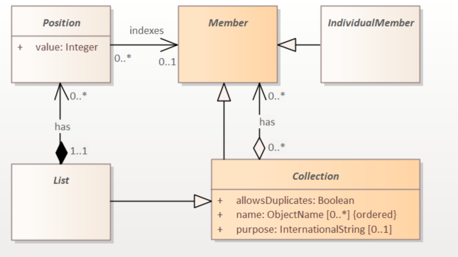
Collection as a List

Slide 28
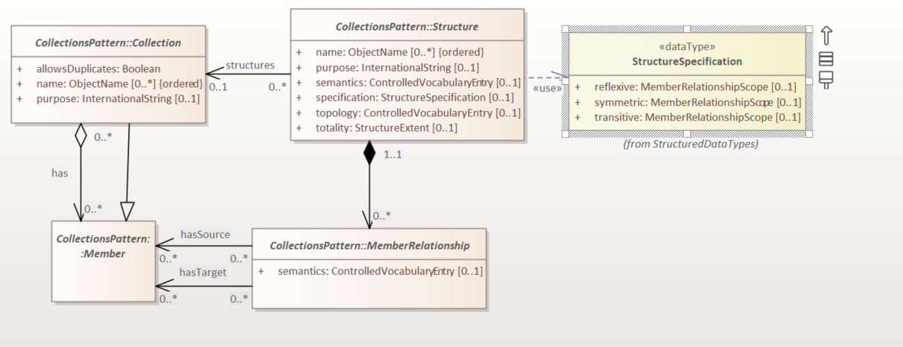
Structured Collection

Slide 29
DDI4R
We have been developing an R package that implements DDI4 as R6 classes.
Class definition code written programmatically from the Model XMI file.
Functions to
Validate objects on creation
Print objects
Manage a session level registry of identifiable objects (DDI URN lookup)
Manage a session level reverse registry of references to objects
Import DDI4 XML
Export DDI4 XML
Import DDI2 XML
Test equality of content of complex objects (Boolean)

Slide 30
DDI4R Functions
We have a function “DDI4ObjectContentsEqual” that compares complex objects, like a codelist, for equality down to the leaf level, even across referenced objects.
We’re using it in importing DDI2 content into DDI4

Slide 31
Network Diagrams

Slide 32
Structured Collections
Many classes in DDI4 are structured collections. A structured collection has an associated description of all of the relationships among the objects in the collection. This is done through a CollectionStructureDefinition that directly corresponds to a network adjacency list.
A function could transform this CollectionStructureDefinition into a CSV compatible with network visualization software like Gephi (a well known network analysis tool).
This would allow visualization of all of the relationships among the objects in the collection.

Slide 33
Network Example: AgentListing (a Collection)
<AgentListing> <Agency>example.org</Agency> <Id>TheFamily</Id> <Version>1</Version> <Contains><Member typeOfClass="Individual">urn:ddi:example.org:IdSpot:1</Member></Contains> <Contains><Member typeOfClass="Individual">urn:ddi:example.org:IdSally:1</Member></Contains> <Contains><Member typeOfClass="Individual">urn:ddi:example.org:IdDick:1</Member></Contains> <Contains><Member typeOfClass="Individual">urn:ddi:example.org:IdJane:1</Member></Contains> <Contains><Member typeOfClass="Individual">urn:ddi:example.org:IdPuff:1</Member></Contains> <Contains><Member typeOfClass="Individual">urn:ddi:example.org:IdMother:1</Member></Contains> <Contains><Member typeOfClass="Individual">urn:ddi:example.org:IdFather:1</Member></Contains> </AgentListing>
Id,Label
IdSally,"Sally Doe"
IdDick,"Dick Doe"
IdJane,"Jane Doe"
IdMother,"Mother Doe"
IdFather,"Father Doe"
IdSpot,"Spot TheDog"
IdPuff,"Puff LeChat"
A Function: NodeList(Collection)
Node CSV file
For those of you who don’t know Dick and Jane see:
https://en.wikipedia.org/wiki/Dick_and_Jane

Slide 34
DDI4 RelationStructure
Edge CSV file
Source,Target,Label,Type
IdSally,IdDick,hasBrother,Directed
IdJane,IdDick,hasBrother,Directed
IdDick,IdSally,hasSister,Directed
IdDick,IdJane,hasSister,Directed
IdSally,IdJane,hasSister,Directed
IdJane,IdSally,hasSister,Directed
IdMother,IdSally,MotherOf,Directed
IdMother,IdJane,MotherOf,Directed
IdMother,IdDick,MotherOf,Directed
IdFather,IdSally,FatherOf,Directed
IdFather,IdJane,FatherOf,Directed
IdFather,IdDick,FatherOf,Directed
IdMother,IdFather,MarriedTo,Directed
IdFather,IdMother,MarriedTo,Directed
IdSpot,IdMother,OwnedBy,Directed
IdSpot,IdFather,OwnedBy,Directed
IdSpot,IdJane,OwnedBy,Directed
IdSpot,IdSally,OwnedBy,Directed
IdSpot,IdDick,OwnedBy,Directed
IdSpot,IdPuff,OwnedBy,Directed
AgentRelationStructure> <Agency>example.org</Agency> <Id>FamilyStucture</Id> <Version>1</Version> <HasMemberRelation> <Semantic><Content>hasBrother</Content></Semantic> <Source typeOfClass="Individual">urn:ddi:example.org:IdSally:1</Source> <Target typeOfClass="Individual">urn:ddi:example.org:IdDick:1</Target> </HasMemberRelation> <HasMemberRelation> <Semantic><Content>OwnedBy</Content></Semantic> <Source typeOfClass="Individual">urn:ddi:example.org:IDSpot:1</Source> <Target typeOfClass="Individual">urn:ddi:example.org:IdFather:1</Target> <Target typeOfClass="Individual">urn:ddi:example.org:IdMother:1</Target> <Target typeOfClass="Individual">urn:ddi:example.org:IdSally:1</Target> <Target typeOfClass="Individual">urn:ddi:example.org:IdDick:1</Target>
</HasMemberRelation>
…
A Function: Edge(RelationStructure)

Slide 35
Imported Into Gephi
We can see the relationships among the individuals and filter by type of relationship as needed.
See: https://gephi.org/

Slide 36
Imported Into Gephi
Here we can quickly see that Puff leChat owns Spot TheDog, but has no other relationship to the family.
Unfortunately Gephi doesn’t show arrowheads with curved lines.
Notes:
The relationship of the cat to then family is much more apparent in the diagram.

Slide 37
Codelists

Slide 38
Codelists – are These Equal?
CodelistA == CodeListB
TRUE
CodelistA
1 denotes “Very unhappy”
2 denotes “Somewhat unhappy”
3 denotes "Neither”
4 denotes "Somewhat happy”
5 denotes "Very happy”
CodelistB
1 denotes "Very unhappy”
2 denotes "Somewhat unhappy”
3 denotes "Neither”
4 denotes "Somewhat happy”
5 denotes "Very happy”

Slide 39
Codelists – are These Equal?
CodelistA == CodeListB
FALSE
CodelistA
1 denotes "Very unhappy”
2 denotes "Somewhat unhappy”
3 denotes "Neither”
4 denotes "Somewhat happy”
5 denotes "Very happy”
6 denotes “Ecstatic”
CodelistB
1 denotes "Very unhappy”
2 denotes "Somewhat unhappy”
3 denotes "Neither”
4 denotes "Somewhat happy”
5 denotes "Very happy”

Slide 40
Codelists – What is the Difference Between A and B?
CodelistA
1 denotes "Very unhappy”
2 denotes "Somewhat unhappy”
3 denotes "Neither”
4 denotes "Somewhat happy”
5 denotes "Very happy”
6 denotes “Ecstatic”
CodelistB
1 denotes "Very unhappy”
2 denotes "Somewhat unhappy”
3 denotes "Neither”
4 denotes "Somewhat happy”
5 denotes "Very happy”
(CodelistA – CodeListB)
6 denotes “Ecstatic”
(CodelistB – CodeListA)
NULL

Slide 41
Codelists – is one a Subset?
Contains(CodelistA, CodeListB)
TRUE
CodelistA
1 denotes "Very unhappy”
2 denotes "Somewhat unhappy”
3 denotes "Neither”
4 denotes "Somewhat happy”
5 denotes "Very happy”
6 denotes “Ecstatic”
CodelistB
1 denotes "Very unhappy”
2 denotes "Somewhat unhappy”
3 denotes "Neither”
4 denotes "Somewhat happy”
5 denotes "Very happy”

Slide 42
What Properties are Different?
PropertyDifference(InstanceVariable1, InstanceVariable2)
takesSentinalValuesFrom
InstanceVariable1 associations
InstanceVariable2 associations
takesSubstantiveValuesFrom
1 denotes "Very unhappy”
2 denotes "Somewhat unhappy”
3 denotes "Neither”
4 denotes "Somewhat happy”
5 denotes "Very happy”
takesSentinalValuesFrom
99 denotes “missing-refused”
takesSubstantiveValuesFrom
1 denotes "Very unhappy”
2 denotes "Somewhat unhappy”
3 denotes "Neither”
4 denotes "Somewhat happy”
5 denotes "Very happy”

Slide 43
Complexities- How do we deal with “Other”?
1=“age 0 to 18”
2=“age 19 to 30”
9=“other”
1=“age 0 to 18”
2=“age 19 to 30”
3=“age 31 to 65”
9=“other”

Slide 44
On What Kinds of Metadata Objects Might We Operate?
Complex objects
E.g. InstanceVariable, Codelist, Question (Capture), Questionnaire (Instrument)
What does it mean if two objects are different? What tools can help explore that?
Shared references
For an InstanceVariable: RepresentedVariable, ConceptualVariable
Semantic similarity (based on structure derived from topic modeling)
What proportion of properties have entries?
Weighting of properties?

Slide 45
What Kinds of Operations and Objects?
Operations
Objects
Transformation
Comparison
Visualization
“print” to various formats or with selected language
Structure of collections
Combination
Complex Single Objects
Collections
Code and Category lists
Processes like GSBPM nodes
Concepts
Agents
What would combining two InstanceVariables mean?

Slide 46
Possible Operations

Slide 47
What Operators Might be Useful?
Comparison Operators on Objects
Exact Equality – e.g. same DdiUrn
Content Equality – TRUE if all content equal, ignoring identification
< or > – Boolean, (based on index) two objects in an ordered collection lessThan(objectA, object, orderDefinition)
(e.g. Seniority Order Definition)
Distance between (order, network hops)

Slide 48
What Operators Might be Useful?
Only show things with examples?
Single Collection Oriented Operators
AsOrdered –
converts collection
AsBag –
converts collection
AsSet –
converts collection
Count –
# of objects in collection
First –
first object in collection
ForAll (Boolean)
(every element satisfies a condition)
IndexOf
index of object in ordered collection
IsEmpty / notEmpty –
TRUE if no content
Last
Last object in the collection
SortedBy
Create index on some property
Sub (Bag, Set)
All obkects

Slide 49
What Operators Might be Useful?
Collection Comparison Operators
Collection A and Collection B
Append
All of A followed by all of B
Difference (“-”)
Objects in A not in B
Excludes (Boolean)
TRUE if B not in A
IncludesAll (Boolean)
All in B are in A
Inner Join
All objects in both collections meeting a condition
InsertAt
B inserted in A after a specific element of A
Intersection
Objects in both A and B
OuterJoin
All objects in both collections meeting a condition
Plus any other objects in one (left) or both (full) collections
SameOrder
A and B contain the same objects in the same order
Union
Objects in both collections, duplicated not included

Slide 50
What Operators Might be Useful?
Iassist Example: cuisine around the world
Individuals?
WorkflowSteps?
Network Oriented Operators
EmptyObject
TRUE if no property or relationship
CommonProperties
Could be used to find shared properties
CommonRelationships
Could be used to find shared associations
These operators could be used to build network diagrams of a set of DDI4 objects. Examples: diagram of variables sharing code lists; studies sharing individuals Variables with the same units of measurement.

Slide 51
What Operators Might be Useful?
Utility Operators on Objects
Class – returns class of object
Size – returns size of object
EmptyObject – TRUE If no content
Properties – Lists properties names
FilledProperties (count)
Relationships - Lists relationship names
Fingerprint

