Slide 1
Development of Methodology Model

Slide 2
Coverage
Part I – Development of the Model from Weighting (SDI model) through current refinements in March 2016
Part II – Examples of applications of the generic model
Part III – Relationship to other process models in Lion
Part IV – Discussion of the intent of the overall coverage of the process models in DDI
Level of detail (it was done, description of process, implementation detail)
Perspectives (prescriptive, descriptive, usage of results)
Time (past activity, current activity, future activity)

Slide 3
Part I – Development of the Model

Slide 4
From Weighting
The first model came out of the work to capture information on weighting
The methodology that was used to define the process
The process that produced the weight
Guidance on the use of the weight for a variable with a specified unit
The goal of the modeling group was to cover three perspectives
Planning and design (prescriptive)
The process that occurred with a resultant weight (action)
How to use the result (future guidance for the analyst)

Slide 5
Model – Class Diagram
Methodology
define
Process
production
Weight
1
0 ..*
1
1 ..*
1
application
1 ..*
Variable
for
Usage
1
1..*
1..*
1 ..*
guide
to
1
Guidance
1
Unit

Slide 6
Über model
Discussions at Dagstuhl 2014 of the Weighting Model resulted in the refinement of that model into a generic methodology model which could be used as a base for specific methodologies
Changes included
Replacement of Methodology with Design and Rationale which defined the Process (Note the Rationale was provided for Design and for Process)
Weight was replaced with “X” (a generic result)
No change was made to the lower right portion of the model although it was possible that a result was not something associated with a variable

Slide 8
Model as entered in Lion
Changes were made and further details defined:
Created a Goal, Precondition, BusinessFunction, and Method
Goal and Precondition are both types of BusinessFunctions
Method is an abstract class that hasProcess, hasRule, specifiesGoal, and isDiscussedIn
Rationale linked only to Design (hasRationale)
Process defined as hasDesign, implementsGoal, hasRule, hasPrecondition, isDiscussedIn
There was no clear link to other process models
ProcessStep in CoreProcess was an extension of Process but could not be used in the Methodology Model

Slide 9
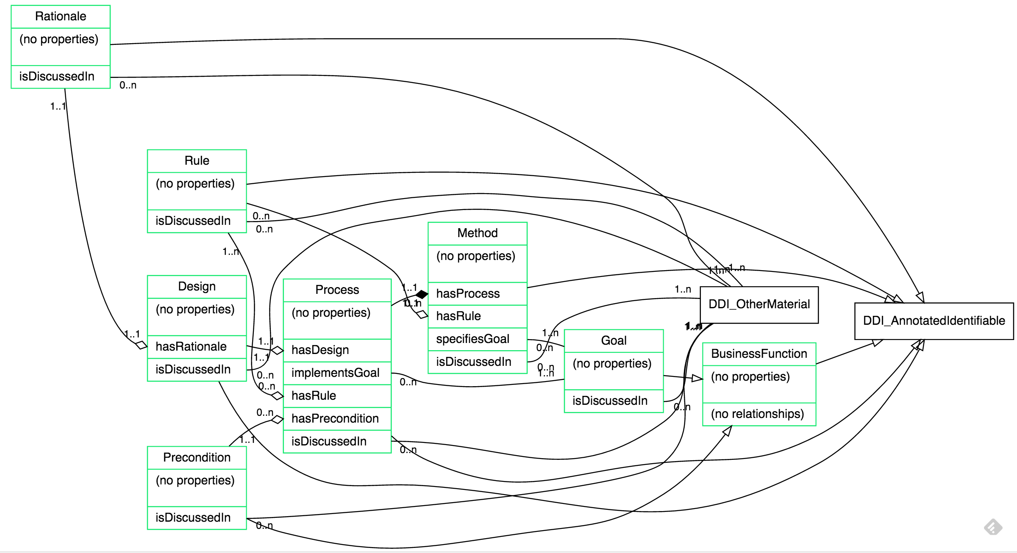
Methodology Model

Slide 10
Suggested modification 3/22/2016
Change the relationship between Method and Process
From a Method containing a Process to a Process being informed by a Method
Add hasSequence 0..1 to Process to allow the inclusion of one or more ProcessSteps and the full functionality of the Core Process model
Add hasUsage to Result bring in a Guide and relating it to a Unit Type and a related class (i.e. guidance for the usage of a result with a specified class)

Slide 11
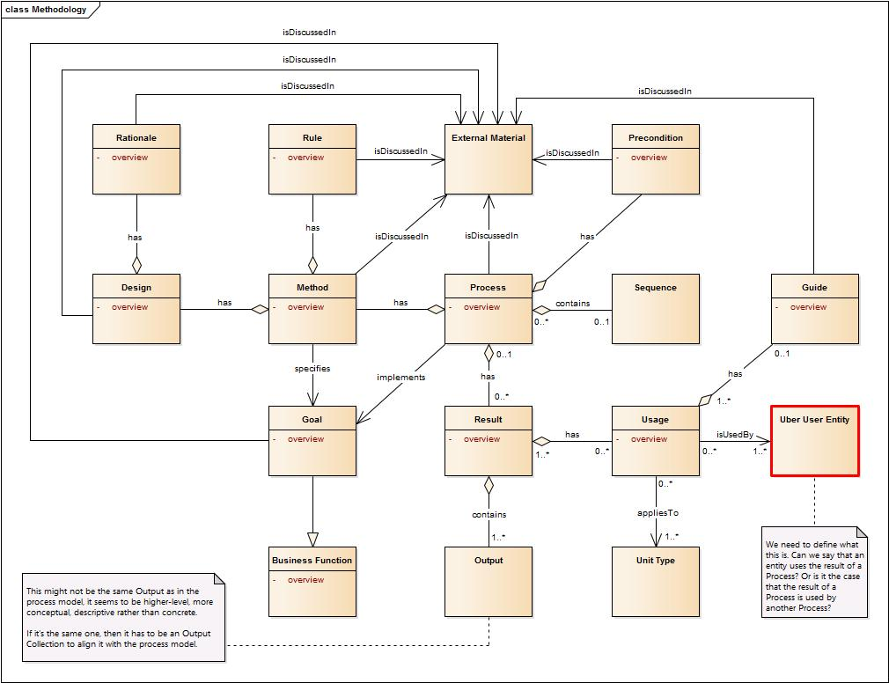
Draft Methodology 2016-03-21

Slide 12
Result of 3/23/2016 discussion
Change Method to Algorithm and relate it to Design
Process becomes a class informed by a Design which may have a related Algorithm
The Result of the Process can have related Usage information

Slide 13
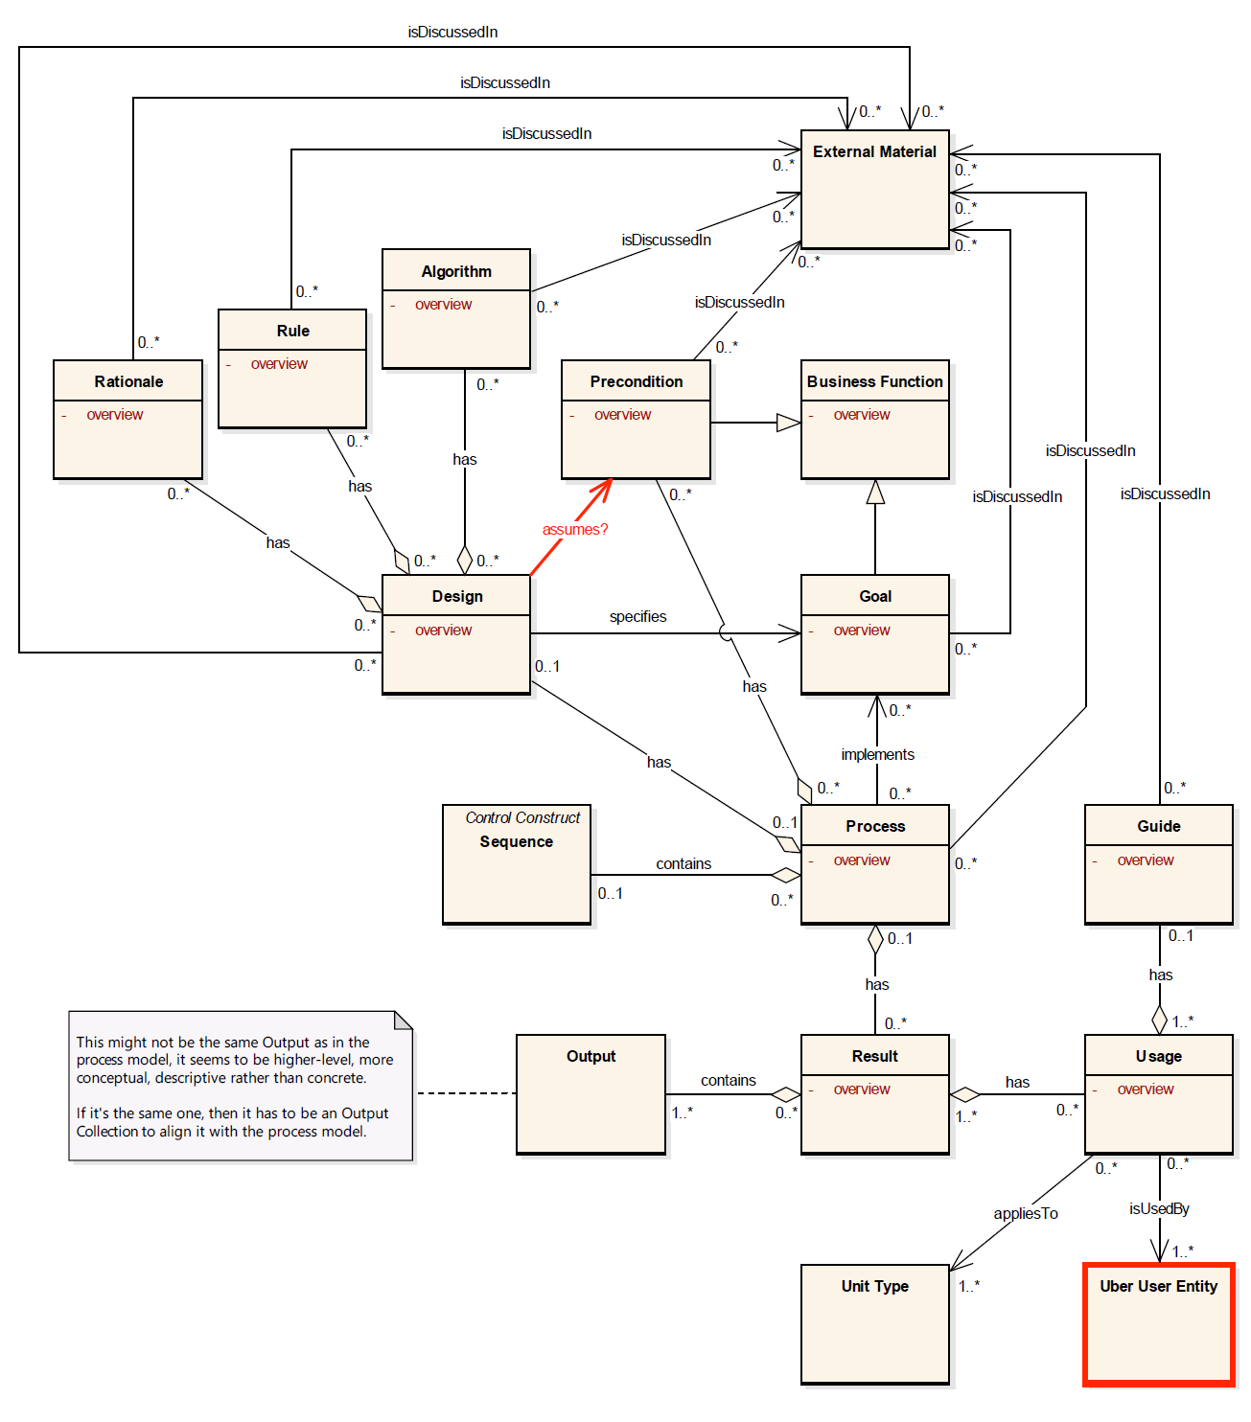
Draft from Discussion
3/23/3016

Slide 14
Issues from entering in Drupal
In response to Flavio’s note on Output I made the following change
Changed containsOutput to hasBindingCollection as the point is to bind outputs from processes to guidance for the use of the process results
Is cardinality correct – please consider the use of 0..n as opposed to 1..n to support the development of a DDI instance over a process
Is the link between Design and Precondition correct?
Many of these classes have no content except an overview and an ExternalMaterial. Do we allow people a place to enter content in-line?

Slide 15
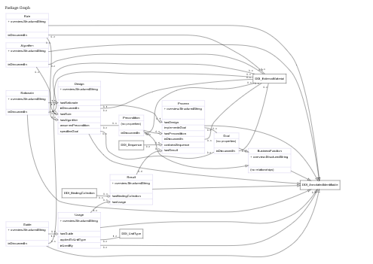
As Entered in Drupal
2016-04-10

Slide 16
Part II – Examples of applications

Slide 17
Model - Class Diagram
Sample Overview
[1..N]
Stage
[1..N]
Stage Sample
[0..1]
[1..1]
[0..1]
[0..N]
follows

Slide 18
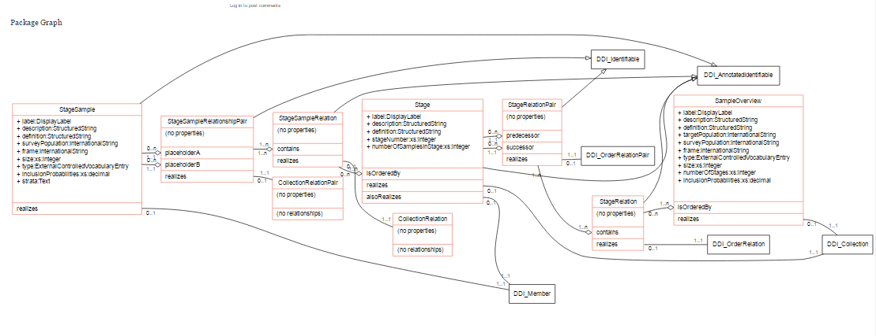
Sampling Model

Slide 19
Model – Design for Classification
Classification Indexes
Statistical Classifications
Correspondence Tables and Maps
Manual Operation
1..N
0..N
1..N
1..N
Rules, Guidelines, Instructions
1..N
Classification Design
Instruct
1
Reference Material
Variables
1
1
1
Computer-Assisted System
1
1
Quality Control
Training System
Knowledge Base

Slide 20
Part III – Relationship to other process models

Slide 21
Relating the different Process Models in Lion
As of March 2016 there are 4 process models in Lion
Methodology – containing design information, a process, and goal
Core Process – containing standard process steps, sequencing ability and binding of inputs and outputs
Complex Process – containing processing step detail to support metadata driven processing (i.e. automation)
Historical Process – a description of a past activity but incorporating ProcessStep through an extended HistoricalProcessStep
These models need to be integrated into a coherent integrated model or provide clear connection points between them
There may be overlap due to sequencing of the activities of the various working groups

Slide 22
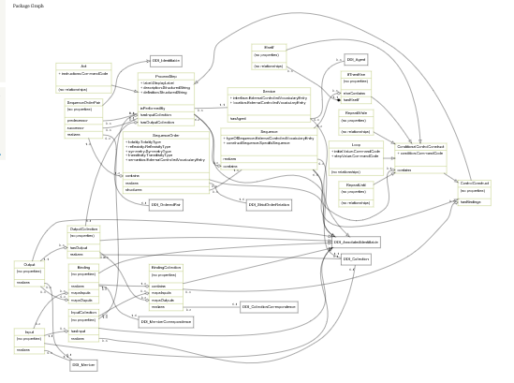
Core Process 2016-04-09

Slide 23
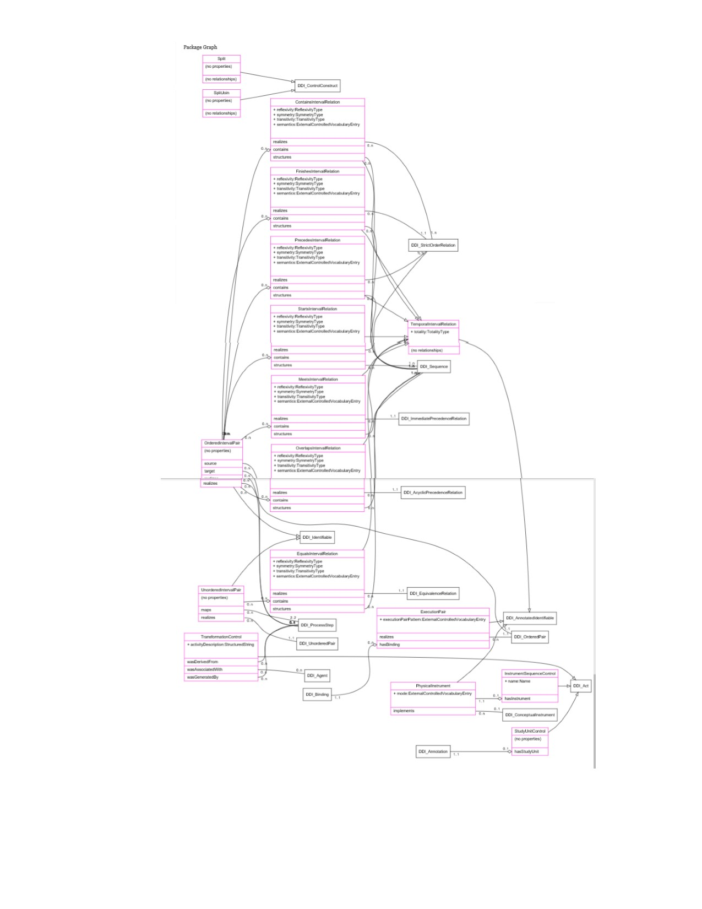
Complex Process 2016-04-09

Slide 24
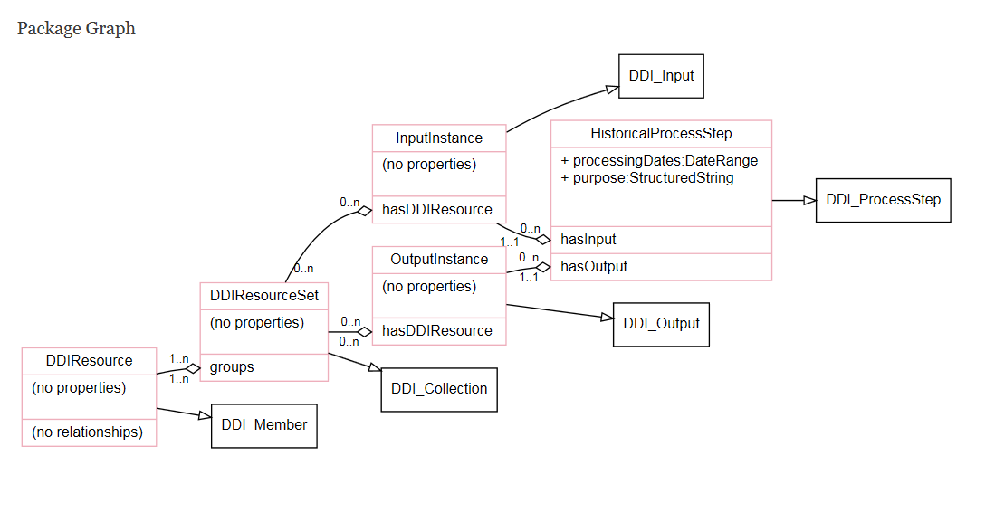
Historical Process 2016-03-22

Slide 25
Part IV – Discussion

Slide 26
Linkages between models
Methodology to CoreProcess
A Process contains a Sequence bringing in the full capability of CoreProcess
CoreProcess to ComplexProcess
Provides types of TemporalIntervalRelationPairs which contain ProcessSteps
Provides types of Acts
Historical Process
Only relationship is through extensions of classes from Core and Complex Processes
This creates a disconnect between designing, implementing, and relating a process within the same documentation stream

Slide 27
Hanging Chads – about Process in general, may not be Methodology Issue
The issue of “when”
There is no means of relating when a process was completed in retrospect other than by creating a whole new Historical process
Should completionPeriod be part of ProcessStep and/or Process or should there be a separate means of associating the following information for the specific implementation of a Process?
Step specification
Actor (if other than specified)
Run time modifications/adaptations
ProcessDate
Quality statement

