Slide 1
DDI Methodology

Slide 2
Aims
Purpose: To describe the study design specifications underlying the conduct of a research/business project.
Possible coverage areas:
Coding (Classification)
Sampling
Weighting
Harmonisation
Editing
Imputation
Estimation
Data linkage?
…

Slide 3
Model – Class Diagram
Methodology
define
Process
production
Weight
1
0 ..*
1
1 ..*
1
application
1 ..*
Variable
for
Usage
1
1..*
1..*
1 ..*
guide
to
1
Guidance
1
Unit

Slide 4
Methodology Model – Class Diagram
Design
define
Process
production
X
1
0 ..*
1
1 ..*
1
1
1
for
for
1
Rationale
1
application
1 ..*
Variable
for
Usage
1
1..*
1..*
1 ..*
guide
to
1
Guidance
1
Unit

Slide 5
Achievements so far
1) Development of model for how a methodology gets used – for background information please see Minneapolis Sprint minutes from the Methodology Team wiki and the current Methodology Package
2) The Minneapolis Sprint members worked through the proposed model and confirmed that it is plausible and works for weighting, sampling, coding, and harmonization
3) Built some specific design models for sampling, questionnaire design (?)

Slide 6
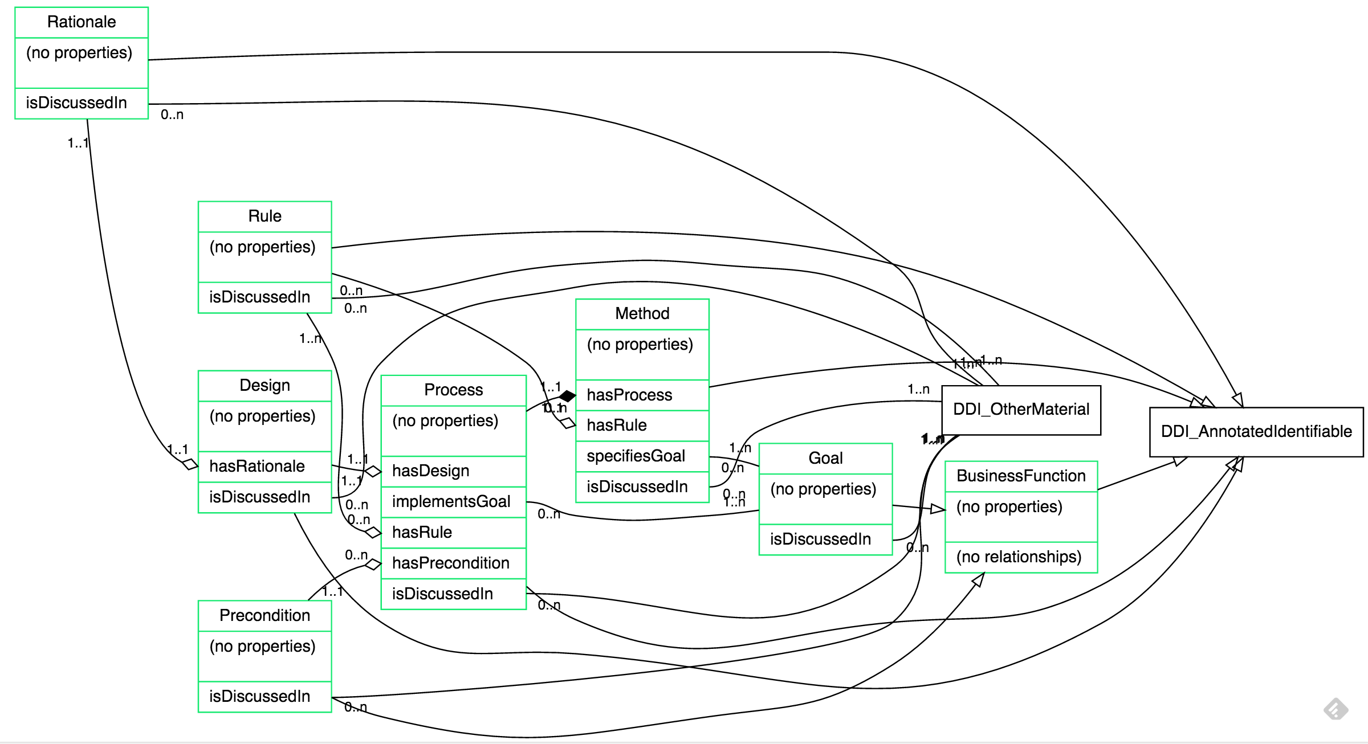
Sampling

Slide 7
Directions for the Methodology group
Confirm current design model
Do we need more discussion on this or are we happy with the current model?
Identify design models (coverage areas)
e.g. sampling, weighting, …
Build specific design models and/or confirm that our current Methodology Package works.
Linkage between Methodology and Data Capture ? This was brought up in Minneapolis – how do we link or do we need to?

