Slide 1
DDI Moving Forward: Sprint 1
Schloss Dagstuhl October 28-November 1, 2013

Slide 2
Why Are We Here?
To build the next-generation DDI specification based on a data model
Goals:
Improve DDI usability
Expand DDI coverage
Express model in different technical formats
Repackage the specification
Enhance the documentation

Slide 3
Timeline of Effort
We envision five Sprints:
Dagstuhl 2013
EDDI – December 2013
NADDI – April 2014
IASSIST – June 2014
Dagstuhl – October 2014
Plus virtual meetings in between
Goal: First version of model March 31, 2015

Slide 4
Accomplishments so far
Focus on four function areas:
Simple data description
Foundational metadata (concept, universe, category, variable, etc.)
Common codebook
Simple instrument
Agreement to align with GSIM

Slide 5
Foundational metadata

Slide 7
Beyond the Survey
“Sanity check” model against other data types:
Qualitative – text
Qualitative – collection of images
Events
Biometry
Think broadly but at the same time create manageable “chunks”

Slide 8
Input to Model
Started with Word templates
Developed a Drupal content type that exports to XML
Will permit us to repurpose structured content for documentation purposes

Slide 9
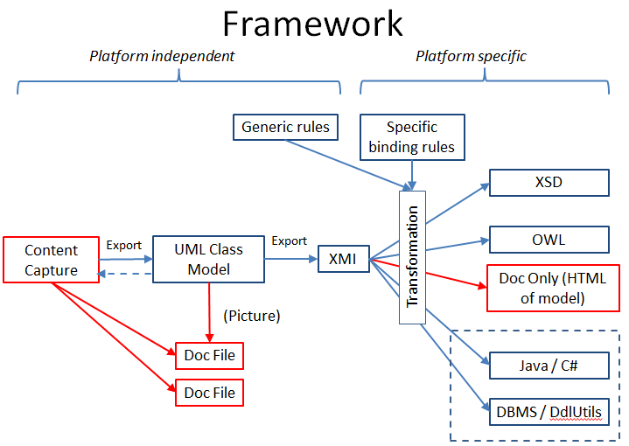

Slide 10
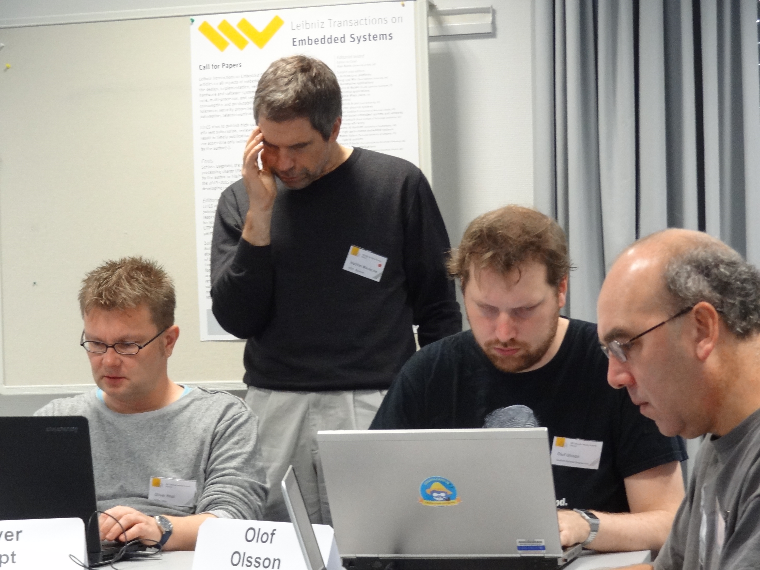

Slide 11
Deliverables
Completed model templates for the 4 identified functional areas – In progress
First draft of common model documentation based on the completed templates – In progress
Draft design and specification of production process – Done
Draft design principles for DDI work products In progress
Documentation of DDI Alliance workflows In progress
Draft XML syntax binding specification In progress
Draft RDF syntax binding specification Mostly done
Draft business rules specification for model transformations In progress
Documentation of modeling style (includes UML profile) In progress

Slide 12
Deliverable 1: Completed model templates for the 4 identified functional areas – In progress
Simple data description In progress
Foundational metadata Done, needs review. Includes Concept, Concept System, Category, Sign, Vocabulary, Designation, Label, Characteristic. (http://ddi4.borsna.se/ddiobjects)
Instrument/questionnaire In progress, mostly complete
Simple codebook (data dictionary, study description) In progress

Slide 13
Deliverable 2: First draft of common model documentation based on completed templates- In progress
DocBook being mined for solution. Tools for making pretty documentation. Work continues on export function from Drupal.
The same Drupal system can likely be used for both the collection of content and the production of documentation.

Slide 14
Deliverable 3: Draft design and specification of production process – Done
Shown earlier; needs review and integration with work flows deliverable (5)
Drupal content and documentation tool nearly ready, currently implementing XML export function

Slide 15
Deliverable 4: Draft design principles for DDI work products -- In progress
Interoperability and Standards
Simplicity
User Driven
Terminology
Iterative Development
Documentation
Lifecycle Orientation
Reuse and Exchange

Slide 16
Deliverable 4: Draft design principles for DDI work products (cont.) -- In progress
9. Modularity
10. Stability
11. Extensibility
12. Tool Independence
13. Innovation
14. Actionable Metadata
15. Remodelling Discouraged (New)
16. Objects Represent Actual Things (New)

Slide 17
Deliverable 5: Documentation of DDI Alliance workflows -- In progress
Process documentation.
Describes the work flow, not the technical production flow.
Approval and review process. Working from Sprints to TC to Scientific Board.

Slide 18
Deliverable 6: Draft XML syntax binding specification -- In progress
Coming along nicely, still work in progress (technical group)
Simultaneously writing the actual translation from XMI to DDI Schemas in XSLT.

Slide 19
Deliverable 7: Draft RDF syntax binding specification Mostly done
RDF syntax binding specification: All but finished
Transform for producing the RDF outputs is about half complete

Slide 20
Deliverable 8: Draft business rules specification for model transformations -- In Progress
Currently working on this in the technical group.
Important output is list of primitives for use by the content modelers
Organization of the different types of packages in the model and rules about use and how to extend
Solved problem about external and internal CV’s and code lists

Slide 21
Deliverable 9: Documentation of modeling style (includes UML profile) -- In progress
Still work in progress.
Focused on documentation of modeling style rather than technical UML profile

Slide 22
Model Package Organization
There will be four types of DDI Packages
Core: Contains “primitive” types for use by content modelers (Reference, International String, etc.). Completely static and controlled by TC modelers.
Foundational: Contains base metadata used in most other packages – should stay relatively stable.
Functional: These are the task-oriented packages which will model document types (one per package).
Utility: Includes controlled vocabularies or other primitive types, but these may be changeable.
Special “Document” utility includes a “universal” document object and an Ur-document type (empty) as an extension base for Functional document types
There may also be non-DDI Utility and Functional packages

Slide 23
Non-DDI
Utility
DDI
Utility
DDI
Codebook
DDI
Document
DDI
Simple Data
Description
Functional
Utility
Core
Foundational
DDI
Foundational
Metadata
Non-DDI
Non-DDI
Functions
DDI
Simple Questionnaire
DDI
Core

Slide 24
Significant Changes (1/2)
Production of RDF and XML schemas can be automated
Development effort will shift to models
Production is more efficient
XML structures will be simpler and more normalized
Payload of metadata should not be fundamentally different
Design principle to not make unjustified changes in modeling

Slide 25
Significant Changes (2/2)
Many XML doctypes instead of one huge one
Better for many types of implementation (web services)
Enables incremental releases
Enormously increased transparency
Minutes of meetings will be published
Process will be documented

Slide 26
Questions?

