Slide 1
DDI Moving Forward: Sprint 1
Schloss Dagstuhl October 28-November 1, 2013

Slide 2
Why Are We Here?
To build the next-generation DDI specification based on a data model
Goals:
Improve DDI usability
Expand DDI coverage
Express model in different technical formats
Repackage the specification
Enhance the documentation

Slide 3
Timeline of Effort
We envision five Sprints:
Dagstuhl 2013
EDDI – December 2013
NADDI – April 2014
IASSIST – June 2014
Dagstuhl – October 2014
Plus virtual meetings in between
Goal: First version of model March 31, 2015

Slide 4
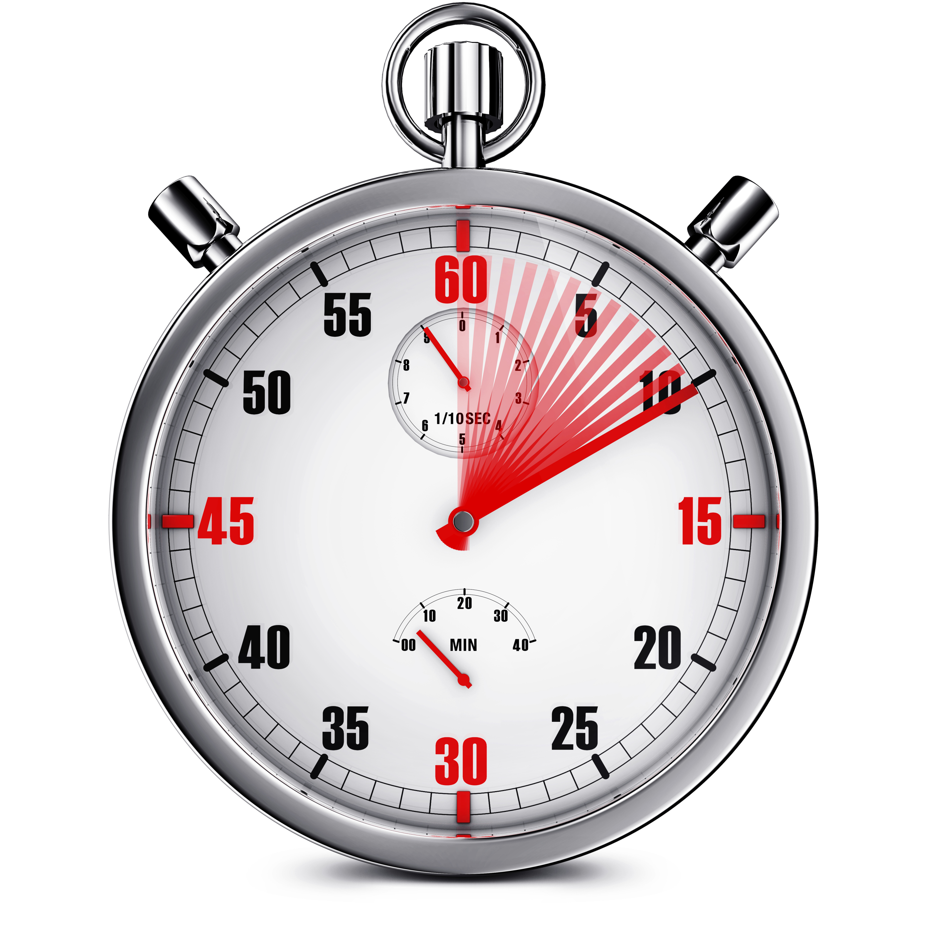
The clock is ticking
We have a lot to accomplish here
Four function areas:
Simple data description
Foundational metadata (variables, questions, categories, etc.)
Codebook
Instrument

Slide 5
For each function we need several parts
Enterprise Architect File
XML Binding
RDF Binding
UML Model
Documentation

Slide 6
This is a lot of work!
We have to be efficient
Some ground rules:
No academic discussions
Use “parking lot“ approach
Set goal for # objects to cover
Status report meeting on Thursday morning – we want to tell a good story

Slide 7
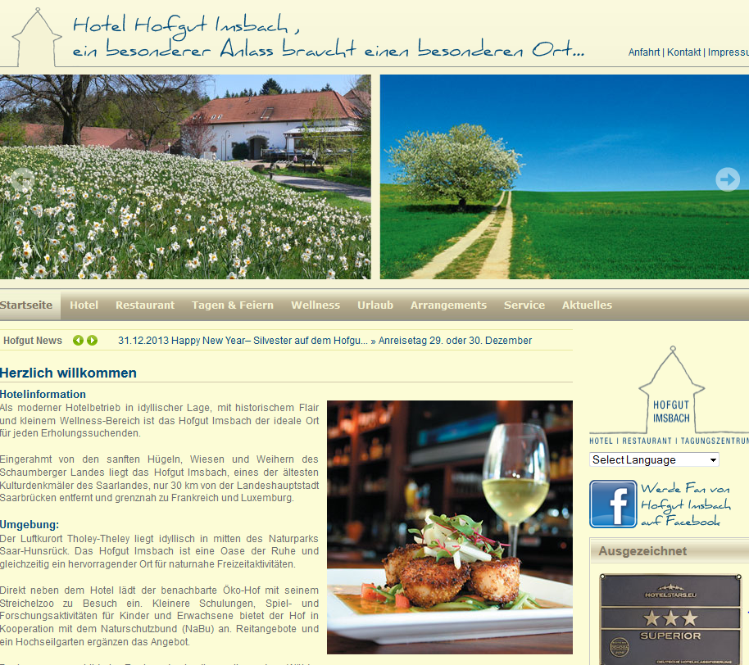
Rewards
A job well done!
A special dinner on Thursday night

