Slide 1
Qualitative Data in DDI

Slide 2
What is “Qualitative Data”
Text, mixed mode documents
Images
Video
Physical Objects

Slide 3
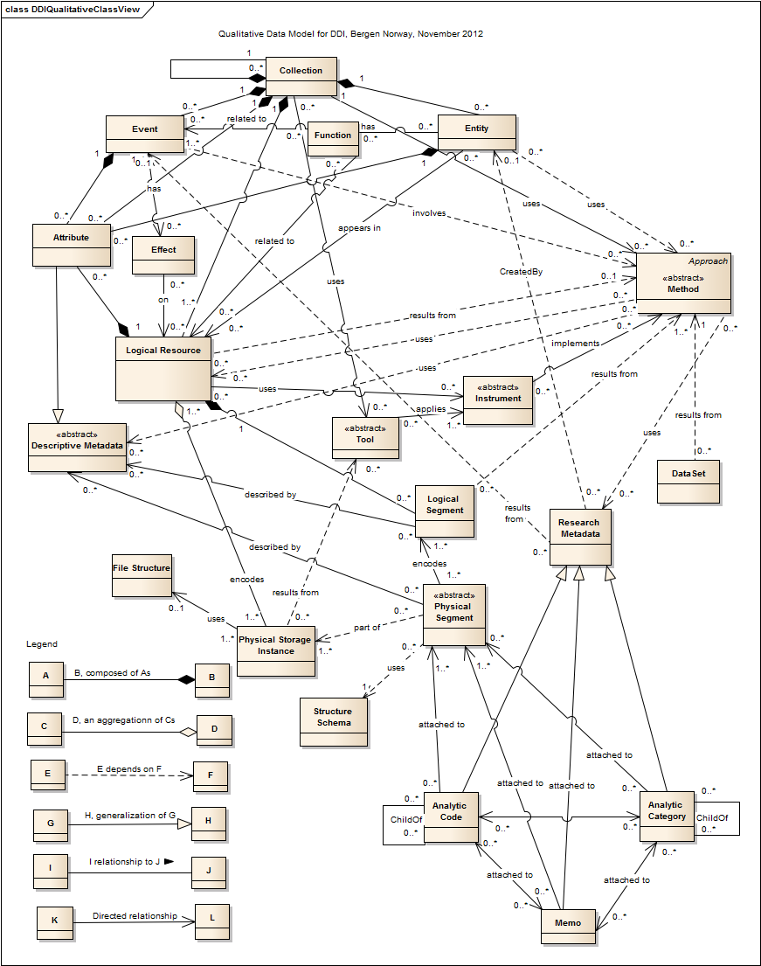
From Qualitative Working Group (QWG) Top Level

Slide 4
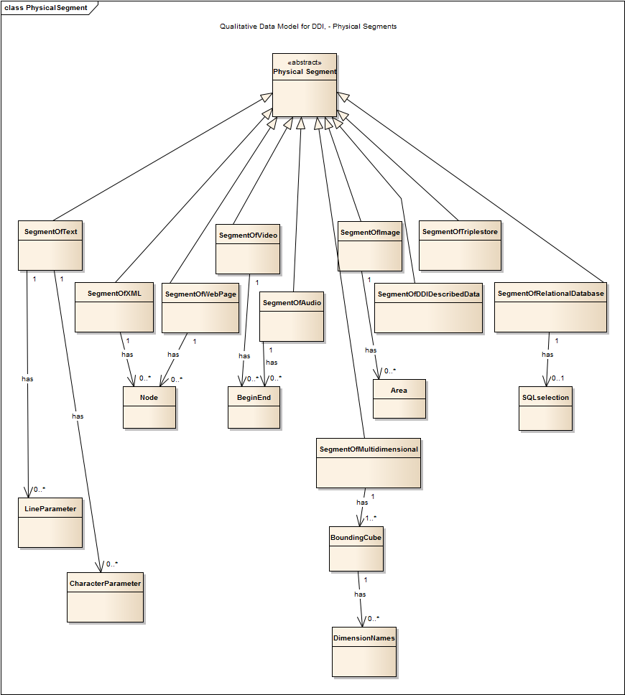
From Qualitative Working Group (QWG) Segment Definition

Slide 5
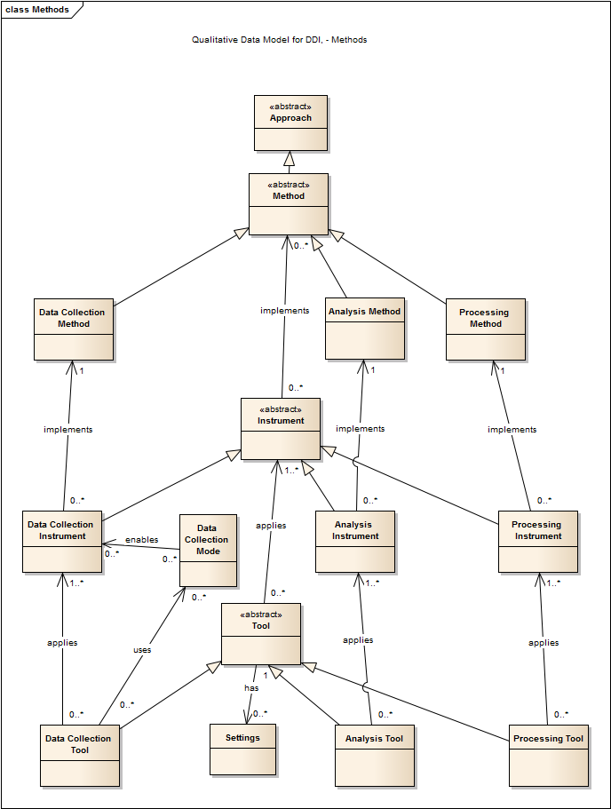
From Qualitative Working Group (QWG) Methods

Slide 6
(QWG) Collections, Resources, Events, Method

Slide 7
(QWG) Files, Segments, Codes, Categories, and Memos

Slide 8
DDI4
A lot of what QWG modeled was already in DDI4
DDI4 has Collections and Relations

Slide 9
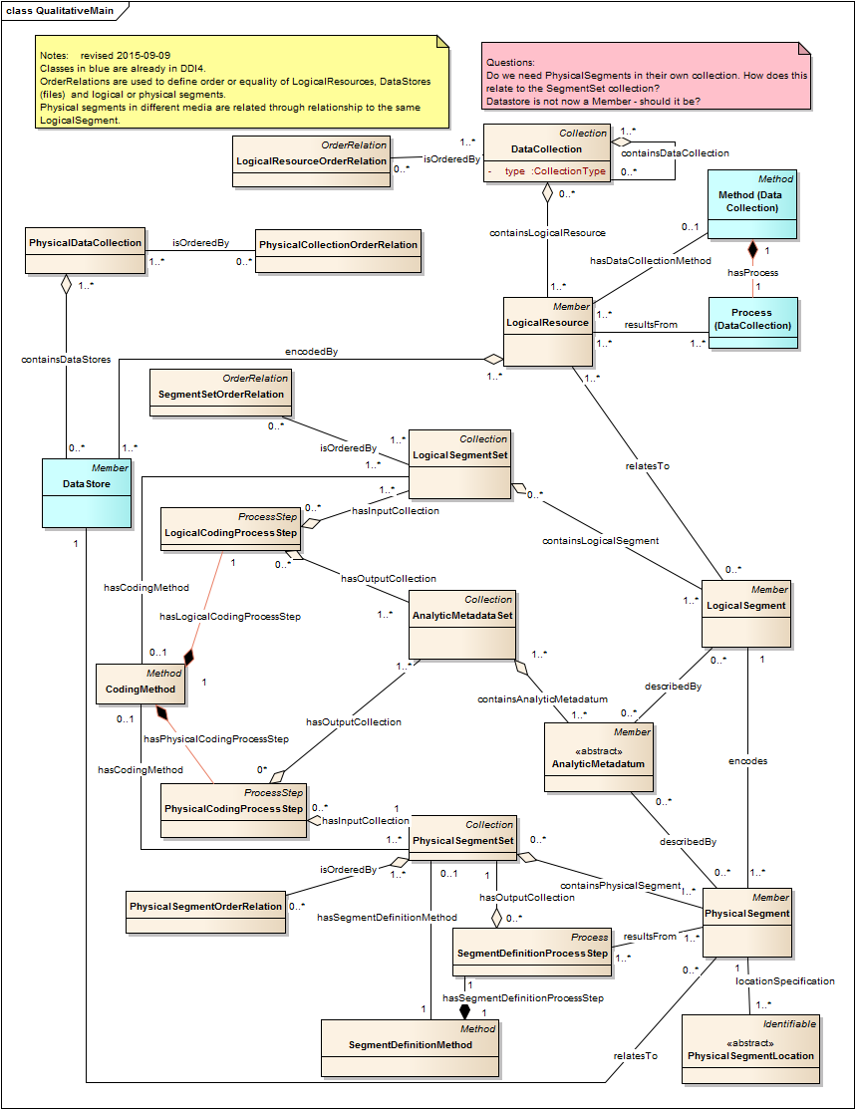
DDI4 Main

Slide 10
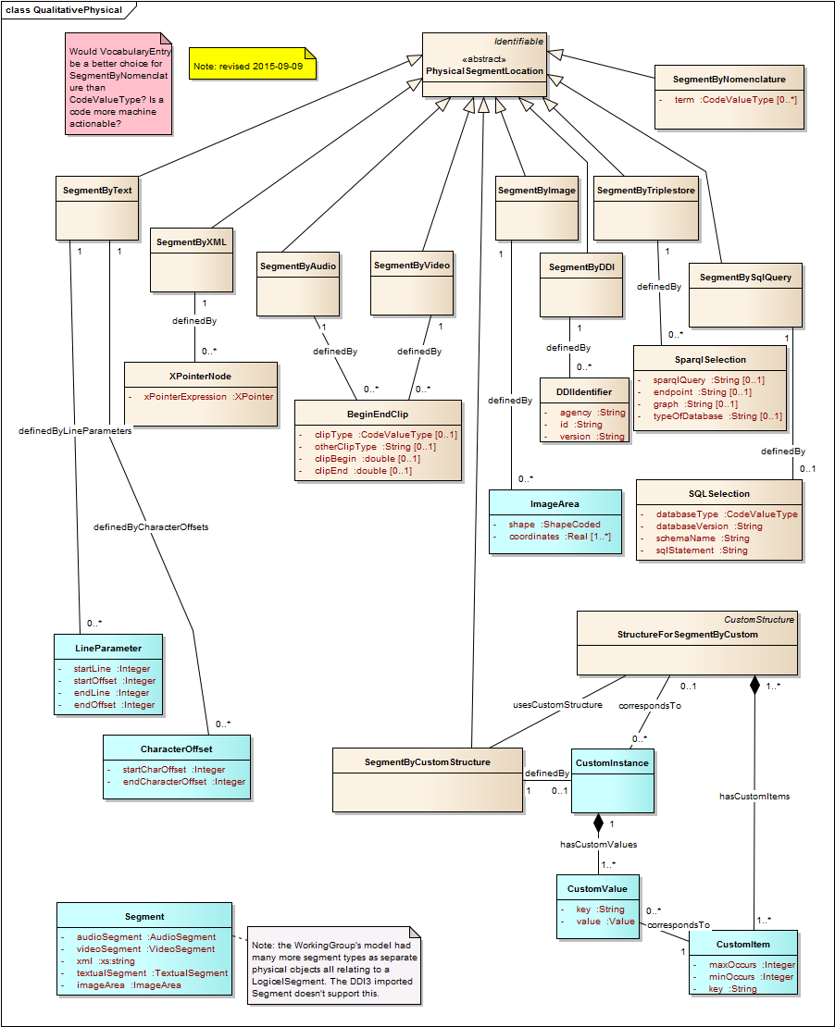
DDI4 Physical

Slide 11
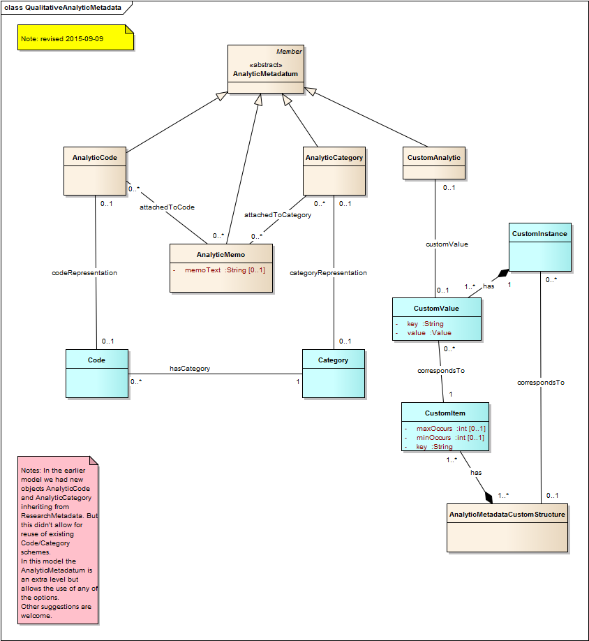
DDI4 Analytic

Slide 12
Use Case
Novel with alternate endings
Original is digital text stored in one file per chapter
Chapter 3 has two versions (alternate endings)
Derived version is audio stored as one stream with alternate chapter 3 in sequence

Slide 13
Text and Derived Audio
Original Text
Hierarchical Document in Multiple Files
e.g. novel with alternate endings
Derived file
Audio in one file,
addressable segments
Chapter 1
Chapter 1
610239 ms
Chapter 2
Chapter 2
1210239 ms
Chapter 3a
Chapter 3a
Chapter 3b
1910239 ms
Chapter 3b
2510239 ms

Slide 14
DDI4 Relations
Collection: Family
In UML
parent
Jim
Collection
ParentChildPair
1..n
0..n
In DDI4 relations between objects are described with a set of objects describing the relationship between a pair of other objects
0..n
1..n
child
Jim Jr.
Relation
Members
parent
ParentChildPair
1
Jim III
n
RelationPair
child
Collection: Novel
precedes
Chapter1
HierarchicalPair
Follows
Chapter 2

Slide 15
Relationships among files (order)
Hierarchical Document in Multiple Files
e.g. novel with alternate endings
Collection: Linear Document in Multiple Files
Chapter 1
Chapter 1
precedes
precedes
RelationPair
RelationPair
follows
Chapter 2
follows
Chapter 2
precedes
precedes
precedes
RelationPair
RelationPair
RelationPair
follows
follows
follows
Chapter 3
Chapter 3a
Chapter 3b
equivalent
equivalent
RelationPair
Order relations might be used to describe relationships among files for qualitative objects. Two alternative cases are
shown here. One a simple linear ordering, the second a more hierarchical relationship among files.

Slide 16
Relationship among files (derivation/provenance/linking)
Original Text
Hierarchical Document in Multiple Files
e.g. novel with alternate endings
DerivationRelation
Derived file
Audio in One File,
Addressable Segments
RelationPair
Chapter 1
from
to
{
Chapter 1
RelationPair
610239 ms
{
Chapter 2
Chapter 2
from
to
RelationPair
1210239 ms
from
to
{
Chapter 3a
Chapter 3a
Chapter 3b
1910239 ms
{
Chapter 3b
from
RelationPair
to

Slide 17
Segment descriptions
Segment 1
Start: 204537
End: 290543
Chapter 1
Chapter 1
Segment 2
Start: 184123
End: 537986
610239 ms
Chapter 2
1210239 ms
Chapter 3a
1910239 ms
Chapter 3b
2510239 ms

Slide 18
DDI4 Custom Metadata Classes could allow segment descriptions http://lion.ddialliance.org/package/custommetadata
Using the Structure
CustomValue: Segment 1
CorrespondsTo: TimedAudio
Start: 204537
End: 290543
Defined Once and Reusable
CustomStructure: TimedAudio
CustomItem: Key=“Start”,
numeric,
maxOccurs=1,
minOccurs=1
CustomItem: Key=“End”,
numeric,
maxOccurs=1,
minOccurs=1
CustomValue: Segment 2
CorrespondsTo: TimedAudio
Start: 184123
End: 537986

Slide 19
For “Well Known” Descriptions these can be built-in Classes
TimedAudioSegment
Start: 204537
End: 290543
TimedAudioSegment
Start: 184123
End: 537986

Slide 20
Segment Descriptions – Allen’s Interval Algebra? https://en.wikipedia.org/wiki/Allen%27s_interval_algebra
The relationship among segments could be qualified by terms from Allen’s interval Algebra
CustomValue: Segment 1
CorrespondsTo: TimedAudio
Start: 204537
End: 290543
precedes
RelationPair
Predicate: Overlaps
follows
CustomValue: Segment 2
CorrespondsTo: TimedAudio
Start: 184123
End: 537986

