Slide 1
The Data Object Description Type
November 18, 2014

Slide 2
Scope of Data Object References
A data object description type has many facets. These facets conform to the 5WH + SP design pattern:
Who (institutional responsibility, authorship, funding sources)
What (Title(s) and project description – including its spatial, temporal and topic coverage)
When (date of publication)
Where (access points to structure, provenance and the data itself as applicable)
Whether (management of access: who can use, edit, reference a data store)
How (how was data collected, and what additional information may be necessary for its interpretation)
Note that in this design pattern the SP facet group is included by reference under Where

Slide 3
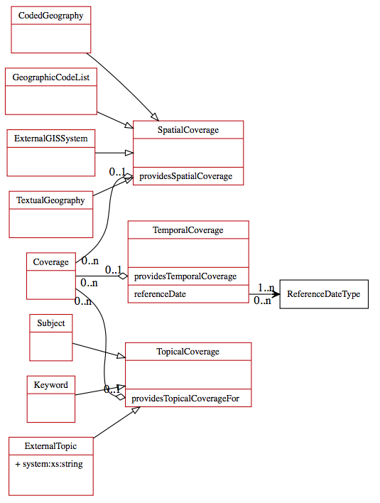
Coverage (What)
Coverage is an extension of What specific to data objects
Coverage conforms to the DDI 4 model of Coverage as shown here
Note that Subject is included in Topical Coverage
Also, note that subjects may come from a controlled vocabulary such as MeSH

Slide 4
Data Structure (Where)
There may be several data structure pointers at Where
One pointer might go to a Physical Description. This would be the DDI 4 Physical Description which is inclusive of the the DDI RDF Physical Data Description Vocabulary (PHDD)
Another pointer might go to the DDI RDF Discovery Vocabulary (DISCO)
Where is inclusive of none, either or both of these pointer types
The thought here is that the data object reference might support different types of search – one in line with DDI4 and the other in line with DISCO and its adopters

Slide 5
Provenance (Where)
One provenance pointer goes to a PROV-O description
We think perhaps a second pointer type might be supported
This might go to a Dublin Core description of the different states that a data object had until it reached its final state
In fact, there is a mapping from Dublin Core to PROV
The mapping indicates how the PROV Data Model might be implemented in Dublin Core

