Slide 1
Controlled Vocabularies for DDI 4
How to represent CVs?

Slide 2
Currently Used Options
Genericode (used in DDI Lifecycle 3)
Pro: simple, some generic tools
Cons:
XML only
No hierarchy of codes
No multilingual support
http://www.ddialliance.org/controlled-vocabularies
SKOS
Pro: does the job, acknowledged
Con: RDF only
https://github.com/linked-statistics/DDI-controlled-vocabularies

Slide 3
Requirements
Structure:
Value of the Code: hierarchy should be possible
Descriptive Term of the Code
Definition of the Code: multilingual text
Representation in the UML model
Representation as OWL/RDF
Representation as XML Schema

Slide 4
Possible Solution
SKOS
Reverse-engineered UML model
Existing work: from CSIRO SEE GRID
XML Schema derived from UML model

Slide 5
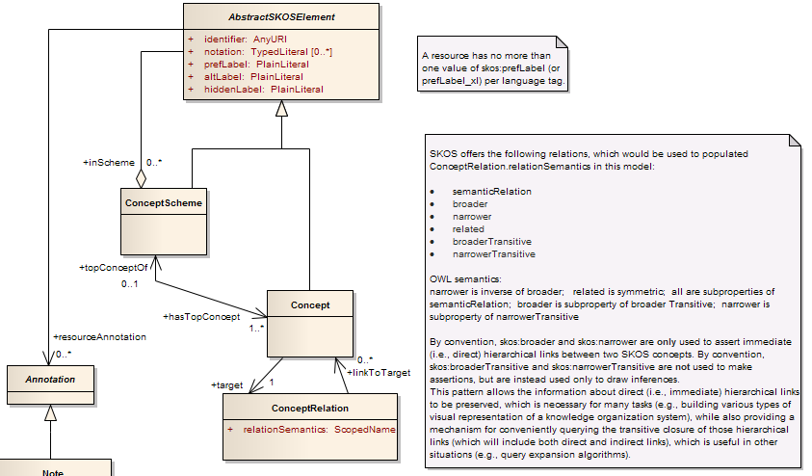
Core SKOS (CSIRO SEE GRID)

