Slide 1
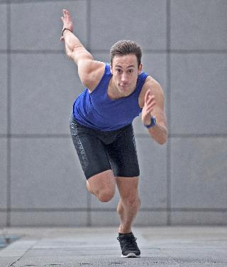
DDI Moving Forward: Sprint 5
Schloss Dagstuhl October 20 - 24, 2014

Slide 2
Why Are We Here?
To build the next-generation DDI specification based on a data model
Goals:
Improve DDI usability
Expand DDI coverage
Express model in different technical formats
Repackage the specification
Enhance the documentation

Slide 3
Progress
Began at Dagstuhl in 2012 with a paper describing the modeling approach and design principles
http://dx.doi.org/10.3886/DDIWorkingPaper04

Slide 4
Progress
Sprint #1 at Dagstuhl in 2013

Slide 5
Progress
Sprint 2 – Paris, December 2013
Sprint 3 – Vancouver, April 2014
Sprint 4 – Toronto, May 2014
Future Sprints Planned
Sprint 6 – London, December 2014
Sprint 7 – Madison, WI, April 2015
Sprint 8 – Minneapolis, MN, May 2015

Slide 6
Accomplishments
Adopted Agile approach with Project Manager (thank you to Therese Lalor)
Established Drupal site for modeling work – lion.ddialliance.org
Established collaboration wiki -- https://dditools.atlassian.net/wiki/display/DDI4
Developed new DDI structure: Functional Views on the Library of Elements -- https://dditools.atlassian.net/wiki/display/DDI4/Structure+of+DDI+4

Slide 7
Teams
Simple/Complex Codebook (Active)
Simple/Complex Instrument (Active)
Simple/Complex Data Description (Active)
Discovery (Active)
Classification (Active)
Modeling (Ongoing)
Production (Ongoing)
Enhanced Citation
Qualitative
Methodology
More teams will come into being as others phase out.

Slide 8
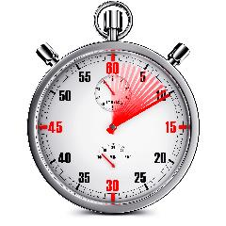
The clock is ticking
We have a lot to accomplish here, including new work related to data citation (thank you to Larry Hoyle)
New Project Manager and Sprintmaster, Kelly Chatain, to help keep us on track
Need to use time wisely to be productive

Slide 9
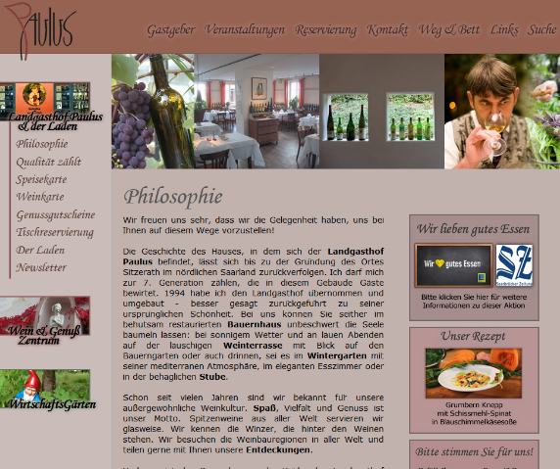
Rewards
A job well done!
Special dinner on Thursday night
Landgasthof Paulus & Der Laden

