Slide 1
Methodology Revisited
Knutholmen Sprint

Slide 2
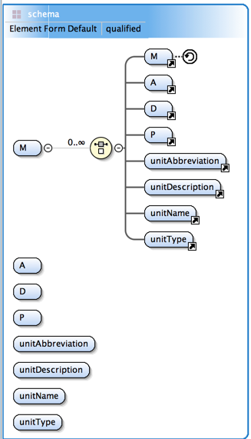
Methodology Progress Note
The model in Drupal was revised in a thought experiment to support studies, RAIRD-like investigations, randomized control trials (RCT) and other research methodologies together with the methodologies they use like sampling, weighting, cohort discovery, etc.
A couple of approaches were weighed
I worked backwards from an XML instance and eventually this schema.
The strength of the schema is that it is at once very expressive and flexible
The weakness of the schema is that because it is so flexible it doesn’t conform to the collections design pattern as a whole. Only the process (P) component does
Instead the schema seems to conform to a factory design pattern where a methodology factory creates both methodologies and factories that create methodologies
Note that because both methodologies and methodology factories are created, different attributes and relationships apply. So for methodology factories and methodologies different profiles are needed
I am currently trying out the model with Studies, RAIRD and RCT
I created the three UML models based on the schema and wrote some “pseudo-instances” corresponding to each model
Next I need to create actual instances
Perhaps what is most promising about this approach is that it generalizes DDI subsuming studies and collection under research methodologies and the design/algorithm/process triple to support many types of capture and data

Slide 3
DDI 4 Data Lifecycle
Research Methodologies
Measurement
Collections
Capture and Structuring
Processing
Documentation
Format
DDI 4 UberModel

Slide 4
Models and Pseudo-Instances

Slide 5
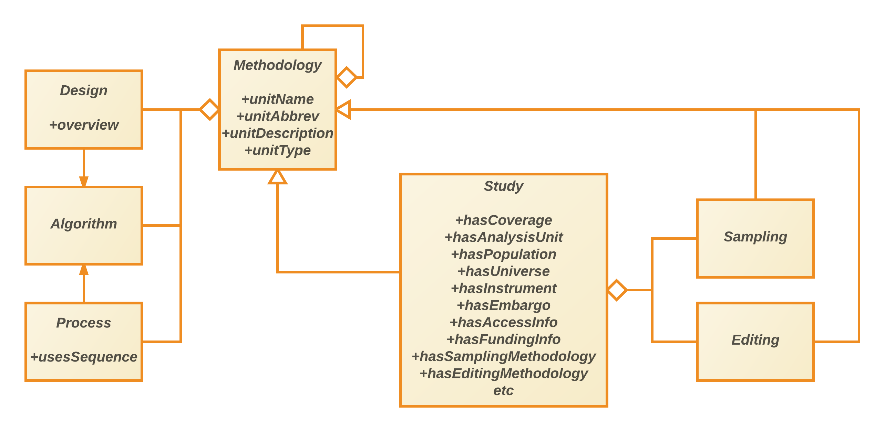
Research Methodologies (1)
DDI 4 UberModel

Slide 6
Research Methodologies (1) - Example
Study Management
profile: no instrument
Initial Study
Subsequent Study
Final Study
Process
usesSequence
Initial Study precedes Subsequent Study
Subsequent Study precedes Final Study
DDI 4 UberModel

Slide 7
Research Methodologies (1) – Example (continued)
Initial Study
hasSamplingMethodology
hasInstrument
hasEditingMethodology
Process
usesSequence
Perform Sampling(sample) precedes Ask Instrument(sample, data)
Ask Instrument(sample, data) precedes Store Data(data, store)
Store Data(data, store) precedes Perform Editing(store, store)
DDI 4 UberModel

Slide 8
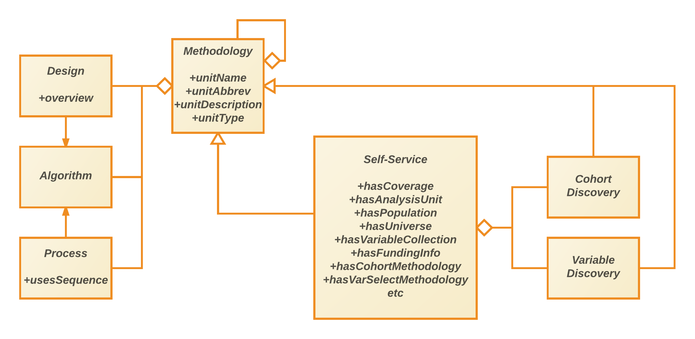
Research Methodologies (2)
DDI 4 UberModel

Slide 9
Research Methodologies (2) - Example
Self Service Management
profile: no variable collection
Initial Self Service
Subsequent Self Service
Subsequent Self Service
Process
usesSequence
Loop while continue
Conditionally perform Self Service(listener(self service, legal), continue)
DDI 4 UberModel

Slide 10
Research Methodologies (2) – Example (continued)
Self Service Management
Initial Self Service
profile: cohort discovery, variable discovery
Process
usesSequence
Perform cohort discovery(population, cohort) precedes Perform variable discovery(cohort, variable list)
DDI 4 UberModel

Slide 11
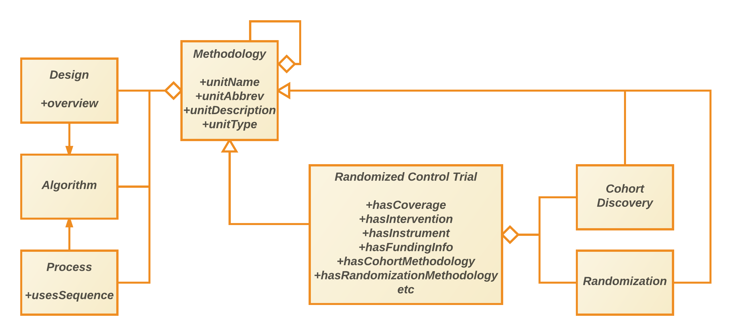
Research Methodologies (3)
DDI 4 UberModel

Slide 12
Research Methodologies (3) - Example
RCT Management
profile: uses cohort discovery and randomization
Intervention Arm
Control Arm
Process
usesSequence
Identify Cohort(population, cohort) precedes Perform Randomization(cohort, Intervention Arm, Control Arm))
DDI 4 UberModel

