Slide 1
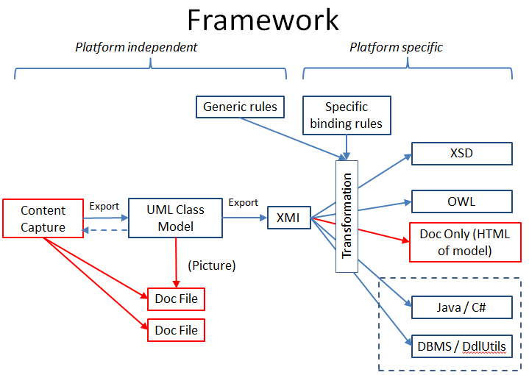
Content
modellers define
views, but
create needed
new objects.
View
Formal modellers
create Packages in
the library.

