Slide 1



Moving Forward
IASSIST Sprint

Slide 2
Housekeeping
Internet
  Network: UofT
  Username: iassist2014
  Password: robarts
Lunch
Toilets

Slide 3

What is a Sprint?

Slide 4
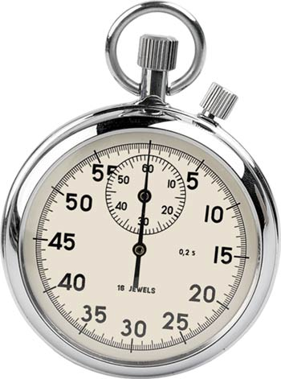
Time boxed sessions with specific outputs

Slide 5
Sprint rules
Accept personal responsibility for the success of the Sprint process and its outputs
Contribute and share generously and openly - all perspectives are valid and important
There is no hierarchy in the group of Sprint participants
Actively listen and learn from others perspectives and experiences
Participate fully – without diversions or interruption
Notes:
• Participants should be prepared to work flexible hours throughout the Sprint and this is likely to involve some out of hours work.
• There is no hierarchy in the group of Sprint participants. Everyone is expected to contribute and be listened to equally.

Slide 6
Sprint Master assists the Product Owner in planning the release and making resources available
Sprint Master (Thérèse):
responsible for facilitating the process
Sprint Master helps Sprint Team make progress by removing impediments
Planning
Progress
Product Owner:
represents the DDI Alliance and owns the requirement
Sprint Team: responsible for completing the work
Clarification
Product Owner works with Sprint Team to provide clarification and approval for requirements

Slide 7
Sprint roles: Sprint Masters
The Sprint Master serves as the team's coach, helping team members work together in the most effective manner possible.
Provides a service to the team, removing impediments to progress, facilitating meetings and discussions
The Sprint Master’s authority extends only to the process.
The Sprint Master is an expert on the process and on using it to get a team to perform to its highest level.

Slide 8

In-Sprint Feedback
AGREE:
DANGER:
Too much detail!
INFORMATION: I want to say something
STOP:
I think we’re off the topic

Slide 9
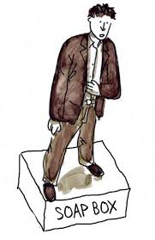
Soap box
Opportunity to air opinions, propose controversial perspectives, challenge thinking
2 x 2 minute timed daily sessions
No questions or discussion during the session
Daily bookings received at 8.50am

Slide 10

Posters
WANTED
….
for…..?

Slide 11
Sprint Team
The team itself assumes the responsibility for determining how to best achieve the output.
Team members will collaboratively decide which person should work on which tasks and so on.
All participants need to come with an open mind, be prepared to listen to other points of view and contribute freely to the process.
This means that everyone must be prepared to lead, organise, contribute, create and critique within the Sprint process.
        All participants will be expected to assist in a variety of tasks including research, consultation or documentation.
Notes:
A Sprint is a creative process – it is designed to energise participants, generate new ideas, stimulate creativity and accelerate learning and solution design.

Slide 12

Introductions
……..

Slide 13
Missing people
Jon Johnson (remote)
Barry Radler (Wednesday – Friday)
Johan Finn (Thursday – Friday)
Olof Olsson (Thursday – Friday)
Brigitte Mathiak (Thursday – Friday)

Slide 14
Setting the Scene
Notes:
Methods and Technology (in the form of components to support statistical production) – together with Process and Data Repositories – are the primary targets for sharing and reuse within the Strategy.
A key step along the way is likely to be establishing consistently structured (and linked) libraries of processes, methods and components available for sharing and reuse.

Slide 15
DDI 4 Vision/ Drivers
“The DDI Alliance has initiated new work to build a model-based specification from which technical bindings can be generated. This approach will carry many benefits in terms of communicating with other standards efforts and maintaining consistency”
(from Dagstuhl 2012 paper)
“The objectives of the structural change are to:
Improve its functionality from a technical perspective
Provide a model that is more accessible to users, particularly those outside the traditional social sciences
Create a more flexible base for further development and coverage extensions”
(from Moving Forward Paper circulated to Members in February 2014)

Slide 16
Agile is:
DDI 4 Design Principles
Iterative and incremental
Adaptive
Value based
Transparent
Iterative Development – The model is developed iteratively, bringing in a range of views from the user community.
User Driven – User perspectives inform the model to ensure that it meets the needs of the international DDI user community.
Agile is inline with our design principles

Slide 17
DDI 4 Product Vision
Architecture / Structure
  (paper from NADDI – April 2014)
Coverage
  (what will the model include – listed in many papers)
Timelines
  (Moving Forward Paper circulated to Members in February 2014 says “project will be completed in 2015)
Operational guidelines
  (Process paper from April 2014)
Resources
  (varies on an ongoing basis, continued push to user group to become involved)

Slide 18
When DDI 4 is complete….
(Using an archive as an analogy)

Slide 19
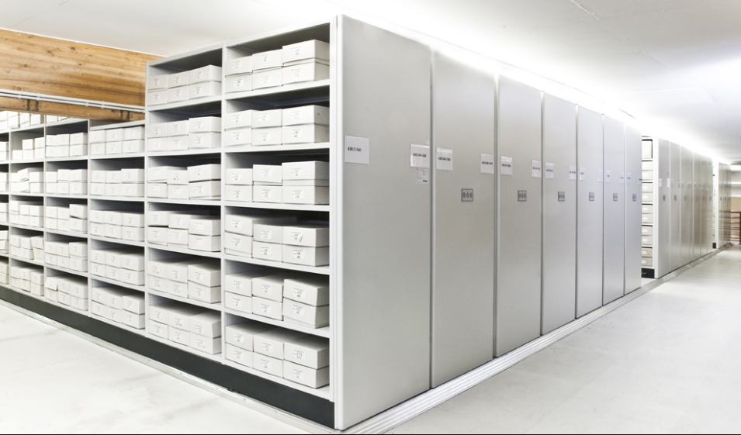
Imagine the DDI4 is like an archive. There is a room full of the information that DDI 4 covers. This information in is nicely organised into rows and shelves and boxes.
Data sets
Constructs
Physical data structures
Study
Glue
Data file
Data
Logical data structures
Record layout

Slide 20
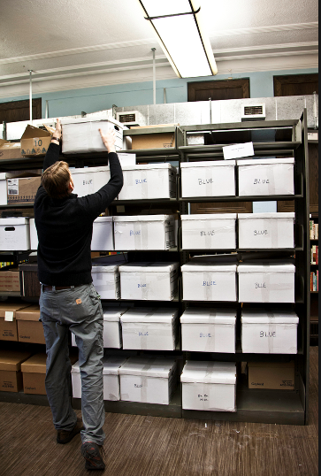
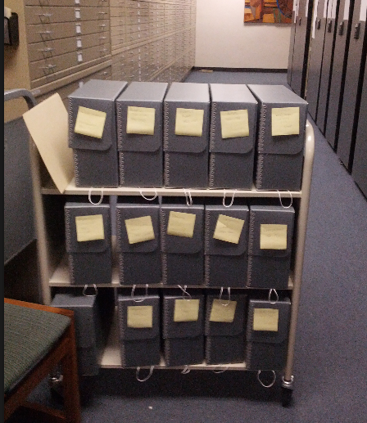
Typical users will come to the archive with a particular use case in mind. The archivist will give them the subset of information that is most useful to them.

Slide 21

Sophisticated users will be able to go into the actual archive to find the set of information that is most useful to them.
Most people never see the way the information is sorted into rows, shelves and boxes.

Slide 22
IN DDI 4 terms..
Library
Package
Data sets
Constructs
Physical data structures
Study
Glue
Data file
Logical data structures
Record layout

Slide 23
IN DDI 4 terms..
View

Slide 24
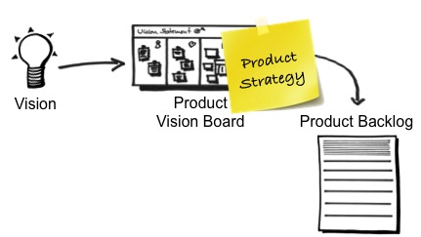
1. We have a vision and agreed drivers for why we are developing DDI 4.
2. We have developed a vision of what DDI 4 will look like.
3. We have to state what the product backlog is.

Slide 25
Product Backlog
DDI 4 Product Backlog
Agent
Conceptual
Process
Core
Discovery
Simple Instrument
Simple Data Description
Collection Management
Data Management Plan
Study Inception
Simple Codebook
Complex Survey
Complex Data Description
Comparison/Harmonisation
Classification
Qualitative
Survey Development
Data Capture Methodology
Field Work Management
A Product Backlog is a high level list of customer requirements for the project. It is a list of the features / functionality that we want in the final product
Each item has an associated user story.

Slide 26
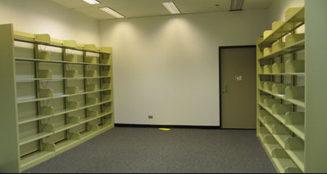
Creating DDI 4
At the moment our library is empty ☹

Slide 27
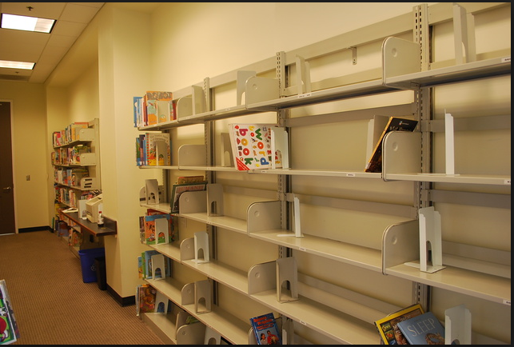
Creating DDI 4
We have to build the library.
The plan is to put in the information that we think the most people will need first
Process
Agent
Core
Concepts
Process
Discovery
Concept
Agent

Slide 28
Creating DDI 4
We know this is not complete and don’t know exactly how best to organise the information yet.
Release 1:
Information about:
Agent
Core
Concepts
Process
Use case:
Discovery
Process
Process
Concept
Concept
Agent
Agent

Slide 29

Creating DDI 4
We will start to work with people who have particular use cases (eg describing a simple instrument). We will have some of the information that is important to them and they will help us find the bit we are missing…and so the library get more things in it.
Release 2:
Information about:
Agent
Core
Concepts
Process
Use case:
Discovery
Simple Data Description
Simple Instrument
Classifications

Slide 30

Creating DDI 4
The further we go through the process, the less new things should have to be added to the library. For example, there should already be a lot of information in the library for complex instrument, because we already have the information for simple instrument.
Each release builds on the information already in the library.
Release 3:
Information about:
Agent
Core
Concepts
Process
Use case:
Discovery
Simple Data Description
Simple Instrument
Classifications
Simple Codebook
Comparison/ Harmonisation
Methodology
Complex Instrument
Complex Data Description

Slide 31
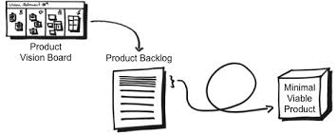
Iteration
Minimally Marketable Products
Based on the objective to be iterative and incremental (no big bang releases), the idea of a Minimally Marketable Product is important. “There is only value if features are delivered to the customers”
What are the sets of features that provide value to our users?
The Product Backlog is grouped into the Minimal Marketable Products. A Minimal Marketable Product is released at the end of each iteration.

Slide 32
DDI 4 Product Backlog
Agent
Conceptual
Process
Core
Discovery
Simple Instrument
Simple Data Description
Collection Management
Data Management Plan
Study Inception
Qualitative
Survey Development
Field Work Management
Classification
Simple Codebook
Complex Survey
Complex Data Description
Comparison/Harmonisation
Data Capture Methodology
MMP includes information that will be common to the majority of users
MMP covers use cases that are common to majority of users – something for everyone’s needs
MMP builds of previous MMP to provide more complicated user stories that are needed by majority of user community
MMPs to be decided: Specific use cases for particular sections of the user community

Slide 33
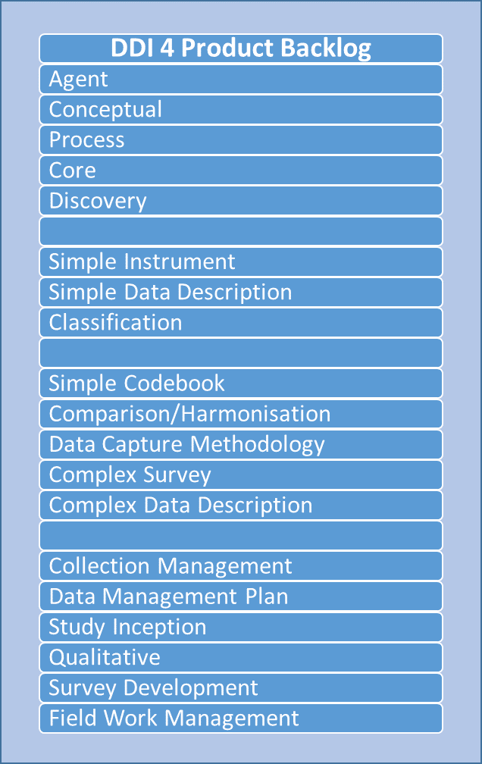
Iteration
No change during iteration
Release
Minimally Marketable Product
Iteration list

Slide 34
Time boxed sessions with specific outputs

Slide 35
Each feature/user story goes through these stages
Requirements
Design
Development
Quality Assurance
Deployment
View is scoped at a meeting of interested users
Content and data modellers
Documentation and Production teams
QA by TC
View is released for comment

Slide 36
Specific Outputs
Release 1 content modelling complete
Figure out production workflow environment (modelling integration, tools etc)
scoping of the classification, methodology and data production views

Slide 37
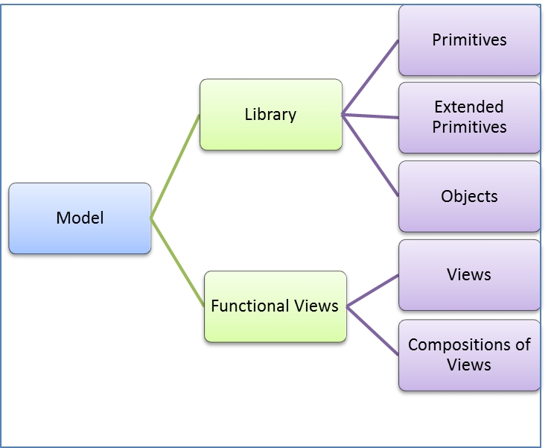
Release 1 work
Design
Core:
  Basic Reusables Description: Objects used directly across DDI in a consistent manner
  Primitives Description: Set of xml primitive data types (xs:string,xs:date, etc.)
  Extended Primitives Description: Extended objects used a primitives in DDI; objects ONLY used as types

Slide 38
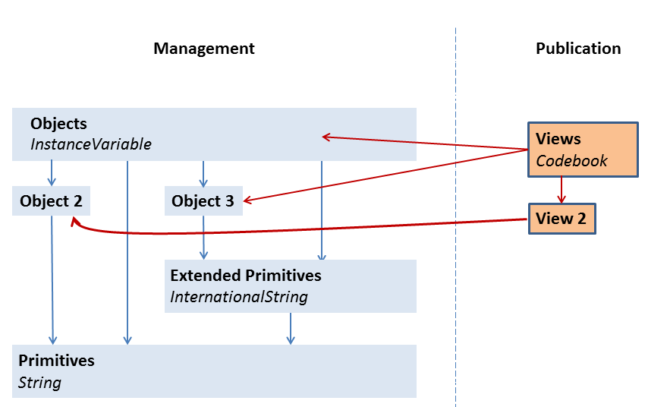

Slide 39
Release 1 work
Design
Agent: Description of agents (organizations, individuals, agents, relationships) who relate to the metadata / data)
Conceptual: Conceptual covers all of the basic components of ISO/IEC 11179 as captured and represented in the GSIM Concepts Group.
Process: Process model and requirements for provenance chain

Slide 40
Release 1 work
Design
Discovery: Enables discovery of relevant metadata and data products at the study, file, and data item (i.e., variable) level. The primary purpose is for discovery of data for re-use (i.e., research and/or analysis), which would enable filtering of search or browse results according to metadata criteria (such as the topical, temporal, or spatial coverage of the data, among others). Additional purposes the view should support are discovery of study products for re-use (e.g., questions or survey instruments for development of another survey) as well as [anything else?]. The group also is considering other potential discovery purposes—discovery of metrics of usage of data products [anything else?]—but are still defining what is in scope.
Out of scope: The Discovery functional view is not intended to (once a study or data item is discovered) provide a thorough description of the study or data for proper re-use; this purpose would be in scope for the Codebook view. The Discovery view also is limited in its coverage of methodology issues to those that would be a factor in discovery, but is not intending to describe the full methodology of how the data was produced (for understanding or to trace back to underlying data sources).

Slide 41
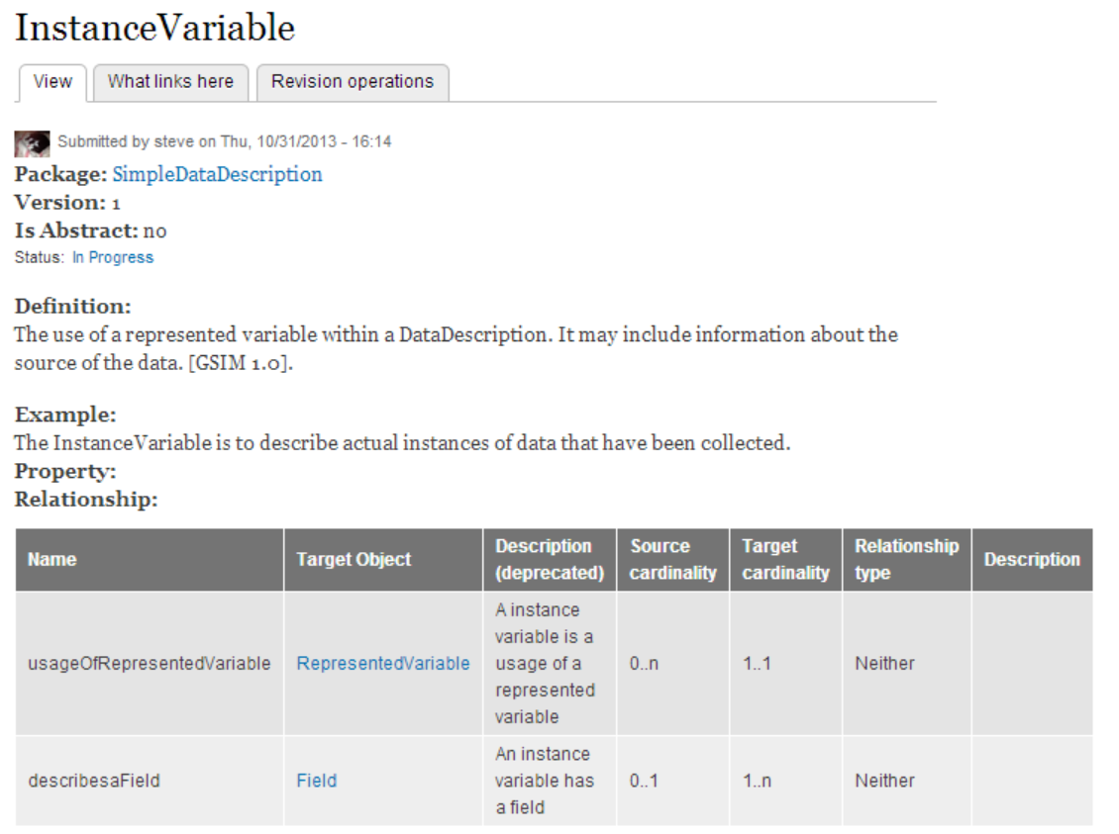

Slide 42
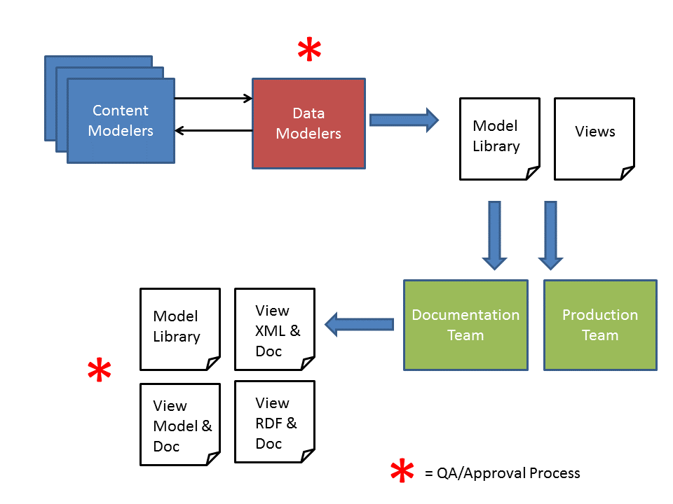

Slide 43
Release 1 work
Design
Relating to other standards
  Something that has been raised by a number of content teams is how we relate to other standards. Examples of other relevant standards are GSIM, 11179, PREMIS
  We need to take a decision on this to ensure each group is consistent.

Slide 44
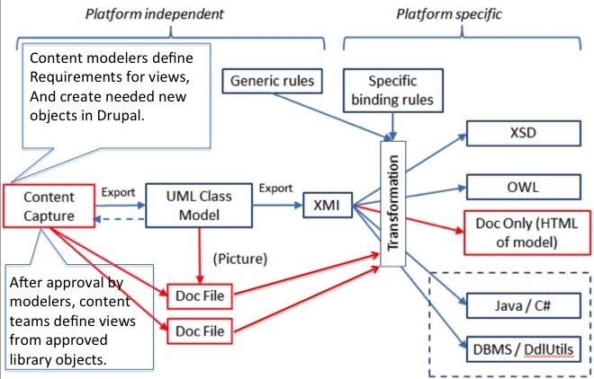
Production Framework
Development
How is this going
to work??

Slide 45
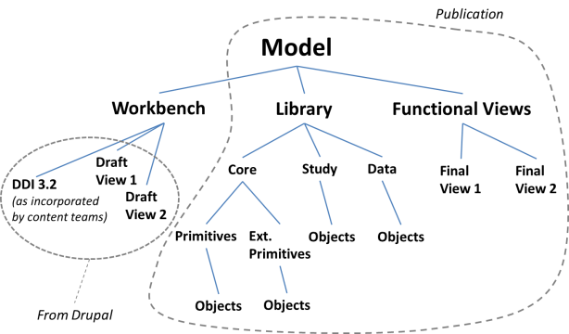
Production Framework
Development
How is this going
to work??

Slide 46
Scoping / user stories
Requirements
Classifications
Methodology
Data Production

Slide 47
Agenda
Content modelling:
  Core
  Discovery
  Agent
  Conceptual
  Process
  Relating to other standards
production workflow environment
Scoping:
  classification,
  methodology and
  data production views

Slide 48
Managing the Sprint Work Program
Individuals sign up for work of their own choosing
Work is never assigned
Estimated work remaining is updated daily
If work is unclear, define a sprint work item with a larger amount of time and break it down later
Update work remaining as more becomes known

Slide 49
Daily Work Programming & Planning
The daily review meeting is used to:
  inspect progress toward the Sprint goals
  make adaptations to the work program that optimise the value of the next day
  inspect progress toward the expected outputs
  agree and distribute overnight work tasks

Slide 50
Agenda
Content modelling:
  Core
  Discovery
  Agent
  Conceptual
  Process
  Relating to other standards
production workflow environment
Scoping:
  classification,
  methodology and
  data production views
Started
Started

Slide 51
Monday | Tuesday | Wednesday | Thursday | Friday
Introduction Relevant Standards Listing the Technical work | Conceptual continued EA packages XMI docbook….? 10.30 Discovery scope Which pictures? |  | Scoping Methodology, classifications, data production
Conceptual Content modelling Relevant Standards document Technical work action plan

Slide 52
 | Structure of DDI 4 | Updated paper
Content work | Core | Rules for primitives and extending primitives, drupal updated
 | Agent | All objects in Drupal and reviewed, Update for team
 | Conceptual | All objects in Drupal and reviewed, Update for team
 | Process | All objects in Drupal and reviewed, Update for team
 | Discovery | New objects created in Drupal, view created and reviewed, Update for team
 | Relating to other standards | Document
Technical | Issues around production environment | Roadmap document
 | Transformations | Documentation to HTML Documentation to PDF XMI to XSD XMI to RDF Proposal for non RDF, non XSD deliverables (eg SQL, Java, C#)
 | Test production workflow environment | Inputs and outputs created for each stage, documentation of dry run
Scoping | Classification | Scoping document written
 | Methodology | Scoping document written
 | Data Production | Scoping document written

