Slide 1
Object Description by Data Records
DDI Moving Forward - IASSIST Sprint, May 2014
Joachim Wackerow
Larry Hoyle

Slide 2
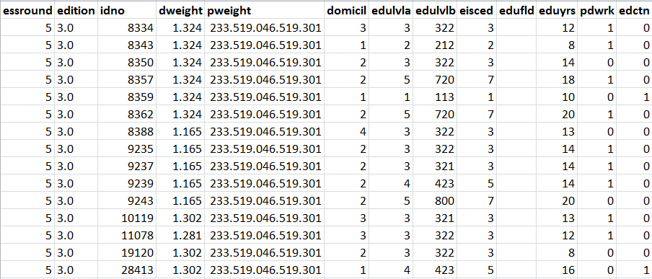
Excursion: Data Record for Survey Data
Record unit is a person
Variables (like edctn) describe a record unit

Slide 3
Record Types
Record units: person, household, family
I.e. person id necessary
Multiple records per unit
Unit id necessary
Event data: unit documents spans of time ending in an event
Person id necessary

Slide 4
„Community Profiles“
Demographic variables
(Social science) classifications like ISCO, ISCED
Unit identifiers for describing relationships (i.e. person/household)

Slide 5
Description of Object Segments by Data Records
Larry Hoyle had this idea while a stay at GESIS in November 2013
Larry presented at NADDI 2014: „Alternatives for Representing Coding of Qualitative Data in DDI“

Slide 6
Codes and Memos
“Dinner site”
“Presentations”
Memo: This is marked here for an example in a PowerPoint Presentation
Segments can also be marked in text. Like in this text example.
“Marking”
“Text reference”

Slide 7
Example Records
Dataset
SegmentID | SegmentName | CampusBuilding | EveningVenue | YearBuilt | Address | Cluster1 | MiningVar
1 | AlumniCenter | 0 | 1 | 1983 | 1266 Oread Ave. | 0 | 1.27
2 | StudentUnion | 1 | 0 | 1926 | 1301 JayHawk Blvd. | 1 | 0.8

Slide 8
Example Record - Codes
Codes are handled like “Select all that apply” questions.
Codes
SegmentID | SegmentName | CampusBuilding | EveningVenue | YearBuilt | Address | Cluster1 | MiningVar
1 | AlumniCenter | 0 | 1 | 1983 | 1266 Oread Ave. | 0 | 1.27
2 | StudentUnion | 1 | 0 | 1926 | 1301 Jayhawk Blvd. | 1 | 0.8
1=has code
0=does not
Could have Categories and Memo here as well

Slide 9
Example Record – Other Variables
Quantitative Variables
Text Mining Variables
Codes
SegmentID | SegmentName | CampusBuilding | EveningVenue | YearBuilt | Address | Cluster1 | MiningVar
1 | AlumniCenter | 0 | 1 | 1983 | 1266 Oread Ave. | 0 | 1.27
2 | StudentUnion | 1 | 0 | 1926 | 1301 Jayhawk Blvd. | 1 | 0.8

Slide 10
Data or Metadata?
Depends on use, doesn’t it? (c.f. NSA use of phone “metadata”)
YearBuilt might be metadata when searching for image segments or text descriptions of old buildings
It might be data if we used the text mining variables to predict building age
Metadata?
Data?
SegmentID | SegmentName | CampusBuilding | EveningVenue | YearBuilt | Address | Cluster1 | MiningVar
1 | AlumniCenter | 0 | 1 | 1983 | 1266 Oread Ave. | 0 | 1.27
2 | StudentUnion | 1 | 0 | 1926 | 1301 Jayhawk Blvd. | 1 | 0.8

Slide 11
Possible Usage of Description by Data Records in Future
„Any“ object as record unit:
Segment („qualitative“ data)
New data sources
New instruments
New methods
Approach most powerful together with process description (interplay with process model)

Slide 12
Object Description by Data Records Summary I
Another way of a model „extension“
Description of any objects where no wide agreement exists
Description of objects which are unknown at design time of model
No advanced modelling skills required, less work than a formal model extension
Entity–relationship modelling useful for more complex usage
Can be driven by user communities
Best practices and specific profiles per domain are useful
Data record descriptions in resource package enable reuse and sharing

Slide 13
Object Description by Data Records Summary II
Easy data entry (spreadsheet)
Only software built for a particular community can understand the data records
Proof of concept (theoretical): description of a questionnaire
Similar approach as in ROLAP (Relational Online Analytical Processing)
Could be later transformed to a model extension when semantics are understood and widely agreed

Slide 14
Limitations of Model Extensions
Can only describe current understanding of a domain
Should rely on widely accepted understanding
Requires modelling skills and work for integration in existing model
DDI cannot describe all possible data sources, instruments, methods, and data objects
One possible solution: DDI can rely on metadata standards of other domains. This is not always the case.

Slide 15
Ideas on Future Work
Required machine-actionable additions for DDI 4:
Purpose of „logical product“
Type/role of logical record
Type/role of variable
Description of relationship between variables
Hooks for process description?
Qualitative: identification of purely qualitative objects, possible candidates for DDI 4

