Slide 1
Soapbox: Producing Database Schema for DDI4
Dr. Brigitte Mathiak

Slide 2
Libraries for automation
Conceptual layer
English + UML
Data exchange layer
JAXB
XML Schema
Implementation layer
Java
.NET
TODO
Data storage layer
relDB
JPA

Slide 3
UML meta model
Classes (DDIObject, Study) the entities/objects
Attributes (label, year) properties of said objects
Inheritance (between DDIObject and Study) means one class has all the attributes of the other
Aggregation (between Study and Dataset) Dataset belongs to the study
DDIObject
label
Study
year
Dataset

Slide 4
Example
@Entity
@XmlAccessorType(XmlAccessType.FIELD)
@XmlRootElement(name="DDIStudy")
public class Study extends DDIObject {
@Column
@XmlElement
private String year;
}
<Study id="Tj9vFl">
<label xml:lang="de">ALLBUS</label>
<year>1984</year>
</Study>
<xs:complexType name="Study">
<xs:complexContent>
<xs:extension base="DDIObject">
<xs:sequence>
<xs:element name="year" type="xs:string" minOccurs="0"/>
</xs:sequence>
</xs:extension>
</xs:complexContent>
</xs:complexType>
@JPA
@JAXP
JAXP generates
Minor manual adjustments needed for core and some relationships

Slide 5
Aggregation complex example
@XmlElement(name=„DatasetRef")
@XMLIDRef
@ManyToMany
private List<Dataset> variable = new ArrayList<Dataset>();
Aggregation is a bit more complicated, as it has to be treated differently between XML (one-to-many) and relDB (ManyToMany)
We automatically produce a flat-hierarchy XML with IDs for everything
DB is more complicated
manyToMany is undesirable for many reasons
Better is to restrict navigation as often as possible to produce artificial one-to-many relationships
More on that tomorrow
@JPA
@JAXP

Slide 6
TODO
Synchronize with the work already done by Oliver Hopt concerning XSD Schema
Update the prototype with the new input from this Sprint
Make decisions concerning grouping and its DB representation

Slide 7
Grouping modelling options (1)
*
Code
CodeScheme
Dedicated grouping objects
Disadvantages
Bloats the model, because many objects double
Transforms to a lot of manyToMany tables in DB
Instances have an additional required level
Many level hierarchies have to be modeled explicitly
Advantages
Can model every level of type safety

Slide 8
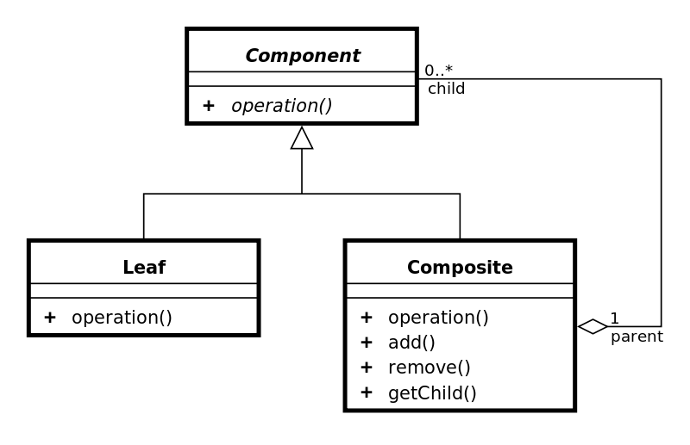
Grouping modelling options (2)
Composite pattern:
Reduces complexity on the instance level
Really simple DB representation
OR
Component
information | parent
Component
information | parent | hIndex

Slide 9
… even simpler
This is the natural collapse of the Composite Pattern
(only if both leaf and the composite do not carry additional attributes)
This is not type safe
*
Stuff

Slide 10
Target structure
<DDIDocument >
<FirstObject id=„XXX“>
<Property>property value</Property>
…
<SecondObject>
<ObjectReference>XXX</ObjectReference>
…
</DDIDocument>

