Slide 1
Using the Collections Pattern
Jay Greenfield
8/3/15

Slide 2
Dan Gillman’s Sampling Plan (Design)
Dan put together a sampling model that is at once simple and arguably exhaustive
The model was, however, developed before all the work on Collections that Flavio Rizzoli has been leading
In the next few slides I place Dan’s model in a Collections framework and then “test” the new model by instantiating it with a real world example

Slide 3
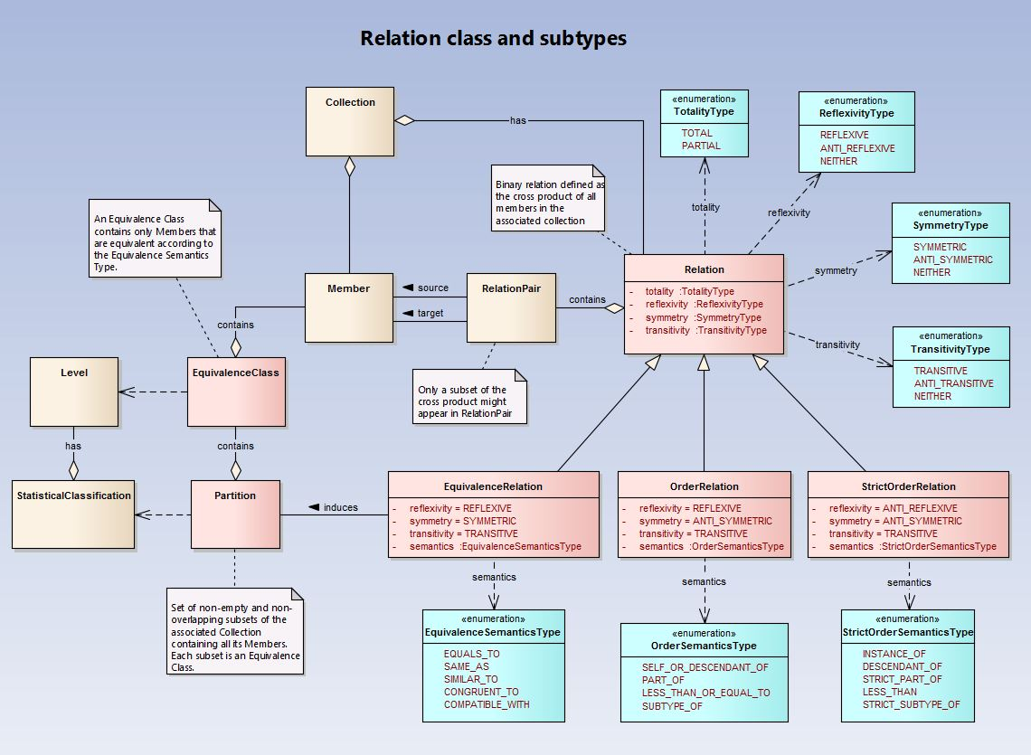
Aligning the Sampling Plan with the Collections Pattern
The collections pattern is a work in progress
The relation subtypes are not exhaustive
The pattern began with an OrderRelation and now it is growing
See Drupal for proposal details for a collections aligned sample plan

Slide 4
A Collections Aligned Sampling Plan (Drupal)

Slide 5
An Instantiation of a Collections Aligned Sampling Plan
Sample Overview
StageRelation
StageRelationPair
Provider is followed by Patient
Stage
Provider
Stage
Patient
StageSampleRelation
StageSample RelationPair
Physician Practice is followed by Hospital
StageSample
Hospital
StageSample
Physician Practice
StageSampleRelation
StageSample RelationPair
Physician Practice contains Monday appointments
StageSample RelationPair
Monday appointments are followed by Wednesday appointments
StageSample RelationPair
Wednesday appointments are followed by Friday appointments
StageSample
Monday appointments
StageSample
Wednesday appointments
StageSample
Friday appointments
StageSampleRelation
StageSample RelationPair
Hospital contains New Patient Admissions
StageSample
New Patient Admissions
This is a multi-stage sampling design in which first two types of providers are sampled – physician practices and then hospitals. Then patients are sampled within providers.
What isn’t clear in the SampleStageRelations here is how each patient might have exactly one chance of being selected. We think this detail might be specified in the SampleStage.
Alternatively, there are the relations. They might have this role. One thing for sure we need to think through are the kinds of inference we can make across different relations like “contains” and “follows”.

