Slide 1
Adaptive Protocols and the DDI 4 Process Model
Jay Greenfield Booz Allen Hamilton
NSF-Census Research Network Meeting Spring 2014
Suitland, MD

Slide 2
Agenda
Describe several uses of an emerging process model that is part of the future DDI 4 specification
The uses we will cover today include:
The representation and execution of multi-mode contact procedures
The representation and execution of data transformation pipelines
Putting the two together in a process model able to both represent and facilitate the execution of data driven adaptive protocols

Slide 3
Disclaimer
GSIM 1.1 is a mature specification. So is OWL-S. So is DDI-3 which uses OWL-S.
However, DDI 4 is the the early stages of development. While it integrates with mature specifications, it is very much a work in progress. Many of its details remain to be finalized.

Slide 4
Background: What is DDI 4?
It is the next major version of the DDI specification
Instead of being XML-based it is information model based
Being model-based enables DDI 4 to more easily:
Interact with other UML models including GSIM
Modularize the specification by resolving it into a set of more or less specialized, extensible functional views
Create functional views that support the use of heterogeneous data sources (including auxiliary data, process data and registries) across the data lifecycle

Slide 5
Background: What is GSIM?
We need consistent information
Modernization of statistics requires:
Reuse and sharing of methods, components, processes and data repositories
Definition of a shared “plug-and-play” modular component architecture
The Generic Statistical Business Process Model (GSBPM) will help determine which components are required
GSIM will help to specify the interfaces
From What is GSIM? at GSIM 1.1 portal

Slide 6
Background: What are DDI 4 Functional Views?
The primary publications of the DDI Alliance are functional views
From these views various artifacts including XML schemas and RDF vocabularies are generated

Slide 7
Our use case: meet the players…
Information Model
GLBPM GSBPM
Application Layer

Slide 8
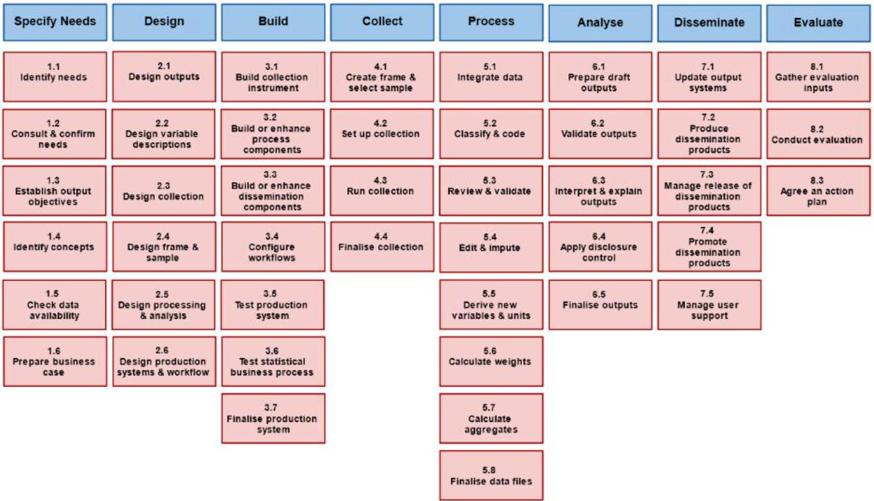
GSBPM
From Introducing the GSBPM at the GSBPM portal

Slide 9
In the adaptive protocol use case…
The relationship between Collect and Process is non-linear:
We use administrative and other data collected and processed previously together with almost real time processing of current data to guide data collection now
Collect can depend on Process and vice versa
Although GSBPM and the business processes that GSBPM represents were not intended to form a linear model, the systems that we Build behave by and large in a linear way

Slide 10
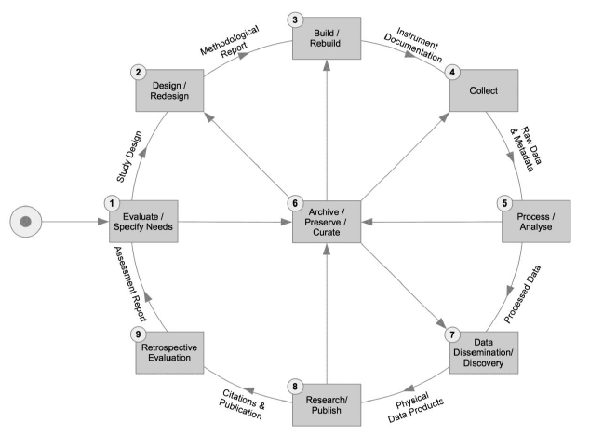
GLBPM
From: Generic Longitudinal Business Process Model

Slide 11
GLBPM
Because the L in GLBPM is longitudinal, GLBPM thinks in circles
And the systems we Build to support longitudinal studies are formed around an Archive
There are many lessons learned from ordering processes around archives and archival services

Slide 12
Meet the Information Model we will use to design, build and collect the adaptive protocol use case…
DDI specializes OWL-S atomic processes with:
Contact procedures
Data transformation objects
OWL-S implements GSIM
Composite Process
Atomic Process
GSIM provides core conceptual model
Business Process
Process Design
Process Control
Process Step
Process
Atomic Process
machine readable
human readable

Slide 13
Using GSIM, how might we represent an adaptive design?
Imagine that we want to use the current representativeness of study participants to decide if, for a specific individual, we want to engage in a refusal conversion
In such a design we would conditionally attempt to convert based on the calculation of a statistic
Let’s first examine how GSIM might represent the calculation of this statistic…

Slide 14
The design of a calculation…
Following FDA guidelines for adaptive designs we might undertake “analyses of the accumulating study data…at prospectively planned time points within the study”
This might entail comparisons over time of historical demographic data with current demographic data
In the process we might want to integrate data (GSBPM 5.1) and calculate aggregates (GSBPM 5.7)

Slide 15
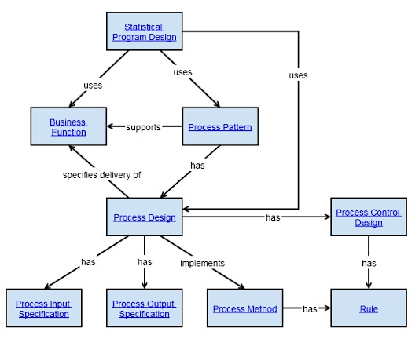
GSIM Process Step (Top Level)
FDA Adaptive Design Guidelines
GSBPM 5.1, 5.7
???

Slide 16
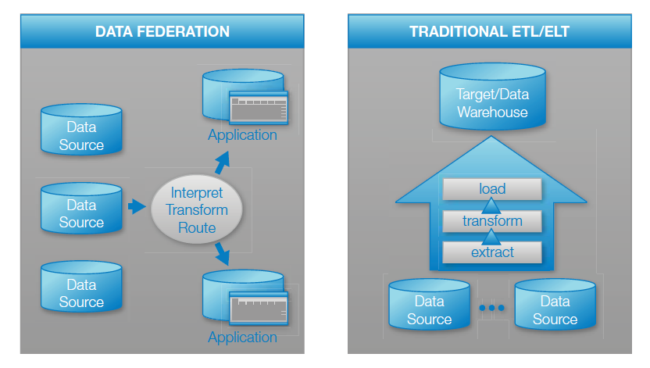
A tale of two process designs and the case for data federation
From Best Practices in SAS Management for Big Data

Slide 17
A tale of two process designs and the case for data federation
Data is too sensitive: organizations don’t want to provide direct access to data sources.
Data is too diverse: data is stored in multiple source systems that all have different security models, duplicate users and different permissions.
Data is too ad hoc: when data is changing frequently, constant updates are needed to maintain integration logic. It becomes difficult to make a repeatable integration process, especially if there are many data integration applications that need access to the same data.
From Best Practices in SAS Management for Big Data

Slide 18
Our process design is…
…a data federation data lake that collects everything and supports dive in anywhere, flexible access data processing
The data lake is, in turn, traversed in a series of sub-steps that together form a map reduce algorithm for numerical summarization
The algorithm both integrates and aggregates…

Slide 19
Our process design is…
…a data federation data lake that collects everything and supports dive in anywhere, flexible access data processing
The data lake is, in turn, traversed in a series of sub-steps that together form a map reduce algorithm for numerical summarization
The algorithm both integrates and aggregates…

Slide 20
GSIM Process Step (Top Level)
FDA Adaptive Design Guidelines
GSBPM 5.1, 5.7
Numerical summarization map reduce algorithm
Data Lake

Slide 21
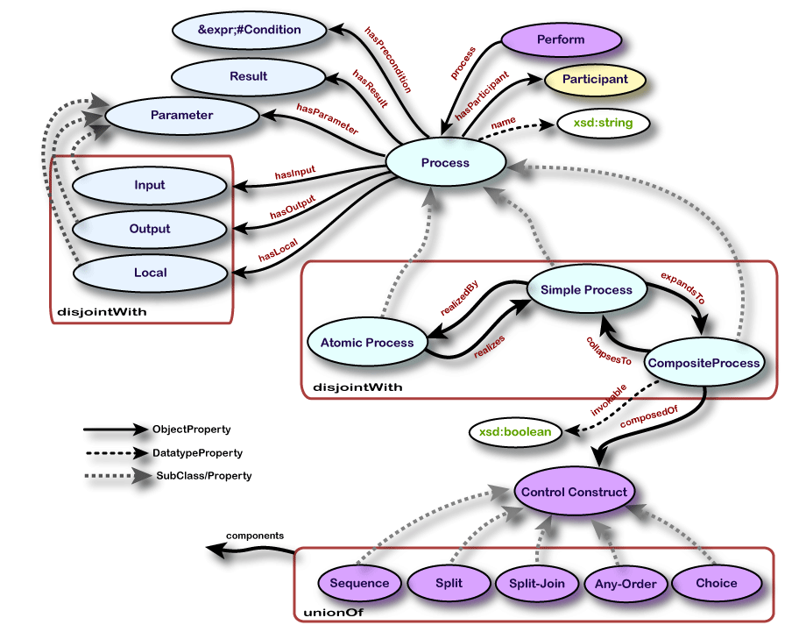
Enter OWL-S…
From OWL-S: Semantic Markup for Web Services

Slide 22
Enter OWL-S…
Previously, in DDI 3, OWL-S information objects were utilized to specify control constructs and the skip logic of questionnaires
OWL-S did this with such specificity that software connectors were developed by the Australian Bureau of Statistics and others that take DDI 3 OWL-S as input and code complex instruments in Blaise as well as other survey systems

Slide 23
Enter OWL-S…
Now, in DDI 4, OWL-S information objects are about to be put into play alongside GSIM that can specify both parallel processing and sequential processing
OWL-S describes parallel processing in enough detail that, in the adaptive design use case, it will be able to assist in the automatic production of map reduce algorithms for constructing numerical summarizations

Slide 24
Enter OWL-S…
Also, OWL-S describes sequential processing in enough detail that, in the adaptive design use case, it will be able to assist in the automatic production of schedulers that conditionally determine and produce next actions – such as refusal conversion – in multi-mode contact procedures

Slide 25
Enter OWL-S…
Finally, using OWL-S, it is possible to define a service profile for each process
In conjunction with a software agent, the service profile enables:
Automatic web service discovery
Automatic web service invocation
Automatic web service composition and interoperation
In this context a software agent might be a Web Service Business Process Execution Language (WSBPEL) program

Slide 26
In summary in DDI 4…
DDI specializes OWL-S atomic processes with:
Contact procedures
Data transformation objects
OWL-S implements GSIM
Composite Process
Atomic Process
GSIM provides core conceptual model
Business Process
Process Design
Process Control
Process Step
Process
Atomic Process
machine readable
human readable

Slide 28
Big data Primer
Appendix

Slide 29
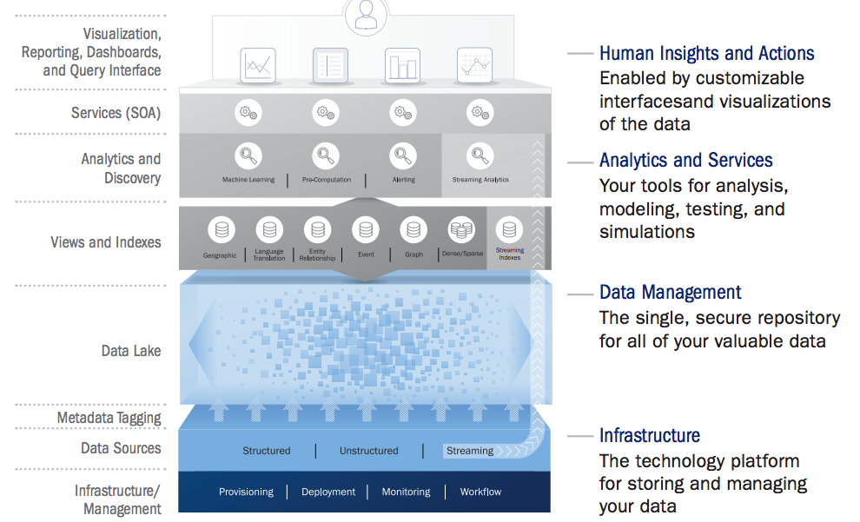
Big Data Primer (1)
From The Data Lake: Turning Big Data Into Opportunity

Slide 30
Big Data Primer (1)
MapReduce work in conjunction with a file system
The data lake is this file system
One metaphor for the data lake might be a giant collection grid, like a spreadsheet – one with billions of rows and billions of columns available to hold data
Each cell of the grid contains a piece of data
Cells might contain names, photographs, incident reports, Twitter feeds, OAIS submission information packages – anything and everything

Slide 31
Big Data Primer (2)
The image of the grid helps describe the difference between data mining and the data lake
With the data lake there is definitely an ingest process
During the ingest process certain details called “metadata” are added so that the basic information can be quickly located and identified

Slide 32
Big Data Primer (3)
These metadata tags serve the same purpose as old-style card catalogues which allow a reader to find a book by searching the author, title or subject
A MapReduce job uses these metadata tags first to retrieve the appropriate data from the data lake
Next MapReduce maps each piece of information to a processor, assigning the piece of information a key – K1 – one for each processor

Slide 33
Big Data Primer (4)
Next the processor runs a user-defined program on the many pieces of information it receives
During processing it very likely shreds each piece of information into other units, producing for each initial key/value pair one or more additional key/value pairs
So the map process looks like this: map(k1, v1) -> list(k2, v2)
Finally the reduce() function is applied to all the lists, aggregating them, and return the value v3

Slide 34
Data Lake MapReduce Pipeline
Ingest into Data Lake
Metadata tag for retrieval
Invoke MapReduce
MapReduce retrieves data from data lake
Map() assigns data to a processor
Processor processes data
Reduce() aggregates data across processors

Slide 35
Big Data Primer References
The Data Lake: Turning Big Data Into Opportunity
The Data Lake: Taking Big Data Beyond the Cloud
NoSQL Data Modeling Techniques
Note that this reference is of interest for those who want to work through the problem of how data structures might be described and annotated using metadata tags in a data lake environment where on the surface the lake consists of just a big bag of key/value pairs

