Slide 1
Process Modeling
NADDI Sprint 2014
30 March

Slide 2
Background
Prior to the NADDI 2014 Sprint a design paper on the process model was developed
It remains a work in progress
The design paper needs to be informed by the emerging information object architecture which has its roots in a short EDDI 2013 sprint where the idea of views was first introduced
The view architecture has matured a bit at NADDI 2014
The emerging view architecture has informed some additional modeling work undertaken at NADDI 2014 and reported here

Slide 3
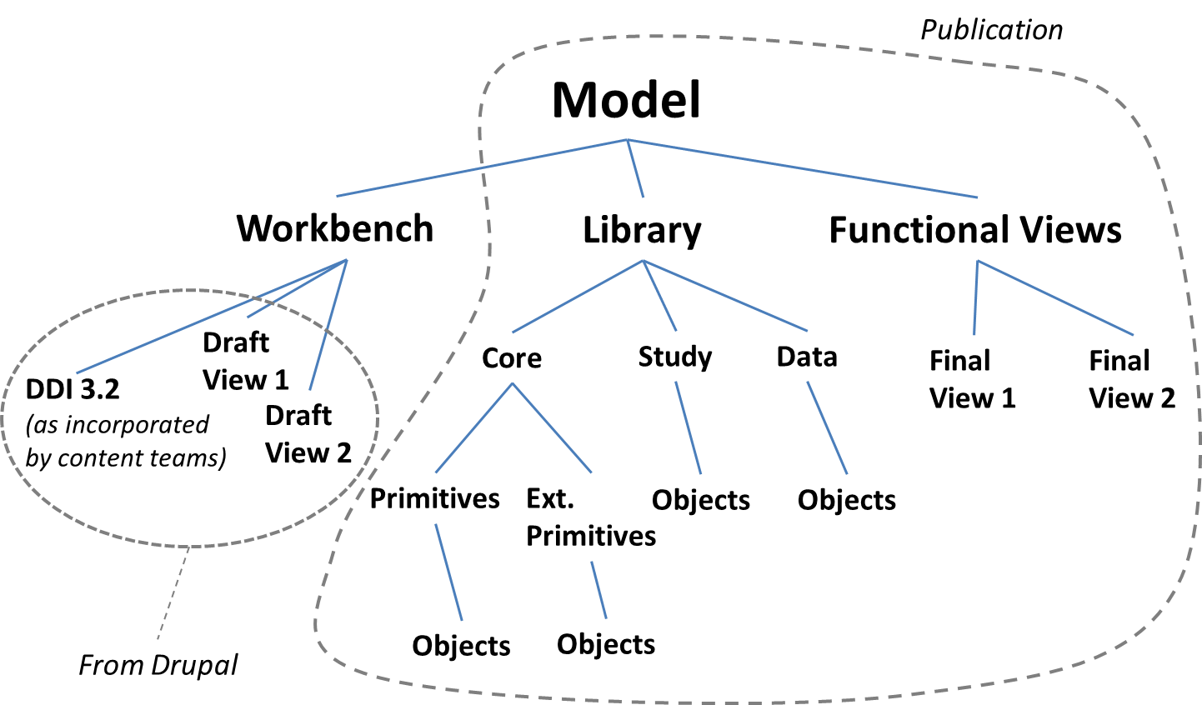
View Architecture Enterprise Architect Perspective

Slide 4
View Architecture (continued)
In the context of the process model, functional views are templates published to end users that they are able to render useful by substitution, instantiation and plug-and-play
In substitution an abstract class is replaced by a child class
In instantiation a class is instantiated by the end user. For example, a choice/select statement instance might be developed by the end user for an OWL-S choice control construct class
In plug-n-play other views are either included in or can subsequently be hooked to the current view

Slide 5
Simple Data Transformation Pipeline
Other functional views that are users of the simple data processing pipeline include:
The Archiving View
The Protocol Execution View (also presented here)
Archiving uses the simple data transformation pipeline at the point it prepares an archival information package (AIP)
Protocol Execution might use the view to construct a computed variable at visit runtime as part of a preload

Slide 6
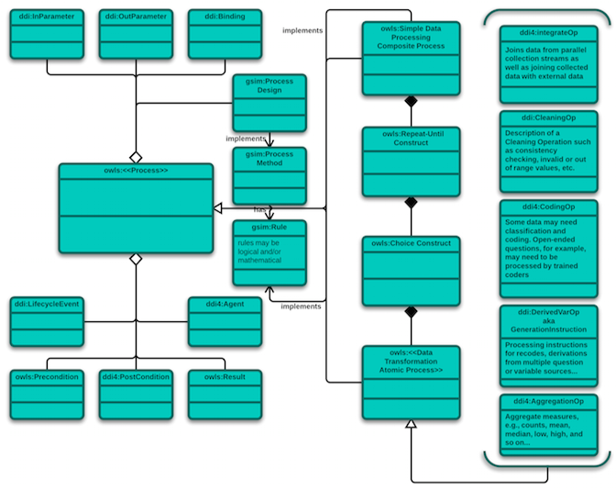
Data Transformation View
paradata
statuses
substitution

Slide 7
Simple Protocol Execution View
The simple protocol execution view might be used to document a protocol plan
However, it has enough specificity that it could be used in conjunction with an application like, for example, BPEL to run parts of an observation research protocol
The design paper referenced earlier puts the process model in a larger context
In this context the process model has a business process core, information objects and implementation applications

Slide 8
Process Model Architecture
Information Model GSIM/OWL-S/DDI
GLBPM GSBPM
Application Layer
Process Pipeline Types (Use Cases)

Slide 9
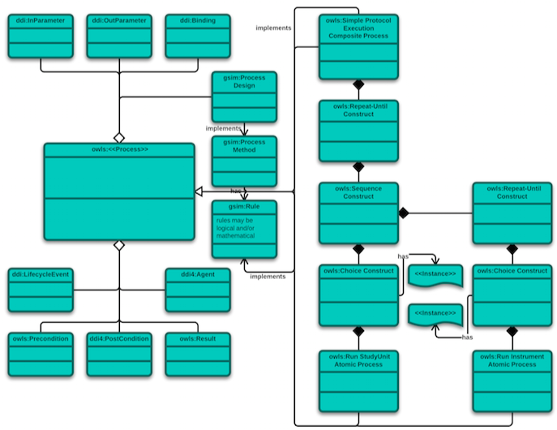
Conditional execution of instruments
Protocol Execution View
instantiation
paradata
Conditional execution of longitudinal study visits
statuses

Slide 10
Next Steps
The process model view development team plans to update the design document based on the emerging view architecture
Also, this document and the two views it describes will be circulated to a wider audience for comment
Also, we will work examples:
The plan now is to work a protocol example in time for a DDI workshop at Census in May where we will make a presentation on adaptive protocols
The data transformation example will be completed in time for a June meeting sponsored by the World Bank and NSF on documenting data transformations in DDI

