Slide 1
An Approach to Data Description
May 26, 2015 – Minneapolis, MN

Slide 2
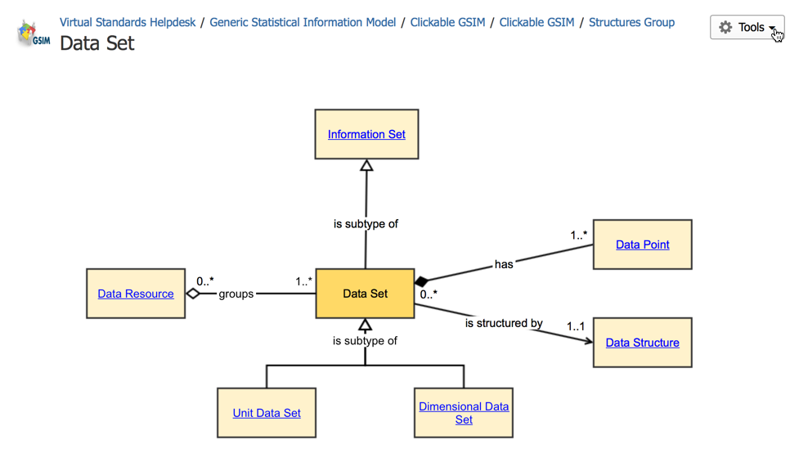
Our general approach…
Let’s start with GSIM
This means first that in place of “Data Store” we use “Data Set”

Slide 3
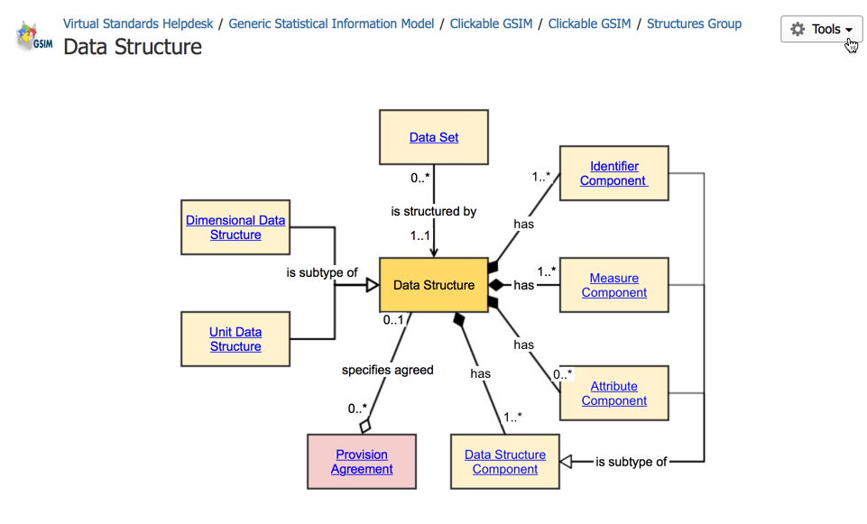
Our first extension…
Let’s also adopt this with the understanding that attributes can also have a structure – they need not be just a bag of key/value pairs
Attribute component is the hook for the work that Arofan and Larry are engaged in

Slide 4
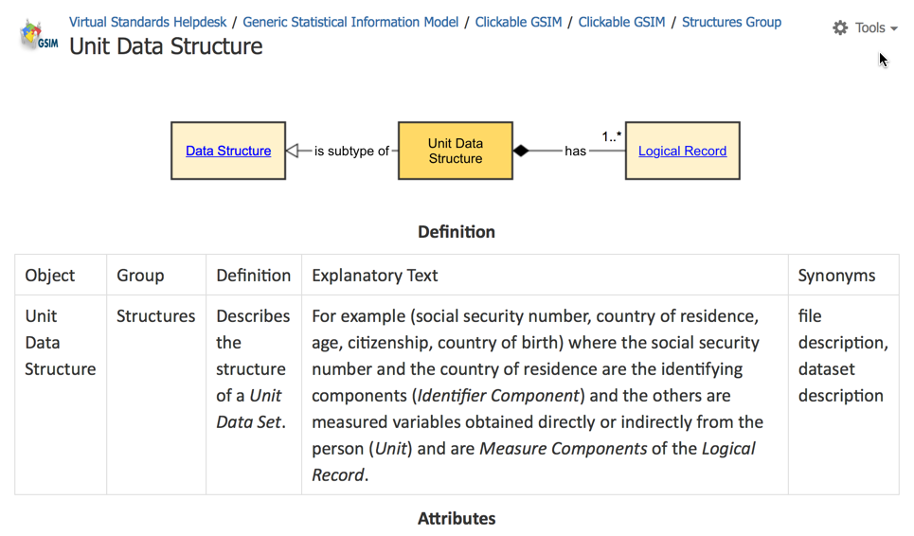
Another “extension”…
Here lies a problem with GSIM
There are different types of unit data structure
For now imagine there are just two: 3NF and 1NF
3NF has a logical record
1NF is a family called NoSQL

Slide 5
Adding 3NF and 1NF…
My proposal is to make Unit Data Structure abstract, add the 1NF and 3NF subtypes and attach a “Logical Record” to the 3NF one

Slide 6
More thinking about 1NF…
1NF has just one identifier component and one measure component
1NF has a set of attribute components that can either be a bag or something more
1NF specializes Data Structure adding a Time Component

Slide 7
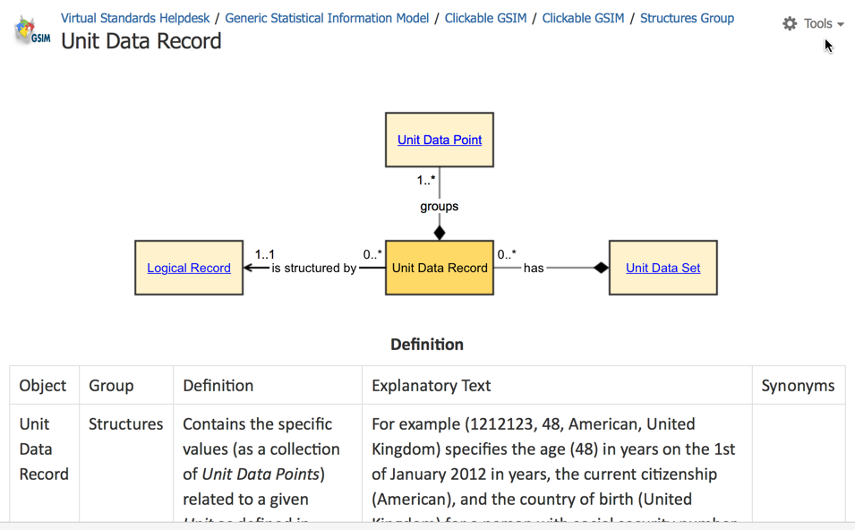
3NF and CSV…
Perhaps each Unit Data Record from a Unit Data Set that is the product of a 3NF Unit Data Structure could have a Unit Data Record Type
One type could be CSV

Slide 8
Next Steps
Make Data Set into a Collection in which a Data Structure can organize Data Points in a order or not

